Slide 1

WELCOME
TO THE JULY EDITION
OF THE 2019
M&R SEMINAR SERIES

Slide 2
BEFORE WE BEGIN
SAFETY PRECAUTIONS
  PLEASE FOLLOW EXIT SIGN IN CASE OF EMERGENCY EVACUATION
  AUTOMATED EXTERNAL DEFIBRILLATOR (AED) LOCATED OUTSIDE
PLEASE SILENCE CELL PHONES OR SMART PHONES
QUESTION AND ANSWER SESSION WILL FOLLOW PRESENTATION
PLEASE FILL EVALUATION FORM
SEMINAR SLIDES WILL BE POSTED ON MWRD WEBSITE (Link to be provided soon as the District website was just updated recently )
STREAM VIDEO WILL BE AVAILABLE ON MWRD WEBSITE (Link to be provided soon as the District website was just updated recently )

Slide 3
Erik R. Coats, P.E. Ph.D.
Dr. Erik R. Coats is a Professor of Environmental Engineering at the University of Idaho, and is a licensed professional engineer in Oregon, Washington and Idaho. Prior to earning his doctorate, Dr. Coats spent 13 years working as a professional engineer designing municipal water and wastewater systems. His expertise is in the area of biological wastewater treatment and waste resource recovery systems. At the University of Idaho Dr. Coats is focused on advancing microbial processes for upcycling industrial/municipal/agricultural waste streams to high-value commodities, and developing an enhanced molecular-level understanding of biological nutrient removal processes.
To date his research team has advanced a biotechnology for producing biodegradable plastics on dairy manure (and other waste streams, including sugar beet waste; tomato cannery waste; and municipal wastewater), with commercial application on the horizon. The process integrates with anaerobic digestion for bioenergy production, but can also be deployed independently. Dr. Coats' research team also has conducted extensive research into the wastewater resource recovery process known as enhanced biological phosphorus removal (EBPR), with current efforts additionally focused on short-cut nitrogen removal integrated with EBPR.

Slide 4
2019 seminar series
Research presentation: ebpr (incl. ras fermentation) & biological nutrient removal
July 26, 2019
Metropolitan Water Reclamation District of Greater Chicago
Erik R. Coats, P.E., Ph.D.
Professor of Civil and Environmental Engineering

Slide 5
Coats’ professional background
BSc (1990), MSc (1992): University of Idaho
1992-2002: Engineering consultant, Portland, OR. region
Licensed PE in Idaho, Oregon, Washington
PhD (2005): Washington State Univ. (Dr. Frank Loge, major prof.)
2006: joined UI as Assistant Professor
2012: tenured, promoted to Associate Professor
2018: promoted to Professor

Slide 6
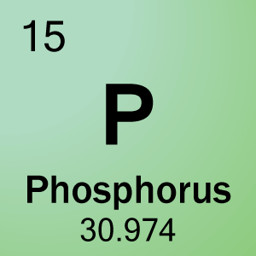
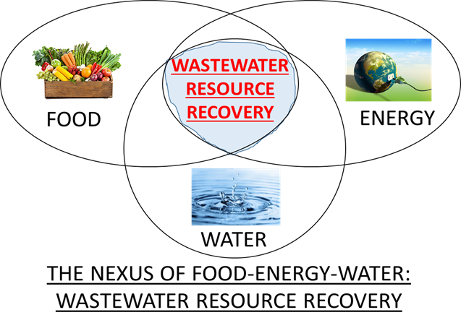
Coats’ research emphasis
Biological Nutrient Removal:
  Phosphorus removal (EBPR); nitritation
Resource Recovery: emphasis on polyhydroxyalkanoates (bioplastics)
Anaerobic Digestion
Appropriate blend of fundamental and applied
Integrate molecular methods

Slide 7
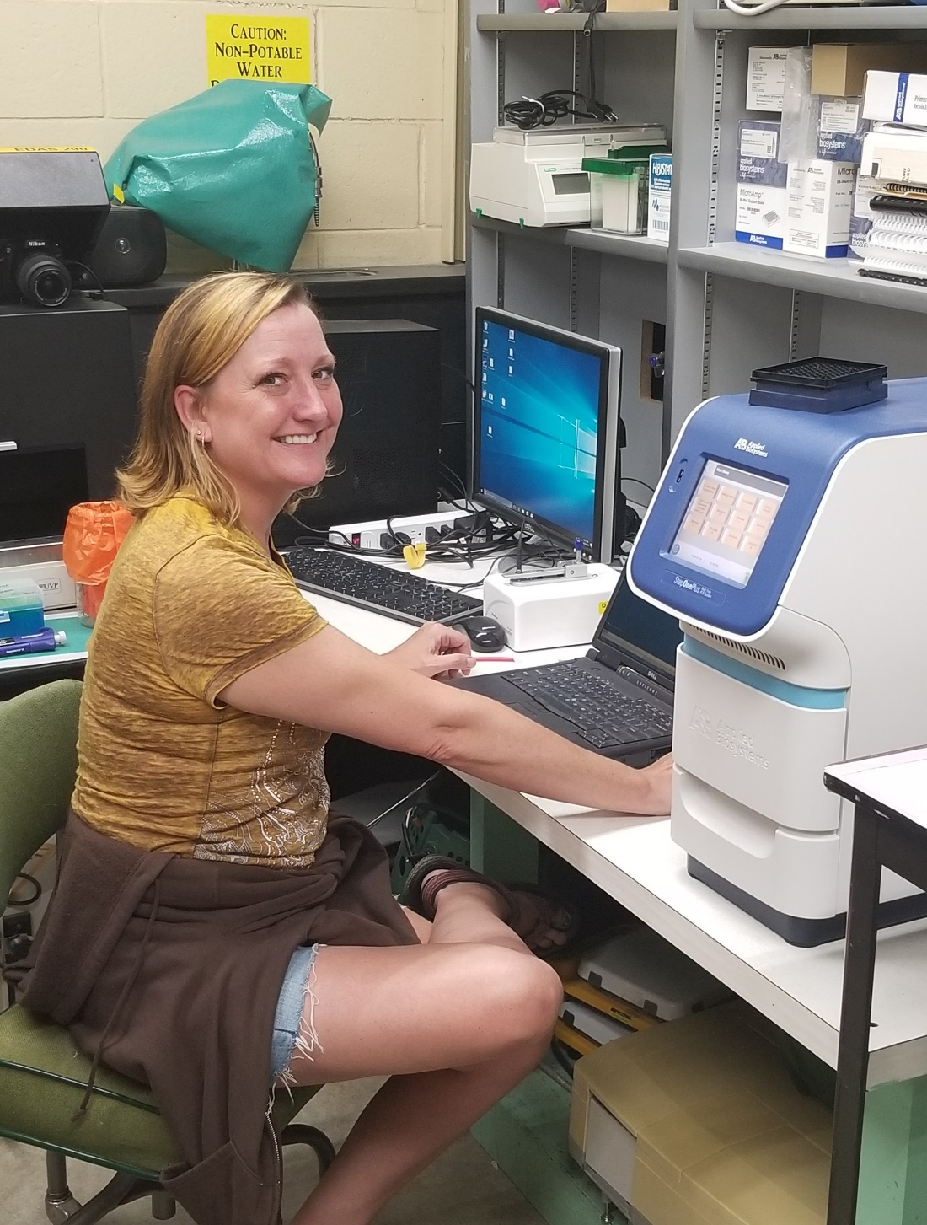
Coats environmental engr. lab
Molecular capabilities:
qPCR
PCR
DNA sequencing
Proteomics
Transcriptomics
Metabolomics
multi -Omics

Slide 8
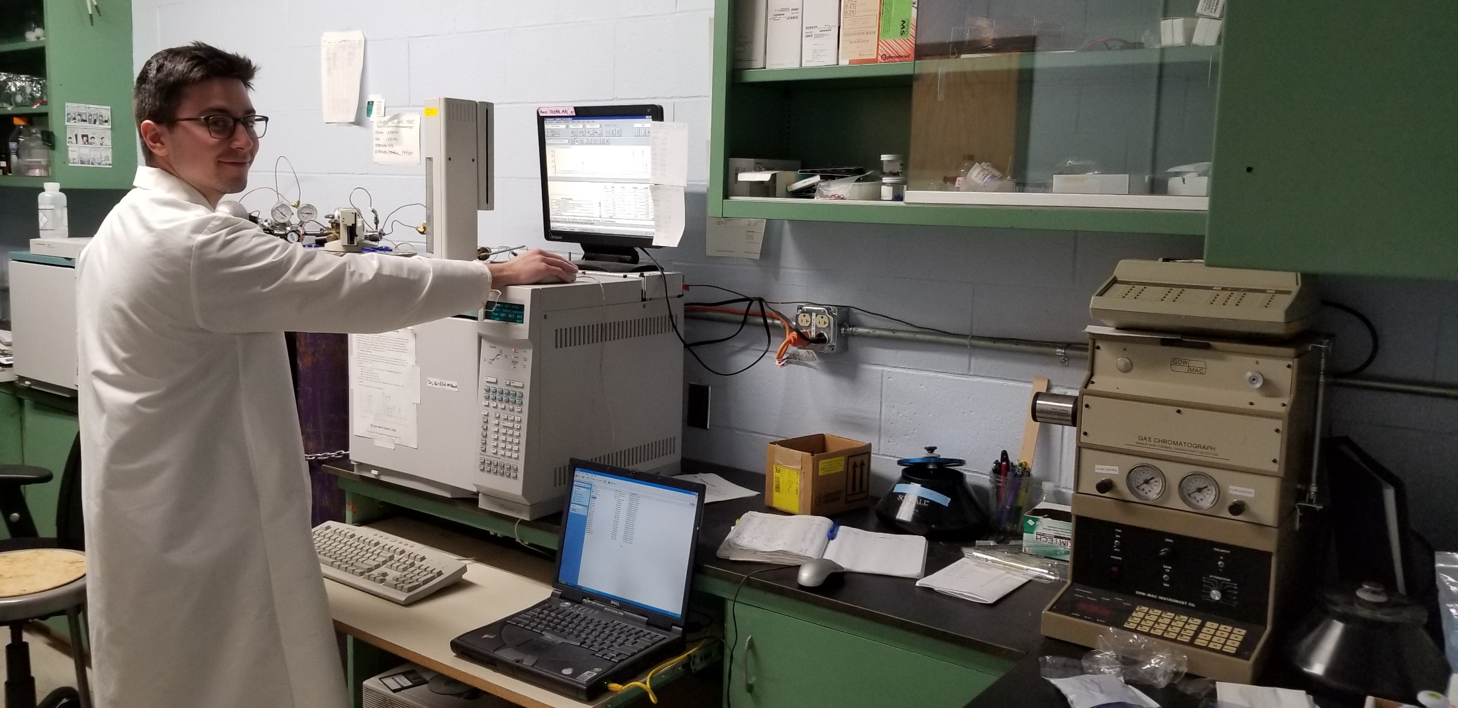
Coats environmental engr. lab
Comprehensive analytical capabilities:
PHA; VFAs; nutrients; CH₄; solids characterization
PLC-controlled operations

Slide 9
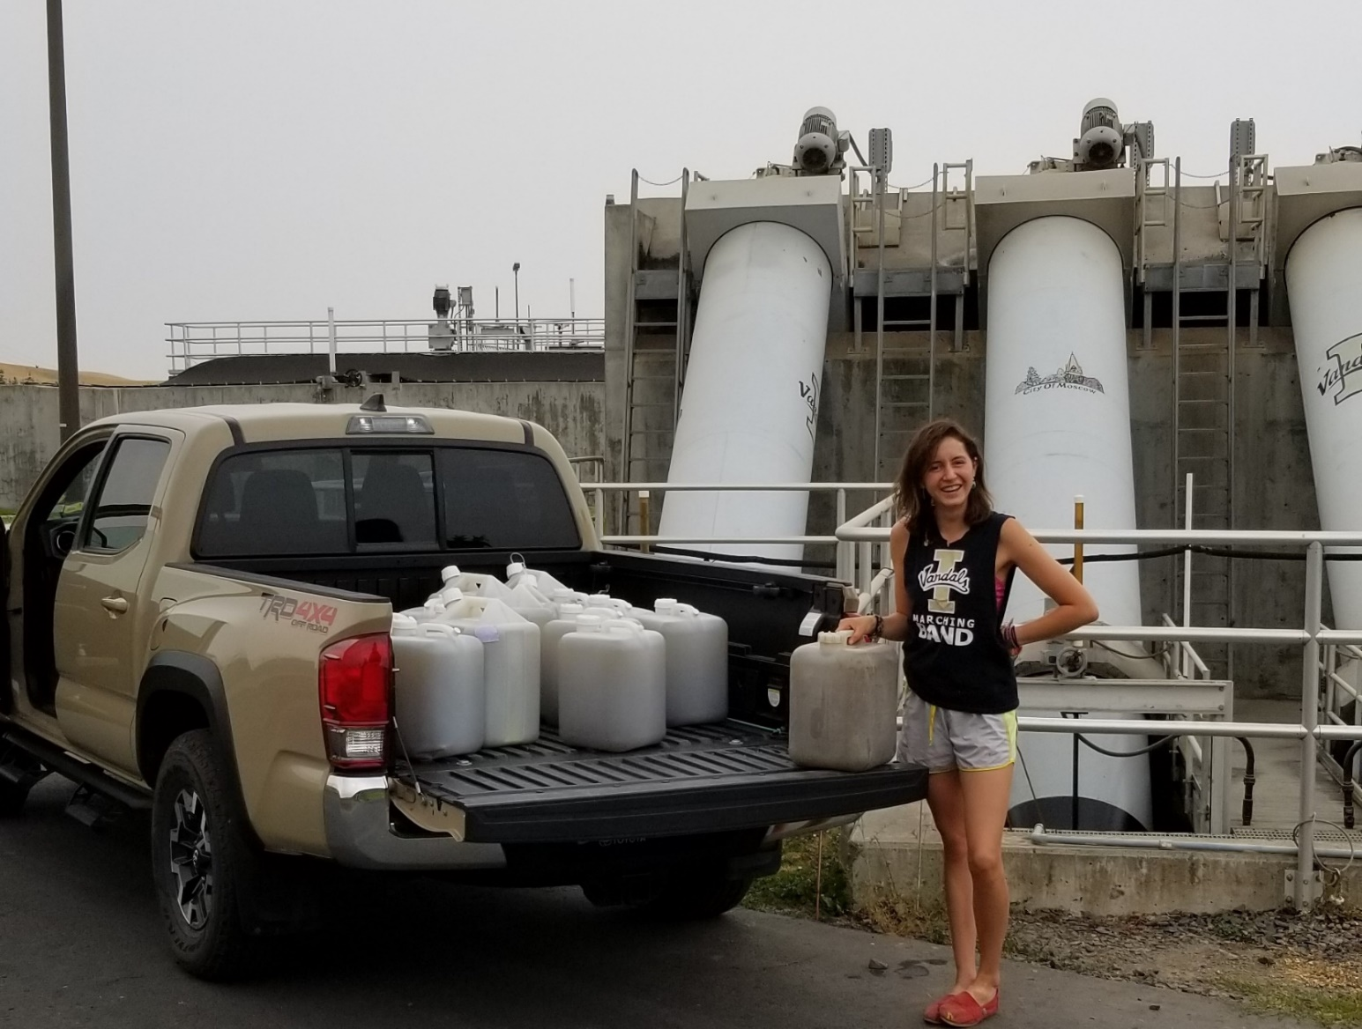
Always use real wastewater
Currently >80 gallons weekly
Also ferment primary solids

Slide 10
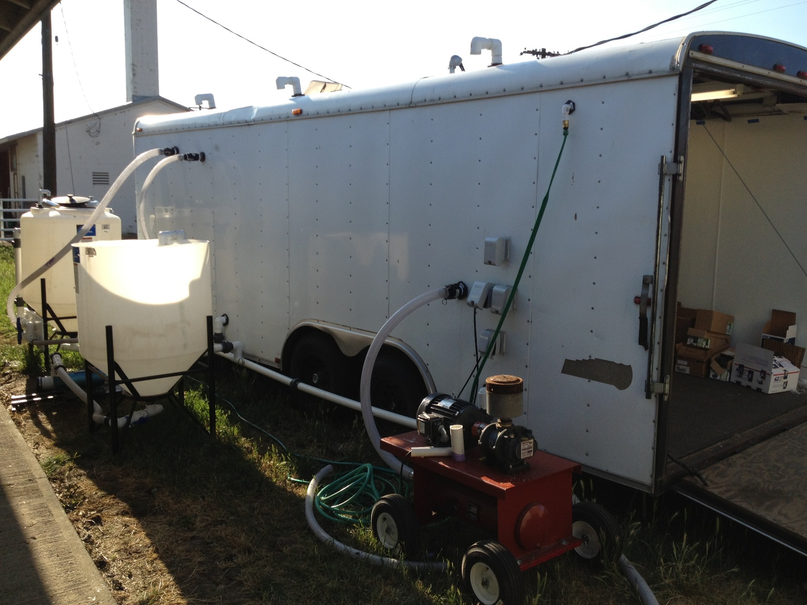
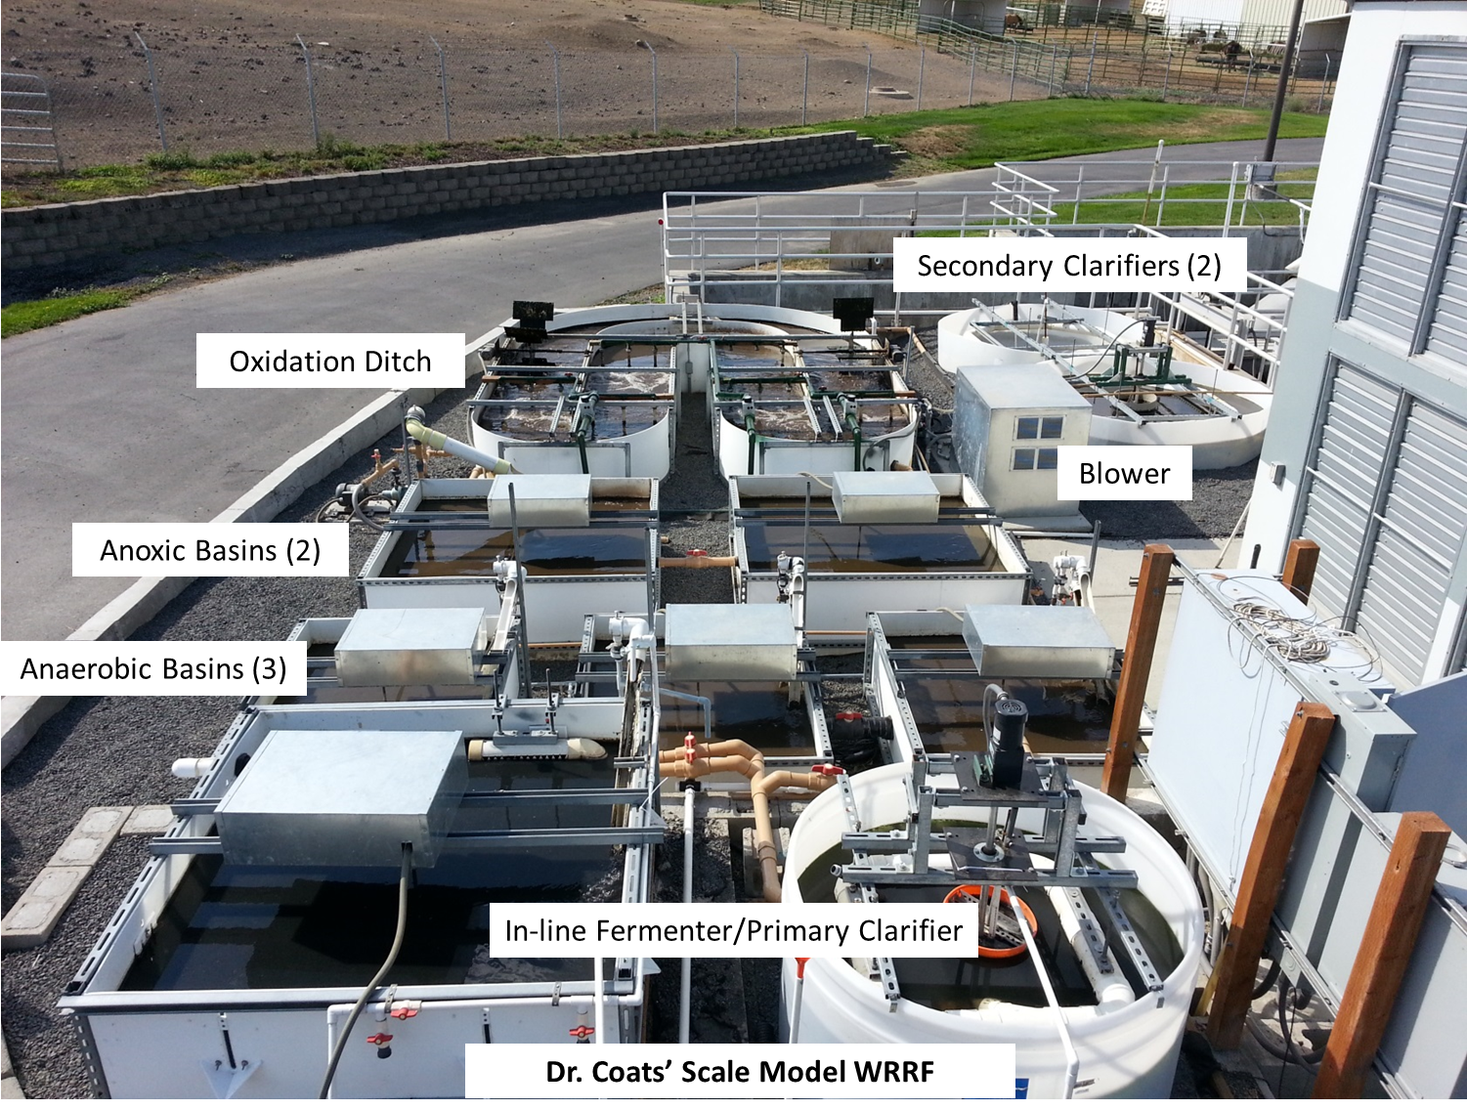
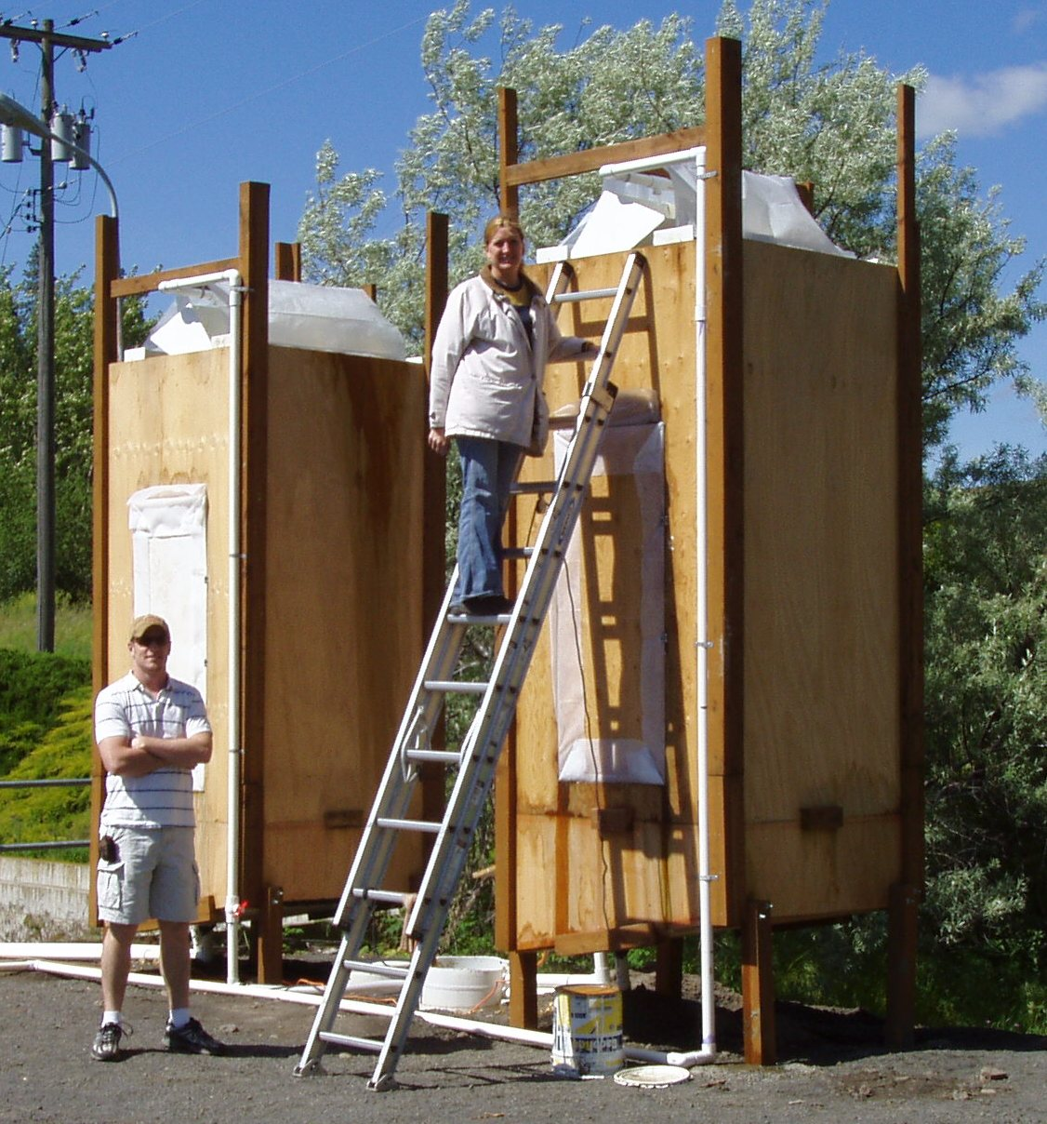
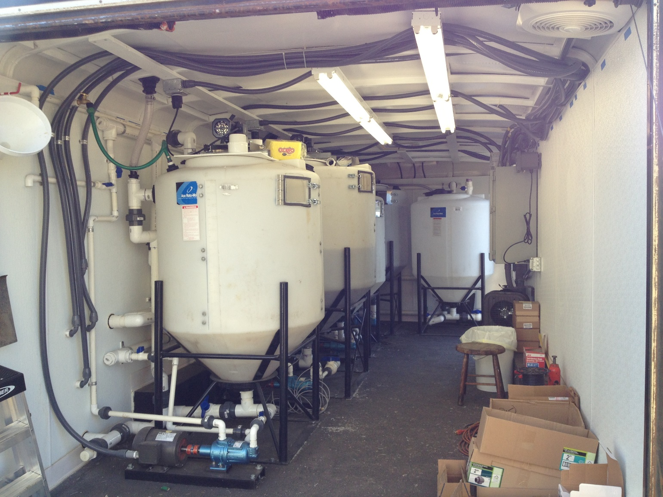
Bench to Pilot scale

Slide 11
Topics for today
Sharing progress on and status of…..
EBPR/RAS fermentation
Insights on critical EBPR metabolisms
BNR & Nitritation studies

Slide 12

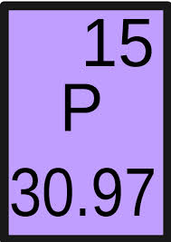
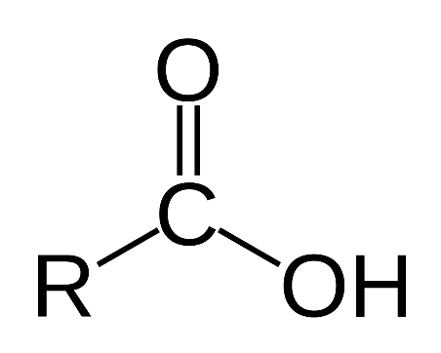

Studying ebpr
Many challenges with EBPR….
  What are PAOs? How to maximize enrichment?
  Optimal operating conditions?
  Best carbon source? Ensuring sufficient carbon?
  How to achieve/ensure process stability, resiliency?
  Why does the EBPR ‘fail’? How to induce ‘recovery’?
My group’s research focus….
  Build from known process fundamentals, principles
  Be pragmatic, practical – how can results be effectively translated?
  Carefully validate empirical observations
  Focus on mixed culture function over phylogenetic structure

Slide 13
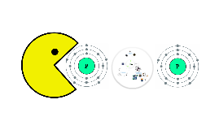
What is EBPR?
Biological process targeting near-complete recovery of wastewater PO₄
Cycle MLSS through anaerobic – aerobic zones
Enrich for PAOs
  Uptake and store excess PO₄ as polyphosphate

Slide 14
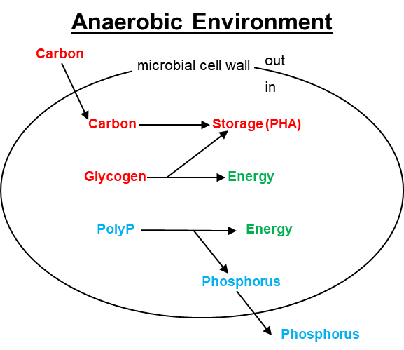
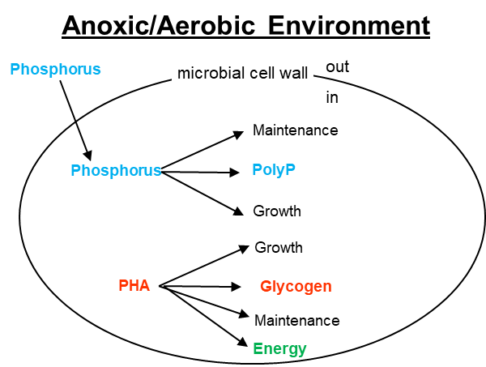
brief refresher on core ebpr principles

Slide 15
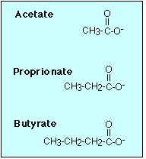
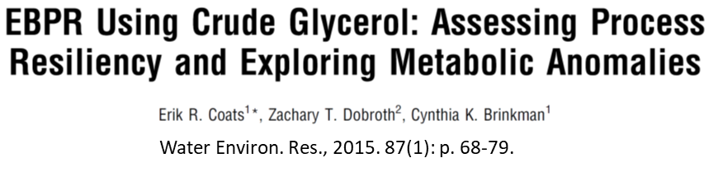
Ebpr Carbon sources
EBPR fundamentally centers on VFAs….potential sources:
  Primary solids fermentation
  Ferment imported organic matter
  Generated in collection system
  Purchase
  RAS fermentation?
Other forms of useful carbon?

Slide 16
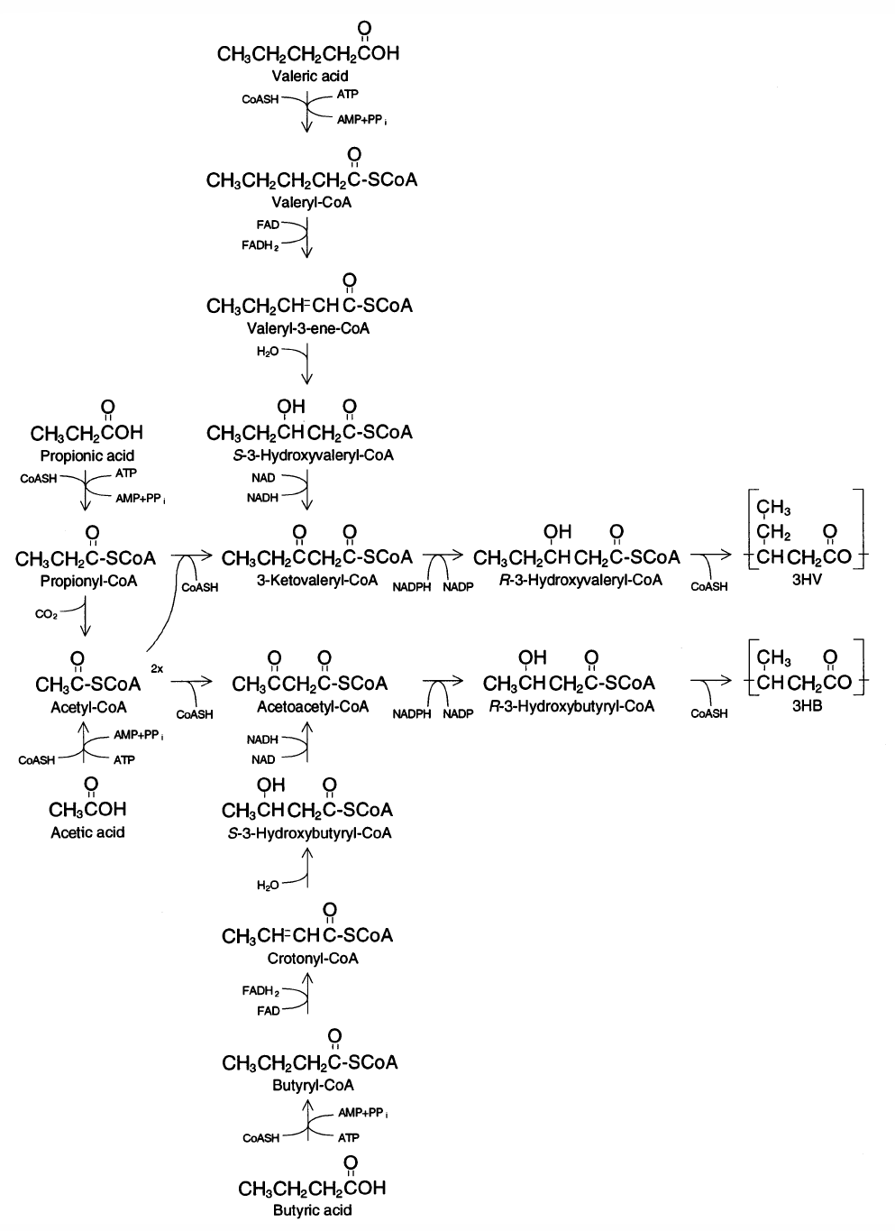
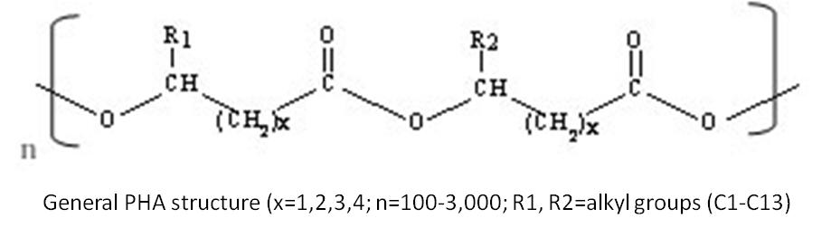
VFAs and Pha synthesis
Valeric Acid
Propionic Acid
Polyhydroxyvalerate (PHV)
Polyhydroxybutyrate (PHB)
Acetic Acid
Butyric Acid

Slide 17

Are all vfa’s the same??

Slide 18
Are anaerobic conditions necessary?
No evidence to the contrary
Indeed: excess NO₃ in RAS has been shown to induce BPR failure

Slide 19
What and who are paos?
Bacteria with specific metabolic capabilities capable of accumulating excess orthophosphate
VFAs PHA PHA Glycogen P PolyP
No consensus that a PAO is a single species.
  Could be comprised of several different bacterial groups…..but, cannot isolate PAOs
HOWEVER, in quantifying PAOs: methods currently based on the model bacterium “Candidatus Accumulibacter phosphatis”
Anaerobic-Aerobic Cycling

Slide 20
are all ebpr bacteria the model Pao?
Research suggests that EBPR bacteria are more than simply “Candidatus Accumulibacter phosphatis”
Only bacteria grown on synthetic wastewater aligned well with “Candidatus Accumulibacter phosphatis”
Tetrasphaera only detected in crude glycerol-fed EBPR reactor (1.9%)
  Only 0.3% in Moscow EBPR……with VERY long anaerobic HRT

Slide 21
Ebpr and ras fermentation
Published in Water Environment Research, 7/18

Slide 22
Our Ras fermentation research
Viewing “RAS Fermentation” through a literal metabolic lens….
Fermentation occurring on the “substrate” (i.e., RAS) immediately preceding the word “fermentation”
Phase 1 – batch RAS fermentation studies
Phase 2 – integrate RAS fermentation within an EBPR configuration
Evidence of VFA production?
Enhance EBPR performance?

Slide 23
Phase 1 research evaluate ras fermentation
Source #1 – Moscow, ID water resource recovery facility (WRRF)
  A2/O process, with an oxidation ditch
    Nitrification, pre-anoxic denitrification, and biological phosphorus removal
  RAS: 5500-7600 mgTSS/L
  pH 7.0-7.25
Source #2 – Pullman, WA WRRF
  Modified Ludzak Ettinger (MLE) process
  Nitrification and pre-anoxic denitrification
  RAS: 18000 mgTSS/L; pH ~ 7.0
Bench-scale, batch reactors
  20-22˚C

Slide 24
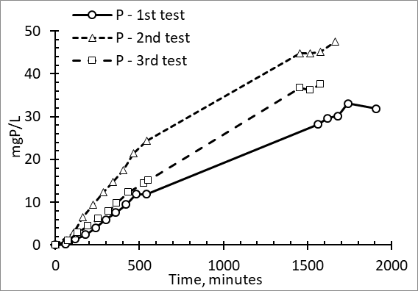
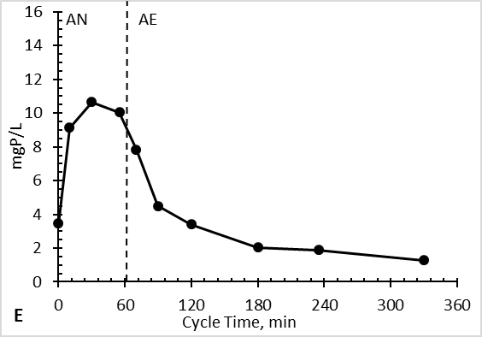
Fermenting Moscow ebpr Ras effect on soluble phosphorus
“Typical” anaerobic P release
  > 10 mgP/L…..rapidly
RAS fermentation P release
  < 2 mgP/L in 1st two hours
  AND…..much higher TSS concentration than typical MLSS
EBPR P release is associated with….
  Energy production
  In support of VFA consumption
Data suggests little-to-no VFA production
Typical AN-AE EBPR and P cycling

Slide 25
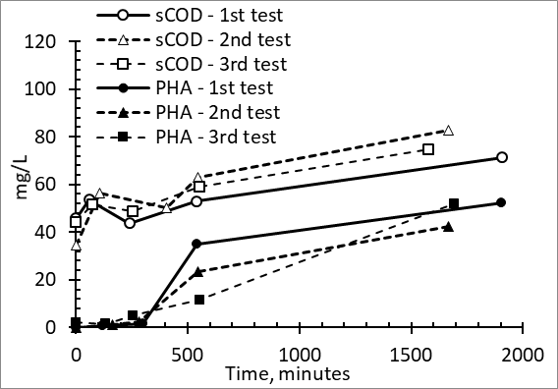
Fermenting Moscow ebpr Ras effect on carbon
No observed VFA accumulation
PHA production
  None during 1st 300 minutes
  Ultimately 40-50 mgPHA/L
    Predominantly polyhydroxyvalerate (PHV)
  5 carbon PHA – synthesized from even/odd carbon VFAs
  Suggests fermentation of cells – lipids
Carbon data aligns with P data
  0-300 minutes: P release not associated with EBPR
  EBPR metabolisms MAYBE induced after 300 minutes

Slide 26
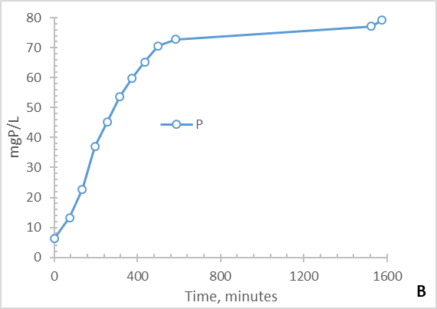
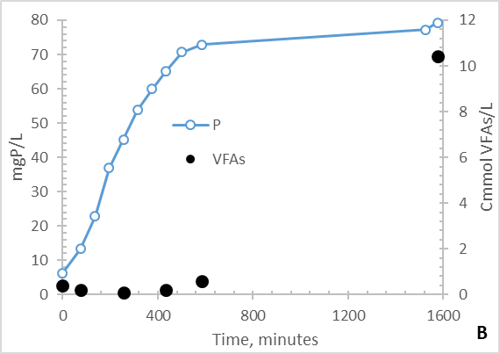
Fermenting Pullman mle ras
Comparable “deep” anaerobic conditions
Rate of P release 2.5-5 greater than Moscow EBPR RAS
No PHA synthesis
VFAs
  No production for 1st 7.5 hrs
  Ultimately ~ 530 mg VFAs produced
    50% acetic acid
    20% propionic acid
    16% butyric acid
    14% valeric acid
No evidence of induced EBPR metabolisms

Slide 27
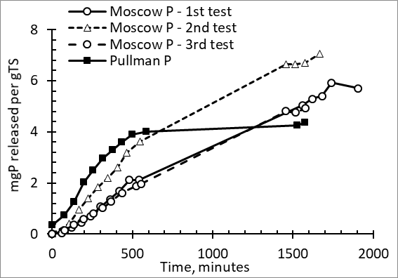
Ras fermentation & p release
RAS concentrations varied
  Moscow: 5500-7600 mgTSS/L
  Pullman: 18000 mgTSS/L
Bulk solution P concentrations varied
BUT….on a mgP/gTSS basis
  P release comparable

Slide 28
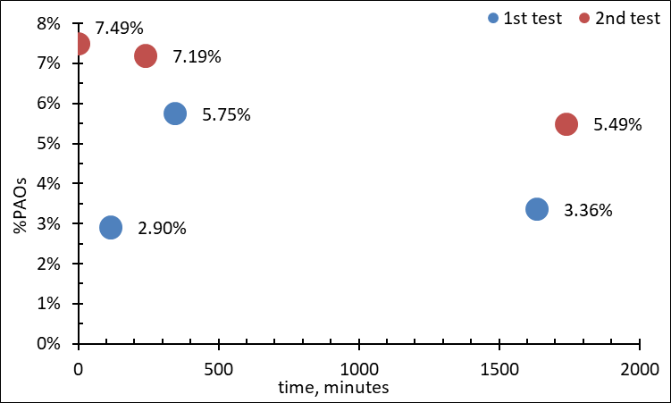
Ras fermentation & pao’s
Data does not suggest that RAS fermentation “selects” or “enriches” for PAOs

Slide 29
Ras fermentation preliminary takeaways
BPR RAS
  Can realize significant P release
  Likely some VFA synthesis – to PHA
  Inducing requisite BPR metabolisms?
  Significant retention time
    > 5 hrs
  No adverse pH effects
Non-BPR RAS
  Can realize significant P release
  VFA synthesis – but significant retention time
  Inducing requisite BPR metabolisms?
  No adverse pH effects
BUT – WHAT IS THE EFFECT OF RAS FERMENTATION INTEGRATED WITH BIOLOGICAL PHOSPHORUS REMOVAL??

Slide 30
Phase 2 integrate ras fermentation with ebpr

Slide 31
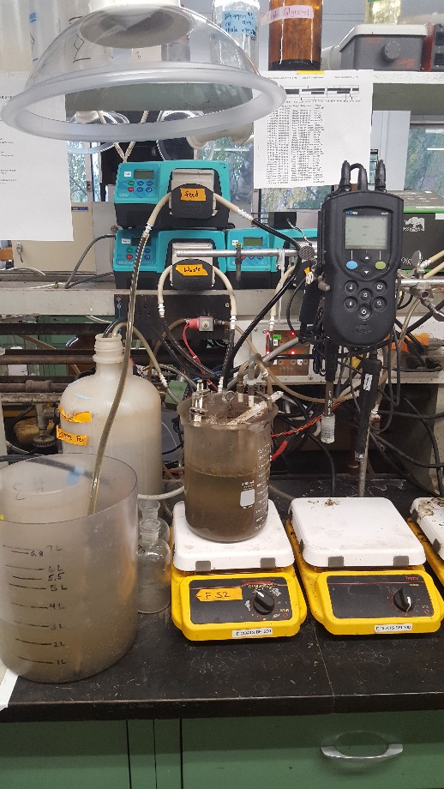
EBPR & RAS FERMENTATION
SBRs
  Compare/contrast raw wastewater only vs. augmentation with primary solids fermenter liquor
  Substrate added after RAS fermentation period
Monitor: P, VFAs, NO₃, PHA, glycogen, pH, redox, DO, MLSS
 | Fall 2016 | Jan. 2017-Oct. 2017
RAS Fermentation, hrs. | 4 | 2
Anaerobic, hrs. | 1 | 1
Aerobic, hrs. | 3 | 5
Evaluate effects of NO₃ in the RAS
  Control nitrification with thiourea and nitrapyrin

Slide 32
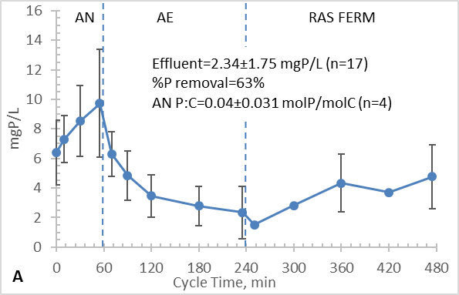
4 hr. ras fermentation period
P cycling & removal
Raw wastewater augmented with primary solids fermenter liquor
effluent

Slide 33
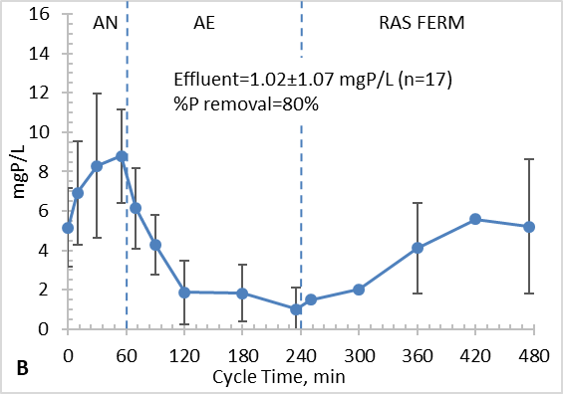
4 hr. ras fermentation period
P cycling & removal
Raw wastewater only
effluent

Slide 34
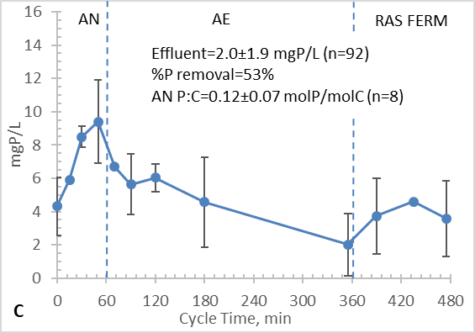
2 hr. ras fermentation period
P cycling & removal
Raw wastewater augmented with primary solids fermenter liquor
effluent

Slide 35
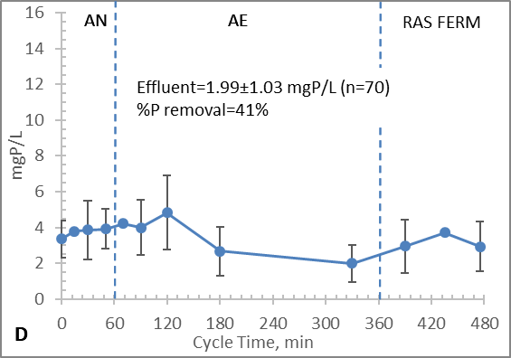
2 hr. ras fermentation period
P cycling & removal
Raw wastewater
effluent

Slide 36
Impacts of ras nitrate
(here is where the research got a bit more interesting)

Slide 37
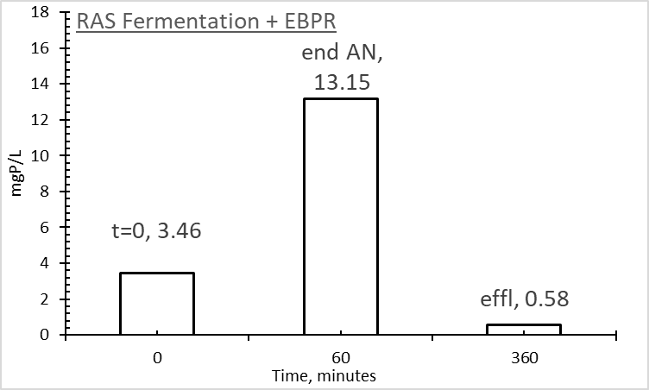
RAS Ferm-ebpr; some RAS NO₃-N
For a short period during our investigation we lost nitrification control
Influent VFA:P = 42.3±14.2 mgVFA:mgP
Effluent NO₃-N = 3.13 mg/L – supplied to RAS fermentation period
With improved effluent phosphorus

Slide 38
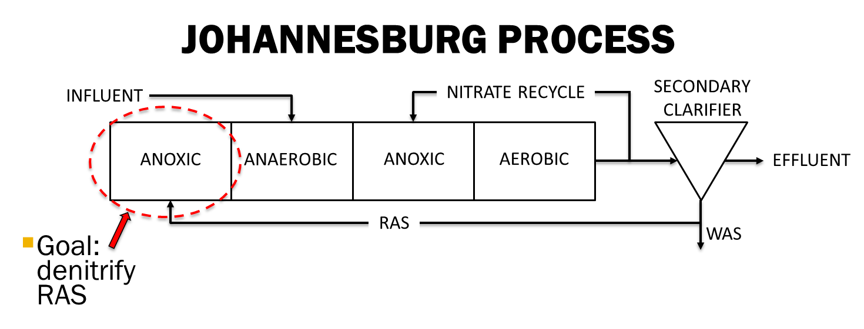
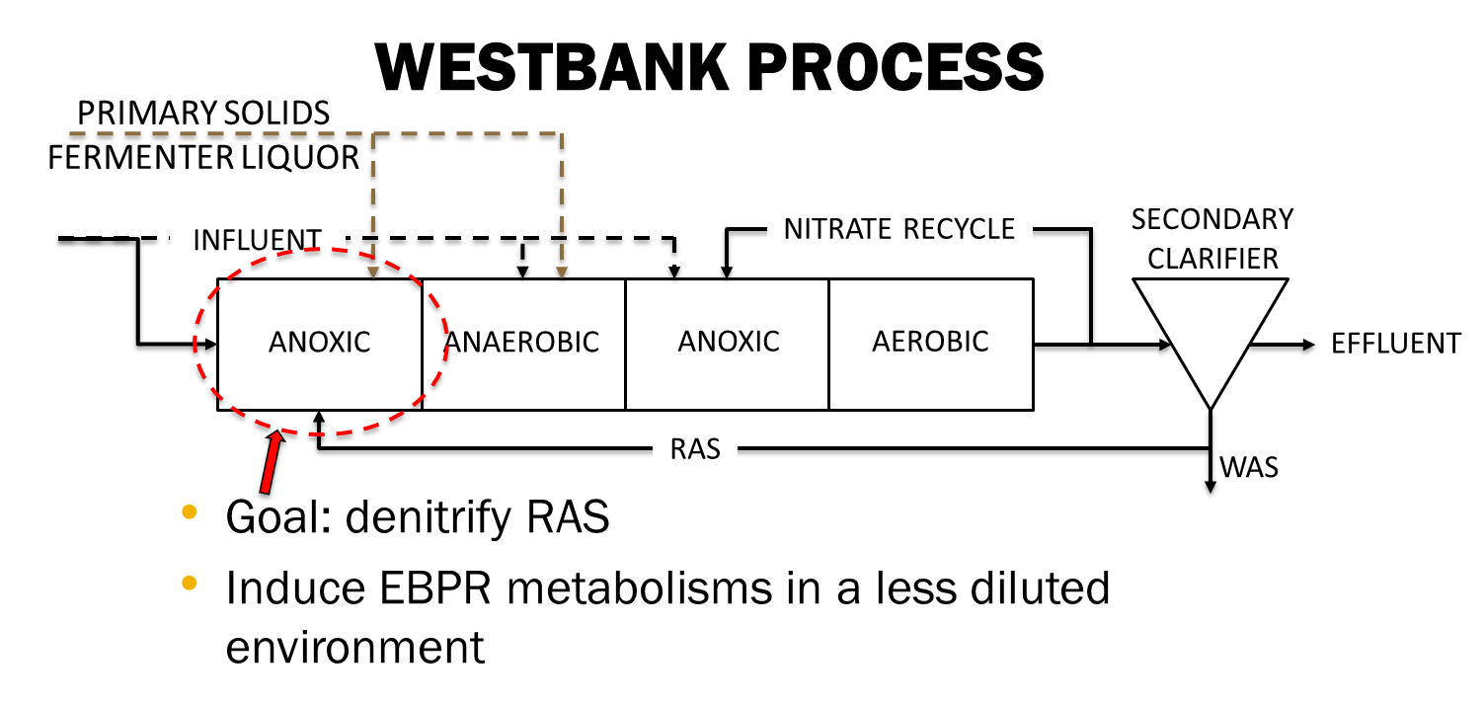
Ras fermentation effects ras denitrification?

Slide 39
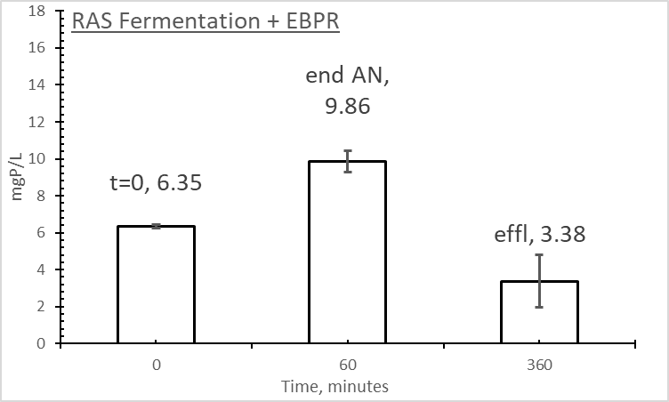
RAS Ferm-ebpr; minimal RAS NO₃-N
Influent VFA:P = 15.7 mgVFA:mgP
Effluent NO₃-N = 1.31 mg/L
Anaerobic P:C = 0.081 (mol basis)
RAS Fermentation
  No measurable VFAs or PHA
  Glycogen = 1.2 Cmmol consumed
  1.4 mgP/L release
Anaerobic period
  2.9 Cmmol VFAs consumed
  3.1 Cmmol glycogen consumed
  3.2 Cmmol PHA synthesized

Slide 40
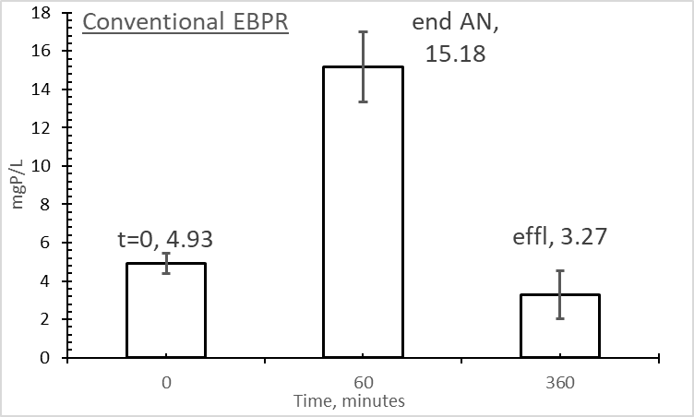
Control reactor: Conventional ebpr; minimal nitrate
Influent VFA:P = 15.7 mgVFA:mgP
Effluent NO₃-N = 1.03 mg/L
Anaerobic P:C = 0.354 (mol basis)
Anaerobic period
  2.0 Cmmol VFAs consumed
  1.1 Cmmol glycogen consumed
  1.5 Cmmol PHA synthesized
  ~50% of the C → PHA

Slide 41
EBPR anaerobic metabolisms
ATP production & demands can be theoretically estimated

Slide 42
Ras fermentation, glycogen, & energy
Anaerobic Response | RAS Fermentation EBPR – No NO₃ | Conventional EBPR
VFA Consumption, Cmmol | 2.9 | 2.0
Glycogen Consumption, Cmmol | 3.1 | 1.1
PHA Synthesis, Cmmol | 3.2 | 1.5
% Carbon to PHA | 53 | 48
Phosphorus Release, mg | 7.0 | 20.5
% Energy from Glycogen | 86 | 48
Significant glycogen use in RAS Ferm EBPR
~ 2X energy production from glycogen in RAS Ferm EBPR

Slide 43
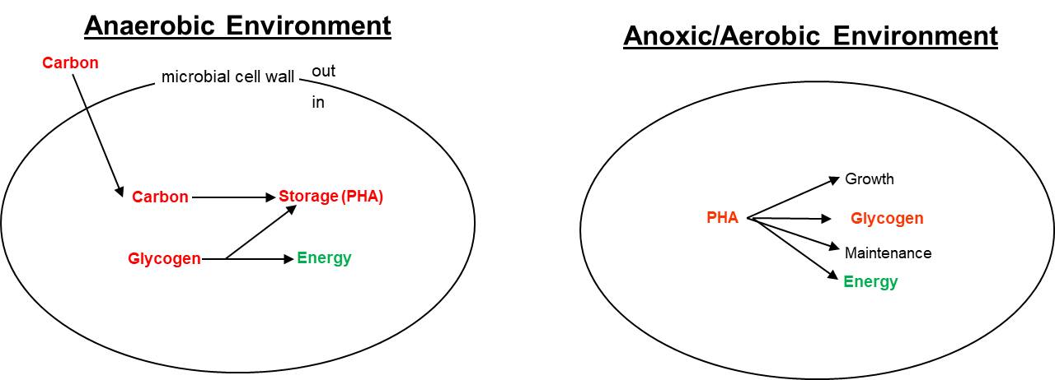
Ras fermentation → gao’s?
When NO₃ was negligible….
RAS Ferm GAO’s >>>>>>>> conventional EBPR (qPCR)
When NO₃ sustained RAS Ferm….
RAS Ferm GAO’s ~ = conventional EBPR (qPCR)

Slide 44
Elevator speech “going down”
Good news – EBPR fundamentals still apply
    Produce VFAs
    Ensure anaerobic conditions
    Recommend implementing conventional process schemes that build from core process fundamentals
RAS fermentation – as applied in this study – does not appear to “move the EBPR needle”

Slide 45
Ongoing Research
Understanding and Predicting EBPR Failure, Recovery

Slide 46
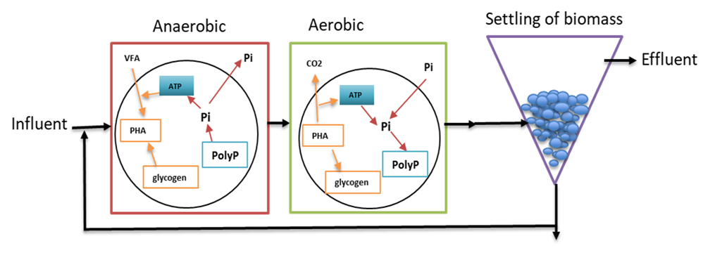
Potential causes of ebpr failure
Dynamic wastewater conditions relative amount of nutrients
Excessive nitrate in RAS
Insufficient quantity of VFAs
PAO ←→ GAO competition
Insufficient “Stress”
Others?

Slide 47
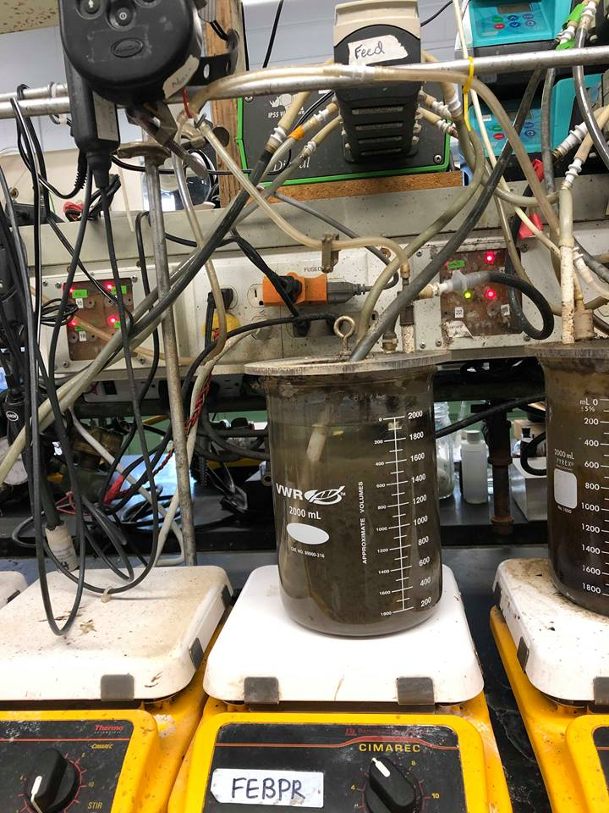
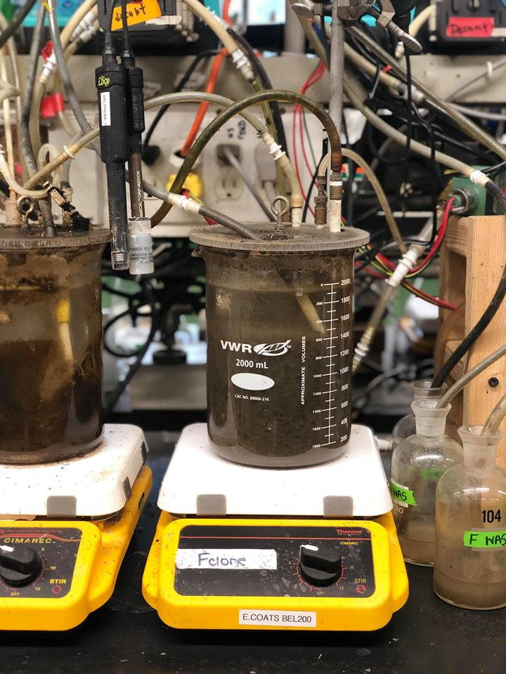
phase 1 – assess conventional ebpr Bench scale reactors
Process | A | B
Volume (L) | 2 L | 2 L
Anaerobic period (mins) | 60 | 180
Aerobic period (mins) | 270 | 150
pH | 6.8-7.5 | 6.9-8.0
SRT | 10.3±1.44d | 10.4±0.9d
HRT (hours) | 18 | 18
Wastewater: 90% raw municipal waste water and 10% primary solid fermentation liquor (FED FROM SAME TANK)
A
B

Slide 48
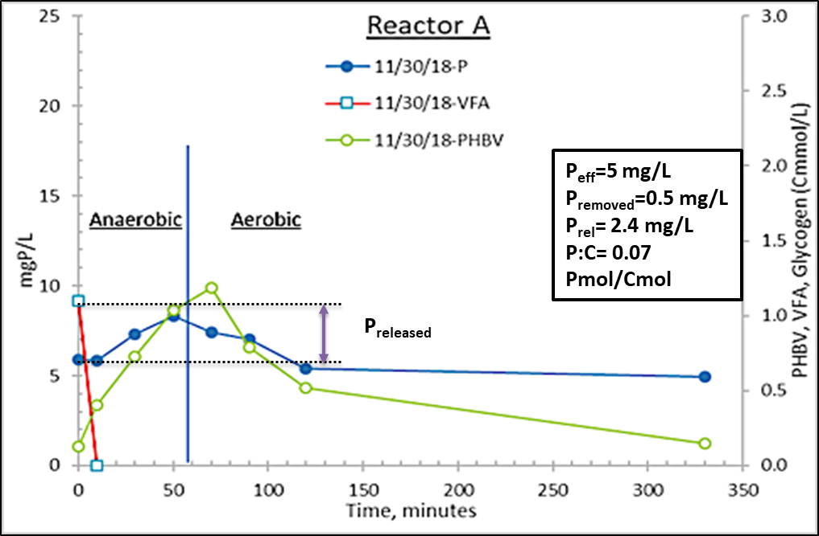
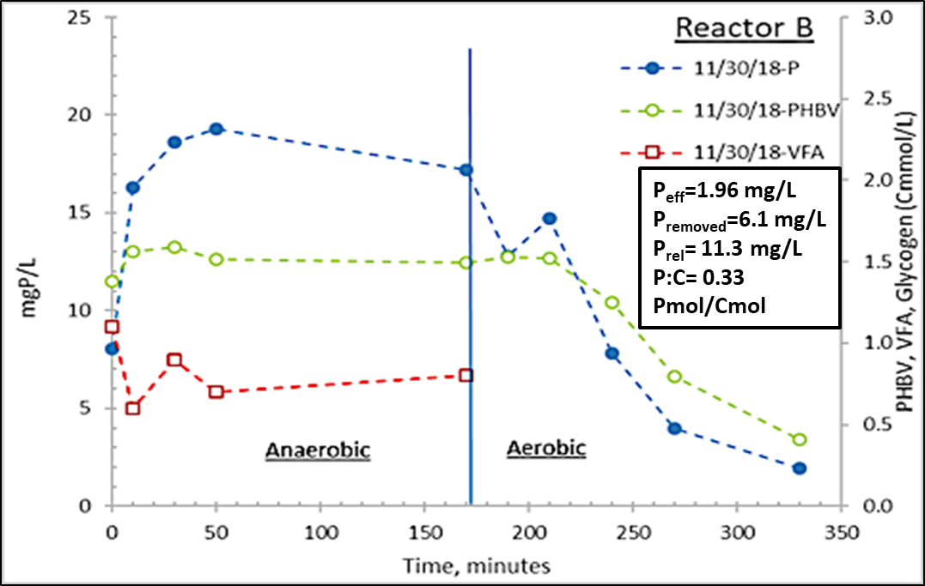
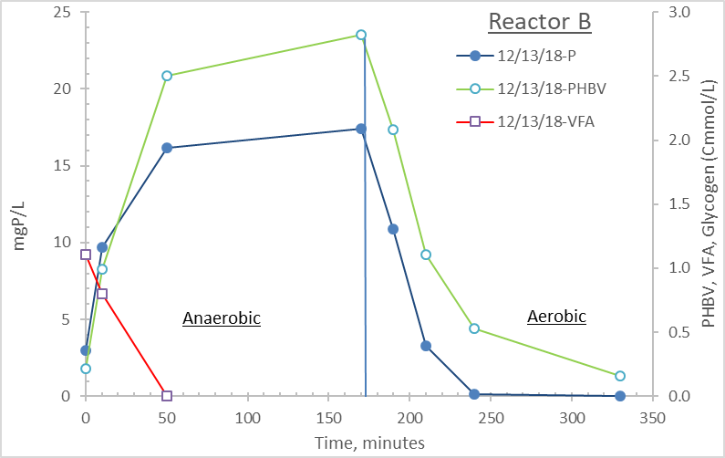
Reactor a – consistently poor EBPR
Reactor b – process upset
Reactor b – process recovery

Slide 49
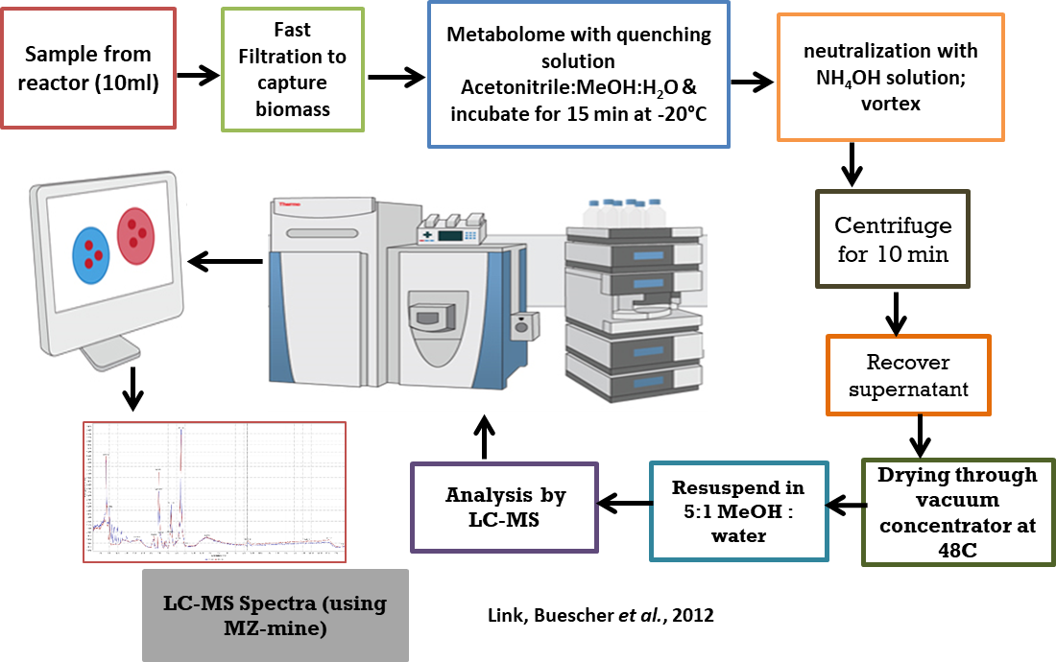
Metabolomics workflow

Slide 50
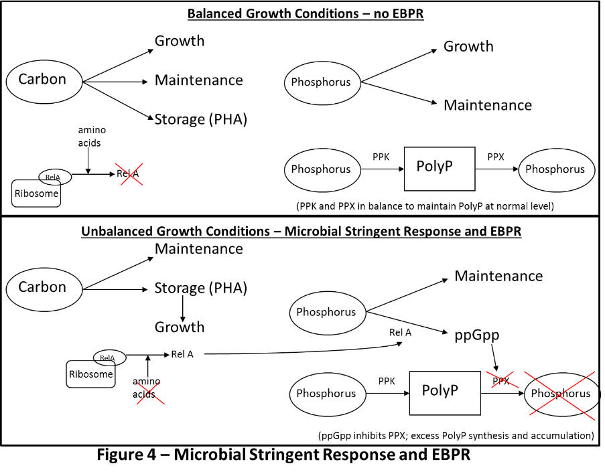
Microbial stringent response
P leakage
No P leakage

Slide 51
Anaerobic “Stress” & EBPR
Microbial Stringent Response & excess phosphorus accumulation
For Quality EBPR, microbial culture increasingly ‘stressed’ by end of AN period…..upregulated Microbial Stringent Response
Comparatively, for Failed EBPR, the Microbial Stringent Response was minimally induced
 |  | Reactor B, Quality EBPR: Metabolites Detected |  |  | Reactor B, Failed EBPR: Metabolites Detected
T=0 | +10 mins (AN) | GTP | ppGpp |  | ppGpp
T=0 | +170 mins (AN) | GTP | ppGpp | pppGpp | ppGpp
T=0 | +10 mins (AE) | GTP | ppGpp |  | ppGpp
+170 mins (AN) | +10 min (AE) |  |  | pppGpp | Non detect

Slide 52
Anaerobic period fermentation
Anaerobic zone VFA production difficult to monitor
  VFAs consumed as produced – stored as PHA
Fermentation could enhance EBPR
Mixed acid fermentation
  Metabolites upregulated in quality EBPR
Glucose
PEP
cis-aconitate
oxaloacetate
Pyruvate
malate
Acetyl-CoA
2-oxoglutarate
succinate
acetate
ethanol

Slide 53
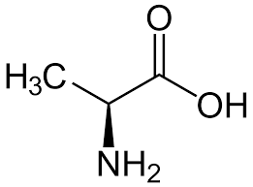
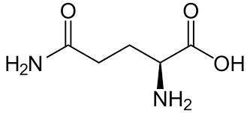
Amino acids as aerobic substrate
Tetrasphaera PAOs store amino acids anaerobically and then use them in aerobic phase for energy (Nielsen et al, 2019)
Potential amino acids used in EBPR
histidine
alanine
lysine
glutamine

Slide 54
phase 2 - Conventional ebpr vs. westbank
Research questions:
  Effect of PE addition outside AN zone?
    P release or uptake?
    Improved EBPR?
  Westbank produce better effluent quality?
    Concentrated VFAs enhance AN response?
  Interrogate “failure” and “recovery”
    Metabolomics, transcriptomics, genomics

Slide 55
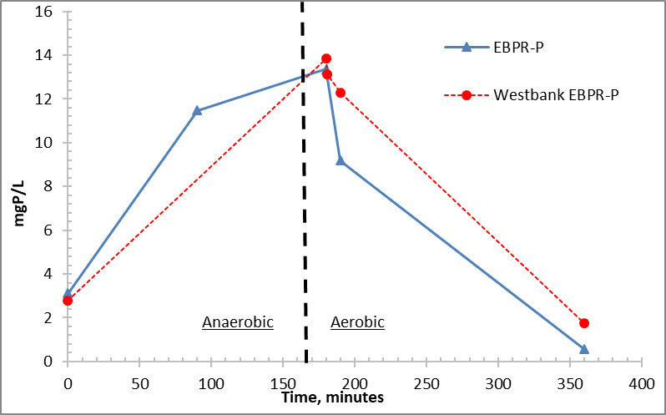
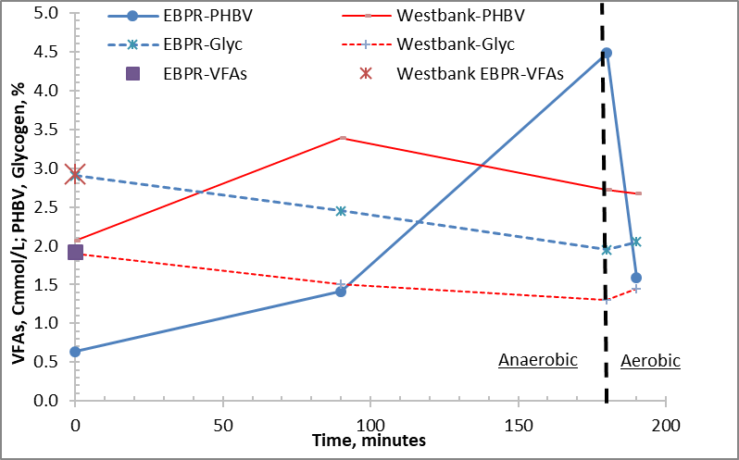
Preliminary data

Slide 56
Ongoing Research
Post-anoxic BNR and Nitritation

Slide 57
What is nitritation?
Stop nitrification at nitrite (NO₂⁻)
Ammonia Oxidizing Bacteria (AOBs)
2NH₄⁺ + 3O₂ → 2NO₂⁻ + 4H⁺ + 2H₂O
Nitrite Oxidizing Bacteria (NOBs)
2NO₂⁻ + O₂ → 2NO₃⁻
Nitrobacter spp.
  r-strategists; low affinity for NO₂ and O₂
Nitrospira spp.
  K-strategists; high affinity for NO₂ and O₂

Slide 58
Potential Value of Nitritation
Less O₂ required in nitritation control
  Low residual DO set point
  Shorter aeration period
  Goal: reduce WRRF energy demand
ΔG= -93.23 kJ/e⁻ for NO₂⁻
  NO₂⁻ reduced to N₂ post anoxically
  Less carbon (i.e., PHA substrate) required in NO₂⁻ reduction (compared with NO₃⁻)
  Goal: conserve wastewater carbon for resource recovery, post-anoxic denit & P removal

Slide 59
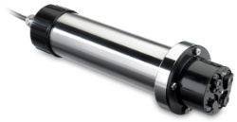
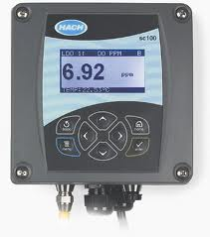


Controlling for Nitritation
NO₂⁻ accumulation inhibits Nitrospira
Length of aerobic period
  Target NH₄⁺ oxidation to NO₂⁻
  NH₄⁺ based aeration control
Residual O₂ concentration
  Nitrobacter favored over Nitrospira
Solids Residence Time?
Real-time NO₂⁻ monitoring

Slide 60


Preliminary data
  DO/aeration control: Nitritation at 42-60% of the influent NH₄
  Biomass enriched with Nitrobacter spp. at 9.3%; Nitrospira represented ~0.1% (>93:1).
    Full-scale: ratio ~ 0.5:1 (i.e., NSR)
  Peer-review research shows same

Slide 61
Our research project
National Science Foundation-funded project (2017-2021)
  Dr. Art Umble, Stantec, is a project partner
Goal: mainstream nitritation within a post-anoxic EBPR configuration
Research led by Jason Mellin, PhD student in CEE

Slide 62
Research hypotheses
Stable and resilient mainstream nitritation can be sustained with an enrichment of Nitrobacter spp. over Nitrospira spp.
The targeted enrichment and outcome (nitritation) can be achieved through the control of the aeration period.

Slide 63

Jason and his Biopho-px reactors

Slide 64
Operational strategy
SRT appears to have negligible influence
Aeration control
  Target 1.5 mgO₂/L
  Aeration ‘off’ when NH₄ = 3 mgN/L
  Strategy 1:
    Continuous aeration until NH₄ target met; maximum aeration period = 50%
  Strategy 2:
    Intermittent aeration
    Use UV NO₂/NO₃ probe for process control
    Air ‘on’ at 0.2 mgNO₂, off at 1.0 mgNO₂
    Targeting simultaneous nitrification-denitritation (denitrification)

Slide 65

Nitritation: r- vs. k-strategists
NOB Enrichment: select for Nitrobacter spp. (r) over Nitrospira (K; potential COMAMMOX)

Slide 66

Complementary scale model ops

Slide 67
Weftec 2019 - chicago
Wednesday, Sept. 25, 9:45 am
Room S403a
Session: “Shortcut Nitrogen with BioP”
Integration of Municipal Mainstream Nitritation With Post-Anoxic EBPR Through Ammonia Based Aeration Control
Jason Mellin, P.E.
Ph.D Student, Dept. of Civil and Environmental Engineering
University of Idaho

Slide 68
Thank you……questions?

