Slide 1

WELCOME
TO THE AUGUST EDITION
OF THE 2019
M&R SEMINAR SERIES

Slide 2
BEFORE WE BEGIN
SAFETY PRECAUTIONS
  PLEASE FOLLOW EXIT SIGN IN CASE OF EMERGENCY EVACUATION
  AUTOMATED EXTERNAL DEFIBRILLATOR (AED) LOCATED OUTSIDE
PLEASE SILENCE CELL PHONES OR SMART PHONES
QUESTION AND ANSWER SESSION WILL FOLLOW PRESENTATION
PLEASE FILL EVALUATION FORM
SEMINAR SLIDES WILL BE POSTED ON MWRD WEBSITE (https://mwrd.org/seminars)
STREAM VIDEO WILL BE AVAILABLE ON MWRD WEBSITE (https://mwrd.org/seminars - after authorization for release is arranged)

Slide 3
Paul V. Rush, P.E.
Mr. Rush serves as Deputy Commissioner for the New York City Department of Environmental Protection’s (DEP) Bureau of Water Supply and is responsible for operating New York City’s upstate water supply system that delivers more than 1.1 billion gallons of water daily to over eight million residents of New York City and one million more in four upstate counties. His responsibilities include source water protection, infrastructure maintenance and operation north of New York City and ensuring drinking water quality throughout the entire system that includes the 2,000 square mile watershed and the City itself. Mr. Rush was appointed deputy commissioner in 2006 and has worked for DEP since 1992. Prior to his employment with New York City he served on active duty in the Army as an Engineer Officer.
Mr. Rush holds a Master of Science degree in Civil Engineering from Michigan Technological University and Bachelor of Science degree in Civil Engineering from the United States Military Academy. He is a registered professional engineer in the state of New York.

Slide 4
Overview of the New York City Water Supply
Paul V. Rush, P.E.
Deputy Commissioner, Bureau of Water Supply
August 23, 2019

Slide 5
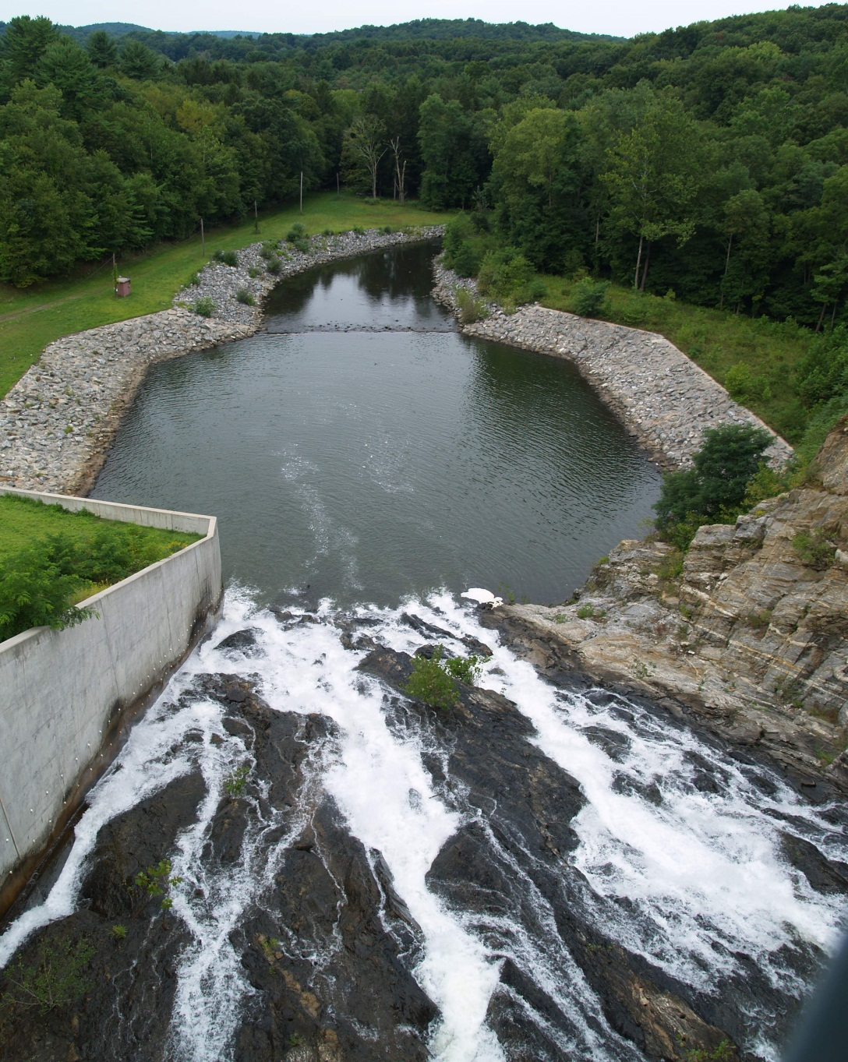
Agenda
DEP Overview
Water Supply System Overview
Bureau of Water Supply Mission
Water Supply History
Filtration Avoidance Determination
Operations
Water Quality
Treatment
Current Challenges
Summary/Questions
Cross River Spillway

Slide 6
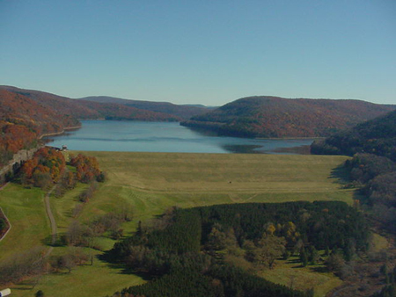
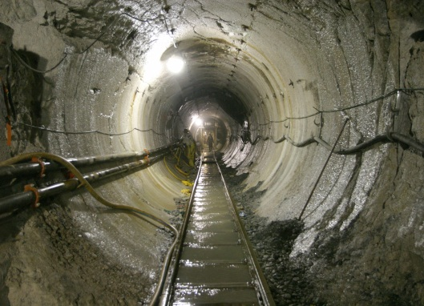
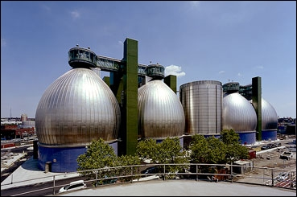
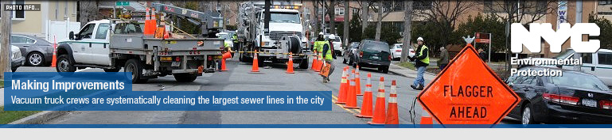
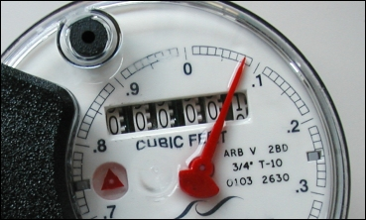
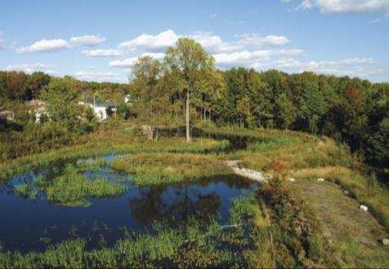
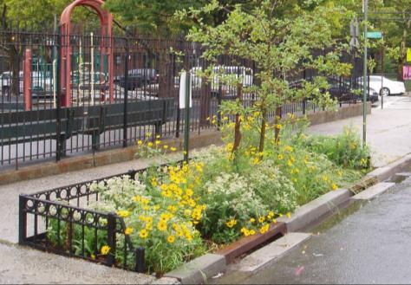
NYC Department of Environmental Protection
Operating Bureaus:
Bureau of Water Supply
Bureau of Water & Sewer Operations
Bureau of Wastewater Treatment
  Major Supporting Bureaus:
Bureau of Engineering, Design and Construction
Bureau of Police and Security
Bureau of Environmental Planning and Analysis
Bureau of Customer Service
  The Agency has 10 other supporting bureaus/offices
Notes:
6000 employees
Generate approximately $2.8 billion from 835,000 rate-paying customers.
1 billion operating budget
$11 billion capital budget
[KG to Insert]
Shaft site (only included tunnel 1 & 2 and the active tunnel 3 shafts)

Slide 7
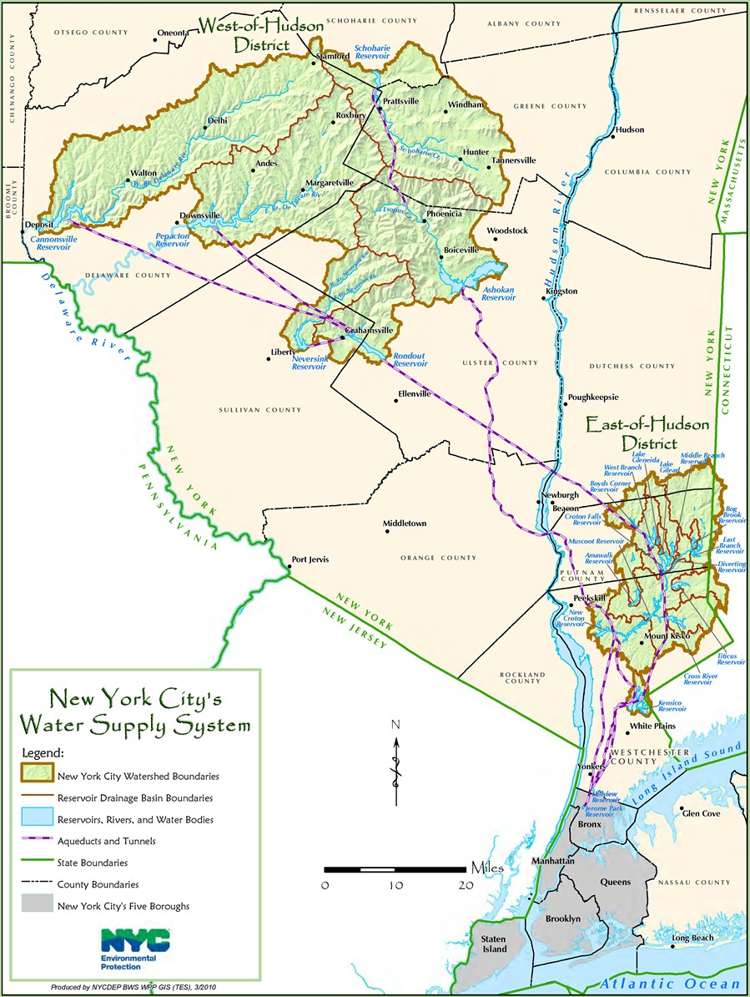
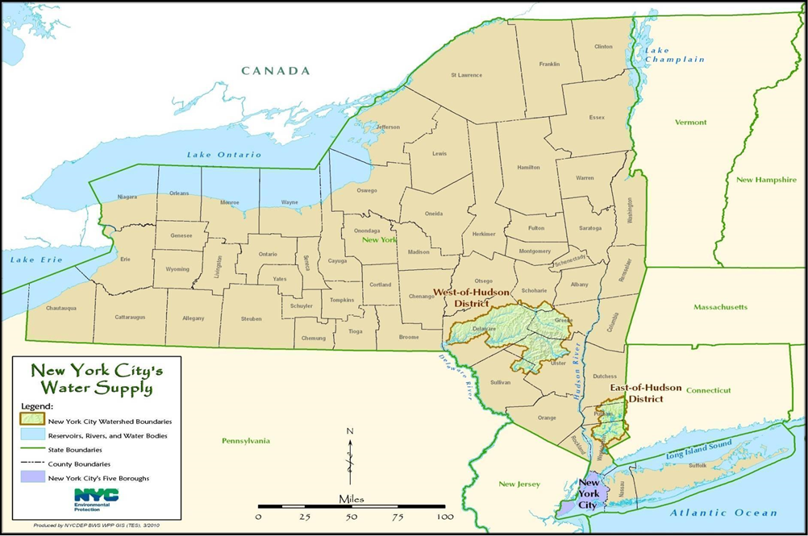
System Overview
Primarily a surface water supply
19 reservoirs & 3 controlled lakes
System Capacity: 570 billion gallons
Serves 9.4 million people (1/2 of population of New York State)
Delivers approx. 1.1 billion gallons per day
Source of water is a 2,000 square mile watershed in parts of 8 upstate counties

Slide 8
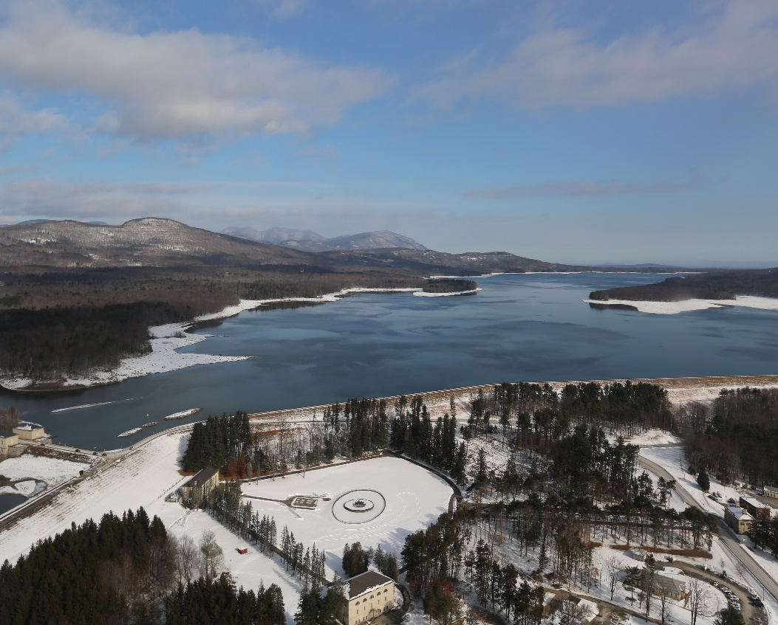
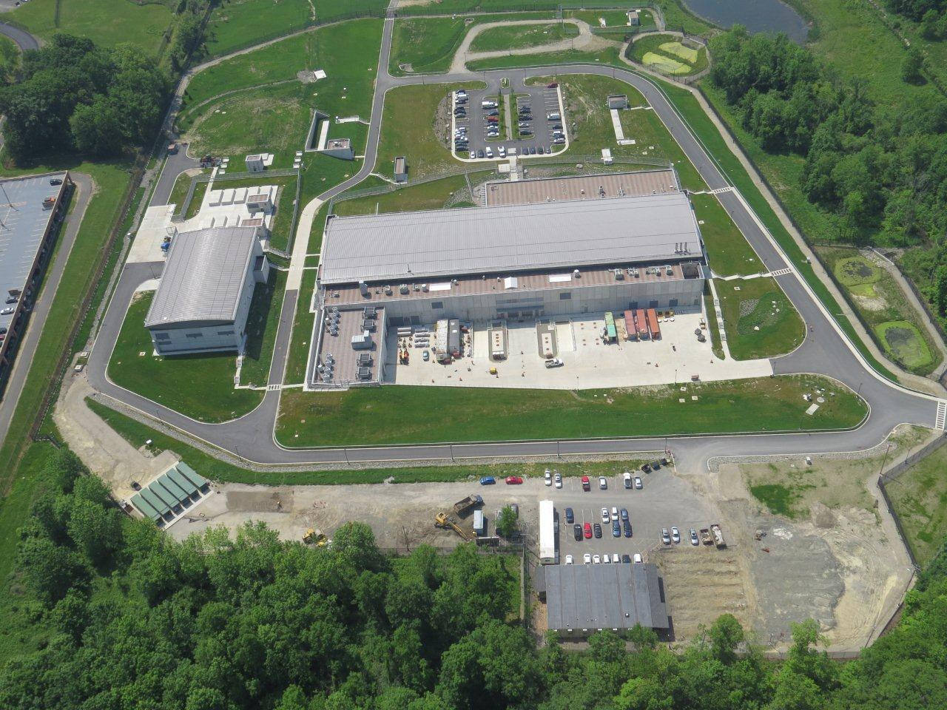
Bureau of Water Supply
The mission of the Bureau of Water Supply is to reliably deliver a sufficient quantity of high quality drinking water to protect public health and quality of life of the City of New York.

Slide 9
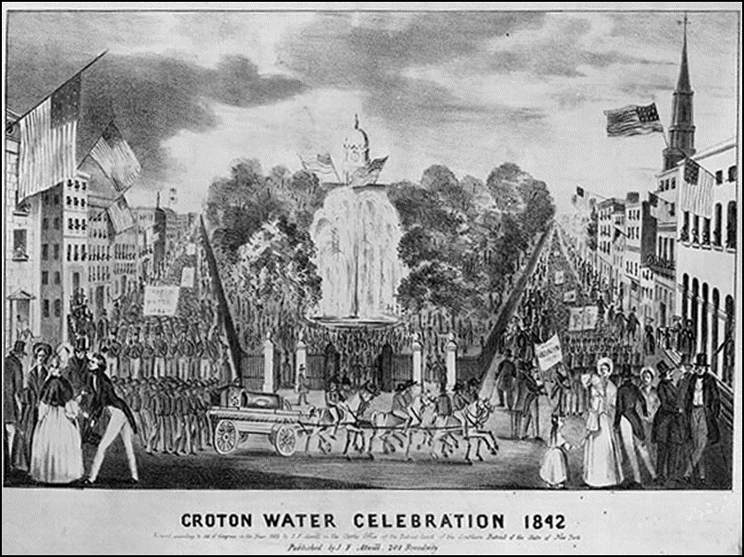
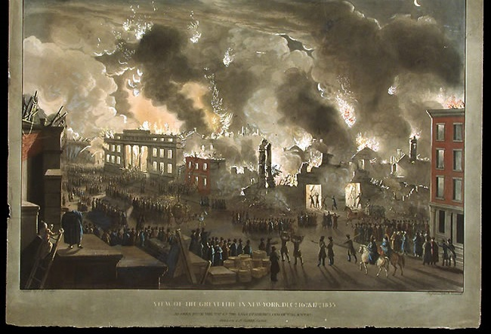
History of NYC’s Water Supply
Early 1600s: 48-acre pond in lower Manhattan
1677: First public well dug in lower Manhattan
1776: First reservoir constructed on East side of Manhattan – groundwater also pumped from wells
    1799: State legislation confers exclusive authority to the Manhattan Company to convey water to the City of New York
Early 1800s: Inadequate water supply leads to public health (disease) & safety (fires) problems
1832: The Manhattan fire
1842: Croton Aqueduct placed in service

Slide 10
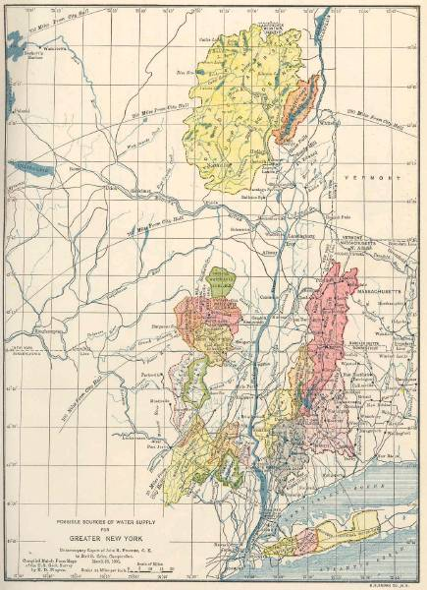
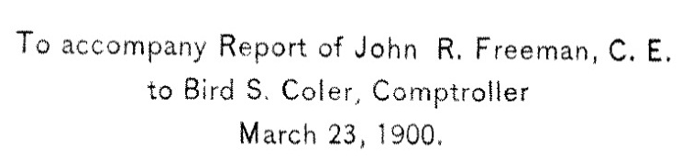
Freeman Report (1900)
Adirondacks
Lake George
VT
Upper Catskills
NY
Berkshires
MA
Lower Catskills
CT
Wallkill/ Ramapo & Moodna
PA
Long Island
NJ

Slide 11
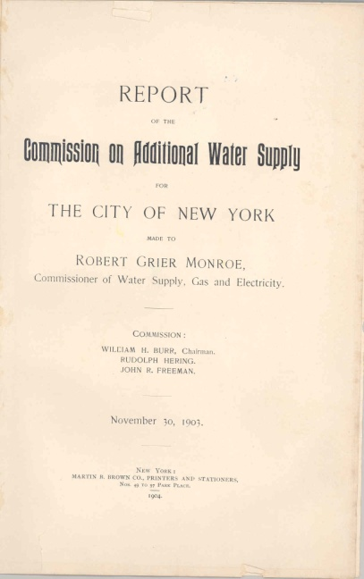
Burr, Herring, Freeman Report (1903)
General Problem
  Provide greater New York area with an abundant quantity of water with satisfactory quality
Requisite Qualities of Public Water Supply
  Free of organisms
  Agreeable appearance
  Odorless and tasteless
  Not too hard
  Not contain substances that are liable to
  corrode pipes
  Should have cool and equable temperature
Notes:
11

Slide 12
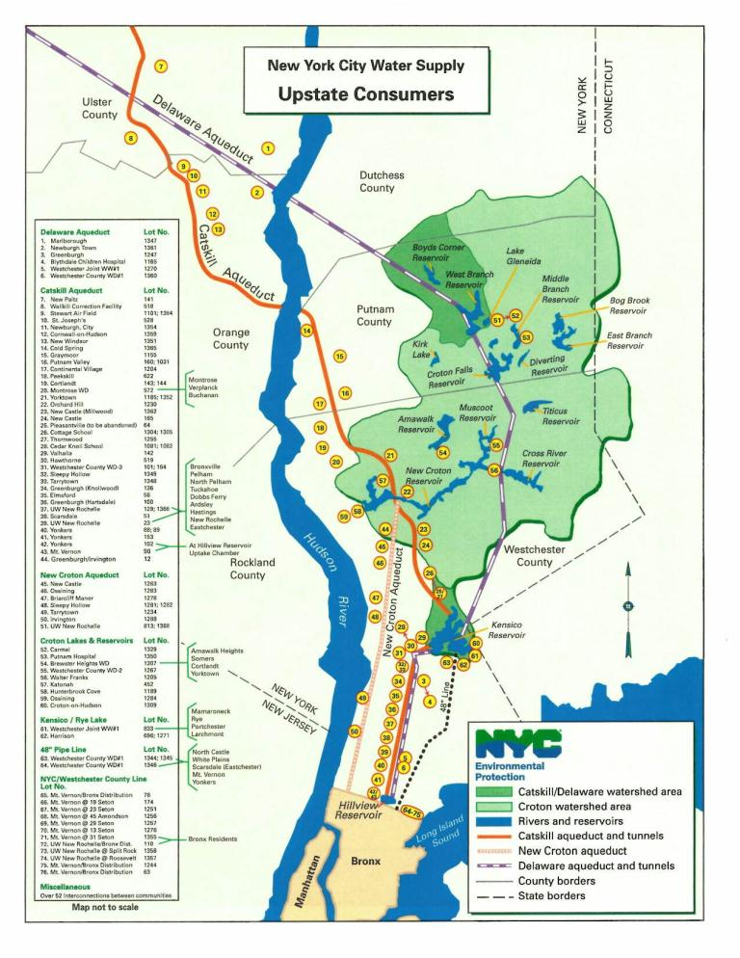
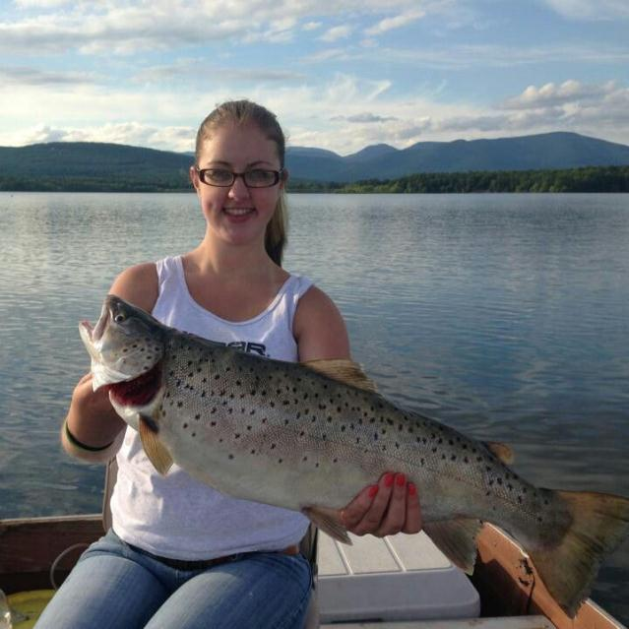
Water Supply Act of 1905
Board of Water Supply created to develop system
NYC required to allow municipal connections to system in counties with water supply infrastructure
Fishing & boating to be permitted

Slide 13
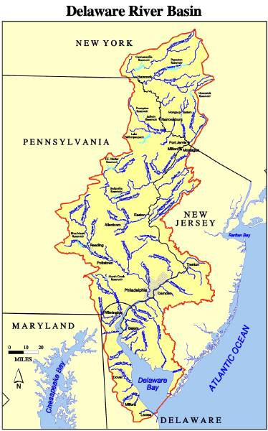
The Delaware System
City next selected Rondout Creek and Delaware River headwaters for development
1924-1927 New York and New Jersey attempt to negotiate for Delaware Reservoir development
In 1928 the City moved forward with Delaware Basin development
In 1929 New Jersey goes to Supreme Court to stop NYC development
In 1931 U.S. Supreme Court upheld the right of New York City to develop supply from Delaware River headwaters
  1954 Supreme Court Decree amended allowing Cannonsville development

Slide 14
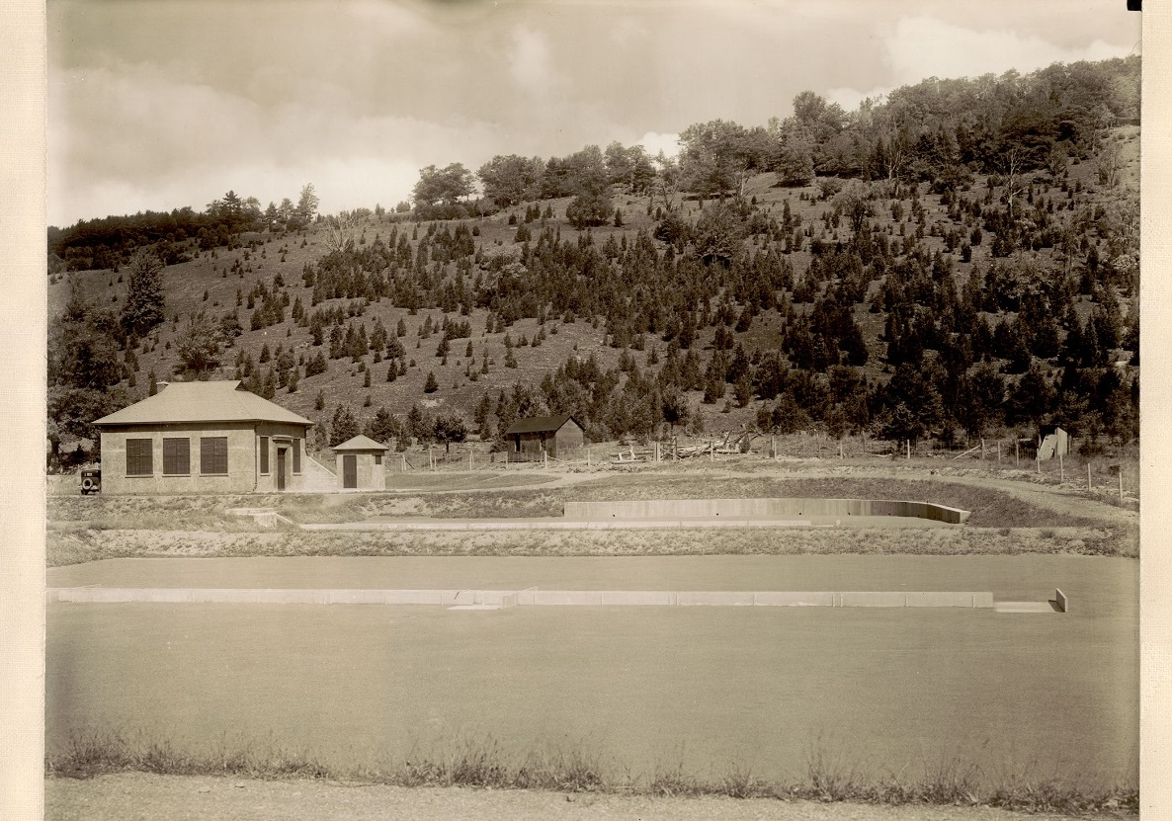
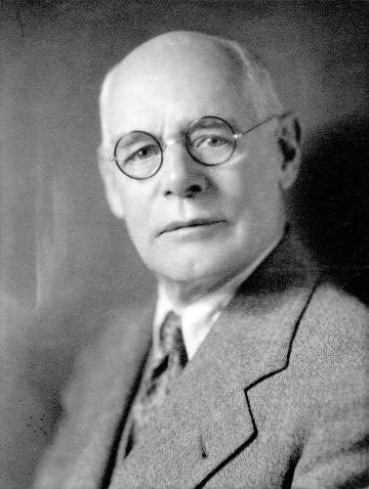
Early Source Water Protection
Source water protection important from the earliest days
NYC built wastewater plants and septic systems in watershed
NYC acquired buffer lands at time of reservoir construction and planted trees around reservoirs to prevent erosion
Regulations promulgated in 1917
The Grand Gorge “sewerage system” - 1929
“It is important that vigilance should be exercised to maintain the quality of all the present supplies by protecting them from pollution and treating them by approved modern methods, and that the structures should be kept constantly in good repair.” - J. Waldo Smith, 1917

Slide 15
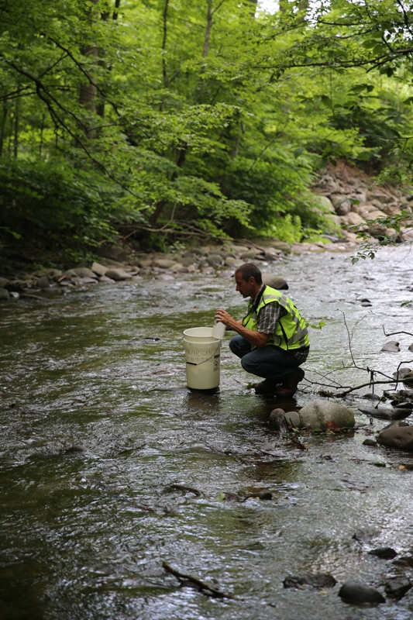
Surface Water Treatment Rule
EPA promulgated Surface Water Treatment Rule in 1989
Requires water systems to filter and disinfect surface water sources
Systems eligible for a filtration waiver if they meet criteria for water quality and watershed protection
  Fecal or total coliform
  Turbidity
  Adequate disinfection
  Maintain a program to control “all human activities which may have an adverse impact on the microbiological quality of the source water”

Slide 16
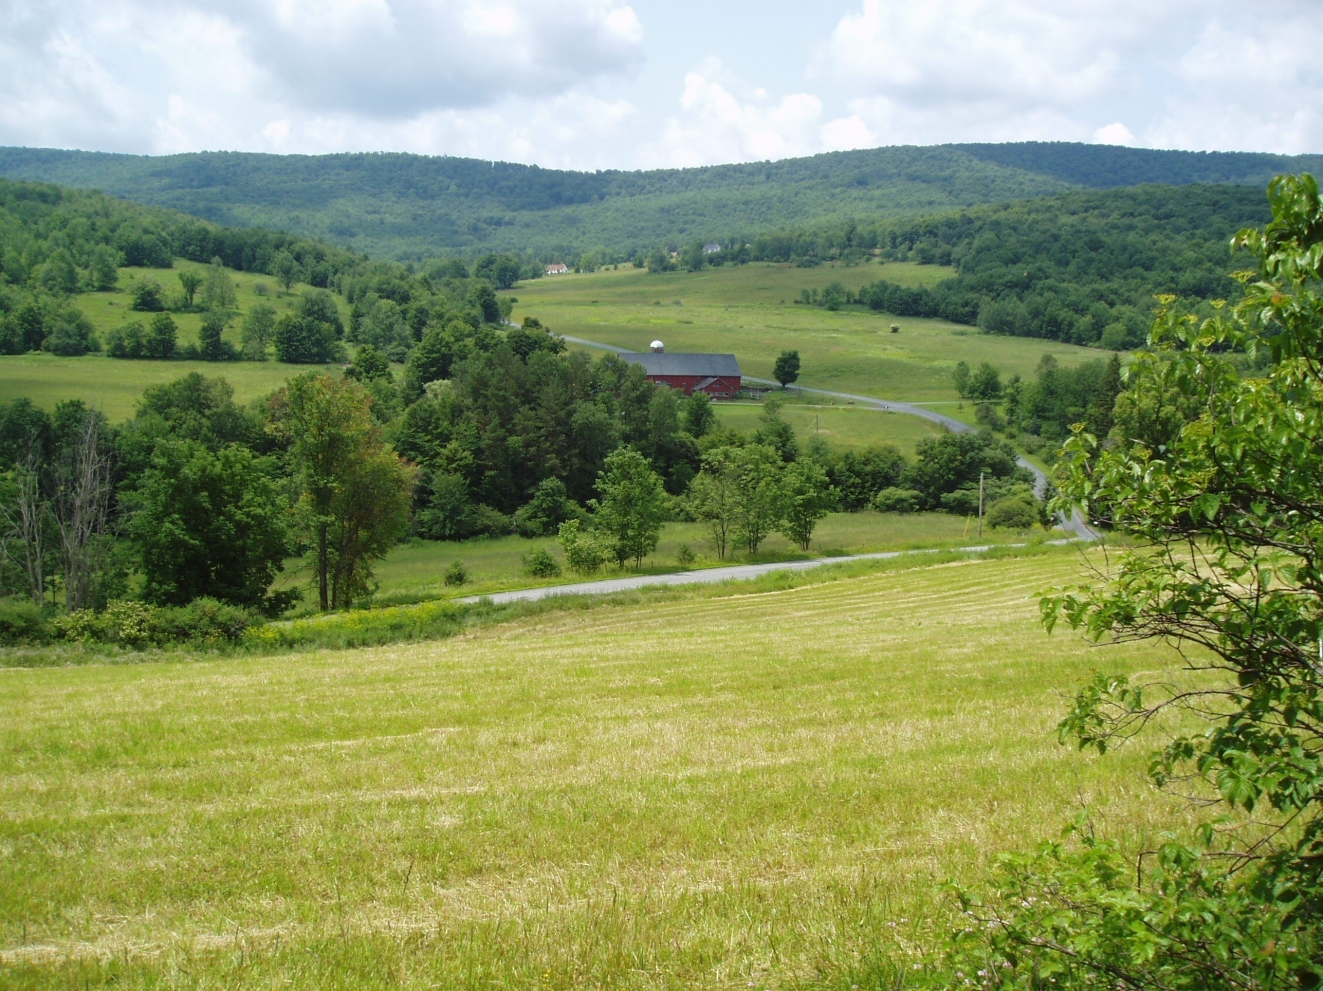
Catskill/Delaware Protection Strategy
Comprehensive source water protection, including
  Regulations governing new development
  Land acquisition
  Wastewater programs including upgrades of existing WWTPs, septic system repairs and construction of new wastewater infrastructure
  Stormwater programs
  Agricultural program
  Stream management program
  Kensico and EOH programs
First Filtration Avoidance Determination (FAD) issued by EPA in January 1993
Watershed MOA signed January 1997
FAD renewed in 2002, 2007, 2014, and 2017

Slide 17
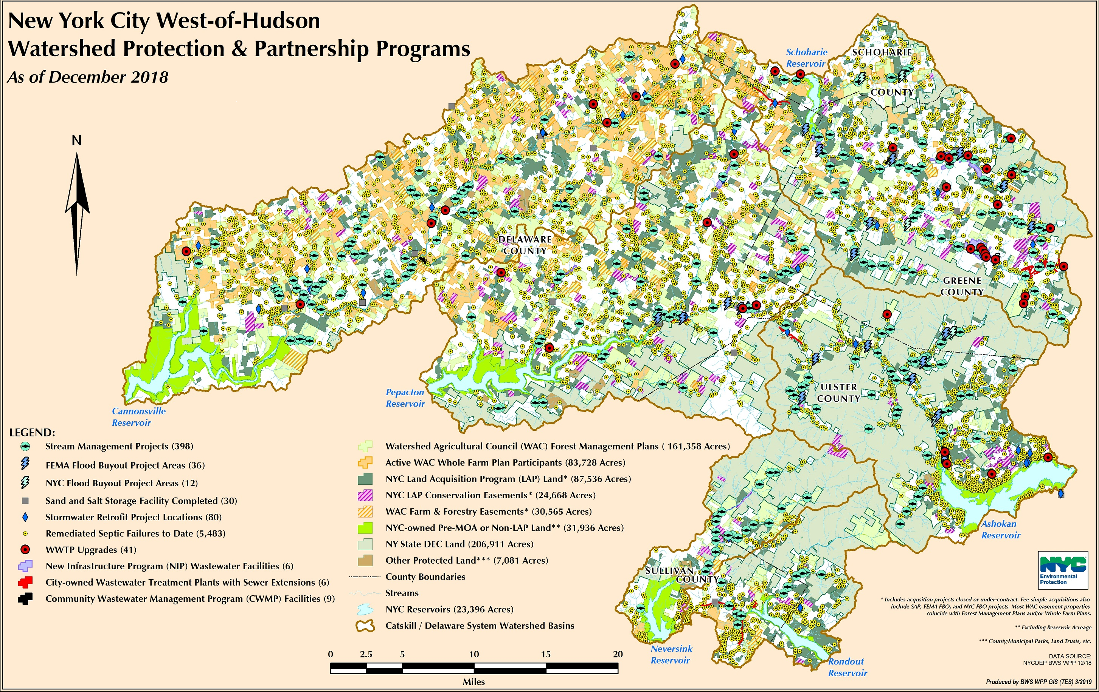
2018 Implementation Status

Slide 18
FAD Program Costs

Slide 19
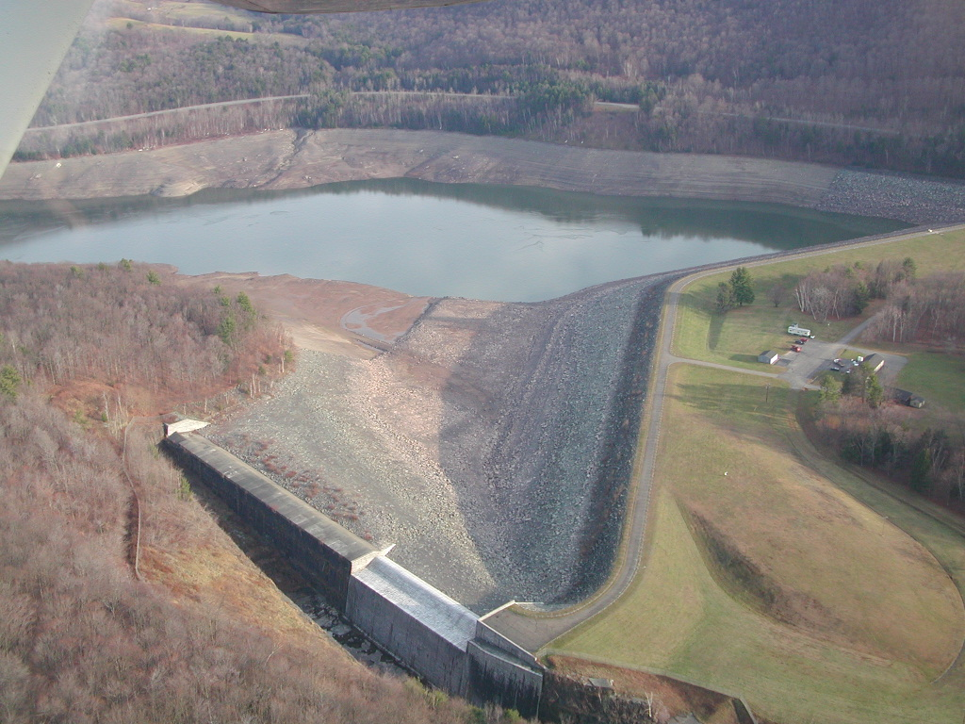
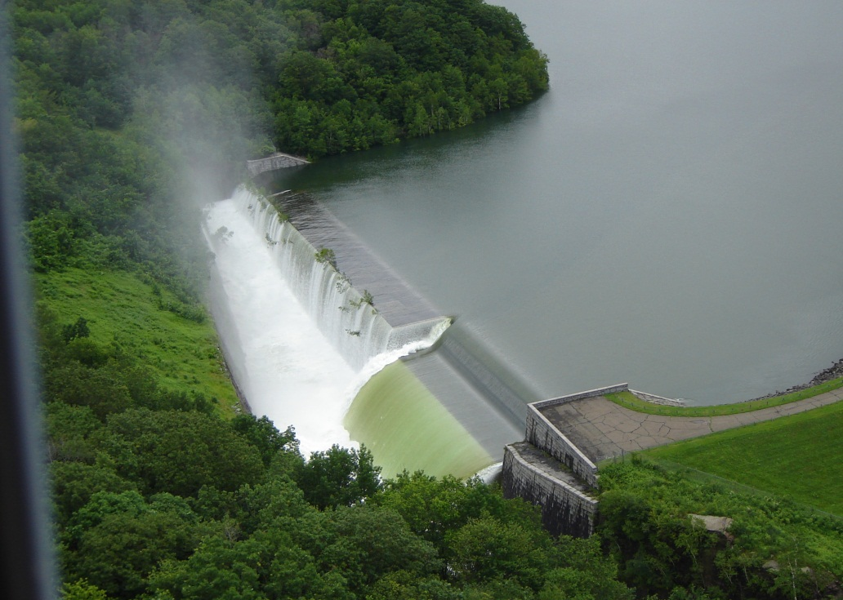
Water System Operations
Essential Tasks
  Meet the supply needs of New York City
  Meet all reservoir release & diversion requirements
    1954 U.S. Supreme Court Decree
    Interstate Agreements
    SPDES permits
    Consent orders
Objectives
  Divert the best quality water available
  Maintain balanced system
  Provide downstream habitat and flood mitigation benefits w/o water supply impact
Notes:
Can just touch on requirements bullet – they’re covered above.
Emphasize water quality as what drives operating decisions.

Slide 20
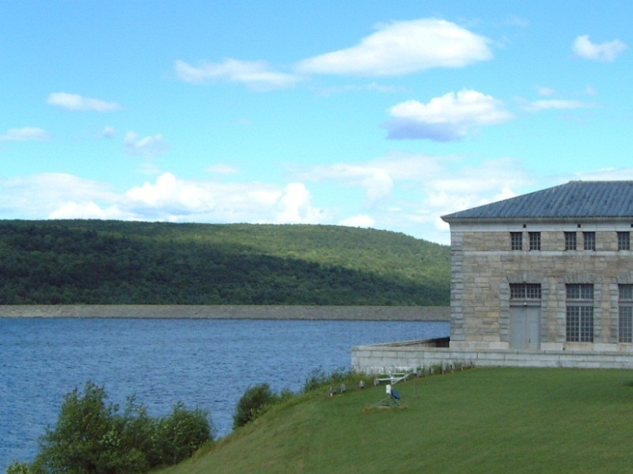
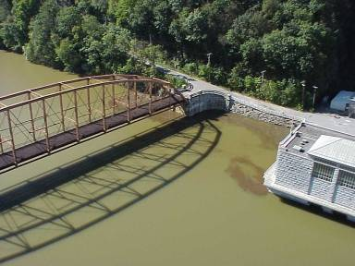
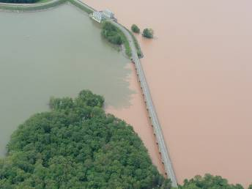
Reservoir Operations
Operational decisions are made based on the following:
  Water Quality
  Demand
  Modeling
  Weather forecasts
  Maintenance
  Hydrological conditions
Ashokan
Rondout
New Croton
Not all NYC systems water quality is created equal
Notes:
As one instance shows in these photos that were taken right around the same time, more often than not we have quality issues with the catskill and croton systems while the delaware system remains good. The geology of the Catskill System and the layout and lack of such a pritine watershed in the croton system work against them.
Due to maintenance, operational and water quality issues, NYC’s Croton system is used sparingly and not factored into NYC’s reservoir balancing operations

Slide 21
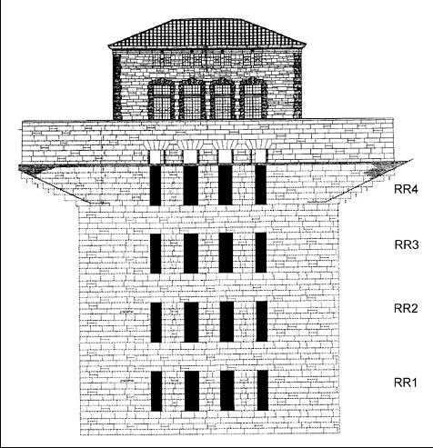
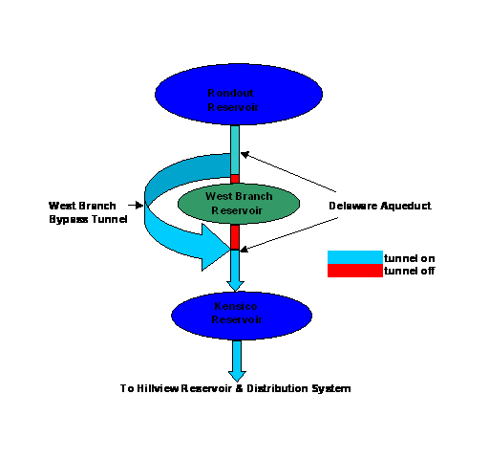
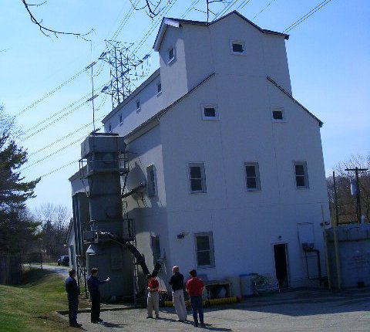
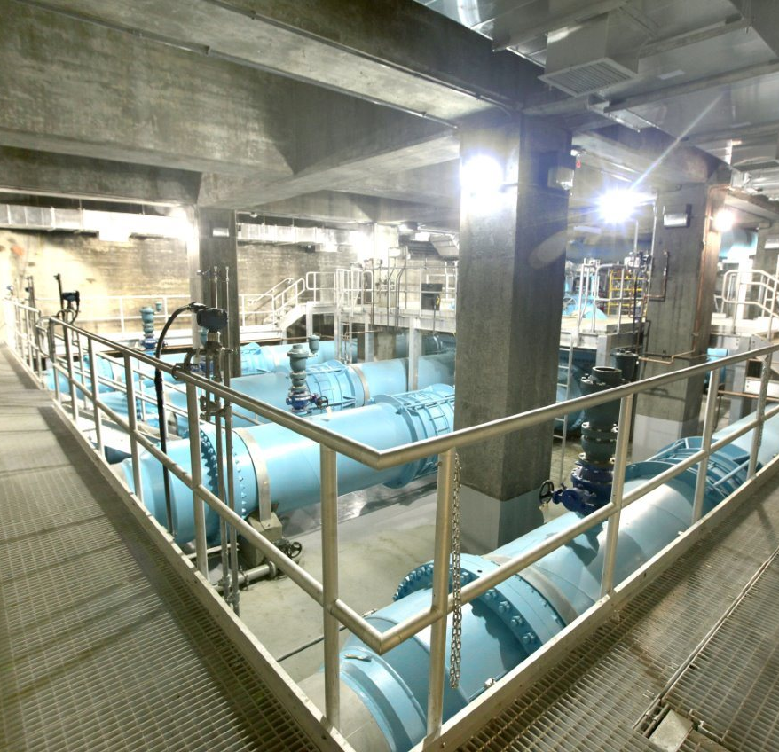
Water Quality and Operational Decisions
Water delivered is selected or mixed based on available quantity and quality
Selective Withdrawal
Selective Diversion
Treatment Operations
Blending Operations
Notes:
Operational options are listed in order of priority
Diversions made are not based solely on Quantity

Slide 22
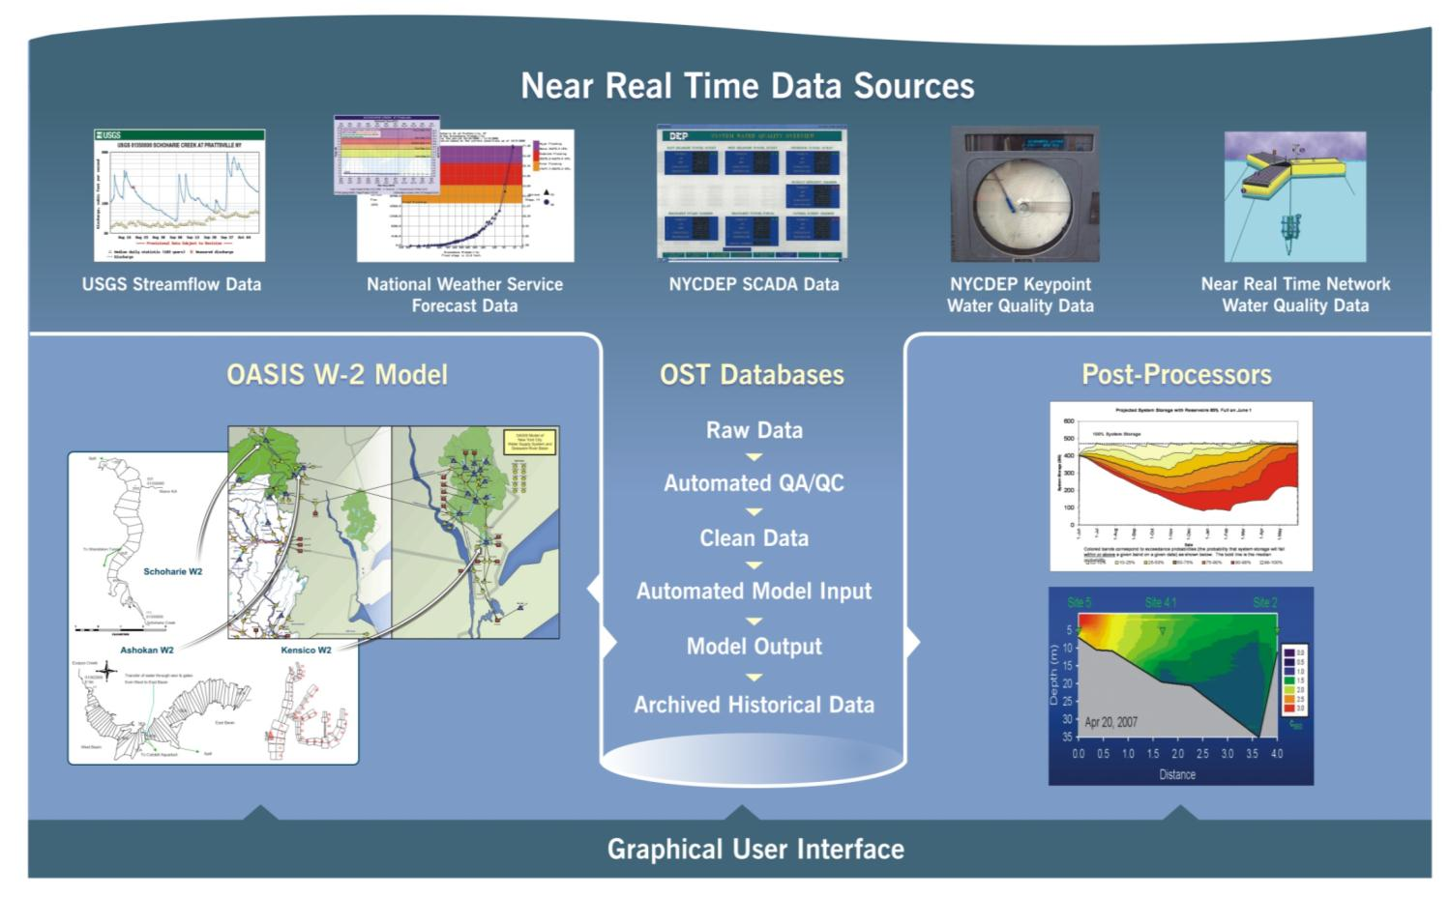
Operations Support Tool
Probabilistic foundation for water supply reliability
  More accurate assessment of likely future inflows, release requirements, storage levels–better drought warning triggers
Better defines system capacity to meet water quality & environmental objectives
System implemented in November 2013
Notes:
OST is our decision support system

Slide 23
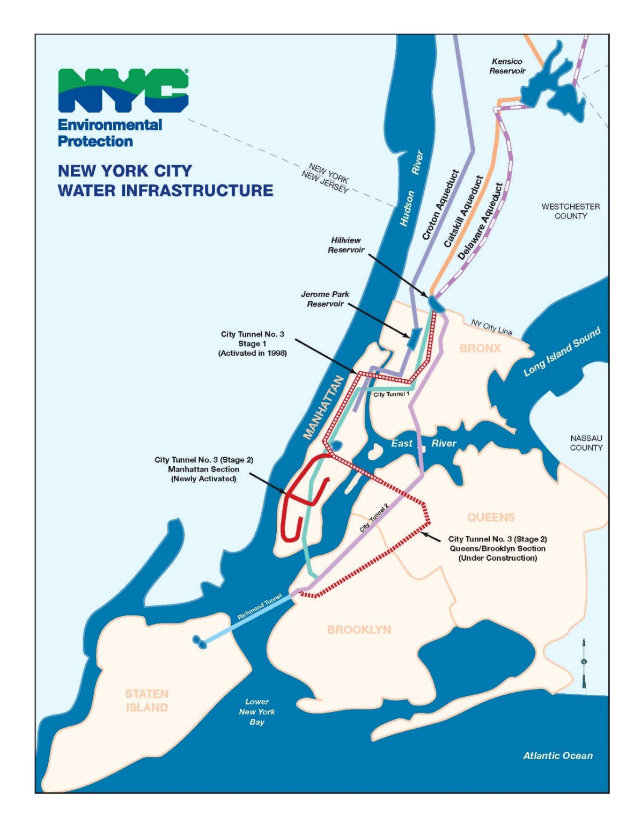
Water Treatment Operations Facilities
Cat-Del UV Facility
Shaft 18
Hillview
Reservoir
Croton
Filtration
Plant

Slide 24
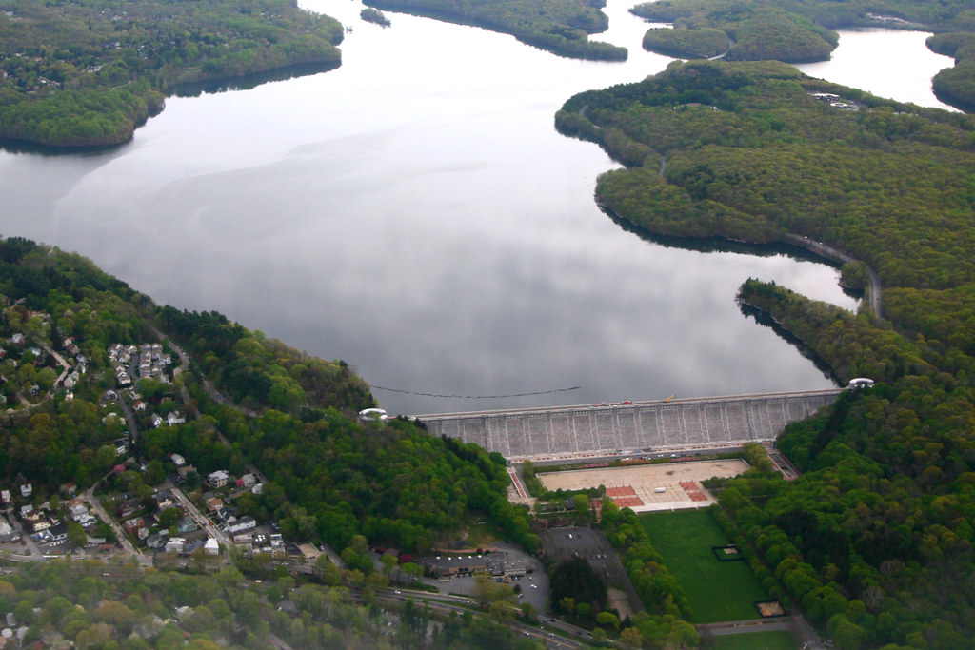
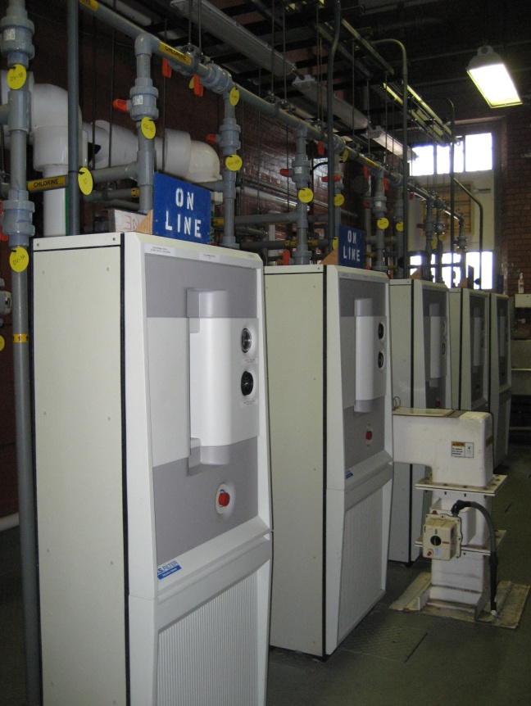
Delaware Shaft 18 – Kensico Reservoir
Intake for Kensico Reservoir for the Catskill and Delaware systems
Chemical treatment provided:
  Chlorination (Cl₂ gas): average daily use 9,654 lbs
  Fluoridation (Hydrofluosilicic Acid)

Slide 25
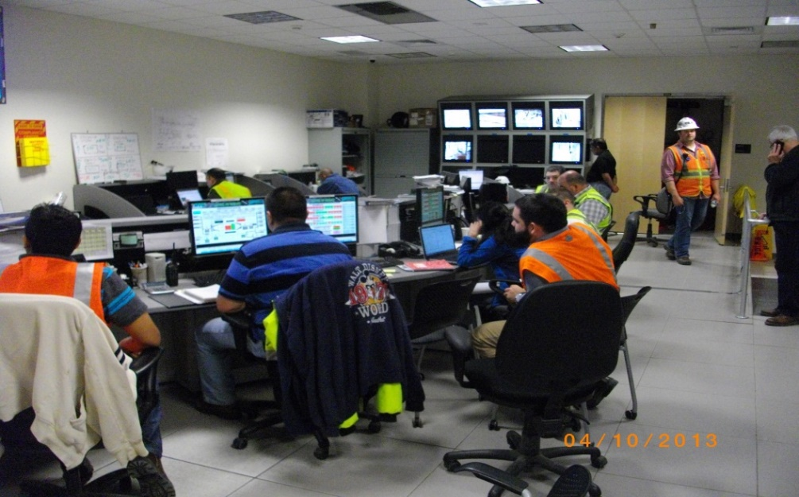
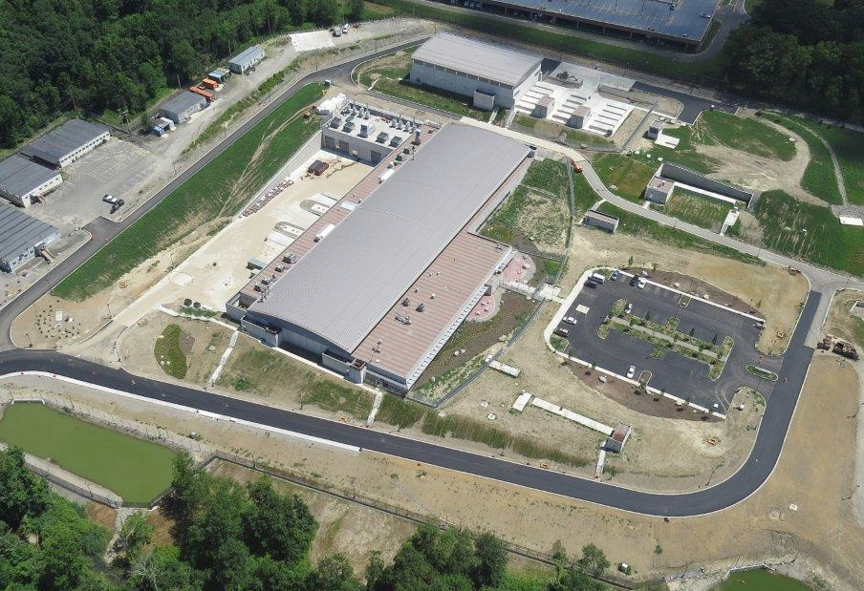
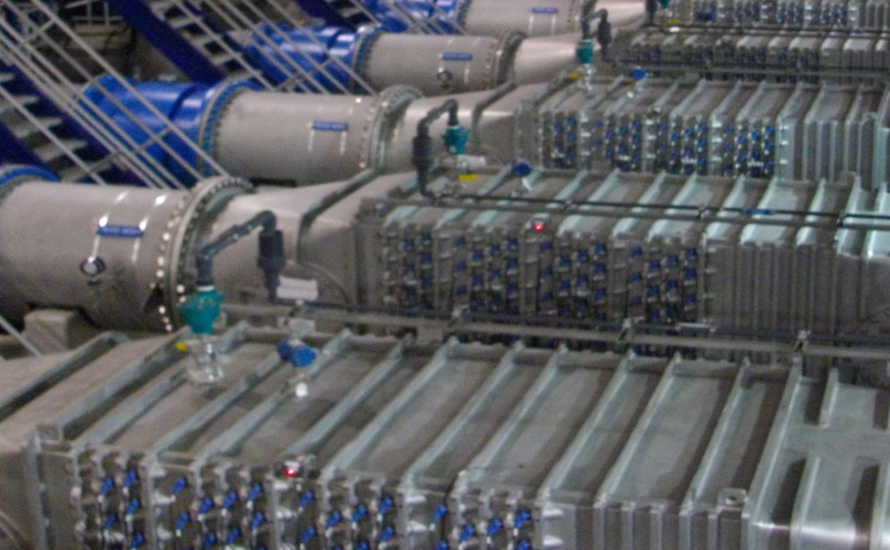
Catskill-Delaware UV Disinfection Facility
Treatment capacity of 2,020 MGD
56 UV reactors
11,760 lamps in facility
Notes:
DEP is the largest combined water and wastewater utility in the United States, with nearly 6,000 employees and an annual budget of $3.8 billion (should be updated yearly)

Slide 26
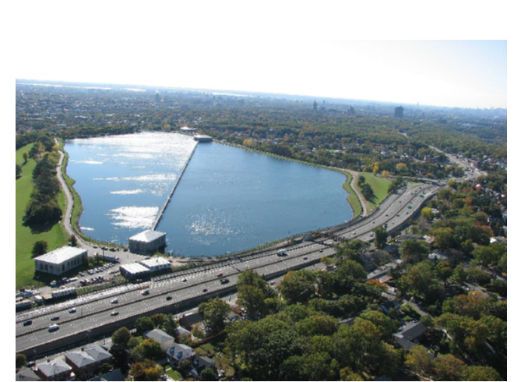
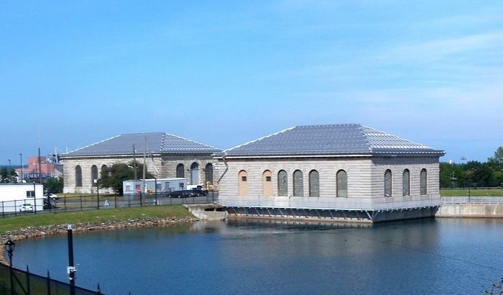
Hillview Reservoir
1 BG uncovered finished water storage reservoir
Final treatment before distribution to City through Tunnels 1, 2, and 3, can be used for disinfection credits if needed
Chemical treatment provided:
  Chlorination, average daily use: Cl₂ gas-3900 lbs and hypochlorite 1130 gallons
  Phosphoric acid
  Sodium hydroxide
Under consent order to cover by 2047

Slide 27
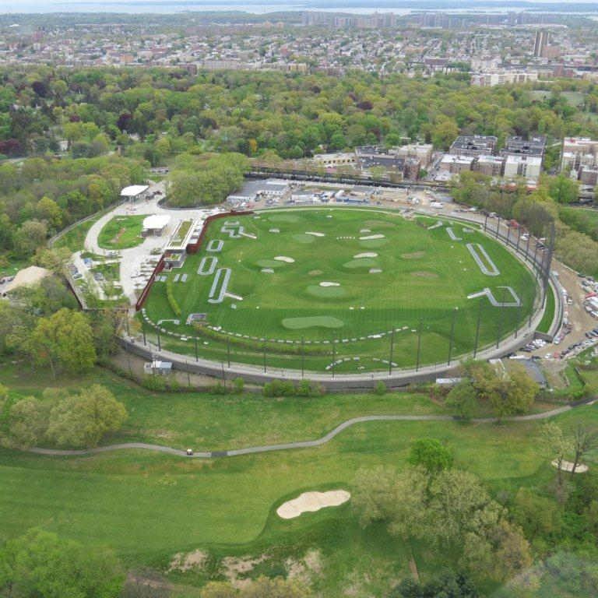
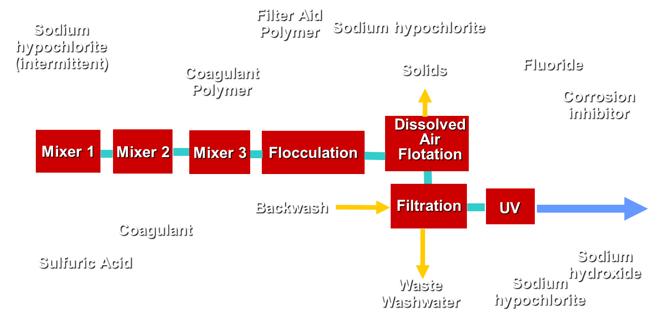
Croton Filtration Plant
Capacity of 290 MGD
Treatment provided:
  Coagulation-flocculation: aluminum sulfate and coagulant polymer
  Dissolved air flotation
  Filtration: sand and anthracite
  UV disinfection
  Chemical treatment provided:
    Chlorination (hypochlorite): average daily use 2100 gallons at 150 MGD
    Sodium hydroxide
    Phosphoric acid
Located completely underground from the Mosholu Golf Course

Slide 28
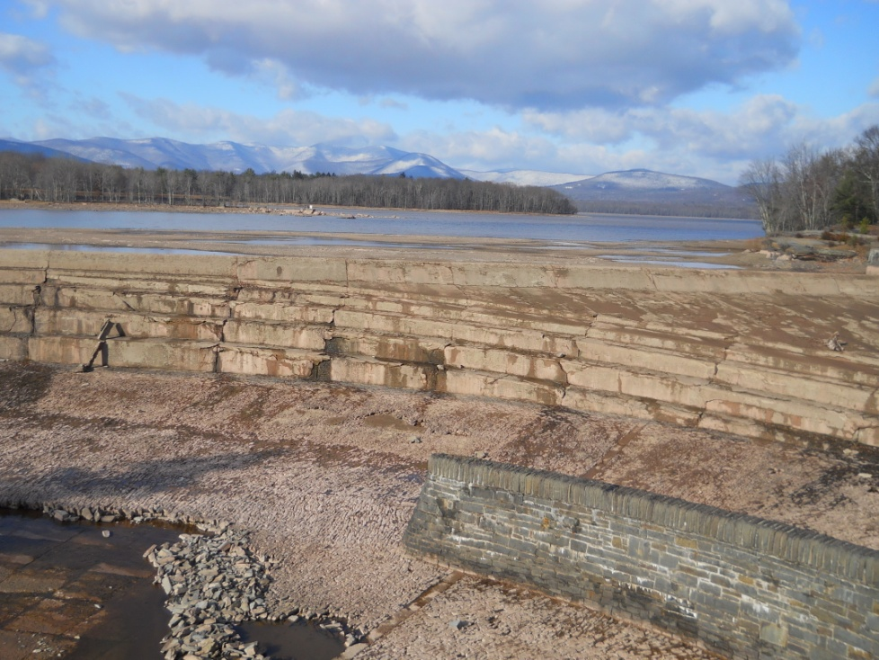
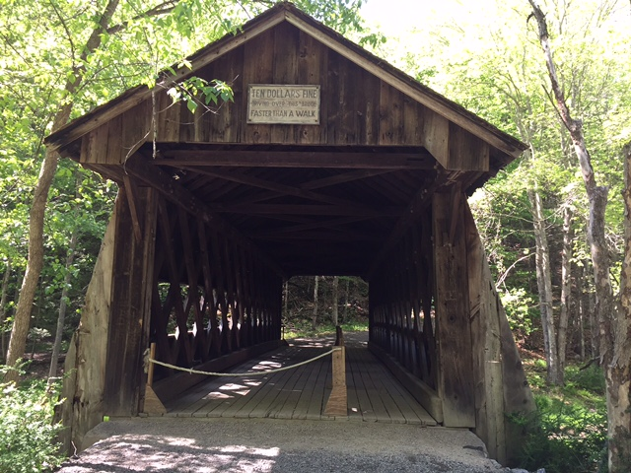
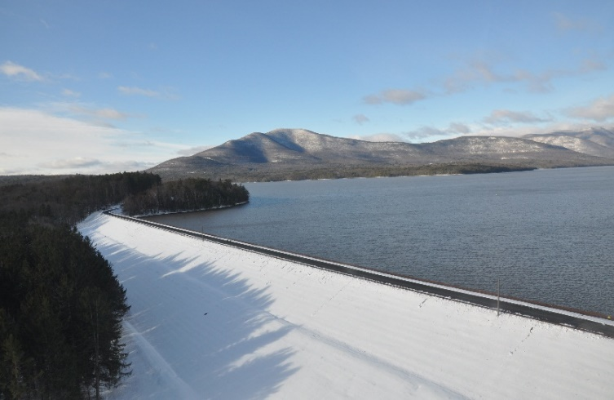
Current Challenges
Maintain FAD long term
Maintain aging infrastructure
  Delaware Aqueduct
  Catskill Aqueduct
  Dams
  Bridges
  Wastewater Treatment Plants
Regulatory compliance
  Stage II DPB rule
  LT2
Future regulatory compliance
  Lead and Copper Rule
  Revised DPB Rule
  Emerging contaminates
Long term agreement on releases from Delaware Reservoirs

Slide 29
Historical Water Demand and Population
  Distribution has declined more than 30% since the early 1990s – despite increasing population
  Since 2009, water usage has been below the 1960s drought-of-record
  Daily demand peaked in 1979 at over 1.5 billion gallons (per capita of 213 gallons)
Average Daily Demand (MGD)
2010: 1,039
2011: 1,021
2012: 1,009
2013: 1,006
2014: 996
2015: 1,009
2016: 1,002
2017: 990
2018: 1,007.5
1979: 1,512 MGD
* 2017: 8.6 Million People
Water Demand (MGD)
Population in Millions
Per Capita Demand (GPD)
2010: 127
2011: 123
2012: 121
2013: 119
2014: 118
2015: 118
2016: 117
2017: 115
2018: 117
1966: 1,045 MGD
2018: 1,007.5 MGD
* Official 2017 New York City Department of City Planning Estimate

Slide 30
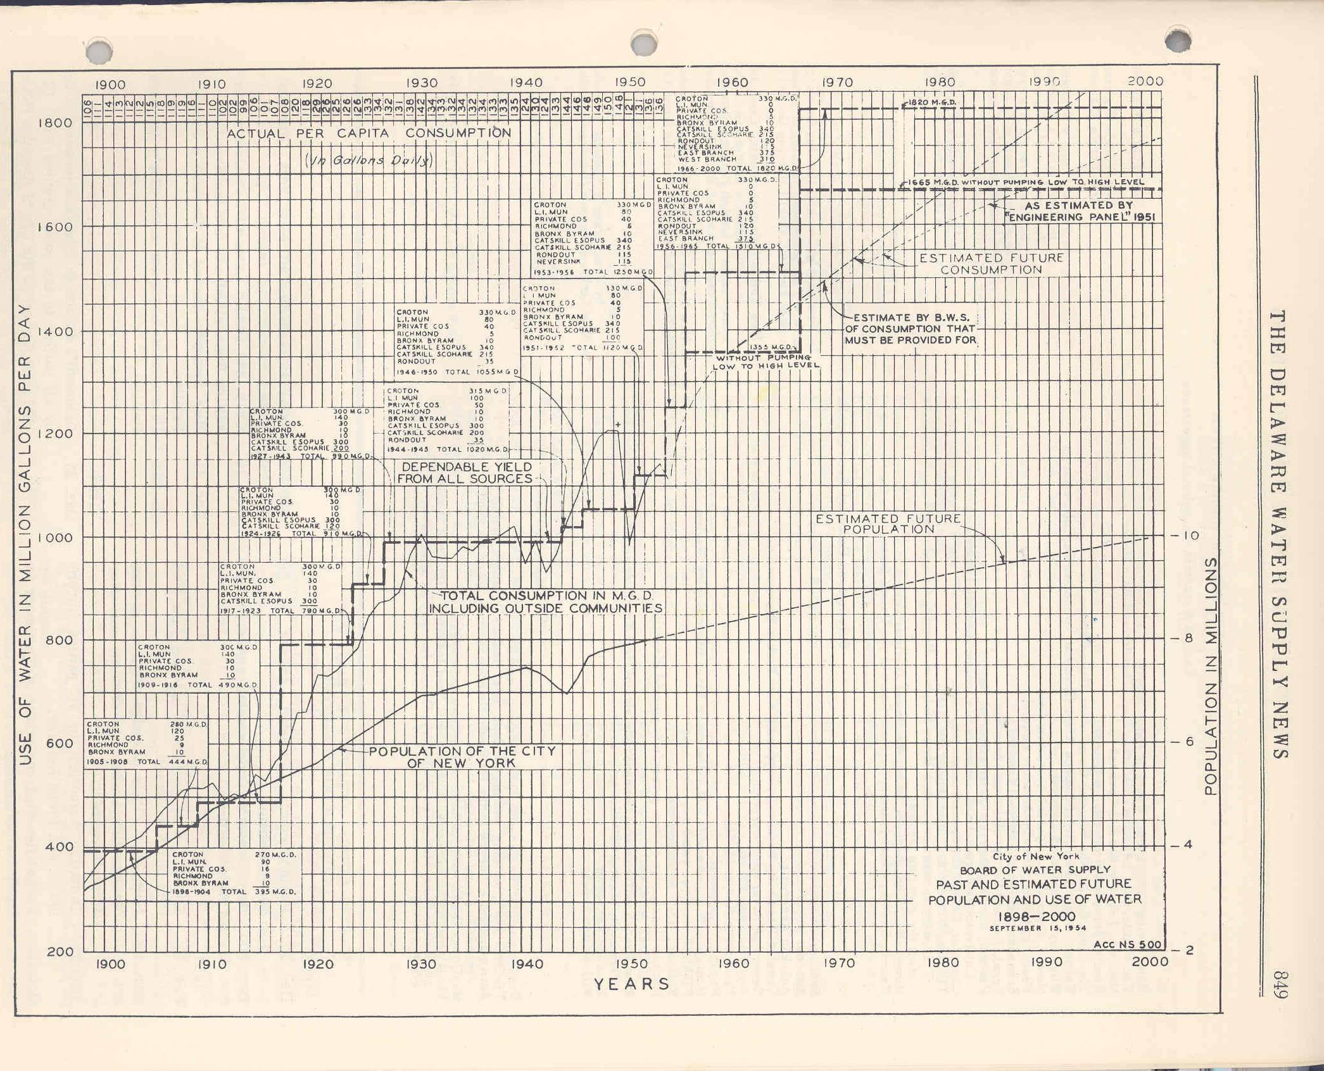
Historical Water Demand and Population
1954 Safe Yield : 1820 MGD
1954 Safe Yield w/o pumping: 1665 MGD
1979-Peak Annual Demand 1618 MGD
2000 Estimated Consumption 1760 MGD
2014 Safe Yield w/ pumping 1310 MGD
2014 Safe Yield w/o pumping 1180 MGD
2018 Demand 1007.5 MGD
1954 Total Consumption Approximately 1140 MGD

Slide 31
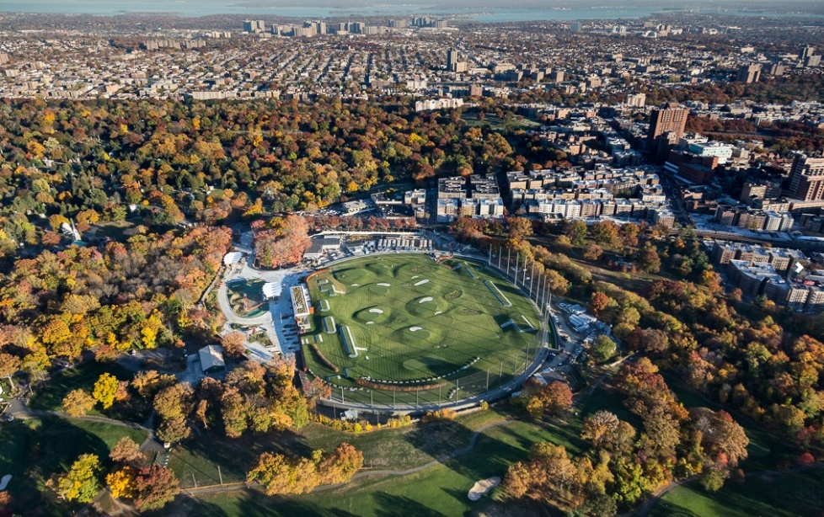

Summary/Questions
NYC DEP is the largest combined water and wastewater utility in the country
Complex water supply system built with flexibility to meet future challenges
Many challenges lie ahead that demand the best science and engineering to support decisions

Slide 32


For more information…
Visit the DEP website at www.nyc.gov/dep
Follow us on Facebook
for more info about events and projects, photos and other watershed updates:
facebook.com/nycwatershed

