Slide 1

WELCOME
TO THE SEPTEMBER EDITION
OF THE 2019
M&R SEMINAR SERIES

Slide 2
BEFORE WE BEGIN
SAFETY PRECAUTIONS
  PLEASE FOLLOW EXIT SIGN IN CASE OF EMERGENCY EVACUATION
  AUTOMATED EXTERNAL DEFIBRILLATOR (AED) LOCATED OUTSIDE
PLEASE SILENCE CELL PHONES OR SMART PHONES
QUESTION AND ANSWER SESSION WILL FOLLOW PRESENTATION
PLEASE FILL EVALUATION FORM
SEMINAR SLIDES WILL BE POSTED ON MWRD WEBSITE (https://mwrd.org/seminars)
STREAM VIDEO WILL BE AVAILABLE ON MWRD WEBSITE (https://mwrd.org/seminars - after authorization for release is arranged)

Slide 3
April Z. Gu, Ph.D.
Dr. April Z. Gu is currently a professor at the School of Civil and Environmental Engineering at Cornell University in Ithaca, New York. Her expertise and area of research interest include biotechnology for water and wastewater treatment and biological nutrient removal; risk-based water quality monitoring and toxicity assessment; global phosphorus cycling and bioavailability of nutrients in natural ecological systems; and biosensors and nano-biosensors. She has led and participated over 30 research projects funded by various agencies including NSF, DOE, EPA, WERF, WRF, USDA/NIFA, and NIEHS. She has been elected to serve on the Board of Directors for AEESP since 2017.
Dr. Gu received her B.S. in Environmental Engineering and Science from Tsinghua University in Beijing, China and a Ph.D. in Civil and Environmental Engineering, jointly in Microbiology, from the University of Washington. She is an elected Fellow of Water Environment Federation for her professional achievement, stature and contributions to the water profession.

Slide 4

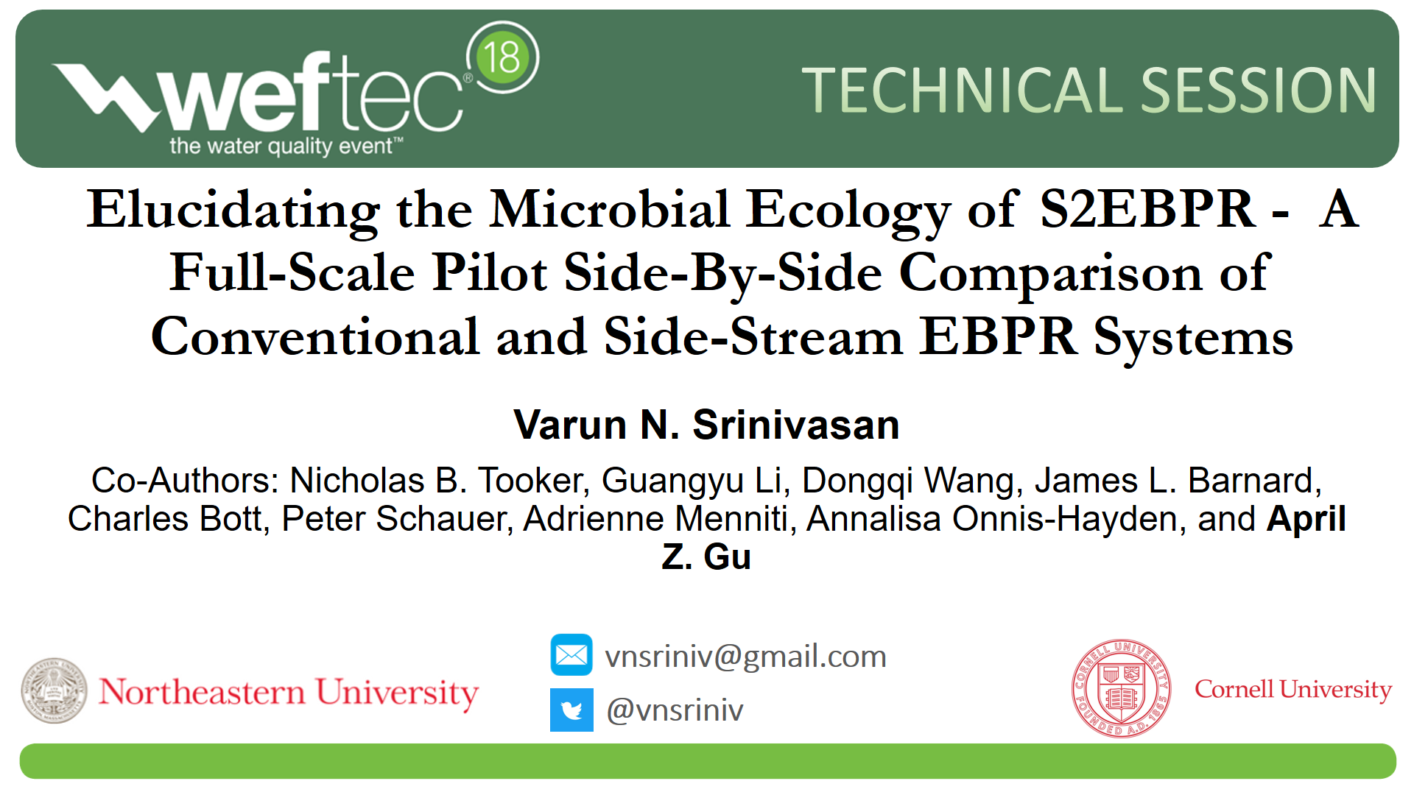
Reform EBPR Design for Sustainable Nutrient Removal with Carbon and Energy Recovery
April Z. Gu
Professor
School of Civil and Environmental Engineering
Cornell University

Slide 5
Presentation Outline
Background
Summary of findings from WERF study
Take-home messages
On-going work and future directions

Slide 6
Current Challenges in EBPR Practice
Increasingly stringent permits demand higher consistency and stability
Backup chemical systems often required
Sporadic metal salt addition negatively impacts P recovery processes
External carbon may be required to obtain desired C/P ratio; increases carbon footprint
Carbon competition between N and P removal
Compatibility with short-cut N removal processes and carbon recovery processes

Slide 7
Conventional EBPR Design
Not true “Anaerobic” zone:
  primary effluent and RAS through the anaerobic zone bring DO
  ORP level usually not supporting sufficient fermentation
  Negatively impact on EBPR- i.e. VFA competition by non-PAOs
PAO/GAO competition:
  limited VFA is being competed by both PAOs, GAOs
  VFA composition and concentrations impact PAO/GAO competition
  Typically low VFAs, Ks-type of competition
  Less efficient carbon/VFA utilization by PAOs
Influent-dependent (C/P ratio):
  Susceptible to influent C/P and fluctuations
  Unfavorable C/P, external carbon supplement

Slide 8
An Alternative EBPR Strategy S2EBPR benefits
  Involve different, less influent carbon-dependent population selection mechanisms;
  Reduced dependence on rbCOD, chemical use, and carbon footprint
  Potentially eliminate anaerobic zone
  Multiple, flexible process configurations
  Enhance denitrification
    Internal carbon-drive denitrification

Slide 9
S2EBPR Configuration
Side-Stream RAS (SSR)
What happens in the side-stream reactor holds the key of how S2EBPR works

Slide 10
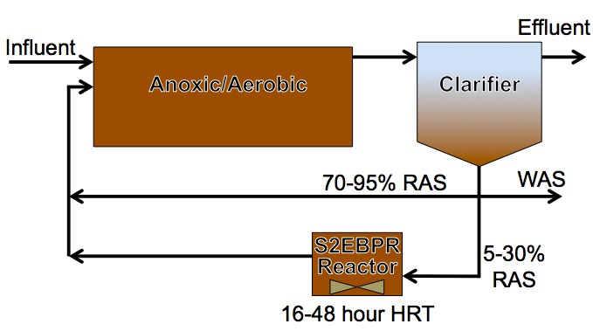
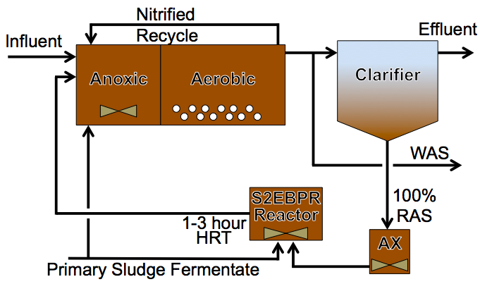
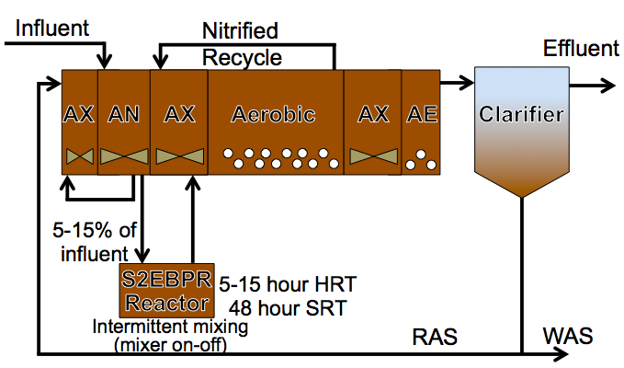
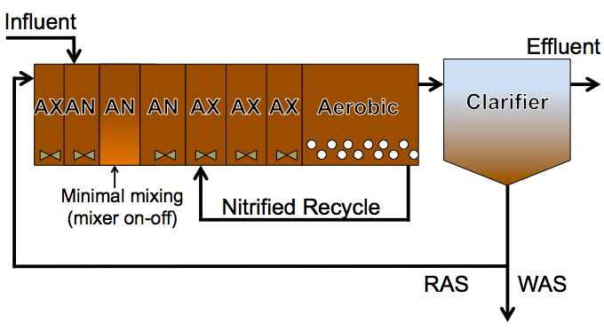
S2EBPR Survey- Four Configurations
Side-Stream RAS (SSR)
Side-Stream RAS plus Carbon (SSRC)
Side-Stream MLSS (SSM)
Unmixed In-Line Fermentation (UMIF)
Gu et al., WERF report2019

Slide 11
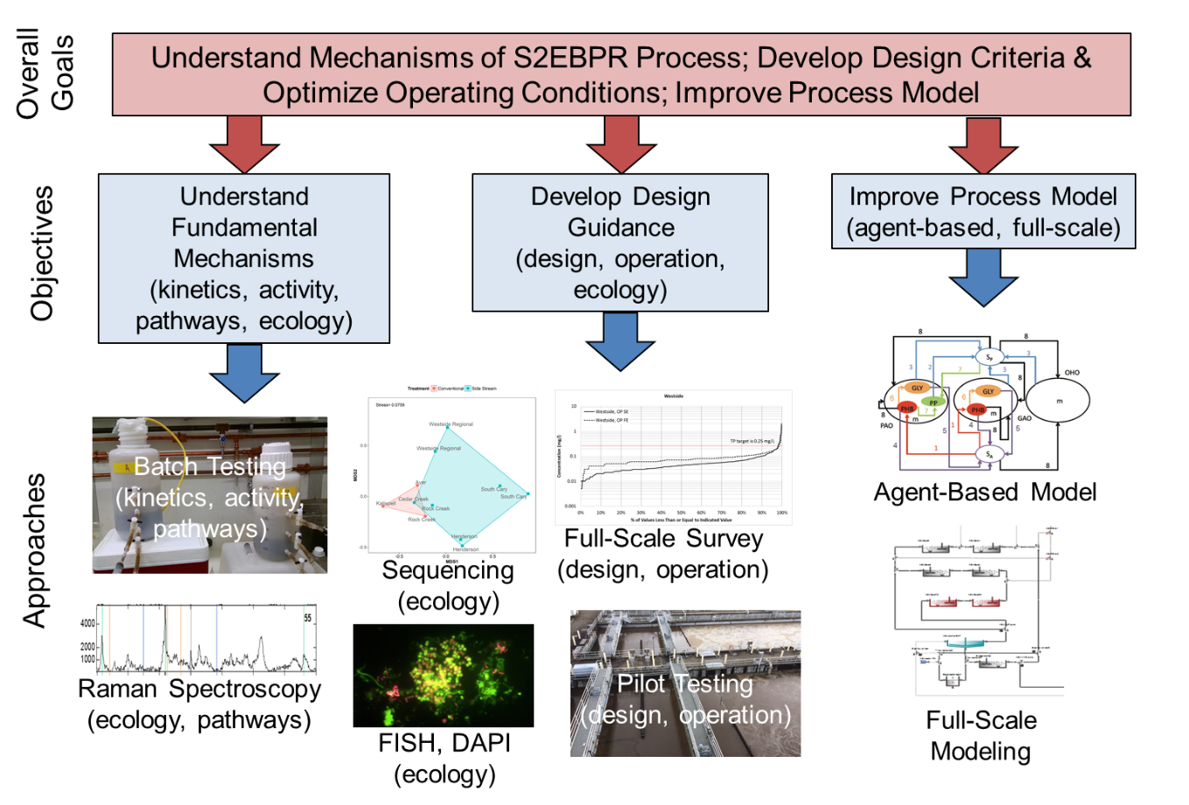
S2EBPR Research Goals and Objectives
Gu et al., WERF report2019

Slide 12
Summary of S2EBPR Facilities Performance
Surveyed 4 S2EBPR facilities, compared to 5 conventional
Data over 3-years statistical performance evaluation
Kinetics analysis
Microbial ecology survey and comparison
Parameter | South Cary | Westside Regional | Cedar Creek | Henderson
Configuration | SSR | SSRC | SSM | UMIF
Average Flow Rate (mgd) | 5.5 | 2.6 | 3.0 | 20.9
Influent BOD:TP ratio | 39 | 38.4 | 102 | 46.5
Secondary effluent OrthoP (mg P/L) | 0.43 (final effluent TP) | 0.12 | 0.75 | 0.46
Effluent TP permit limit (mg P/L) | 2 | 0.25 | 1.5 | 0.22
Gu et al., WERF report2019, Onnis-Hayden et al., WER, 2019
Notes:
For Henderson, Permit is lower thatn performance, does not make sense

Slide 13
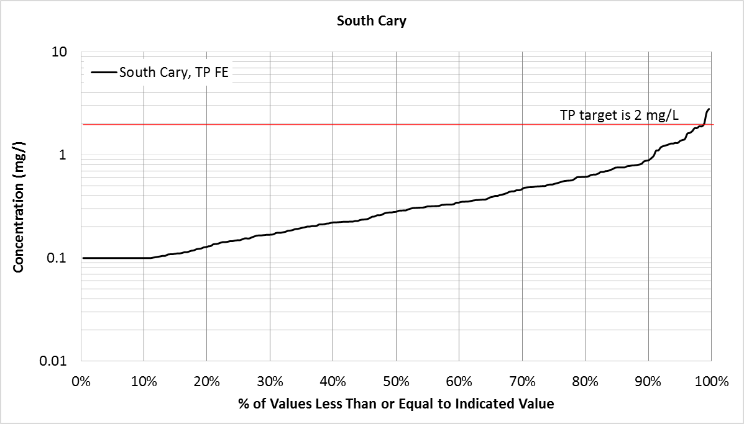
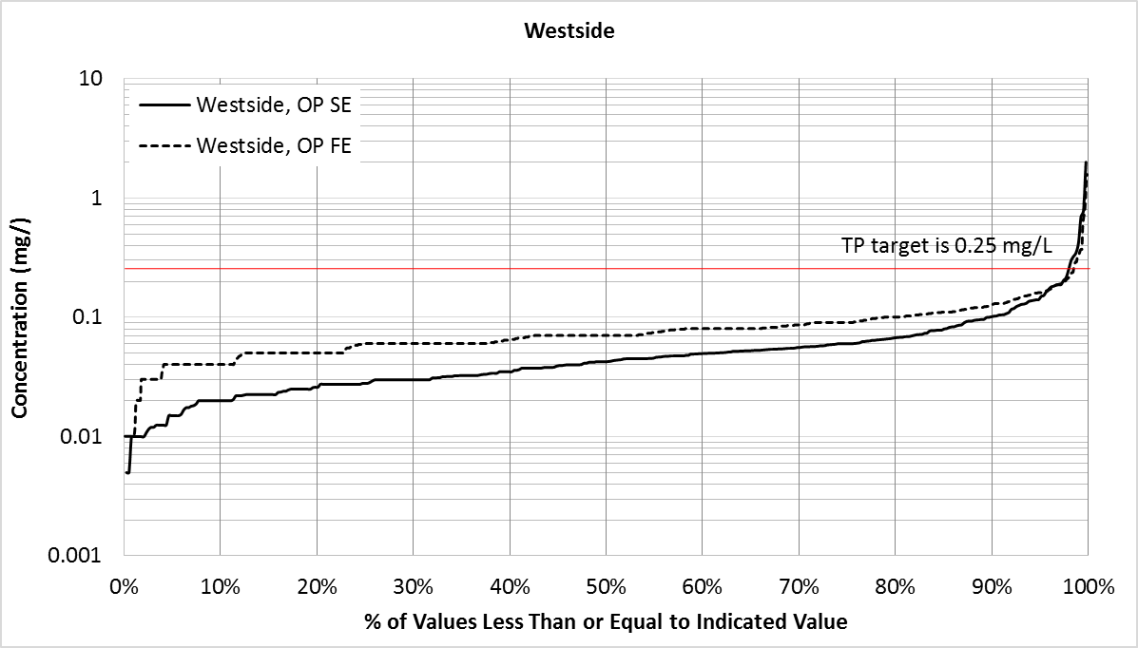
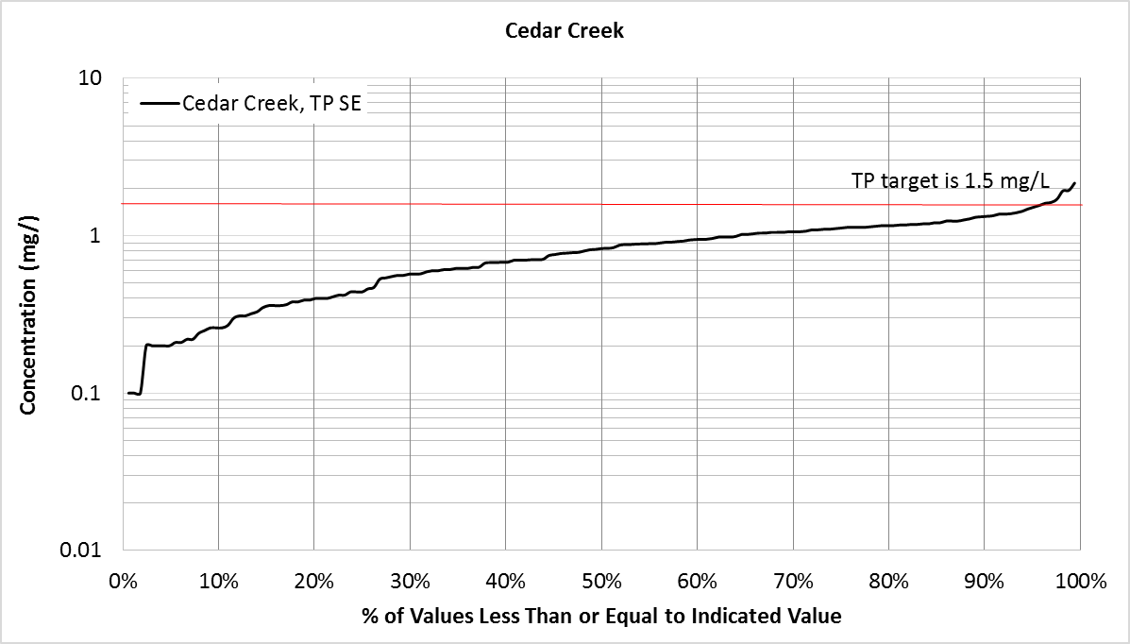
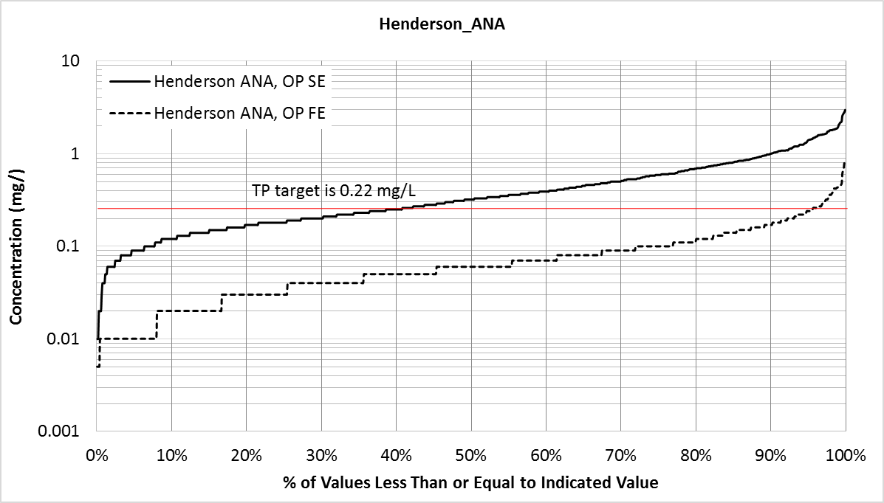
Performance Survey of S2EBPR
South Cary
Westside Regional
10
10
TP target 2 mg/L
1
1
TP target 0.25 mg/L
 | South Cary | Westside Regional | Cedar Creek | Henderson | Conventional EBPR*
50th percentile | 0.28 | 0.04 | 0.82 | 0.32 | 0.26
90th percentile | 0.89 | 0.10 | 1.10 | 1.00 | 1.60
90th/50th ratio | 3.17 | 2.39 | 1.34 | 3.13 | 11.5
Concentration (mg P/L)
0.1
Concentration (mg P/L)
0.1
0.01
0.01
0%
20%
40%
60%
80%
100%
0%
20%
40%
60%
80%
100%
% of Values Less Than Indicated Value
% of Values Less Than Indicated Value
Cedar Creek
Henderson
10
10
TP target 1.5 mg/L
1
1
TP target 0.22 mg/L
Concentration (mg P/L)
0.1
Concentration (mg P/L)
0.1
0.01
0.01
0%
20%
40%
60%
80%
100%
0%
20%
40%
60%
80%
100%
% of Values Less Than Indicated Value
% of Values Less Than Indicated Value
Gu et al., WERF report2019, Onnis-Hayden et al., WER, 2019

Slide 14
Mechanism 1: RAS-fermentation and VFA production
Questions:
1. What conditions required for RAS- fermentation?
2. VFA production rates?
3. VFA composition?

Slide 15
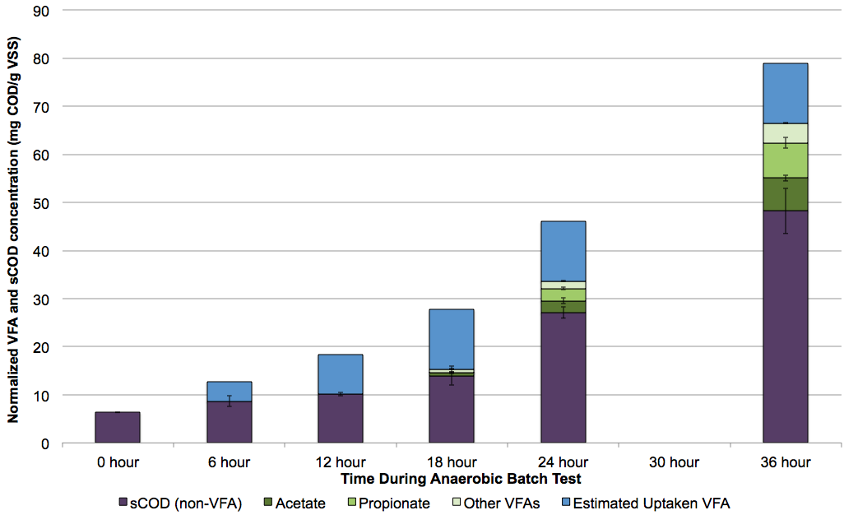
VFA production and composition in side-stream reactor
Continuous VFA production
Simultaneous VFA uptake by PAOs
Uptaken VFA
Other VFA
Propionate
Acetate
Residual sCOD (non-VFA)
0 hour
6 hour
12 hour
18 hour
24 hour
36 hour
Gu et al., WERF report2019

Slide 16
Mechanism 1: RAS-fermentation and VFA production
Why VFA composition and production rate matter?
PAO and GAOs have different kinetic rates towards different VFAs
  Higher propionate/acetate favors PAOs
VFA feeding rates affect population selection
  Different PAOs, GAOs have varying K_{s}/K_{max}
More complex VFAs enrich for more diverse PAOs
  More robust EBPR activity with complex VFAs

Slide 17
Mechanism 2: S2EBPRs Favors PAOs over GAOs
Questions:
What happens to PAOs in side-stream reactor?
    Fate of PAOs?
    Genotype and phenotype of PAOs
2. What happens to GAOs?
3. How about other microorganisms (OHOs)?

Slide 18
Mechanism 2: S2EBPR Favors PAOs over GAOs
What happens to PAOs in side-stream reactor
PAOs stay alive for up to 48-72 hrs ( or longer)
2. PAOs take up VFAs and produce PHAs at higher level than typical
3. EBPR activity increased overtime!

Slide 19
Mechanism 2: S2EBPR Favors PAOs over GAOs
PAOs stay alive for up to 72 hrs
FISH results- measure “live” cells
Gu et al., WERF report2019

Slide 20
Mechanism 2: S2EBPR Favors PAOs over GAOs
PAOs take up VFAs and produce PHA
Gu et al., WERF report2019

Slide 21
Mechanism 2: S2EBPR Favors PAOs over GAOs
EBPR activity increased over time in side-stream reactor- optimal transit time point varies
S2EBPR
Gu et al., unpublished data

Slide 22
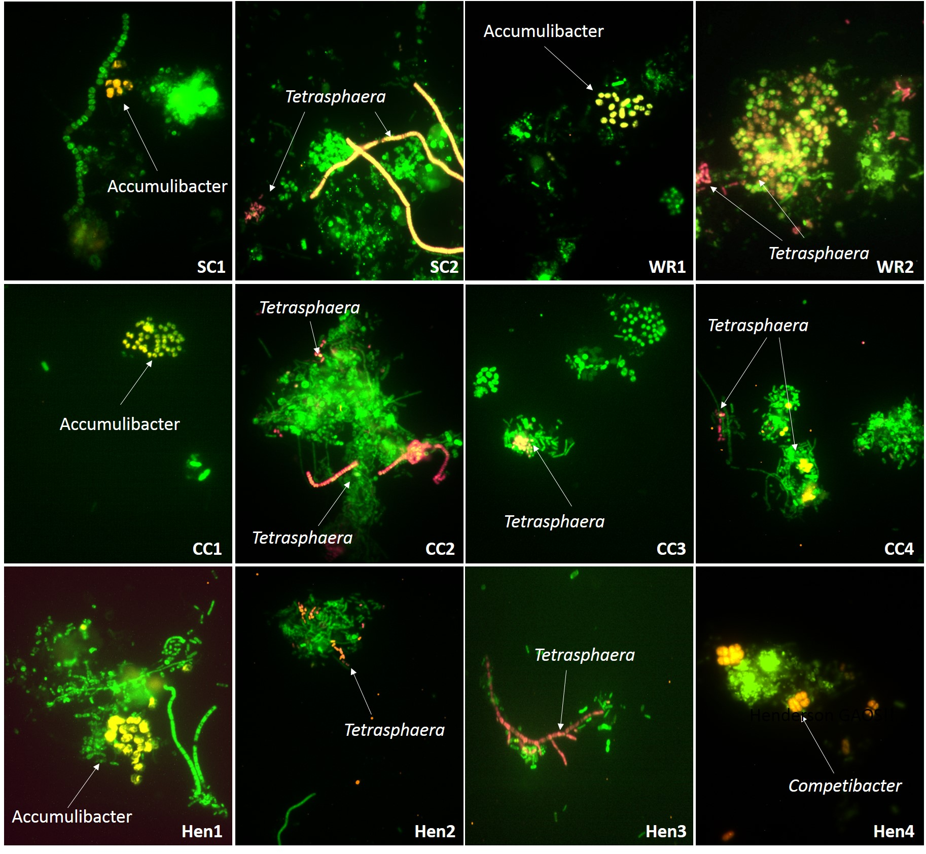
PAOs and GAOs abundance
 | South Cary | Westside Regional | Cedar Creek | Henderson
Accumulibacter | 6.4% | 7.6% | 6.2% | 5.1%
Tetrasphaera | 15.3% | 18.1% | 20.2% | 19.7%
Known GAOs | 0.7% | 0.5% | 0.3% | 3.8%
Accumulibacter and Tetrasphera were abundant in S2EBPRs
Comparable relative PAOs abundances in S2EBPR and conventional;
Low GAOs abundance of known GAOs with the exception of Henderson
Gu et al., WERF report2019, Onnis-Hayden et al., WER, 2019
Notes:
Insert here results of PAOs based on DAPI, FISH and Raman
Key points
Comparison of overall PAOs among Plants
Comparison of DAPI/Raman on total PAOs,
Comparison of FISH accumulibacter
DAPI/Raman> FISH, indicate higher diversity than accumulibacter
GAOMIX (equal amounts of GAOQ989, GAOQ431and GB742) for the Gammaproteobacteria Ca. Competibacter spp. (Crocetti et al. 2002; Kim et al. 2010); DF1MIX (TFO_DF218 plus TFO_DF218) for the Alphaproteobacteria from Cluster 1 Defluviicoccus spp. (Wong et al. 2004); DF2MIX (DF988, DF1020 with helper probes H966 and H1038 in equal amounts) for Cluster 2 Defluviicoccus spp. (Meyer et al. 2006); and Prop207 for the Betaproteobacteria Ca. Propionivibrio aalborgensis (Albertsen et al. 2016).

Slide 23
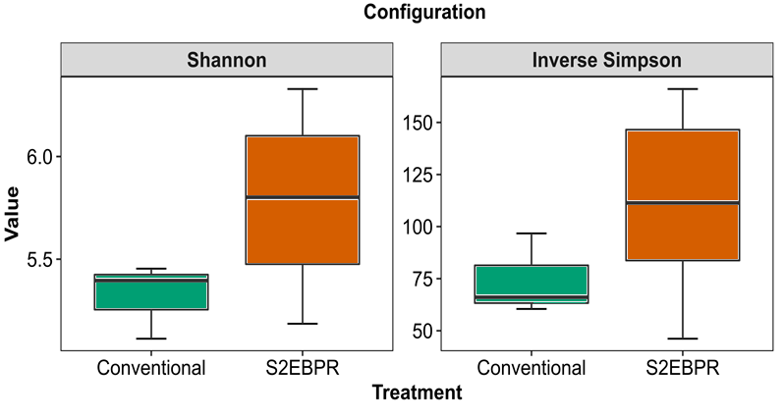
Microbial diversity in S2EBPR plants is higher than those in conventional EBPRs
Gu et al., WERF report2019, Onnis-Hayden et al., WER, 2019

Slide 24
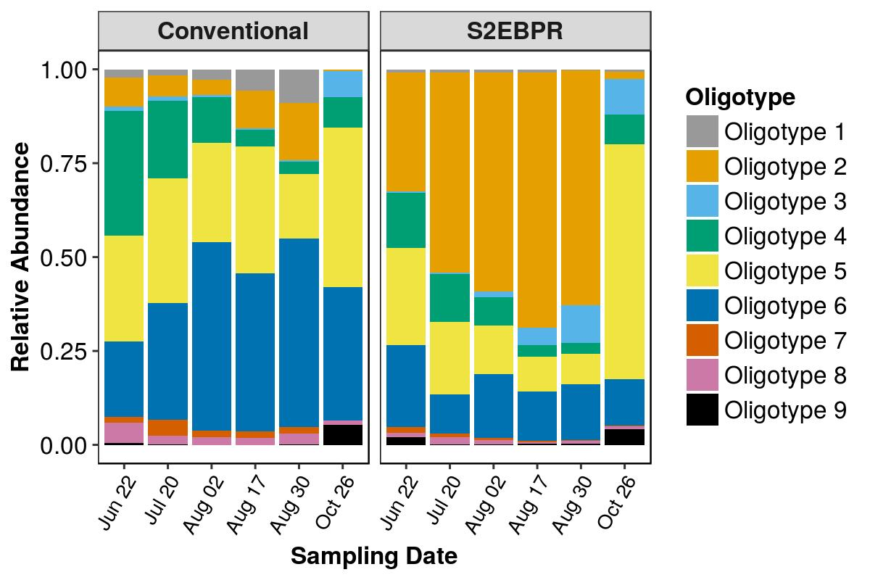
Sequencing/Oligotyping reveals differences in Accumulibacter micro-diversity
Community fingerprints show differences in A2O and S2EBPR if at finer-resolution level beyond 16s OTU
Accumulibacter clades are different between S2EBPR vs Conventional.
  Potential kinetic differences between clades
  VFA preference could be different
Srinivasan et al., We have posted a pre-print of this paper on the pre-print server bioRxiv (https://www.biorxiv.org/content/10.1101/596692v1). (in review)

Slide 25
*Metagenomic analysis discovered new Accumulibacter MAGs for full-scale EBPR
* One unique Accumulibacter MAG associated with S2EBPR
*Comparison with other known Accumulibacter MAGs to reveal potential differences
Genome-resolved Metagenomics of Ca.Accumulibacter in Full-Scale Facilities
Notes:
Metagenomic analysis of full-scale systems highlights clade-specific functions and the presence of uncharacterized clades in full-scale facilities. This highlights a need for high-throughput and inexpensive methods to characterize Accumulibacter clades.

Slide 26
Evidences of sequential polymer usage in PAOs- implications in decay and competition between PAOs and GAOs
Single cell Raman microspectroscopy reveals temporal trend of polyP and glycogen utilization in PAOs and GAOs
PolyP use in PAOs:
Accelerated polyP usage after 24 hours,
Accompanied by cessation of glycogen utilization
Glycogen use in PAOs:
Stops after 24 hours
Implying depletion of available glycogen to PAOs
Glycogen use in GAOs:
Quick glycogen utilization in 12 hours and stabilizes
Gu et all, WERF report (2019), Li et al, unpublished
Notes:
I changes the slides to make the mesasges more clear

Slide 27
Mechanism 2: S2EBPR Favors PAOs over GAOs
Competition among PAOs, GAOs, OHOs
Fate of PAO, GAO and OHOs
PAOs stay alive, store PHA, eventually decay
PAO
Use polyP
Use gly
Use gly
GAO
GAOs stay alive initially, then decay
abundance
OHO
OHOs decay
Side-stream allow carbon “re-shift”
And PAO selection
Anaerobic incubation time
(in side-stream reactor)

Slide 28
Mechanism 2: S2EBPR Favors PAOs over GAOs
Competition among PAOs, GAOs, OHOs
New, different PAOs?
-- New sub-clades of Accumulibacter
Role of Tetrasphaera?
- No statistical difference in abundance between
S2EBPR and conventional
Unknown GAOs
- Lower abundance of known GAOs
- Unknown GAOs revealed by Raman
Other organisms of interest:
--denitrifying PHA-accumulating organisms

Slide 29
Mechanism 3: Phenotypic shifts in PAOs
S2EBPR leads to more PHA content at both individual cell and population level
Carbon type affects phenotypes
(PPB- PHA producing bacteria)
Wang et al., Unpublished data

Slide 30
Mechanism 3: Phenotypic shifts in PAOs
Biochemical Pathway Shifts??
* S2EBPR processes appear to be associated with higher activity of the glycolysis pathway ((Lanham et al. 2013a, our study )
* South Cary, the only long-term running S2EBPR facility in the US with an SSR configuration seem to have higher level utilization of TCA cycle, which was later confirmed with agent-based model simulations
* C/P ratio, C level and composition, availability of various intracellular polymers all affect pathways activities
Unpublished data

Slide 31
Mechanistic S2EBPR model
Mechanism 3: Phenotypic shifts in PAOs
Evidences of sequential maintenance energy and polymers usage in PAOs and GAOs
ASM2
(Henze et al, 2002)
Model development
Based on iAlgae and ASM2
Not Inherited:
Inert organic substance/ fementation
Nitrifiers and denitrifiers
Calibration
Data: Lu et al, 2007
8-day ana. starvation
(lab-scale)
OHOs
PAOs (Smolders et al, 1994)
  PHA+Glycogen+PolyP
Agent-based model
(Bucci et al, 2012)
+
S2EBPR Extension
Validation
Data: 36-hr ana.
(full-scale)
GAOs (Zeng et al, 2002)
  PHA+Glycogen
Agent-based modeling
Application
Industrial model
(SUMO)
Staged maintenance and decay
Sequential polymer usage
Gu et all, WERF report (2019), Li et al, unpublished
Notes:
<here…>
<… with S2EBPR extension -> inherited from ASM2 -> what inherited -> what not>
<calibrated to, 8-day starvation, lab-scale sludge>
<validated 36-hr ana., full-scale sludge>

Slide 32
How do we design S2EBPR?
Side-stream reactor
SRT
- Sufficient for RAS fermentation
- minimize methanogenesis
- Or shorter if supplement carbon/primary fermentation
- Issues or benefits of excessive carbon?
HRT
-Optimization of PHA accumulation
-Give PAOs advantages over others
- Need optimization assessment tools (practical tool kits)
Mixing
- Decouple SRT and HRT
-Any sludge settling and odor issues?

Slide 33
How do we design S2EBPR?
Some experiences..
At present no verified models are available for design which must be based on experience
Divert at least 10% of RAS to side-stream fermenter
Side-stream reactor HRT of 12-48 hrs
Add primary sludge gravity thickener overflow (gto) if available
Without gto allow for 1.5 day to 2 day SRT in fermenter
Pass fermenter effluent to anoxic zone
Size of fermenter could be reduced by switching off mixers for most of the time which will allow for thickening of sludge to at least 1%

Slide 34



Acknowledgements
WE&RF S2EBPR project team-see report
WRRF staff at all partner facilities: see report
Undergraduate research assistants at Northeastern University, and Interns
Dr. Amit Pramanik (WE&RF), Dr. JB Neething (HDR Inc.), Dr. H. David Stensel (University of Washington), Dr. Glen Daigger (University of Michigan), and Dr. Cliff Randall (Virginia Tech) for their advice and support
Contact Dr. April Gu
Email: aprilgu@cornell.edu

Slide 35
On-Going and Future work
Develop detailed design manual for S2EBPR
-- WRF project Led by BV and Cornell
Establish S2EBPR models for full-scale plants
-- Part of the efforts for the WRF project above
Provide practical optimization/diagnostic tools and manual
-- Standardized EBPR assessment protols
Compatibility with AB stage, short-cut N removal processes
- WRF project on-going
- For carbon recovery and C-foot reduction

Slide 36

On-going WERF project-background
The economic efficiency of the A/B process can be improved by adapting High-rate activated sludge (HRAS) and Partial Nitritation/Anammox (PN/A) processes^{2,3}
A-Process : HRAS
Maximum removal and redirection of organics for energy generation using anaerobic sludge digestion
SRT, HRT and DO control for max sludge generation
B-Process : PN/A
Ammonia-based cyclic aeration control (Low DO)
Simultaneous nitrification and denitrification (SND)
NO₂ accumulation by AOB selection and NOB repression; N removal by Anammox MMBR
The increasingly stringent limits imposed on wastewater effluent P demand for more reliable and better optimization P removal processes.
Can we push the limits even further and achieve economical process for
C, N, P removal?
¹Jimenez et al., 2015. Wat. Res., 87, 476-482; Regmi et al. 2015, Biotechnol. Bioeng., 122(10), 2060-2067

Slide 37
On-going WERF project
Overall Objective
Investigate the feasibility and mechanisms involved in a novel implementation of S2EBPR processes in combination with shortcut N-removal processes to enable simultaneous N removal and P removal.
Goals
Investigate the microbial ecology and fundamental mechanisms involved in the integrated nitrite shunt/deammonification and S2EBPR Process
Develop initial design criteria and process control strategies for integration of S2EBPR with Shortcut N-Removal processes
Incorporate fundamental insights into model framework to establish agent-based mechanistic and practical full-scale process models to facilitate process design and optimization

Slide 38
General Information
Project Funding : The Water Research Foundation
Project Number : 04901 (WFR-17-23)
Project Start Date : August 2018
Project End Date October 26, 2021
Research Team: : April Z. Gu, Cornell University
Ameet Pinto, Annalisa Onnis-Hayden, Northeastern University
Varun Srinivasan, BC
Collaborator: George Wells, Northwestern University
Participating Utilities and teams : Charles Bott (HRSD)
Jim McQuarrie (Denver Metro)
Isaac Avila (Denver Metro)
Beverley Stinson (AECOM)
Christine deBarbadillo (DC Water)
James Barnard (BV)
Paul Dombrowski (WC)
Heng Zhang (Chicago Metro)
Chandler Johnson (WWW)
Daniel Dair (WWW)
Imre Takacs (Dynamita)

