Slide 1

WELCOME
TO THE JUNE EDITION
OF THE 2019
M&R SEMINAR SERIES

Slide 2
BEFORE WE BEGIN
SAFETY PRECAUTIONS
  PLEASE FOLLOW EXIT SIGN IN CASE OF EMERGENCY EVACUATION
  AUTOMATED EXTERNAL DEFIBRILLATOR (AED) LOCATED OUTSIDE
PLEASE SILENCE CELL PHONES OR SMART PHONES
QUESTION AND ANSWER SESSION WILL FOLLOW PRESENTATION
PLEASE FILL EVALUATION FORM
SEMINAR SLIDES WILL BE POSTED ON MWRD WEBSITE (www. MWRD.org: Home Page ⇒ Reports ⇒ M&R Data and Reports ⇒ M&R Seminar Series ⇒ 2019 Seminar Series)
STREAM VIDEO WILL BE AVAILABLE ON MWRD WEBSITE (www.MWRD.org: Home Page ⇒ MWRDGC RSS Feeds)

Slide 3
Irene Teshamulwa Okioga, P.E., PhD., LEEP AP, ENV SP
Dr. Irene Teshamulwa (Tesha) Okioga is a Senior Engineering Project Manager with Charlotte Water in Charlotte, North Carolina. She holds a PhD in Infrastructure and Environmental Systems from the University of North Carolina at Charlotte, a Master's degree in Civil and Environmental Engineering from the Massachusetts Institute of Technology, and a Bachelors degree in Civil Engineering from the University of Nairobi, Kenya.
Her specialties include demand forecasting, decision analysis, project prioritization, capital planning and project management; and water/wastewater design. She is currently managing projects and programs with an estimated capital cost of approximately $700 Million anticipated over the next 5 to 10-year period.
Dr. Okioga has more than 15 years of experience supporting and working with the World Agroforestry Center, the United Nations, Black & Veatch, and Charlotte Water. She is a licensed Professional Engineer, a Leadership in Energy and Environmental Design (LEED) Accredited Professional and Envision Sustainability Professional.

Slide 4


Biosolids Market Analysis for a Strategic Long-term Biosolids Management
Metropolitan Water Reclamation District of Greater Chicago
Monitoring And Research Department
June 28, 2019 Seminar Series
Irene T. Okioga “Tesha”, PhD, PE, LEEP AP, ENV SP
Jackie Jarrell, PE
Jean Creech
Chuck Bliss, PE
K. Richard Tsang, PhD, PE, BCEE
Jonathan S. Lapsley, PE

Slide 5
Agenda
Introduction and Background – Charlotte Water
Current Wastewater and Biosolids Management Operations and Challenges
Visions and Goals of the Biosolids Master Plan and Related Projects
Preliminary Implementation Schedule
Questions and Discussion

Slide 6
Introduction and Background
Charlotte Water

Slide 7
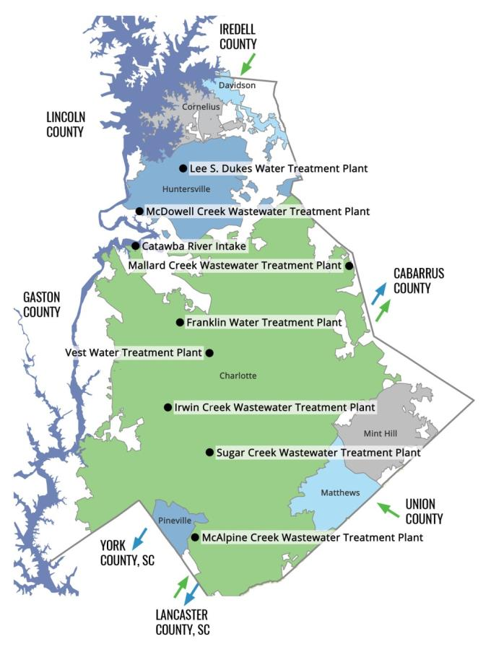
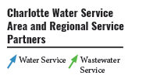
Charlotte Water by the Numbers
2
Drinking Water Supply Intakes
2
Raw Water Reservoirs
3
Drinking Water Treatment Plants
1M
People served in Mecklenburg County
Governments Served (Mecklenburg County, Town of Davidson, Town of Cornelius, Town of Huntersville, City of Charlotte, Town of Mint-Hill, Town of Matthews, Town of Pineville)
8
8K
Miles of Water and Wastewater Mains
7
Wastewater Treatment Plants (Owned &
Operated)
17
Staffed Facilities
81
Wastewater Lift Stations
958
Full-time Positions

Slide 8
Current wastewater and biosolids management operations and challenges

Slide 9
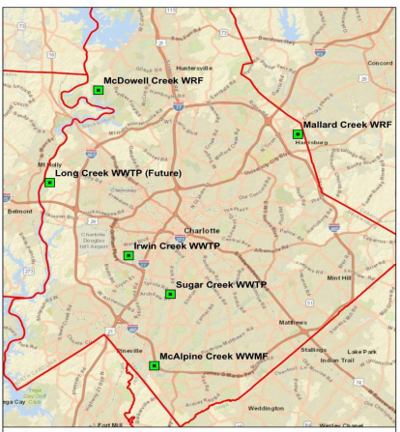
Wastewater Operations
CLT Water operates 5 major WWTPs ranging from 12 mgd to 64 mgd
4 plants have anaerobic digestion and dewatering
Sugar Creek WWTP transfers solids to McAlpine WWMF for treatment
Future plans to pump solids from Irwin Creek WWTP and future Long Creek (Stowe) WWTP to McAlpine Creek WWMF
McAlpine WWMF – 64mgd, average annual flow ~ 50 mgd, average undigested PS + WAS ~ 50 DTPD

Slide 10
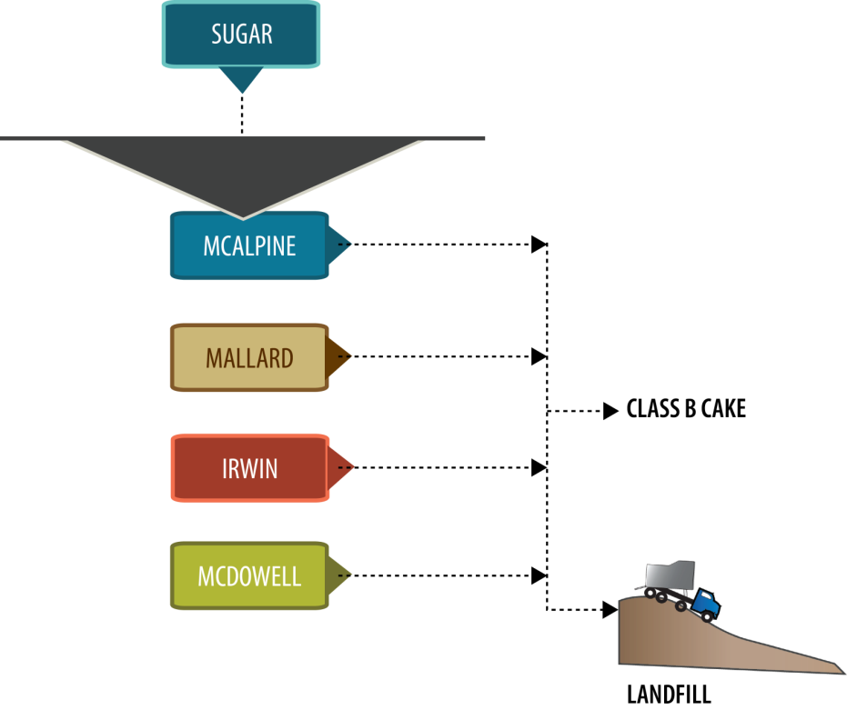
Current Biosolids Management Strategy
Class B Cake To Land Application
Landfill

Slide 11
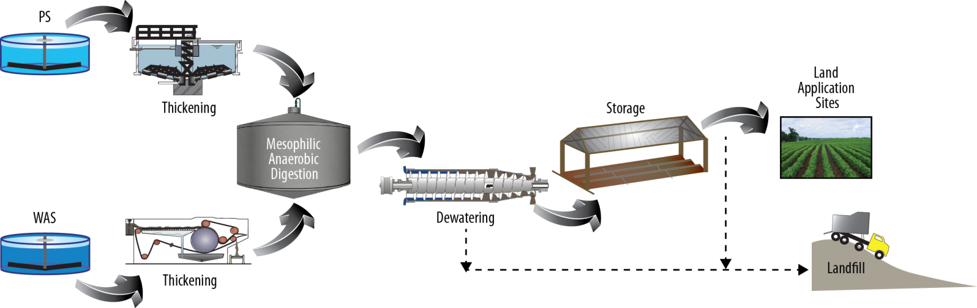
Current Solids Treatment Process at McAlpine WWMF
Gravity thickening of PS from Sugar and McAlpine Creek WWTPs;
Centrifuge thickening of WAS from McAlpine and Sugar Creek WWTP;
Anaerobic digestion;
Centrifuge dewatering of digested sludge; and
Dewatered cake storage at the onsite Residuals Management Facility (RMF),
Land application as a Class B product.
Cake, Class B

Slide 12
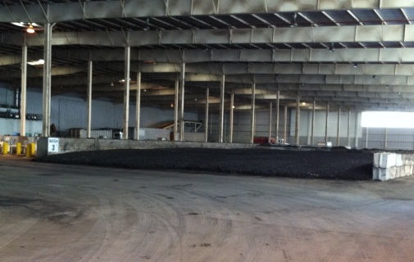
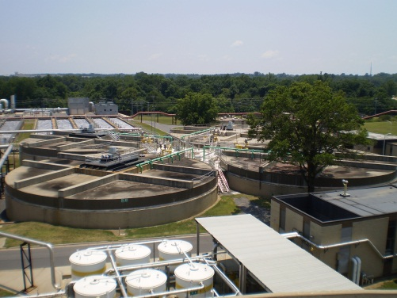
Current Practice Issues and Challenges
  Existing facilities – aging infrastructure, capacity limitations
  Regulatory and social environment – Fecal regrowth, EPA 503 regulation changes, and public opinion on health and safety
  Limited Outlets – Limited landfill availability and reliability, limited beneficial reuse
  Class B cake solids limitations – limited product densification, increased hauling
  Dependence on single independent contractor

Slide 13
Visions and Goals of the Biosolids Master Plan and Related Projects

Slide 14
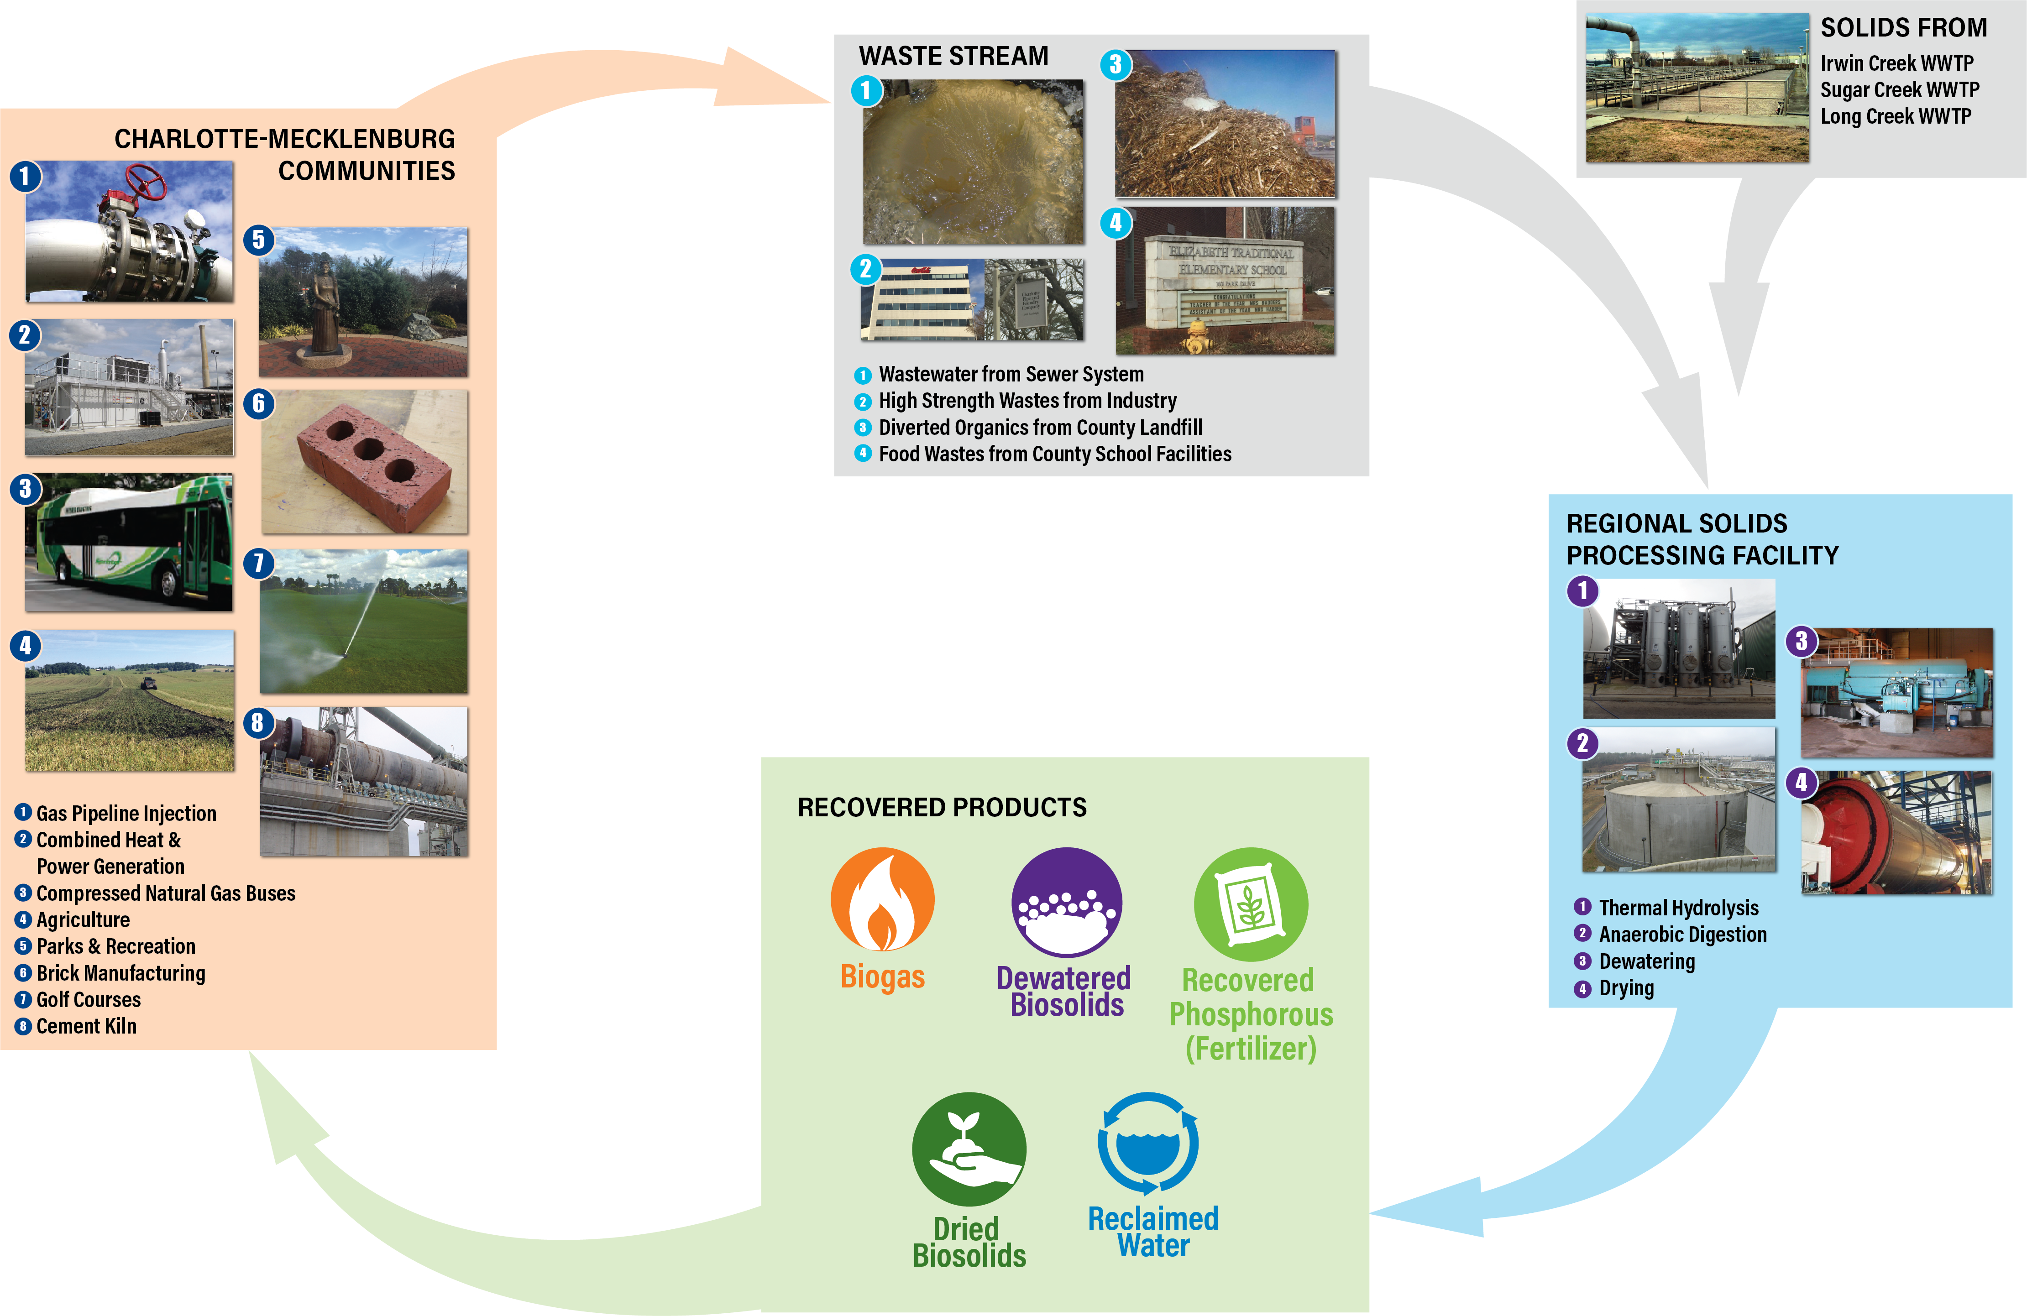
Vision: Biosolids Management in a Circular Economy

Slide 15
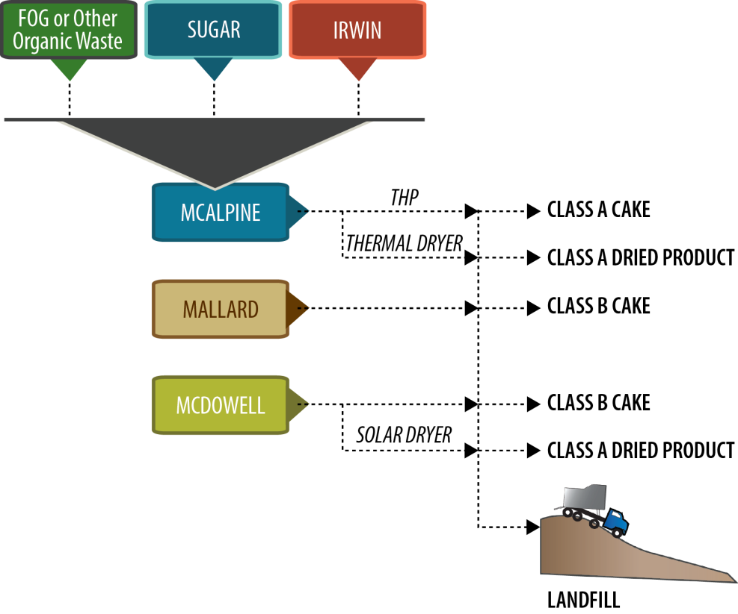
Possible Future Biosolids Management Strategy
Long Creek
Class A Cake To Land Application
Class A Dried Product Distribution
Class B Cake To Land Application
Class B Cake To Land Application
Class A Dried Product Distribution
Landfill

Slide 16
Goals of the Biosolids Master Plan and Related Projects
Goal 1: Optimize Operations through regionalized/centralized biosolids management
Goal 2: Diversify Products/Reduce Risks
Goal 3: Update Facilities and Technologies
Goal 4: Achieve Envision Awards for Related Biosolids Projects

Slide 17
Goal 1: Optimize/Regionalize Operations

Slide 18
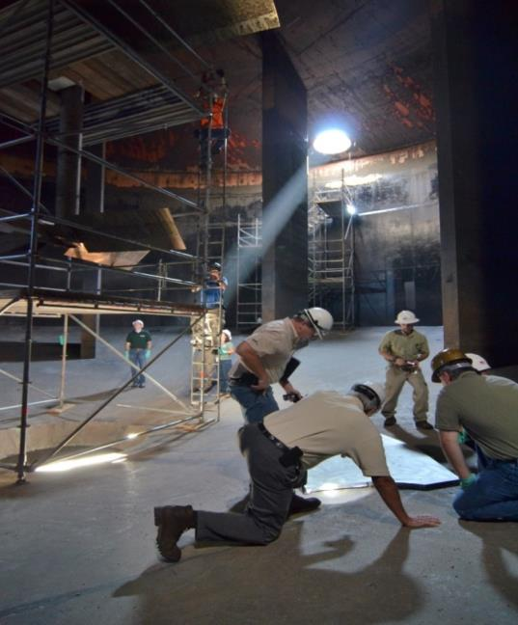
Goal 1 Specific Objective and Strategy
Objective:
  Centralize processing - eliminate the need to process solids at future Long Creek and Irwin Creek WWTPs. Process changes/improvements can be done at one plant instead of multiple facilities
  Streamline operations - consolidate spare parts and operational skillsets (workforce development)
Strategy :
  Phased construction of two parallel transfer force mains: one for WAS and other PS; and construction of EQ storage and blending tanks

Slide 19
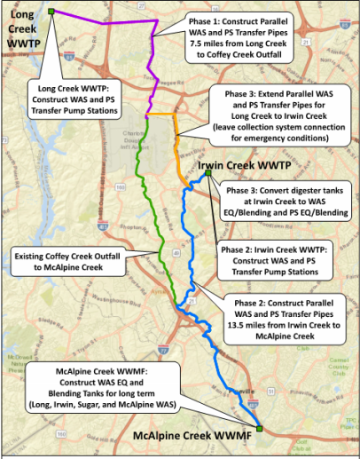
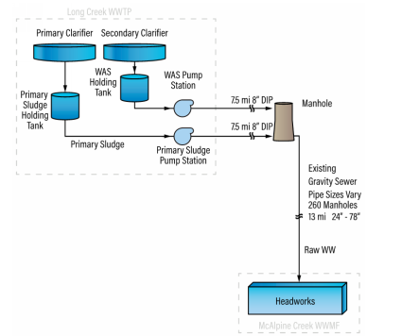
Phase 1 Forcemains (2023)
Pumping station at new Long Creek WWTP (separate project)
WAS and PS force mains from Long Creek WWTP to gravity sewer system (Active with Long Creek WWTP) - $14 M
EQ storage and blending tanks at McAlpine WWTP - $7M

Slide 20
Phase 2 Forcemains (2027)
Pumping station at Irwin Creek WWTP, and PS and WAS force mains from Irwin Creek to McAlpine Creek WWTP ($31M)
Option to initiate THP at McAlpine and activate phase 2

Slide 21
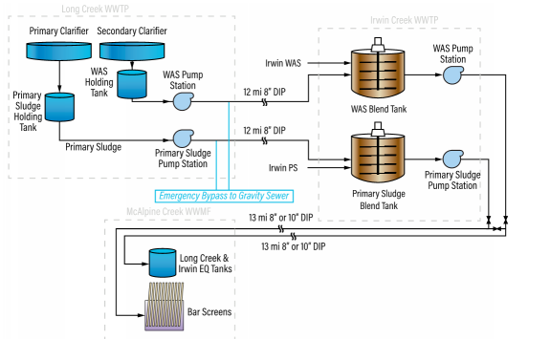
Phase 3 Forcemains (2028)
Extend the parallel Long Creek WWTP PS and WAS transfer pipes from the gravity sewer manhole to the Irwin Creek WWTP ($11M).
Conversion of Digesters at Irwin Creek WWTP to WAS & PS EQ & Blending Tanks (1.5M)
McAlpine Creek WWMF Primary Improvements Solids Receiving Station (new screens etc)

Slide 22
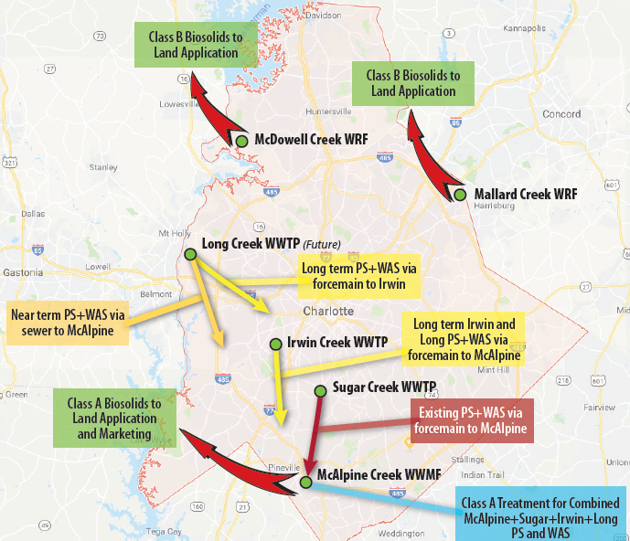
Key Benefits of Centralizing Solids Processing at McAlpine
Operational efficiency
  Better utilization of existing digestion and dewatering infrastructure at McAlpine Creek WWMF
  Consolidation of spare parts and operational skillsets
  Eliminates the need to process solids at Long Creek and Irwin Creek WWTP
  Process changes/improvements can be done at one plant instead of multiple facilities
Opportunities for resource recovery increase with the amount of solids and biogas at one place
Workforce development and Optimization

Slide 23
Goal 2: Product Diversification and Risk Reduction

Slide 24
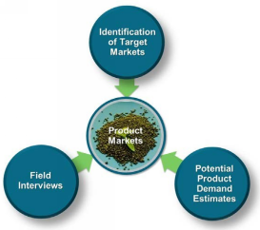
Goal 2 Specific Objective and Strategy
Objective:
  Flexibility and diversification of biosolids management options
  Resource recovery in lieu of disposal
Strategy :
  Market Assessment:
    Identifying target markets (biosolids users)
    Evaluating biosolids alternatives and demands based on user preference
    Risks assessment for biosolids product selection

Slide 25
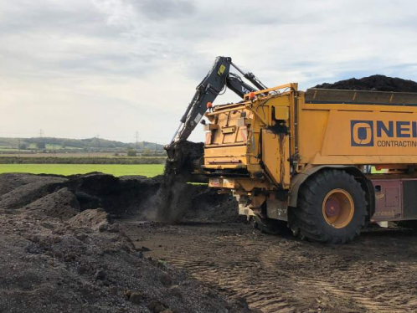
Markets Evaluated
Growers/Agriculture
Fertilizers/Soil Blending
Silviculture
Beautification/Nurseries
NC Department of Transportation
Mine reclamation
Landfills

Slide 26
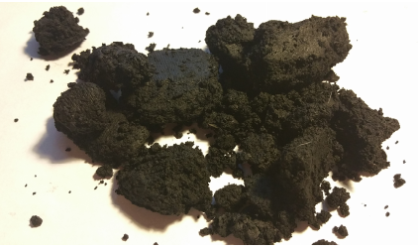
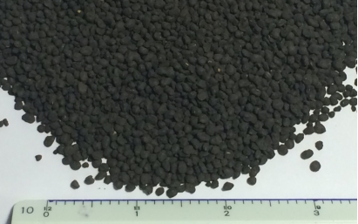
Biosolids Products
Cake Product
Class A Heat-Dried Pellets

Slide 27
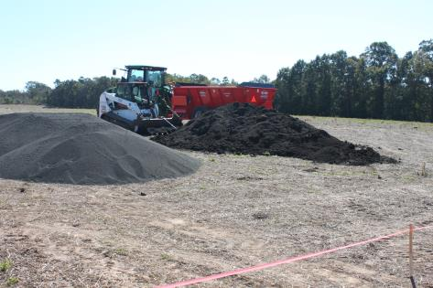
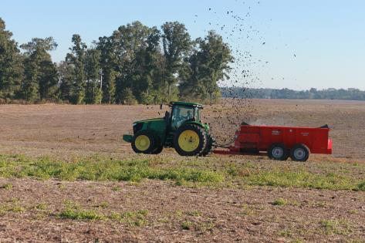
Management Options and Risk Impacts
Distribution of Class A biosolids
  If the biosolids treatment process is not able to produce a Class A product, then land application and landfilling are alternative management options.
Land Application of Class A and/or B on agricultural, forested, or other dedicated sites.
  If non-conforming to Class B, then landfill.
Off-site disposal in a municipal solid waste landfill that has been permitted to receive wastewater solids as a viable emergency option for non-conforming Class B products.
The fewer management options available, the more severe the risk impacts.

Slide 28
Risk Assessment
Risk Inventory
  A log of risk issues
Risk Register
  A re-definition of risks into broader categories to ensure no double-counting
Market and product risk ranking
  Assignment of qualitative scoring of risk likelihood and impacts
  Aggregated impacts of each risk → Risk Priority
      Likelihood (0 through 4)×Impact (0 through 4)=Risk Priority
      ∑(Likelihood ×Impact)=Product Risk Priority

Slide 29
Product Risk Inventory
Emerging contaminants, probability of failure to meet regulatory requirements, land application restrictions, and product contamination
Product acceptance/rejection
Market oversupply
Continuity in case of contractor business failure

Slide 30
Risk Probability Scoring Criterion
Probability Score | Probability/Frequency Likelihood Criterion
0 | Risk not applicable for product under review
1 | Unlikely/improbable: No quantifiable expectation/potential for occurrence (situation has never occurred previously)
2 | Low Possibility: Remote or low potential for occurrence. There is evidence that the risk is possible but highly unlikely to occur (maximum of 1 time in 20 years)
3 | Moderate Possibility: Moderate chance of occurrence. There is evidence of this occurring in the past with impacts to the program (potential to occur 2 to 5 times in 20 years)
4 | High Possibility: Very likely occurrence or has occurred in the past (potential to occur more than 5 times in 20 years)

Slide 31
Risk Severity Scoring Criterion
Severity Score | Severity of Impact Criterion
0 | Risk not applicable for product under review
1 | Nuisance impact with no effects on other markets
2 | Impact affecting one or more markets with the option to shift to other markets as a result. Low cost impact, low impact to operations
3 | Impact affecting all markets with option to shift to landfill as a result. Moderate cost impact, moderate impact to operations
4 | Impact affecting all markets and requiring hazardous waste landfill disposal as a result, stranding new assets or otherwise high cost impact that requires use of fund balance that disrupts the Community Improvement Plan(CIP), significant impact to operations

Slide 32
Product Analysis Conclusions
Product | Total Risk Score
Class B Dewatered Cake | 46
Class A Pellet | 27
Class A Hydrolysis Cake | 30
Class A Other (e.g. Semi-liquid Product) | 36
Interest in biosolids product is strong
Cost is paramount
Education is key to expanding market
Class A products preferred
Diversification of Class A products beneficial
Handling of the heat dried pellets easier
Pellets most desirable option unless spreading would continue to be provided as part of the Charlotte Water Biosolids program.

Slide 33
Goal 3: Update Facilities and Technologies

Slide 34
Goal 3 Specific Objective and Strategy
Objective:
  Evaluate technology alternatives, including costs analysis and risks assessment, for the various technologies needed to generate products that are similar to those preferred in Market Assessment
Strategy :
  Technology Assessment:
    Technology risks assessment
    Technology-focused interviews and site visits with multiple utilities nationally and internationally
    Vetting technologies through sessions with vendors

Slide 35
Technology Assessment – Preliminary Findings
Alternative | Technology
1 | Baseline (maintain conventional anaerobic digestion) –Class B
2a | Thermo-chemical hydrolysis with lime system and no anaerobic digester enhancement – Potentially Class A
2b | Thermo-Chemical Hydrolysis with lime system and anaerobic digester Enhancement – Potentially Class A
3a | Combination of dewatered cake processing by 3rd party fertilizer processor and Class B, assuming cost of $20/ wet ton – WT ($0.02 per kilogram).
3b | Combination of dewatered cake processing by 3rd party fertilizer processor and Class B, assuming cost of $0/ wet ton – WT ($0.04 per kilogram).
4a | THP (pre-anaerobic digestion) – Class A
4b | THP (inter anaerobic digestion) – Class A
4c | THP (post anaerobic digestion) – Potentially Class A
5a | Thermal Drying 100% of 2040 Max Month Solids Loading – Class A
5b | Thermal Drying 50% Solids (Class A) and retaining 50% Class B Cake

Slide 36
Alt 1: Baseline (maintain conventional anaerobic digestion)
Assumes no solids transfers from Long Creek
Maintain digestion and dewatering at McAlpine Creek WWMF
Construct Long Creek WWTP Solids Facilities
Treat Irwin Creek Solids at McAlpine

Slide 37
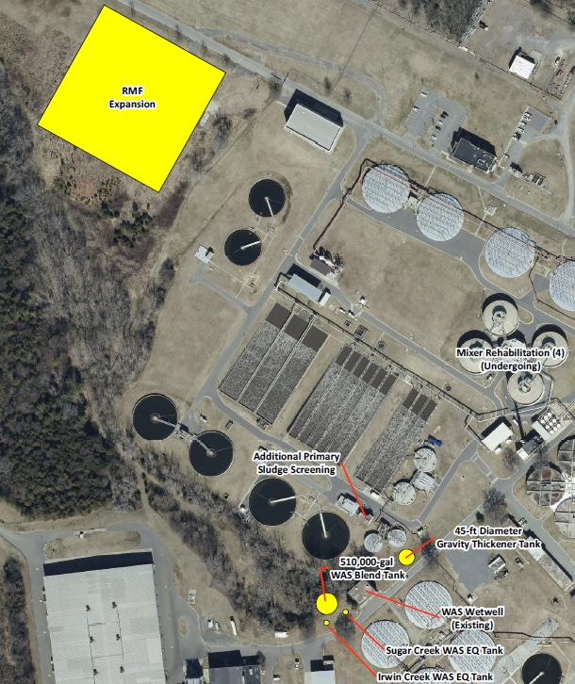
Baseline - Operational and Facility Changes
Additional equipment and facility upgrades required due to increased class B cake from Irwin and projected growth increases
  New PS gravity and centrifuge thickeners
  New Sugar, and Irwin WAS EQ and blending tanks
  New PS screens
  Additional biosolids storage
Thickening/dewatering complex upgrades
Phosphorus recovery system

Slide 38
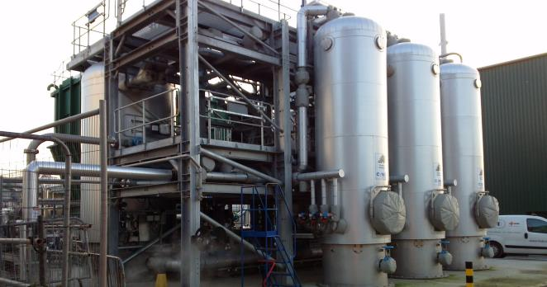
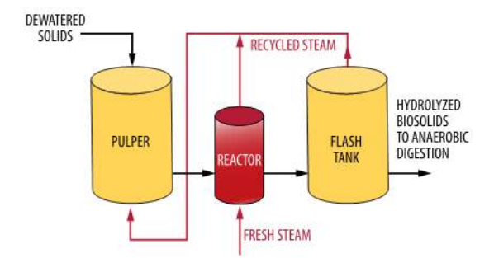
Alt 4a- THP (pre-anaerobic digestion) – Class A
THP breaks down cell walls, hard to digest compounds, by application of high pressure (90psi) and temperature (330 F), for about 20 minutes.
  Reduces viscosity of material
  Destroys pathogens
  Improves bioavailability of nutrients
Pre-anaerobic THP - THP located upstream of the anaerobic digestion process
  Increases digester solids loading
  Higher VSR, resulting in fewer residual solids and optimized biogas production
  Improved post-digestion dewatering performance with drier cake.
Thermal Hydrolysis System at Crawley WWTP (Image courtesy Cambi)

Slide 39
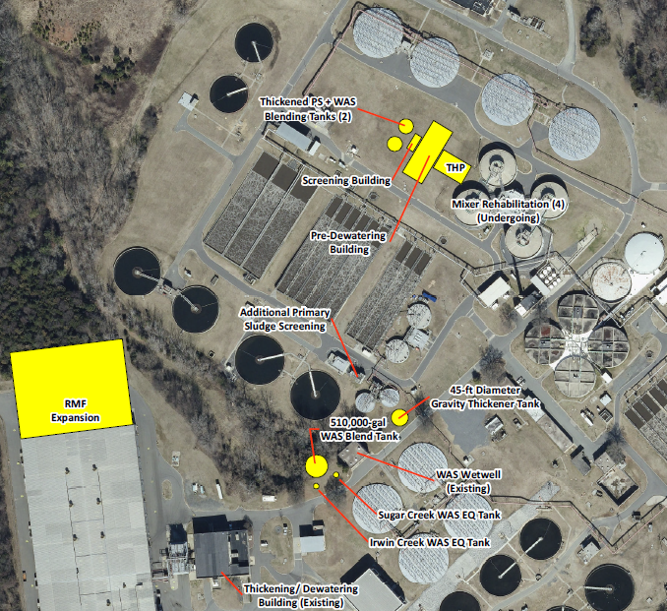
THP (pre-anaerobic digestion) – Class A
Solids transferred from Irwin Creek will be blended with sludge from the proposed Long Creek WWTP.
THP Operational and Facility Changes include:
  THP system
  PS + WAS blending tank required in addition to the WAS blending tanks
  Screening Building and PS+WAS screens
  Pre-dewatering building, pre-dewatering centrifuges and sludge hoppers

Slide 40
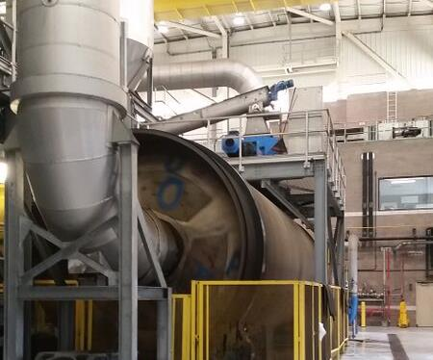
Thermal Drying – Class A
Implement thermal dryers for 100% solids loading at McAlpine Creek WWMF
Solids transferred from Irwin Creek will be blended with sludge from the proposed Long Creek WWTP.
Installation downstream of digestion and dewatering
The rotary drum dryer was the only type of dryer evaluated in detail.
  It is the most prevalent drying technology at medium to large facilities in the U.S
Dryer at Winston Salem

Slide 41
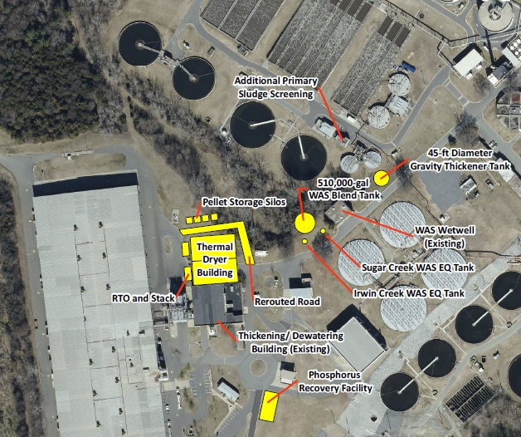
Dryer Operational and Facility Changes
Dryer system including feed hopper, furnace, etc.
Air quality and potential noise control
Dryer Building
Pellet Storage Silos
Notes:
Assumes WAS only blending option: Blended WAS conveyed to thickening centrifuges. PS from Irwin-Long WWTP, Sugar and McAlpine conveyed to gravity thickeners.

Slide 42
Technology Risk Inventory
Considered Quadruple Bottom Line/4P Approach:
  People: Product Distribution and marketability, nutrient content, product densification – transportation, ease of spreading and application restrictions
  Planet: Environmental sustainability - Permitting and Emission, fuel/energy demand, water demand, dust, noise, utilization of existing equipment/facilities or expansion requirements, footprint requirements, side stream treatment requirements.
  “Profits” or costs and offsets: Capital and maintenance costs/life cycle cost.
  Progress in Technology: Technology maturity and complexity – Safety, maintainability, ease to operate, staff and training requirements, parts availability, technical expertise/competencies/support resources.

Slide 43
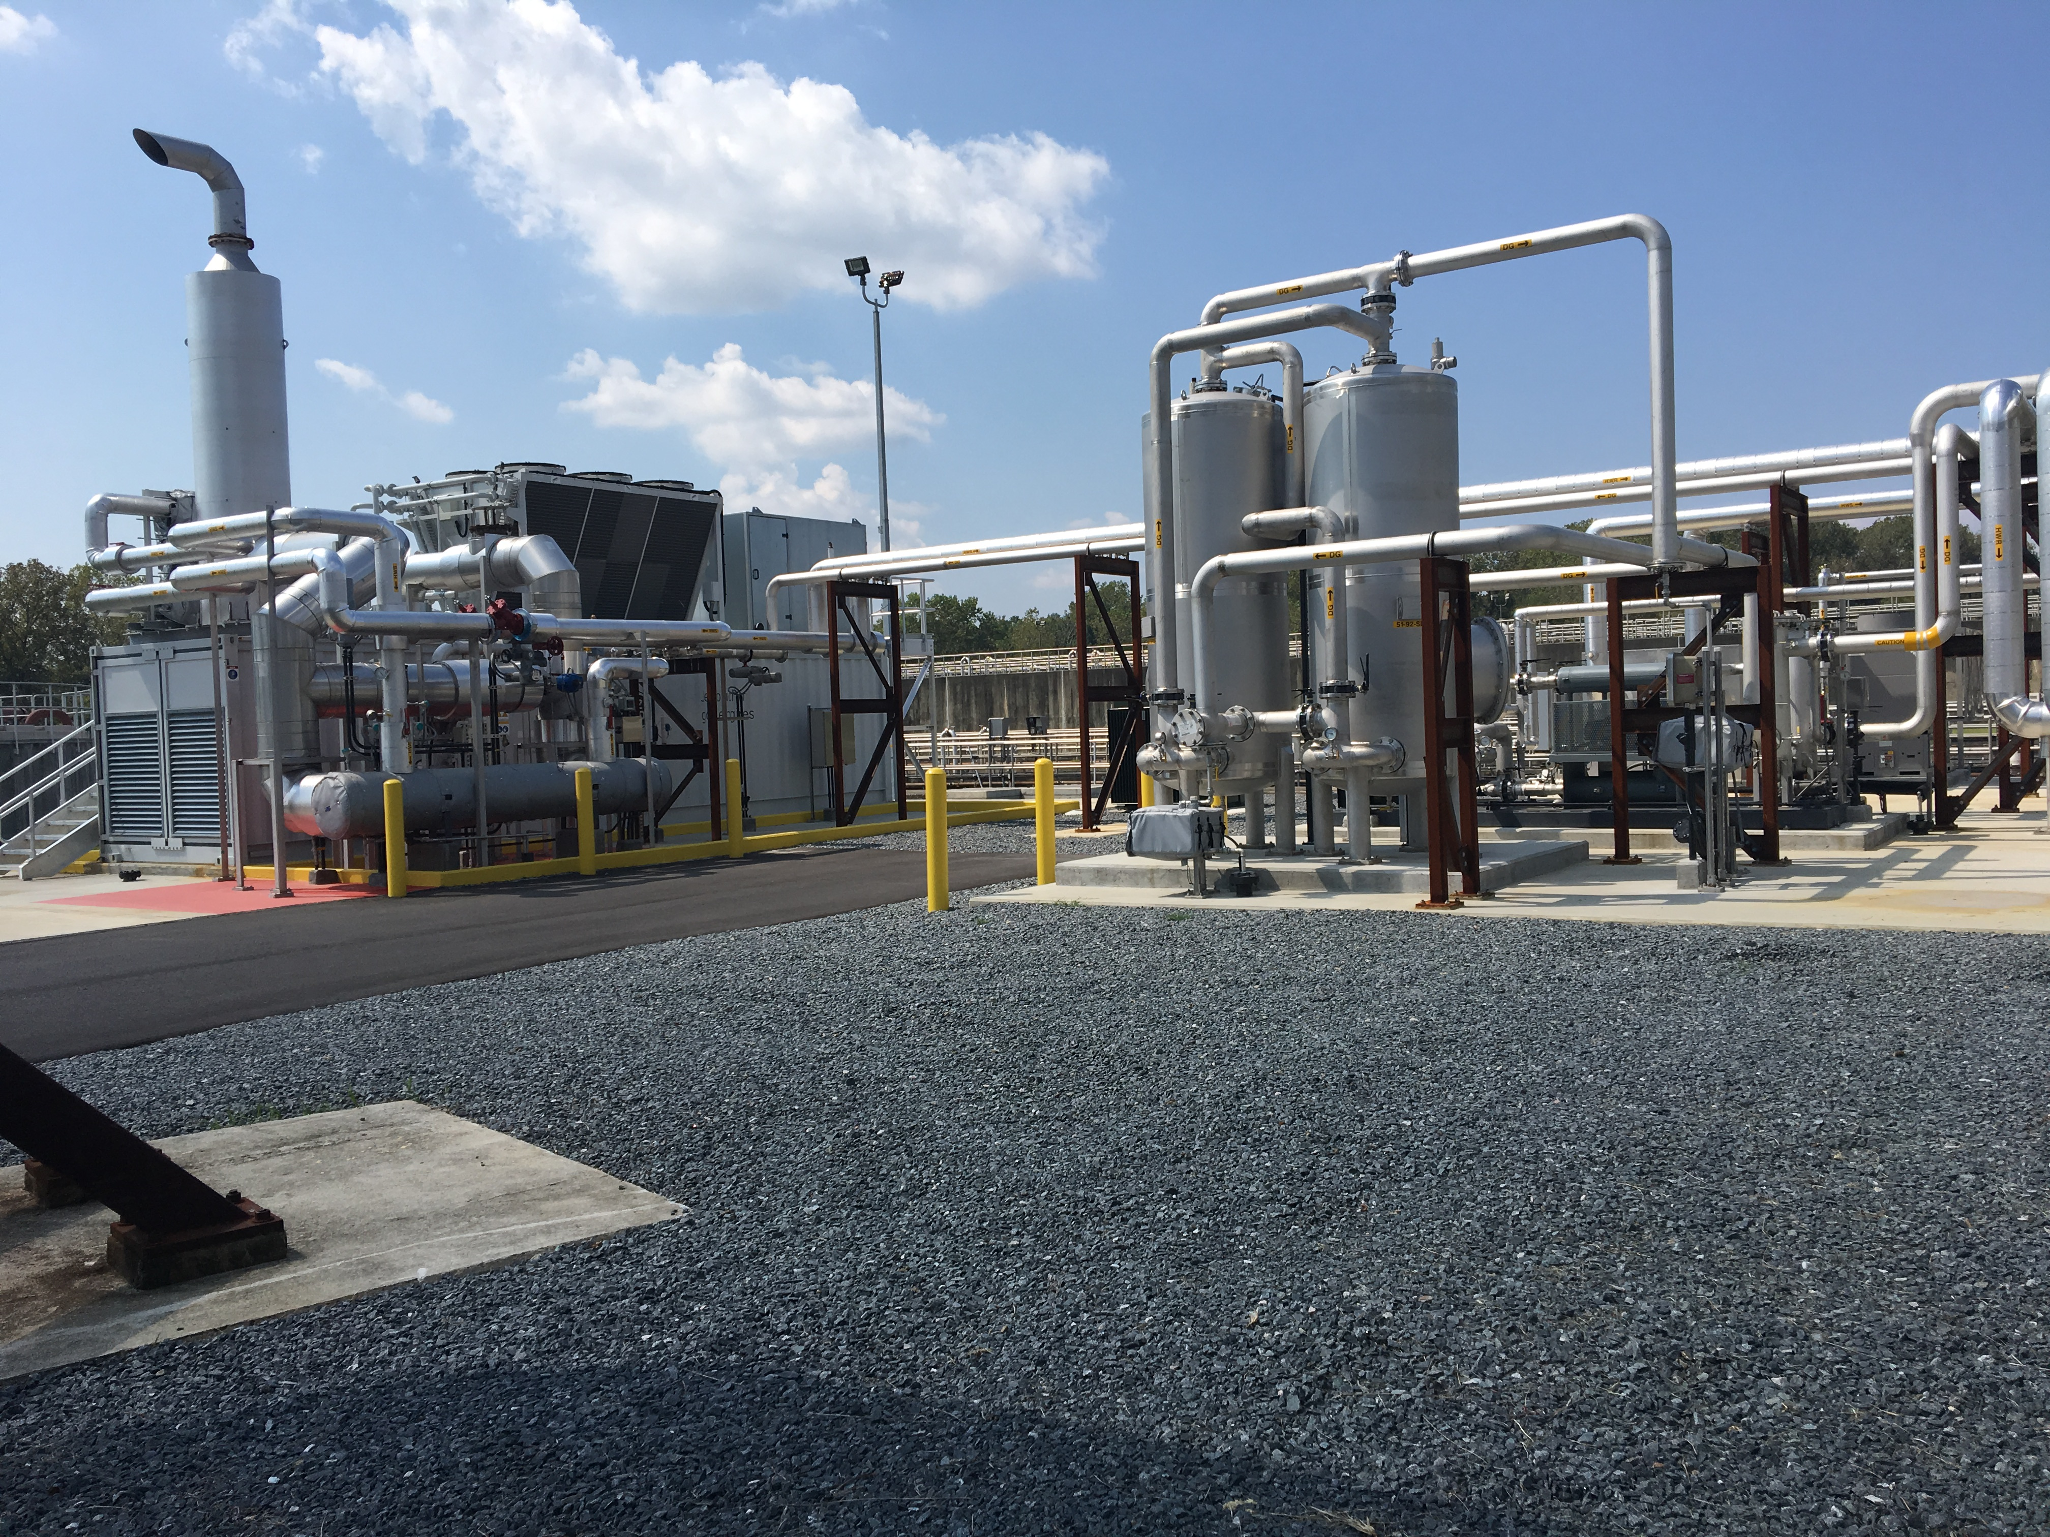
Biogas Production with THP-AD
Assumes biogas production of 10.5 to 15 standard cubic feet (SCF) per pound volatile solids reduction (VSR).
Assumes biogas energy content of 585 BTUs per SCF.
Notes:
1 MW capacity CHP system

Slide 44
Comparison of Energy Balance (MMBTU/day) with THP and Dryer and with Dryer Alone
THP and Dryer
Year | Energy produced from THP AD | Energy required for THP | Energy required for drying | Total energy required for THP and drying | Energy balance
2025 | 767 | 254 | 300 | 554 | 213
2040 | 997 | 332 | 392 | 724 | 273
Only Dryer
Year | Energy produced from AD | Energy required for AD | Energy required for drying | Total energy required for AD and drying | Energy balance
2025 | 660 | 239 | 692 | 931 | -271
2040 | 858 | 305 | 904 | 1209 | -351

Slide 45
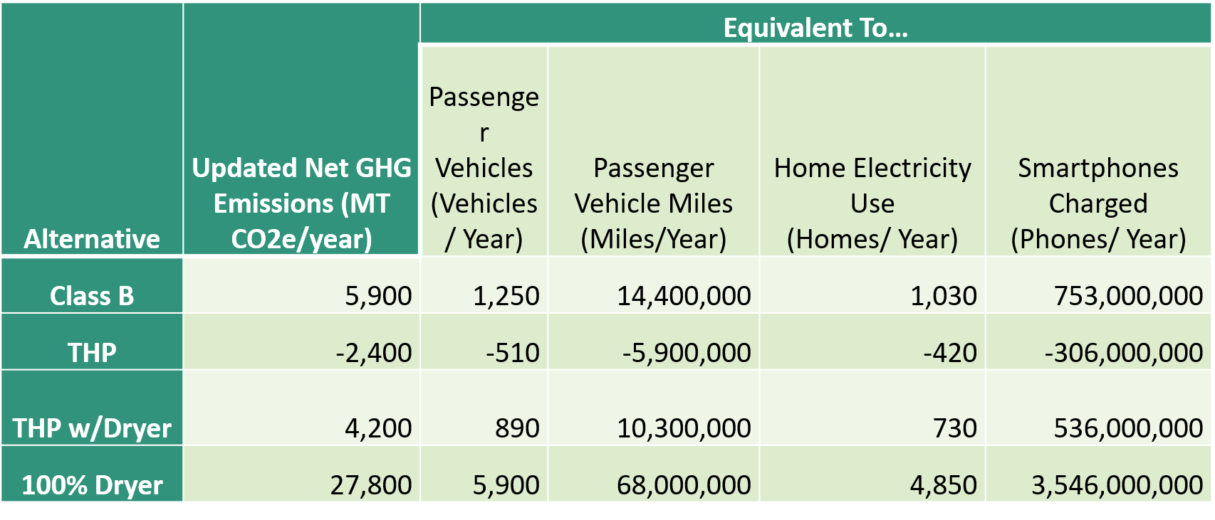
Carbon/GHG Emissions
Considers dependency on fossil fuels and resulting emissions in biosolids processing and hauling.
THP alternatives have net negative GHG emissions due to the increase in biogas production and ability to use this biogas to offset consumption of other fossil fuels.

Slide 46
Cost Analysis Summary
Life cycle cost computed over 20 years (2021 to 2040)
Life cycle cost = Capital cost + O&M NPV (2018-dollars)
O&M includes annual equipment and facilities maintenance costs, labor, fuel/electricity cost, polymers and other chemicals, and biosolids distribution/disposal costs.
 | Baseline Maintain Digestion & Dewatering at McAlpine Creek WWMF, Construct Long Creek WWTP Solids Facilities, Convey Irwin Creek WWTP Solids to McAlpine Creek WWMF for Treatment | THP - Implement THP at McAlpine Creek WWMF, Convey Long Creek and Irwin Creek WWTP Solids to McAlpine Creek WWMF for Treatment | Dryer - Implement 100% Thermal Drying at McAlpine Creek WWMF, Convey Long Creek WWTP Solids to McAlpine Creek WWMF for Treatment
Total Capital Cost | $55 M | $179 M | $203 M
Total Net Present O&M Cost | $98 M | $147 M | $234 M
Total Present Worth Cost | $153 M | $326 M | $435 M

Slide 47
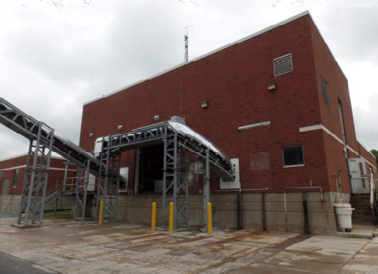
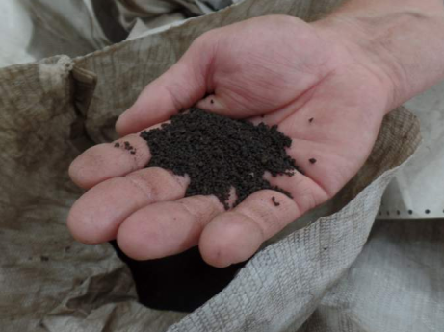
Dryer Site Visit and Meeting with Utility Operators/Owners in the U.S
Archie Elledge WWTP Drying Facility (Andritz Rotary Drum Dryer)
Mooresville WWTP Dryer Facility (Drum Dryer)
Gryphon Environmental/Tyson Facility, Owensboro, KY (Low Heat Belt Dryer System)
Milton Wastewater Treatment Plant Drying Facility, Milton PA (Andritz belt Dryer).

Slide 48
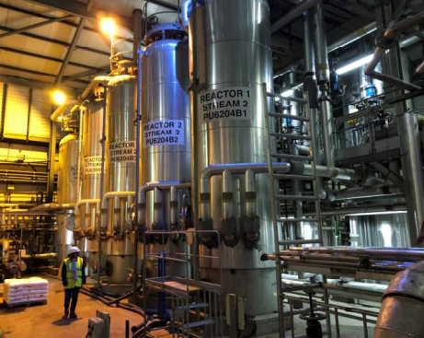
EU Site Visits and Meeting with Utility Operators/Owners
Ringsend WWTP, Dublin, Ireland – Cambi THP, CHP, Drum Dryer post THP
Crawley WWTP (Thames Water), UK (50% sludge imports) – Cambi THP and CHP
Oxford WWTP, UK (50% sludge imports)- Veolia THP
Mondelez Food Plant, Brussels, Belgium – Veolia Dynamic Mixer

Slide 49
Phone interviews/questionnaires with Utility Owners/Operators
Thames Water, UK (Veolia and Cambi THP, Dryers)
Louisville Metropolitan Sewage District, Louisville, KY (Andritz Retrofitted Drum Dryer, planning to switch to THP)
Trinity River Authority of Texas, Dallas, TX (Cambi THP w/AD – start-up late 2021)
City of Raleigh, NC (Cambi THP w/AD, regionalization, start-up early 2022)
City of Franklin Water Reclamation Facility, Franklin, TN (Cambi THP w/AD, regionalization – startup 2021/22, future plans to install solar dryer)
Hampton Roads Sanitation District; Atlantic Wastewater Treatment Plant, Virginia Beach, VA (Cambi THP – start-up early 2022)
DC Water; Blue Plains Advanced Wastewater Treatment Plant – (Cambi THP W/AD)
*Selection process involved EU site visits

Slide 50
Dryer – Advantages and Disadvantages
Advantages | Disadvantages
Established technology with many installations Produce product at 90% or more dryness, with max. volume reduction Transportable product not limited to local market Good quality product can produce revenue to offset some operating cost | Huge energy required to evaporate water Complex, highly mechanical system required to produce high quality product Some newer drying systems are less mechanical, but at the expense of product quality Operation and maintenance of drying system requires special training Excessive maintenance requirements for some drying systems have been reported Dust from the dried product is a fire and explosion hazard Greenhouse gas emissions

Slide 51
THP – Advantages and Disadvantages
Advantages | Disadvantages
Process pretreats the sludge for more complete digestion and stabilization Treated sludge requires less digestion capacity to digest, freeing up valuable capacity to treat additional sludge or other wastes More complete digestion results in more biogas production and less residuals solids to be handled downstream Digested biosolids has much better dewatering characteristics, resulting in drier cake (30% + comparing to current 20% or less) Finished product is drier, and almost odor free. Potential for a net negative GHG emission technology. Plug and play operationally | Not as established in the U.S., with one operating facility, although 5-6 more are under construction Process requires steam generation, which is a new process at the plant Pressure vessels also require periodic inspection An additional dewatering step is needed to feed the process Due to better digestion, a strong sidestream will be produced which will need to be handled

Slide 52
Preliminary Results Leaning towards THP Implementation
Aligns with City of Charlotte’s goal to be carbon neutral by 2050. THP has net negative GHG emissions in comparison to dryers, which have an estimated emission of 27,800 metric tons CO₂ equivalent/year – compare this with emissions from driving 68 million miles/year.
Lower life cycle cost- $100 million lower than thermally dried without THP.
Net positive energy, with biogas production adequate for both THP and thermal dryer energy needs. Does not depend on natural gas. No fluctuations in O&M costs based on natural gas pricing.
Provides more flexibility for future treatment alternatives (dryer can be added downstream of THP-AD in future).
Increased anaerobic digestion capacity facilitating regionalization efforts. THP-AD extends the capacity of the existing digestion assets, allowing the possibility of accepting imported organic wastes to further enhance biogas production in the digesters.

Slide 53
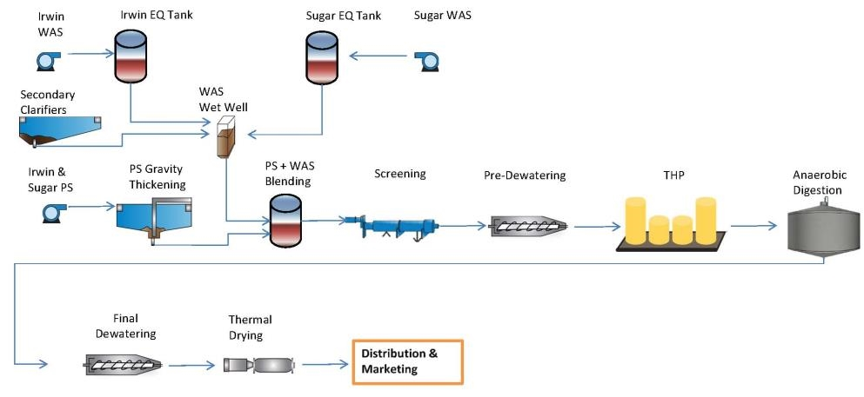
Possible Improvements based on Preliminary Results
McAlpine
  Thermal Hydrolysis and/or Thermal Drying
  Irwin
  Pump to McAlpine
  Mallard & McDowell
  Maintain current operations
  Potentially implement solar dryers at McDowell

Slide 54
Goal 4: Envision Award for Related Biosolids Projects

Slide 55
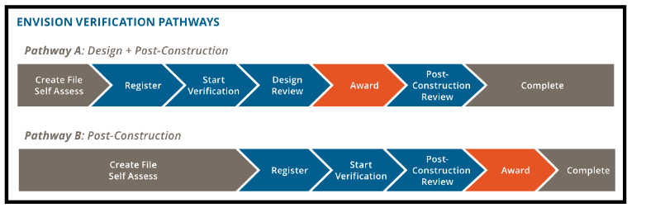
Goal 4 Specific Objective and Strategy
Objective:
  Obtain two envision awards, one for the conveyance project and the other for the plant improvement project
Strategy :
  Pathway A: Earn an Envision award after design completion. Constructed project validated to determine if it still meets award requirements.

Slide 56
Envision Considerations
Envision is a rating system for civil infrastructure by which projects are measured and awarded on their degree of sustainability.
Focuses on sustainable and resilient design, construction and maintenance of non-habitable and horizontal infrastructure that are not eligible for LEED certification, such as pipeline and WWTP projects.
Will capture and showcase our Sustainability Mission/Vision statement
May reduce stigma associated with biosolids reuse
May enhance marketability of Class A products
Relatively “easy/ideal” project: Reuses what others might consider “waste”; reduces fertilizer impacts; recycles material/equipment/structures (digesters at Irwin; gravity sewer for solids transfer); THP boost biogas production → reduces greenhouse gas emission etc.

Slide 57
Preliminary Implementation Schedule

Slide 58
Preliminary Implementation Schedule
Next 5 years
  Complete facilities planning at McAlpine Creek WWMF
  Complete technology evaluation and selection
  Complete sludge conveyance projects
  Implementation of Long Creek WWTP to Gravity FM (Phase 1)
  Class A Technology Facility Planning and Permitting

Slide 59
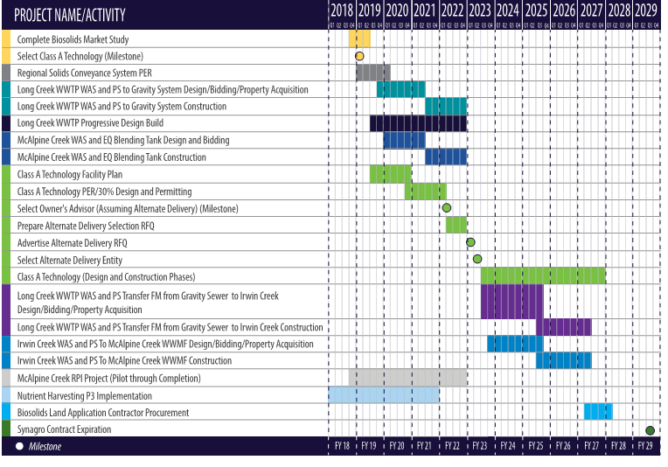
Preliminary Implementation Schedule

Slide 60
Discussion

Slide 61

Contact Information
Irene (Tesha) Okioga, PhD, PE, LEED AP, ENV SP
Irene.Okioga@ci.charlotte.nc.us
Jackie Jarrell, PE
JJarrell@ci.charlotte.nc.us
Jean Creech
jgcreech@ci.charlotte.nc.us
Chuck Bliss, PE
CBliss@ci.charlotte.nc.us
Richard Tsang, PhD, PE, BCEE
tsangkr@cdmsmith.com
Jonathan Lapsley, PE
lapsleyjs@cdmsmith.com
Laurin Kennedy PE, BCEE, PMP
KennedyLB@cdmsmith.com

