Slide 1
WELCOME
TO THE OCTOBER EDITION
OF THE 2019
M&R SEMINAR SERIES

Slide 2
BEFORE WE BEGIN
SAFETY PRECAUTIONS
PLEASE FOLLOW EXIT SIGN IN CASE OF EMERGENCY EVACUATION
AUTOMATED EXTERNAL DEFIBRILLATOR (AED) LOCATED OUTSIDE
PLEASE SILENCE CELL PHONES OR SMART PHONES
QUESTION AND ANSWER SESSION WILL FOLLOW PRESENTATION
PLEASE FILL EVALUATION FORM
SEMINAR SLIDES WILL BE POSTED ON MWRD WEBSITE (https://mwrd.org/seminars)
STREAM VIDEO WILL BE AVAILABLE ON MWRD WEBSITE (https://mwrd.org/seminars - after authorization for release is arranged)

Slide 3
Paul D. O’Brien, P.E.
Mr. Paul D. O’Brien is a Principal Civil Engineer with the Metropolitan Water Reclamation District of Greater Chicago. Working in the Plant Design Management section of the Engineering Department, he is project manager for the design and construction of new sludge thickening facilities and the replacement of Imhoff tanks with primary clarifiers at the Stickney Water Reclamation Plant, a 1440 MGD facility located in suburban Chicago. Prior to these projects, he was in the Construction Division, working as a Resident Engineer at the District’s three largest plants.
Paul has been with the District for twenty-five years. He has a Bachelor of Science from Purdue University, and is a member of the Water Environment Federation, the Illinois Water Environment Association, and the American Nuclear Society. He is a licensed Professional Engineer registered in Illinois and Wisconsin.

Slide 4
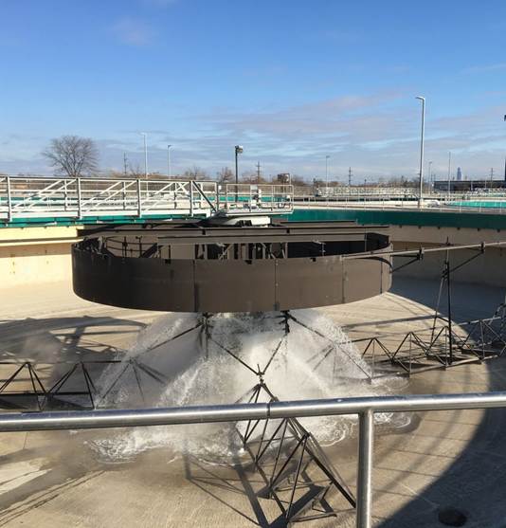
Let the Water Flow: Startup of the New Aerated Grit Facility and Primary Settling Tanks at MWRDGC’s Stickney WRP
Paul O’Brien, PE (MWRDGC)
Notes:
Thanks, everyone. For those of you who attended WEFTEC last month, this will be a familiar topic. Ryan Christopher of G&H and I presented this. But for you, you will get the live, extended version, with a drum solo in the middle. I’m sure Tom and Ginger will forgive me.

Slide 5
Agenda
Overview of Stickney Water Reclamation Plant
Imhoff Tank Replacement Project
Demolition and Construction
Startup
Startup Challenges
Conclusion

Slide 6
Overview of Stickney WRP
Stickney WRP
1,440 MGD
West Side Plant
Preliminary treatment
Primary treatment
Peak capacity of 720 mgd
Southwest Plant
Preliminary, primary, secondary treatment
Over 1,000 mgd preliminary peak capacity
Notes:
You all know these figures and could probably recite them in your sleep.

Slide 7
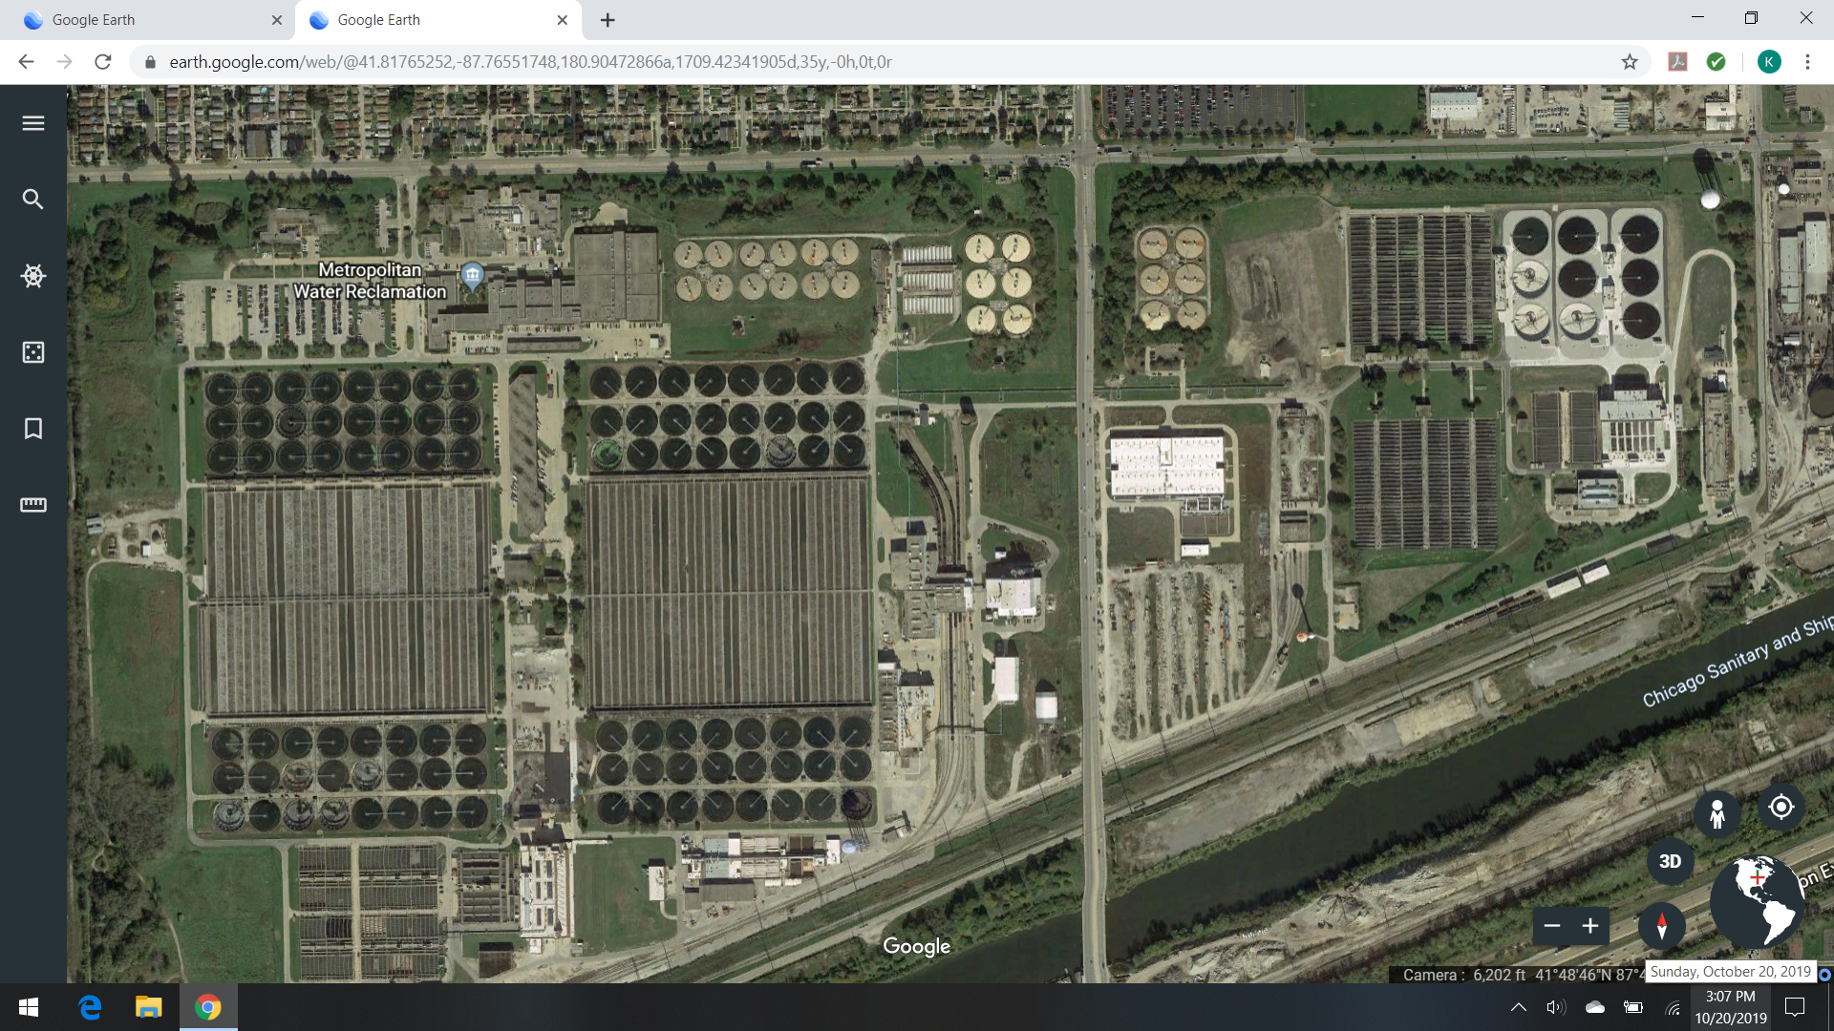
Overview of Stickney WRP

Slide 8
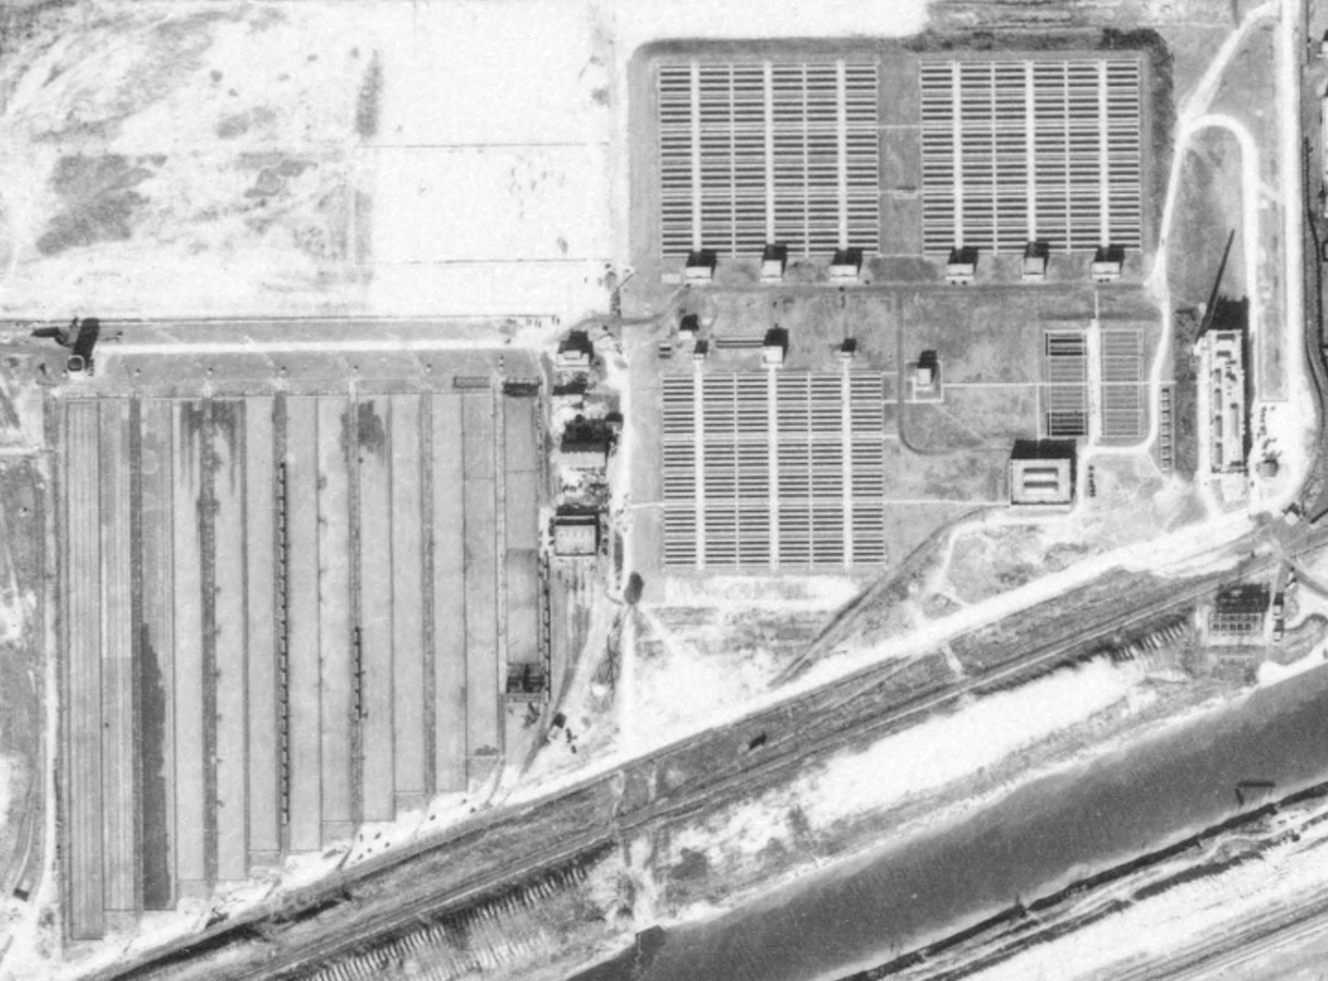
West Side Sewage Treatment Works, 1938
Notes:
Aerial from 1938

Slide 9
Imhoff Replacement Project
Imhoff and Skimming Tanks are at the end of useful life
Insufficient ability to isolate processes leading to shutdowns for normal maintenance
Green House Gas (CH4) Emissions from Imhoff Tanks
Odors from Imhoff Tanks
Solids are digested within the lower compartment of the Imhoff tanks, so sludge produces minimal methane within the digesters

Slide 10
Westside Plant - 2009

Slide 11
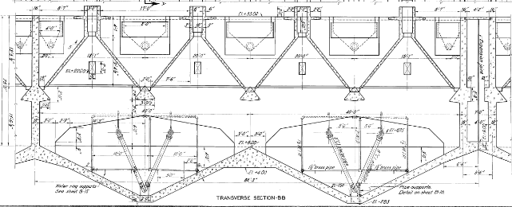
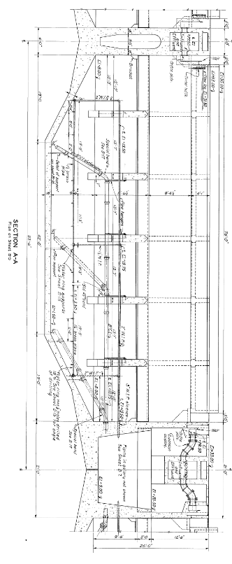
Imhoff Tanks

Slide 12
Original Imhoff Replacement Projects
4 Projects
Phase 1 – Contract 08-171-3P
Work Performed to Isolate Risks
Demo Imhoff Tanks Battery A
Site preparation and demo of skimming tanks 1-8
Phase 2 & 3 – Contract 04-128-3P
New Aerated Grit Facility (AGF)
New Primary Settling Tank’s (PST) 1-9
New TAPS A & B Buildings
Primary Switchgear Building
Phase 4
Demo Imhoff Tanks Battery B
New Primary Settling Tank’s (PST) 10-18
New TAPS C Buildings
$41.6M
$224M
$160M

Slide 13
Hydraulic stress test 480 MGD was determined to be the max we could pass through 8 skimming tanks and 2 Imhoff batteries

Slide 14
Contract 08-171-3P
Construction Completed 2013
Work Included:
Skimming Tanks 1-8 and Imhoff Battery A demolished
Abatement of hazardous material
145,000,000 gal of sludge removal from Battery A
Replace Electrical Feeds to Imhoff Batteries B and C
Site preparation for future contracts

Slide 15
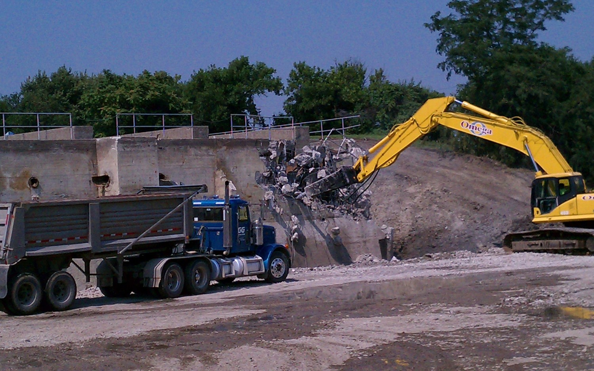
Contract 08-171-3P

Slide 16
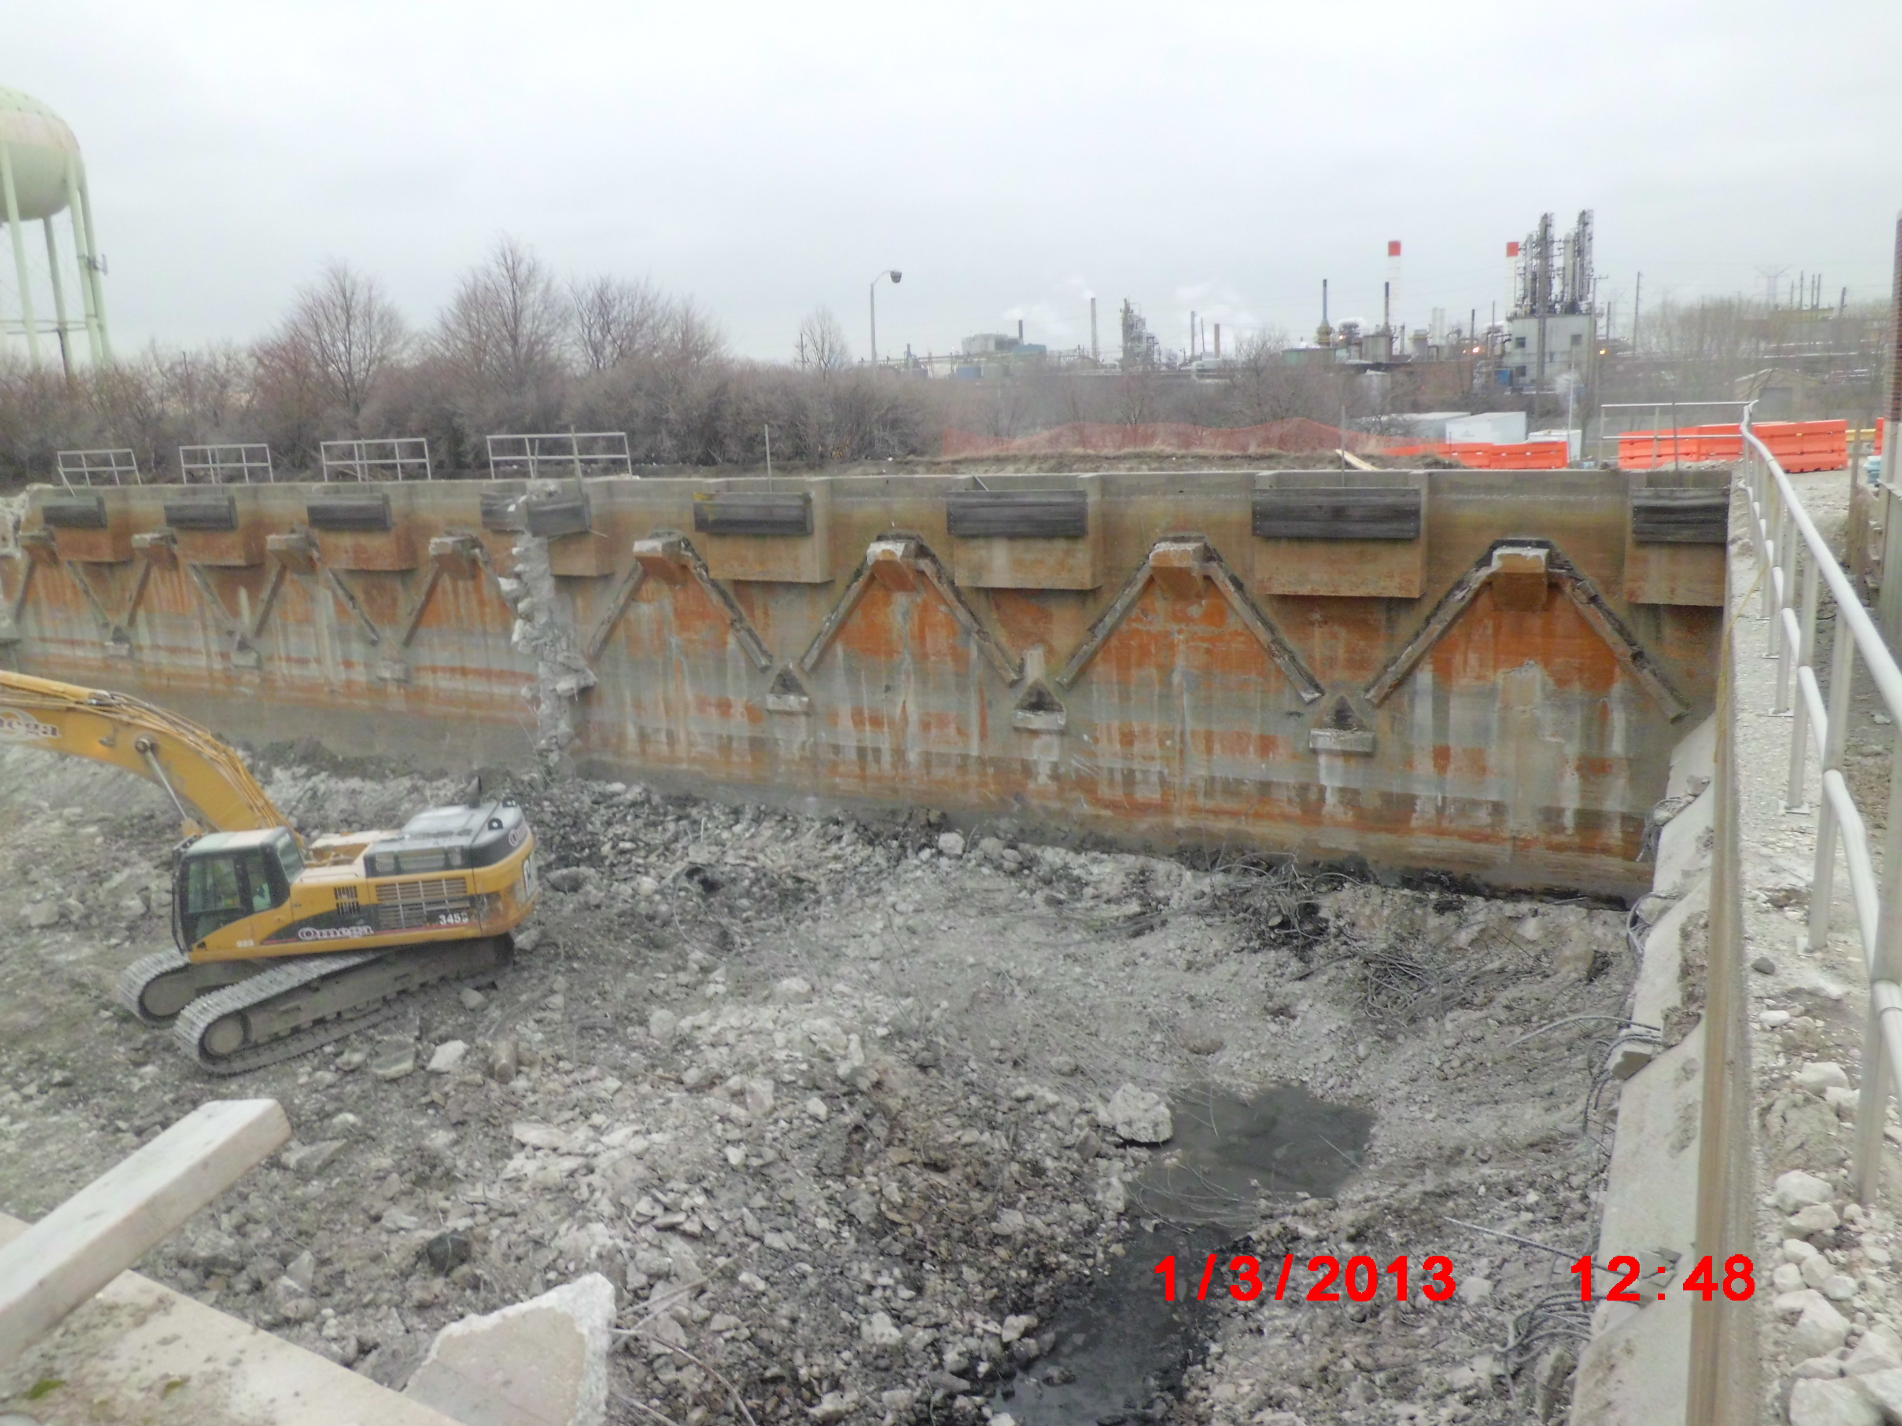
Contract 08-171-3P

Slide 17
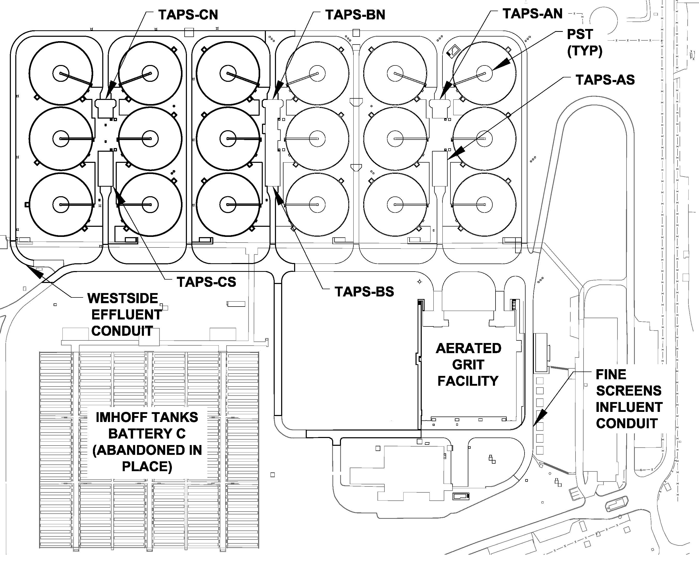
WS Plant After Imhoff Replacement Project

Slide 18
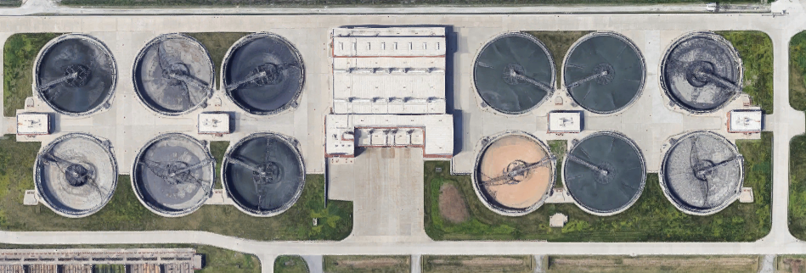
Re-evaluation and Incorporating Lessons Learned. --Calumet PSTs were started while 08-171-3P was underway --CWRP AGRT was larger than necessary and maintenance intensive --Calumet PSTs proved more effective at removing solids than anticipated

Slide 19
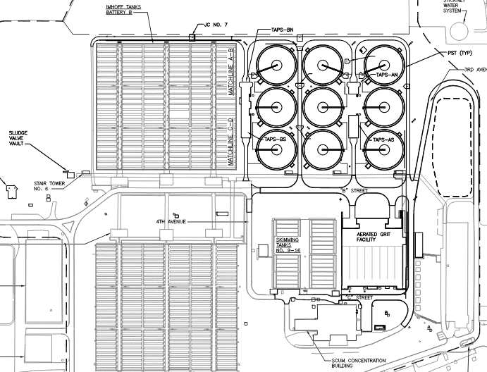
WS Plant After Imhoff Replacement Project

Slide 20
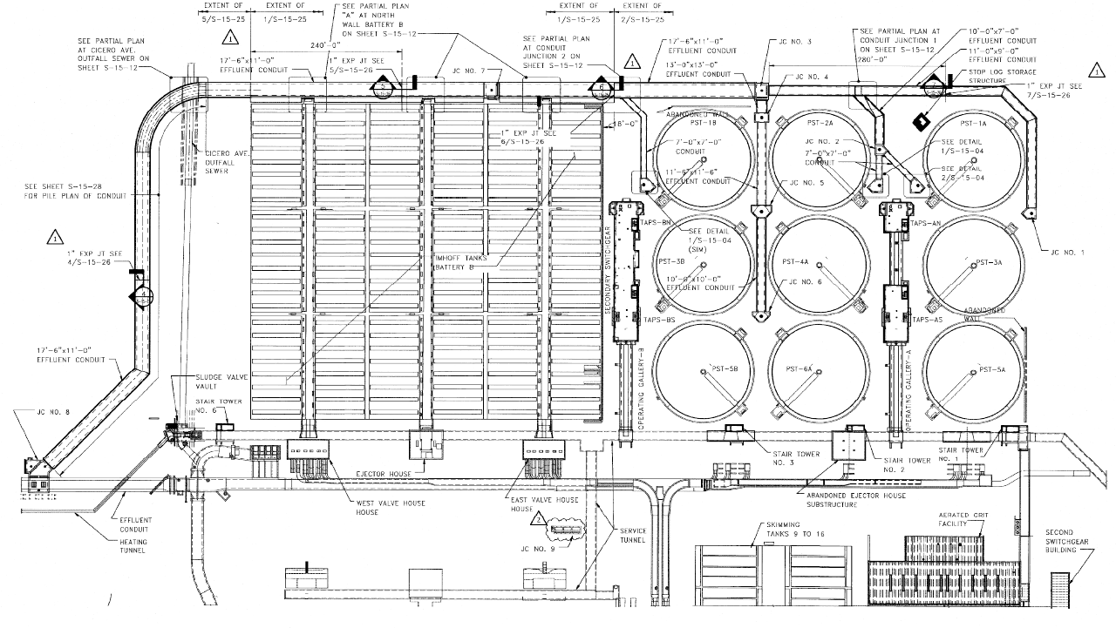
WS Plant After Imhoff Replacement Project

Slide 21
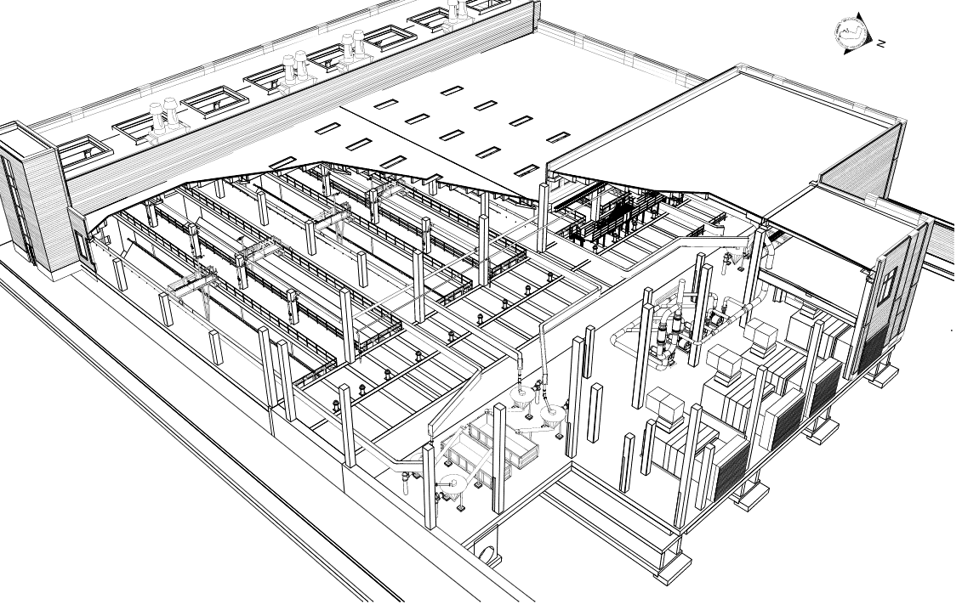
Aerated Grit Facility – Original Design

Slide 22
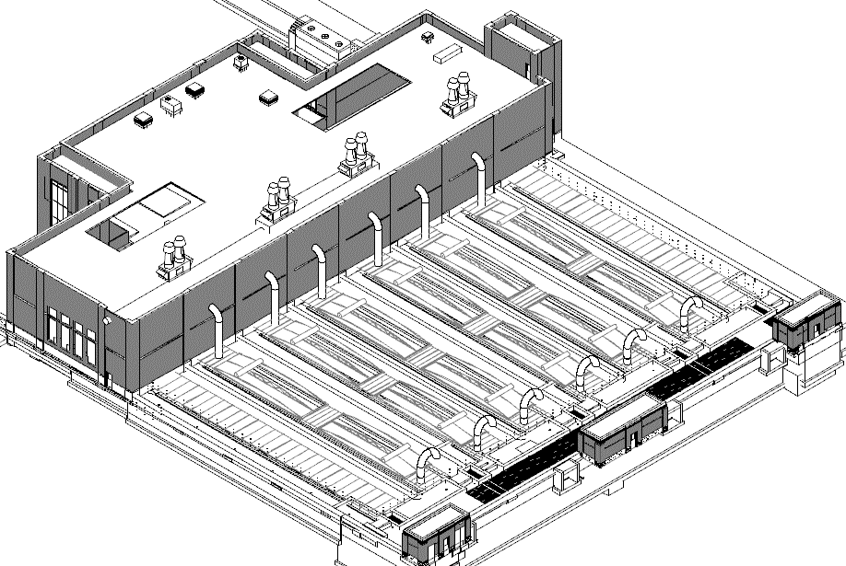
Contract 04-128-3P – Aerated Grit Facility--As-Built

Slide 23
Contract 04-128-3P
Aerated Grit Facility
6 Aerated Grit Tanks
9 160’ Diameter PSTs
System for flow to bypass PSTs and send to secondary process
Tunnel Access Pump Stations (TAPS) A and B
Odor control system for AGF and PSTs

Slide 24
Contract 04-128-3P
Project Bid
Summer 2014
$224 million
1200 calendar days to construct
Construction
Notice to Proceed – December 2014
Startup – November 2018

Slide 25
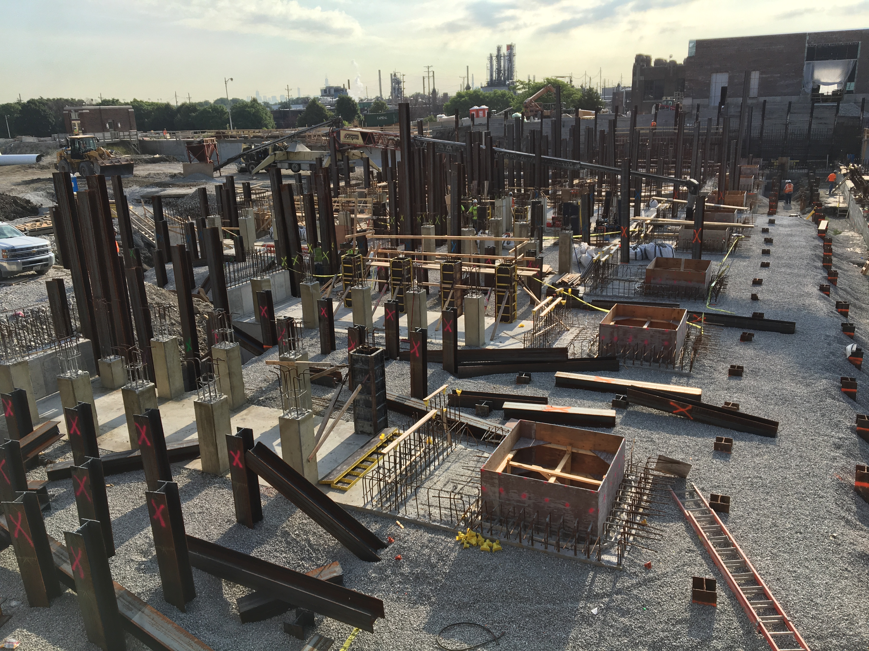
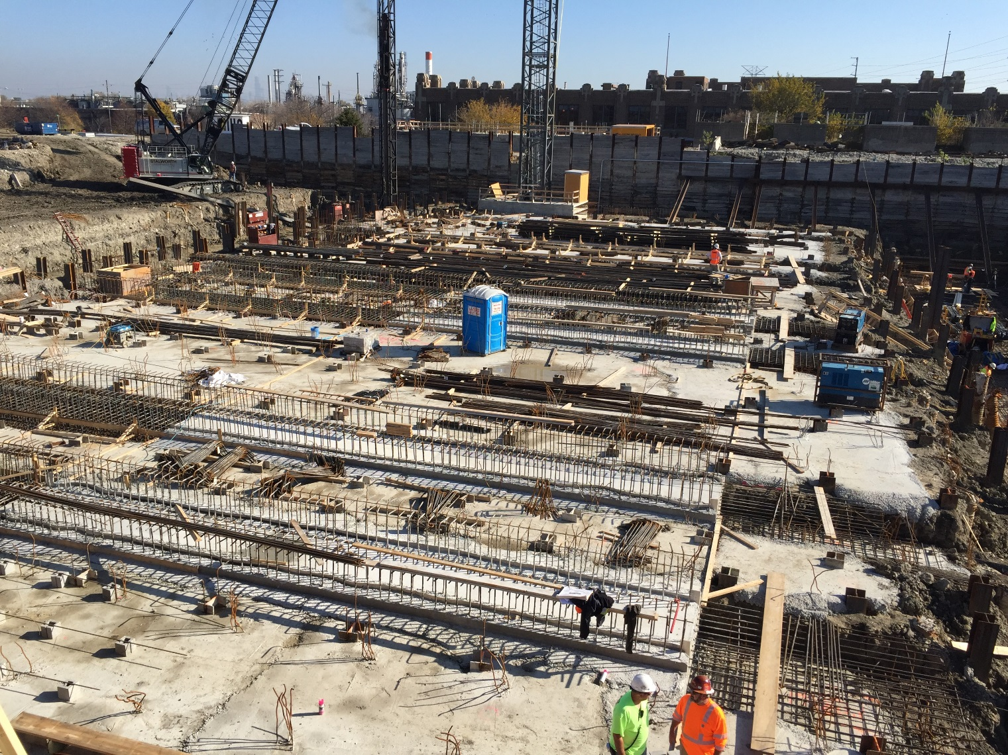
Contract 04-128-3P Construction - AGF

Slide 26
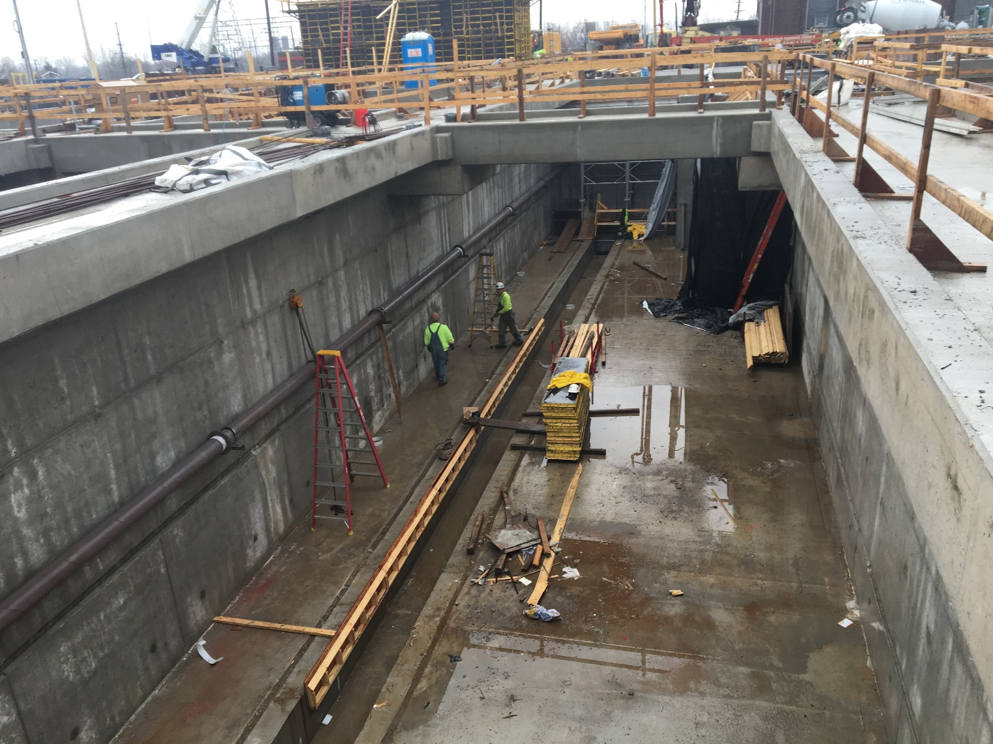
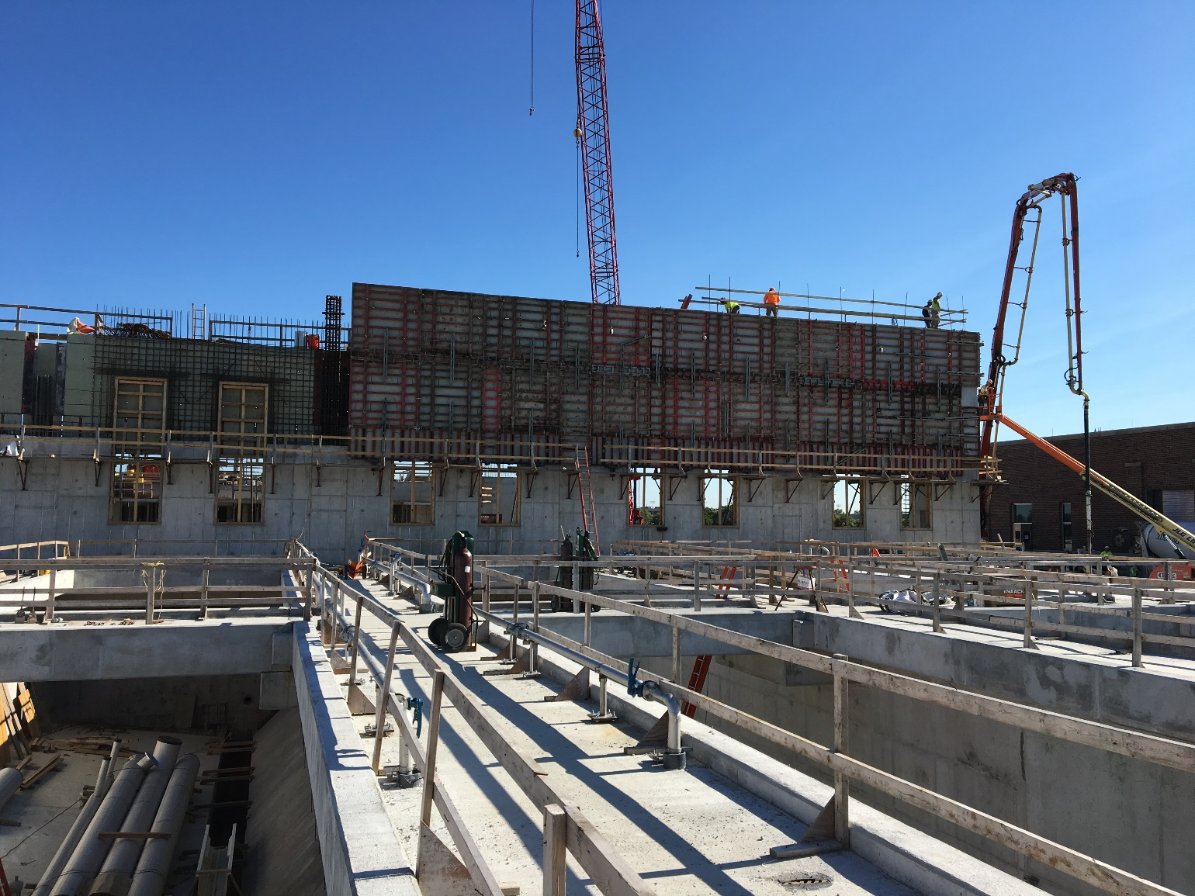
Contract 04-128-3P Construction - AGF

Slide 27
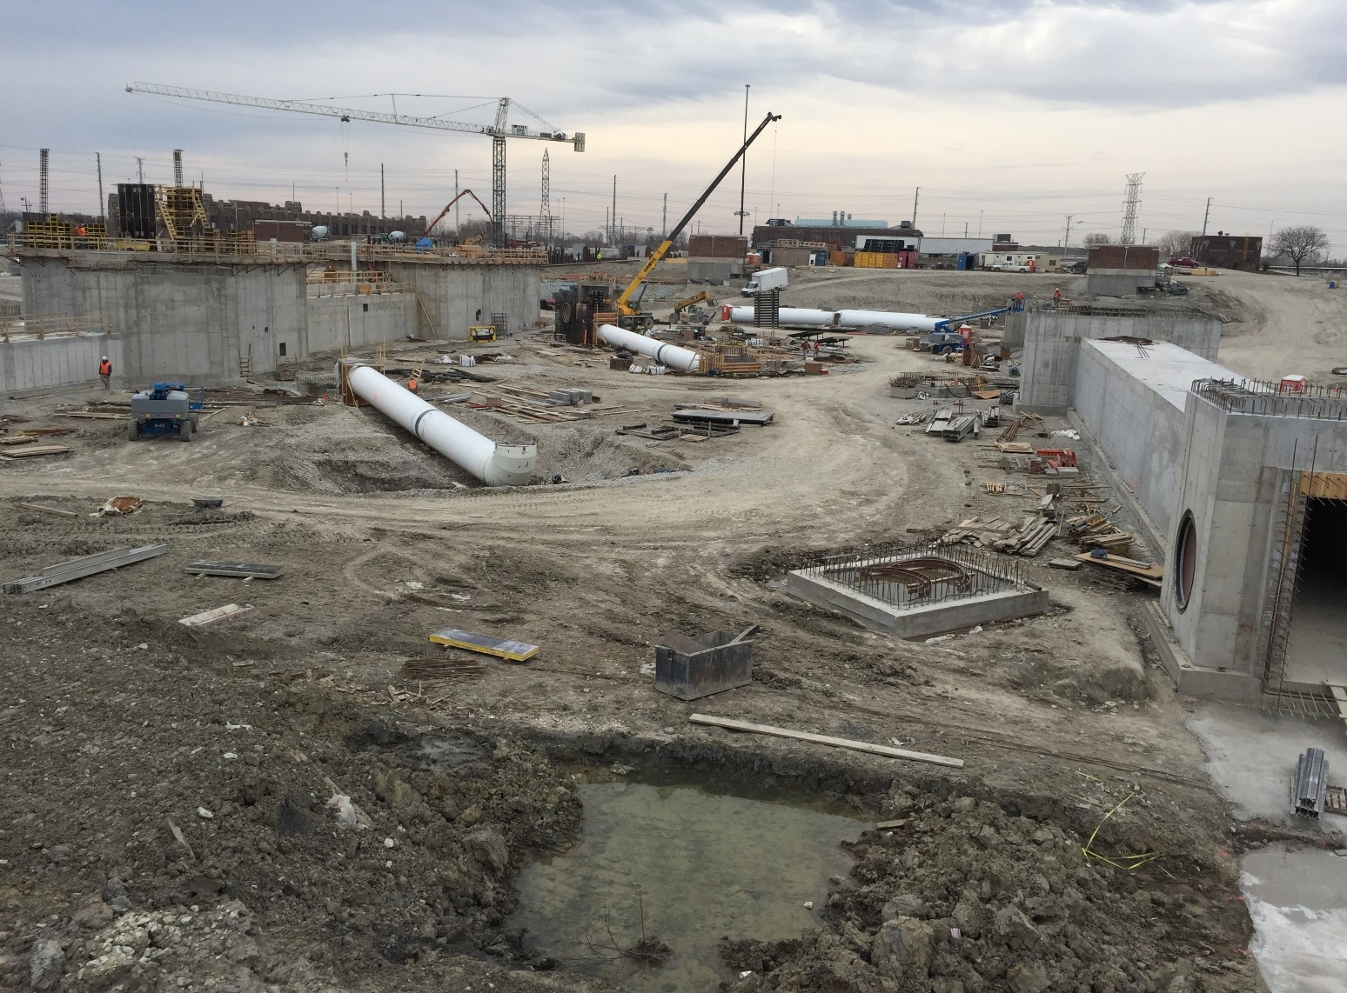
Contract 04-128-3P Construction - PST

Slide 28
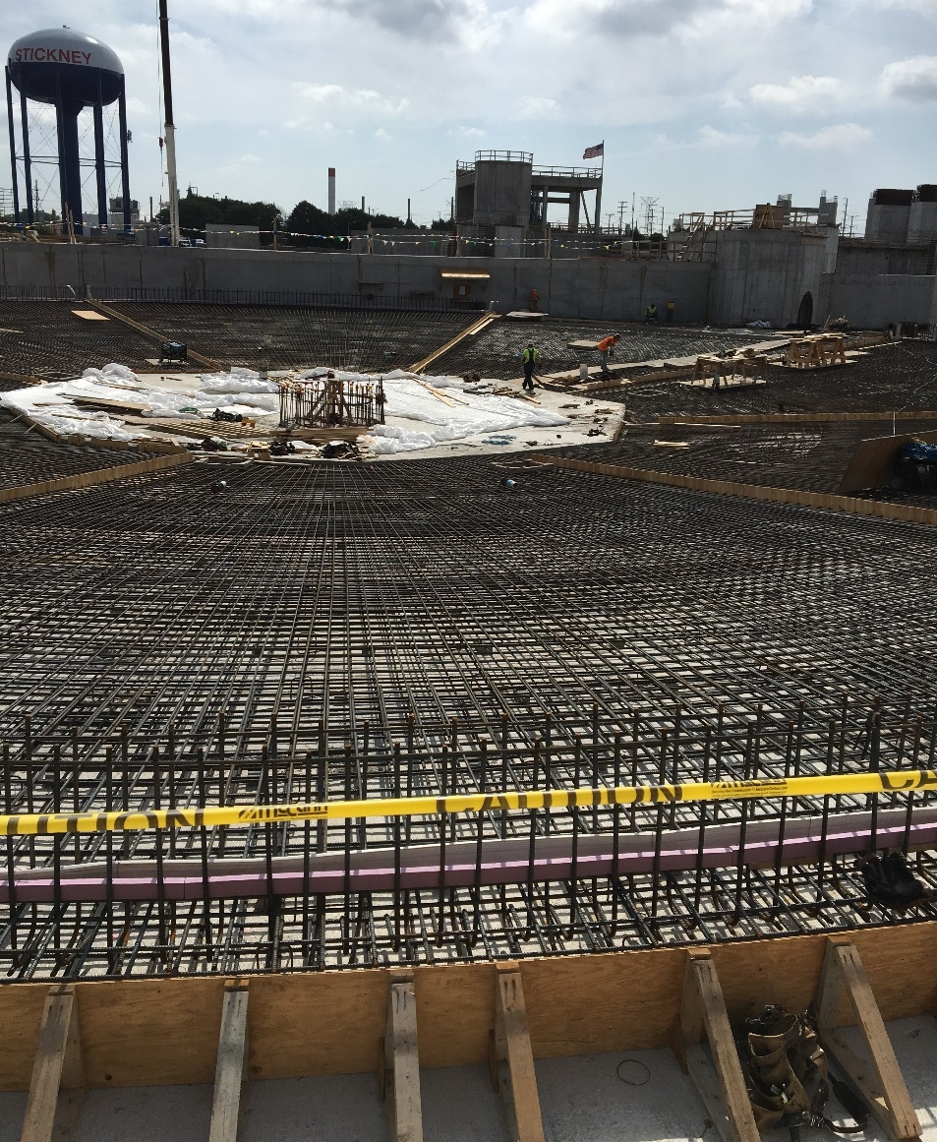
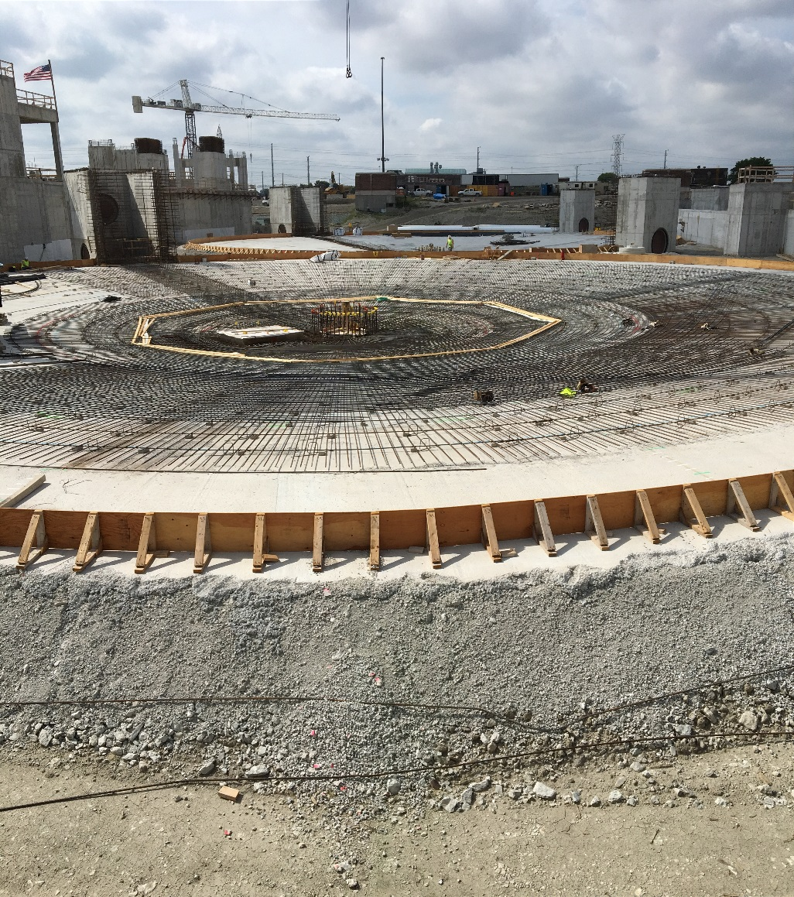
Contract 04-128-3P Construction - PST

Slide 29
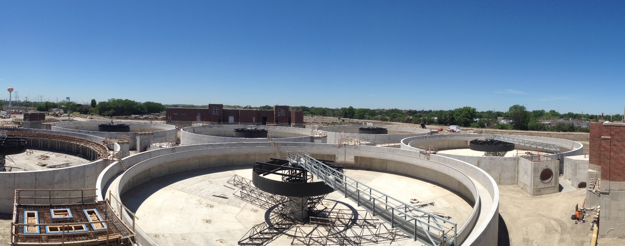
Contract 04-128-3P Construction - PST

Slide 30
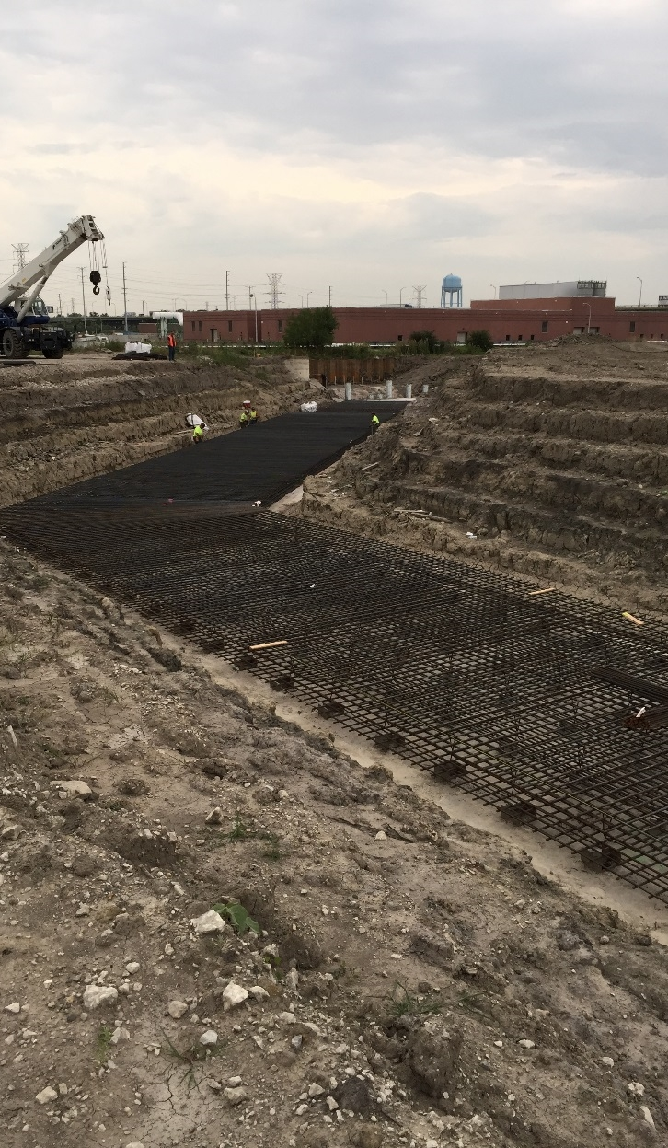
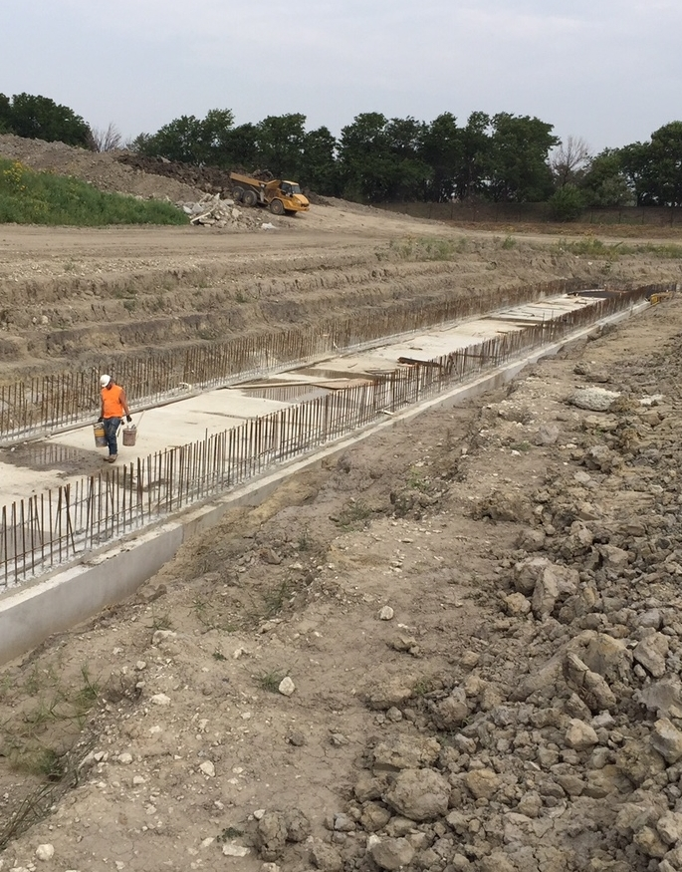
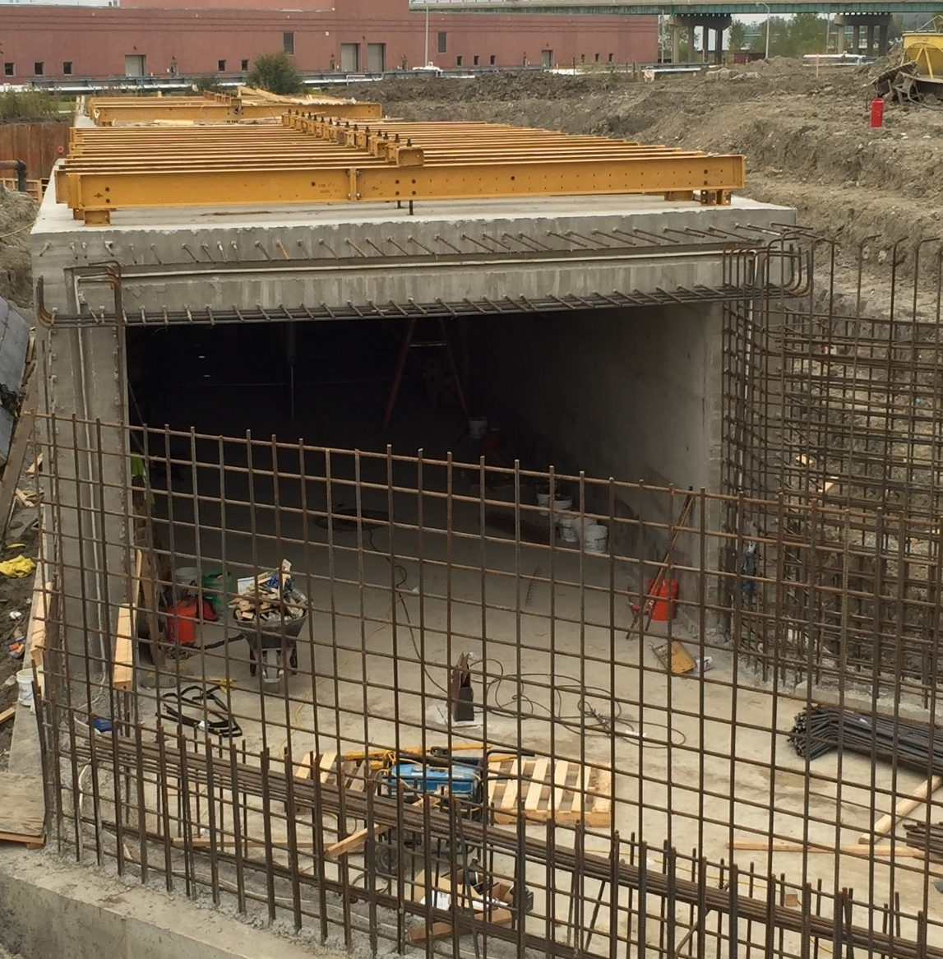
Contract 04-128-3P Construction – Effluent Conduits

Slide 31
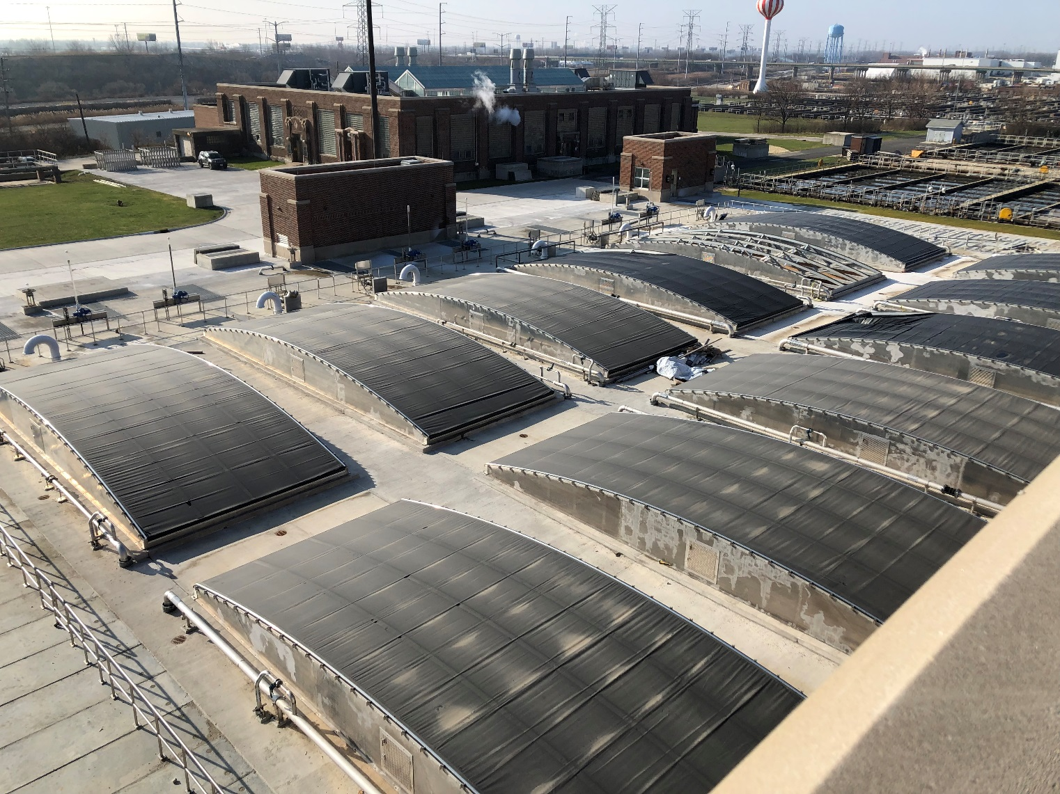
Contract 04-128-3P Construction - AGF

Slide 32
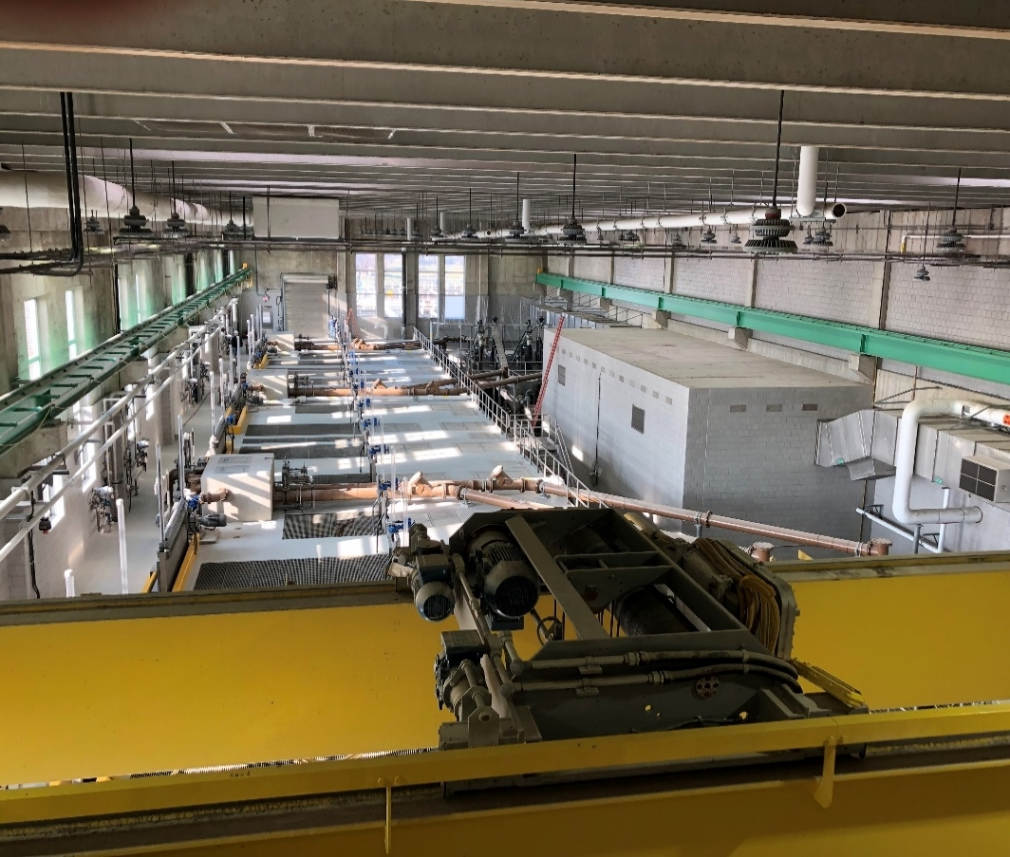
Contract 04-128-3P Construction - AGF

Slide 33
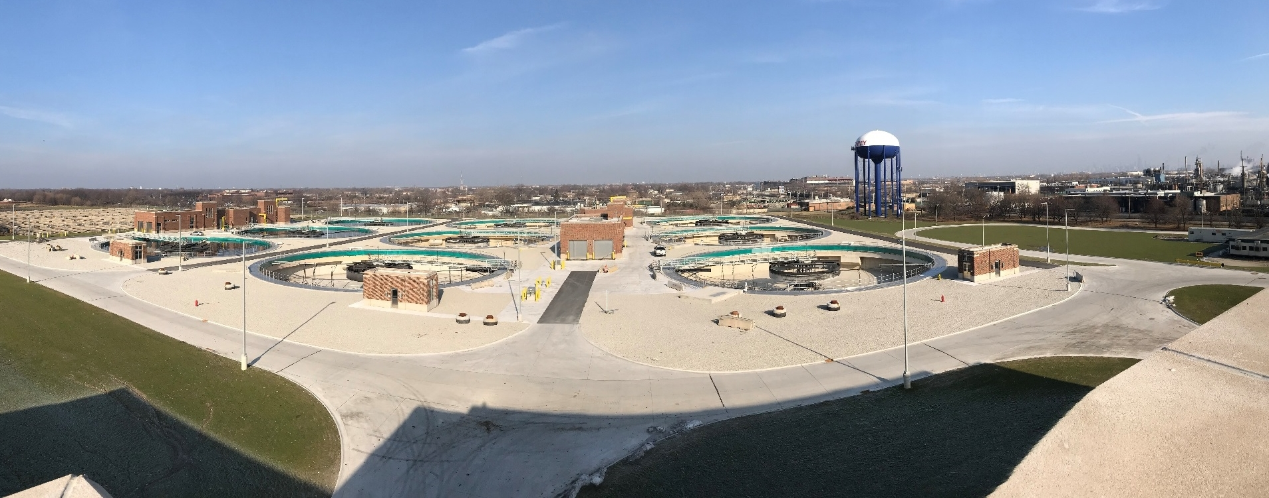
Contract 04-128-3P Construction - PST

Slide 34
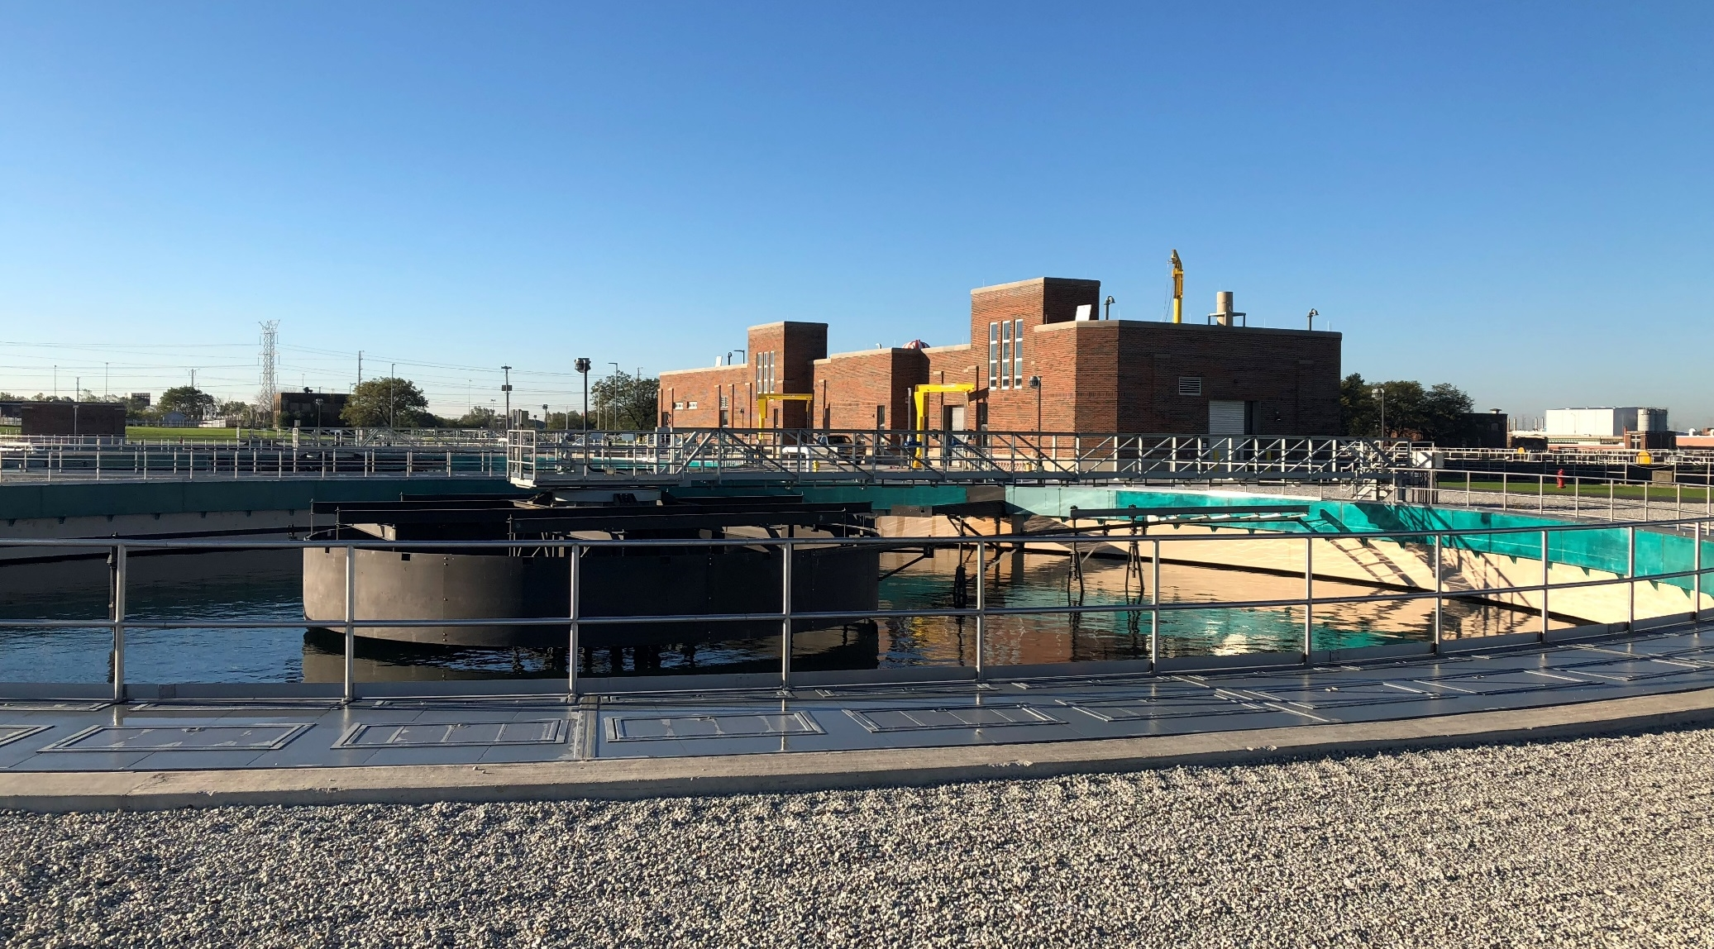
Contract 04-128-3P Construction - PST

Slide 35
Contract 04-128-3P Startup
Coordination and planning between departments at MWRDGC and contractor
Start up at one third of its maximum design capacity
Limit the flow to give MWRDGC staff time to:
Adapt and gain experience to new facilities and equipment
Make necessary adjustments prior to full flow going through the new Project
Allow sufficient time for the other processes at Stickney to adjust, specifically anaerobic digesters

Slide 36
Contract 04-128-3P Startup
PST 1B
PST 2A
PST 1A
PST 3B
PST 4A
PST 3A
PST 5B
PST 6A
PST 5A
AGT No. 6
AGT No. 7
AGT No. 5
AGT No. 2
AGT No. 4
AGT No. 3

Slide 37
Contract 04-128-3P Startup
PST 1B
PST 2A
PST 1A
PST 3B
PST 4A
PST 3A
PST 5B
PST 6A
PST 5A
AGT No. 7
AGT No. 6
AGT No. 5
AGT No. 4
AGT No. 3
AGT No. 2

Slide 38
Contract 04-128-3P Startup
PST 1B
PST 2A
PST 1A
PST 3B
PST 4A
PST 3A
PST 5B
PST 6A
PST 5A
AGT No. 7
AGT No. 6
AGT No. 5
AGT No. 4
AGT No. 3
AGT No. 2

Slide 39
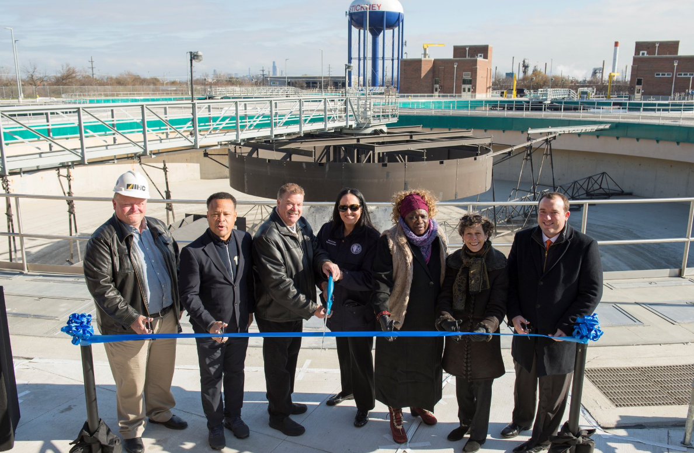
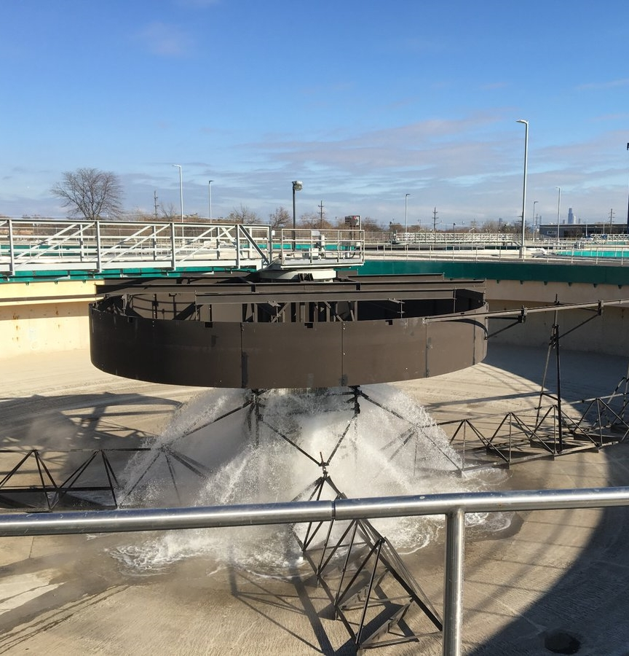
Contract 04-128-3P Startup

Slide 40
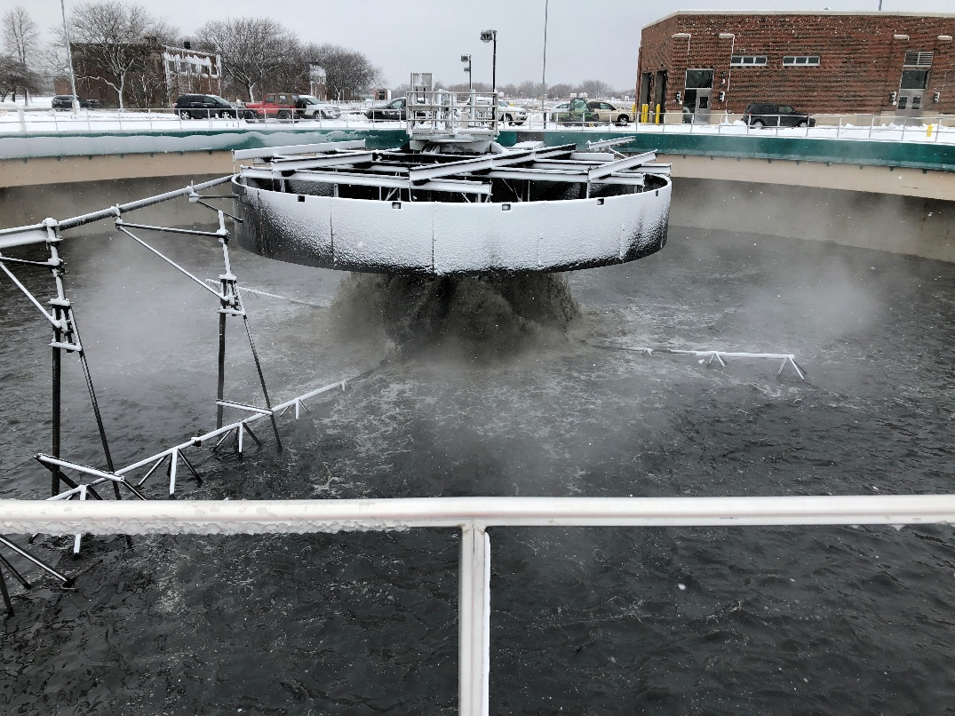
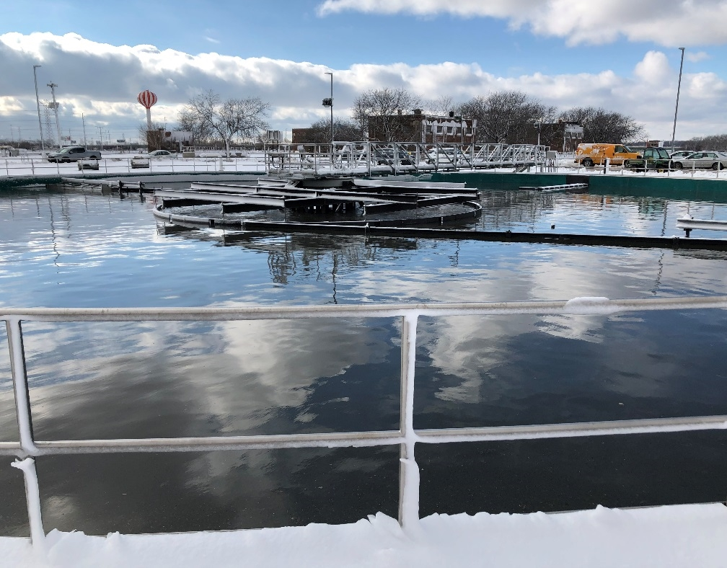
Contract 04-128-3P Startup
Start of 7-day startup test and 60-day performance test
Official Startup - November 27, 2018

Slide 41
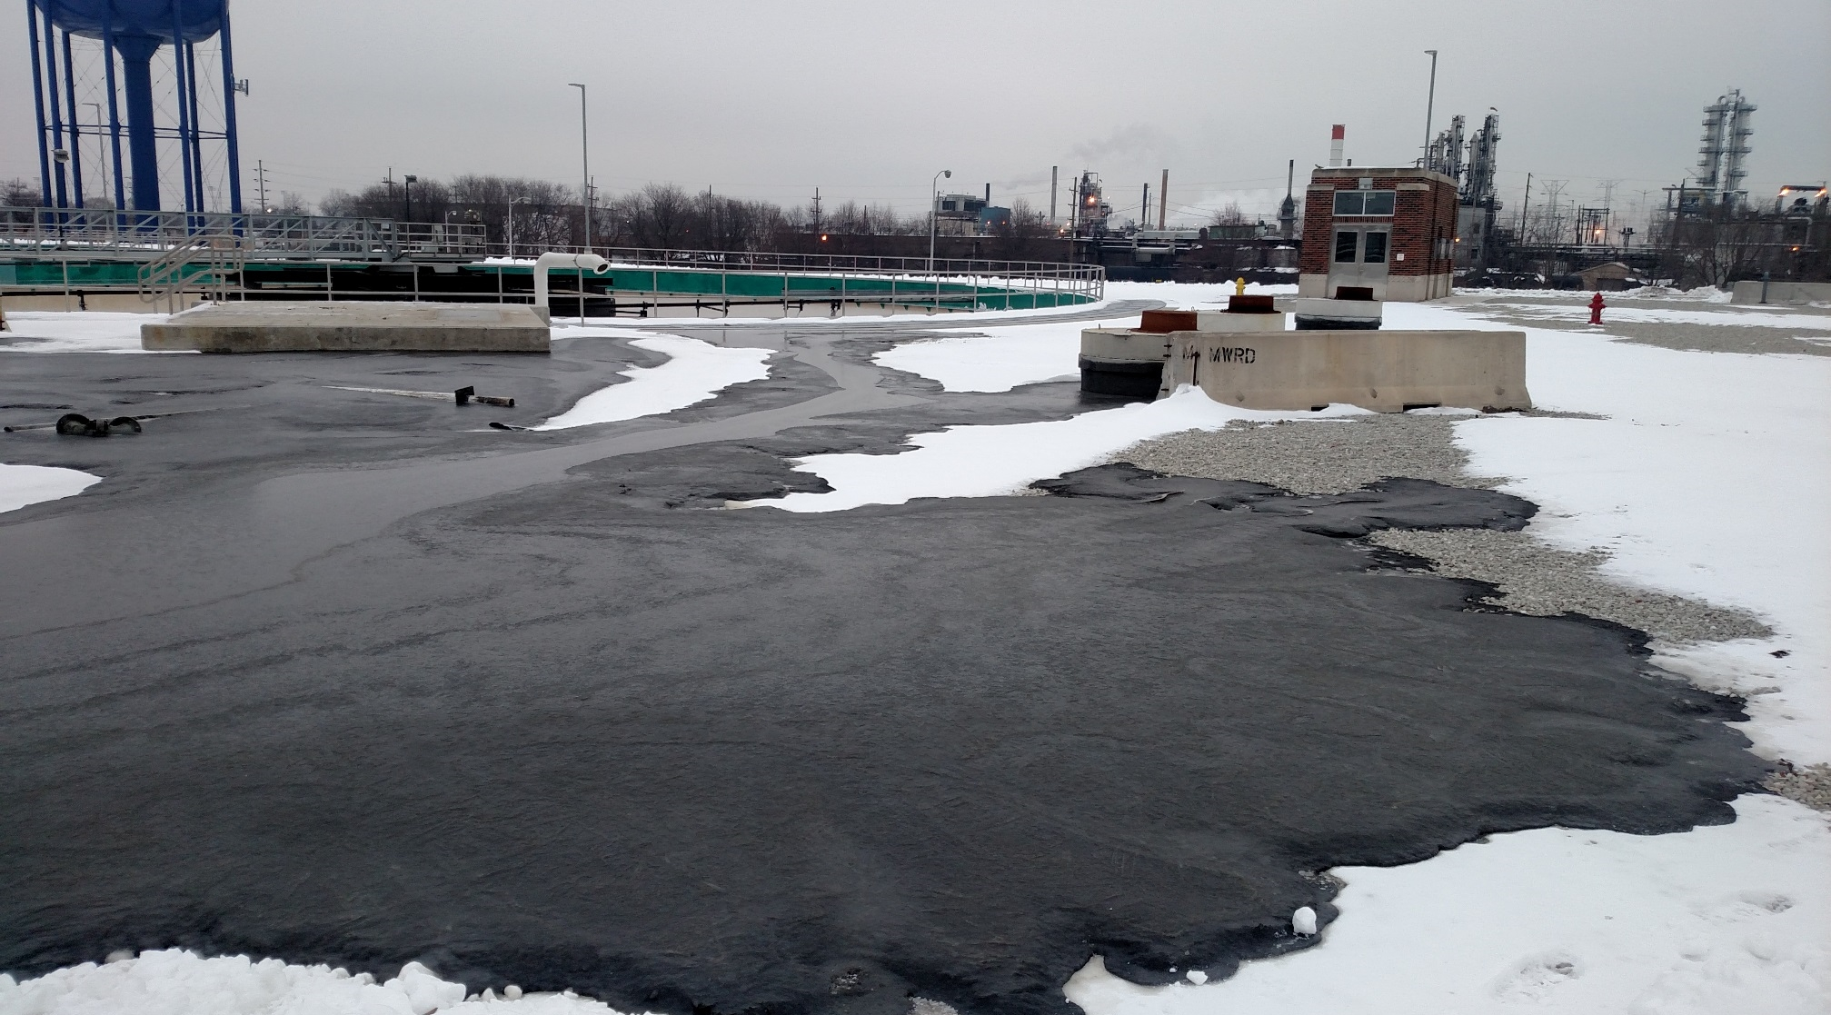
Contract 04-128-3P Startup Challenges

Slide 42
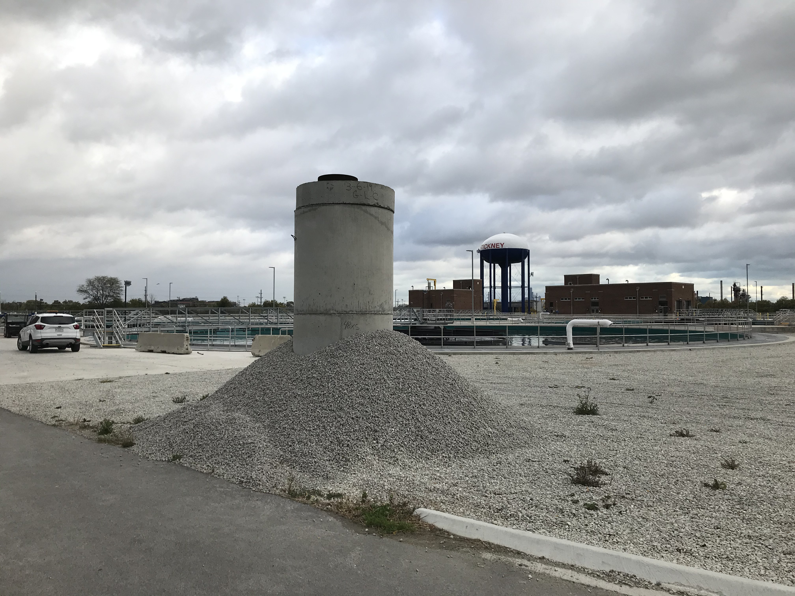
Sludge Vent Containment Structure

Slide 43
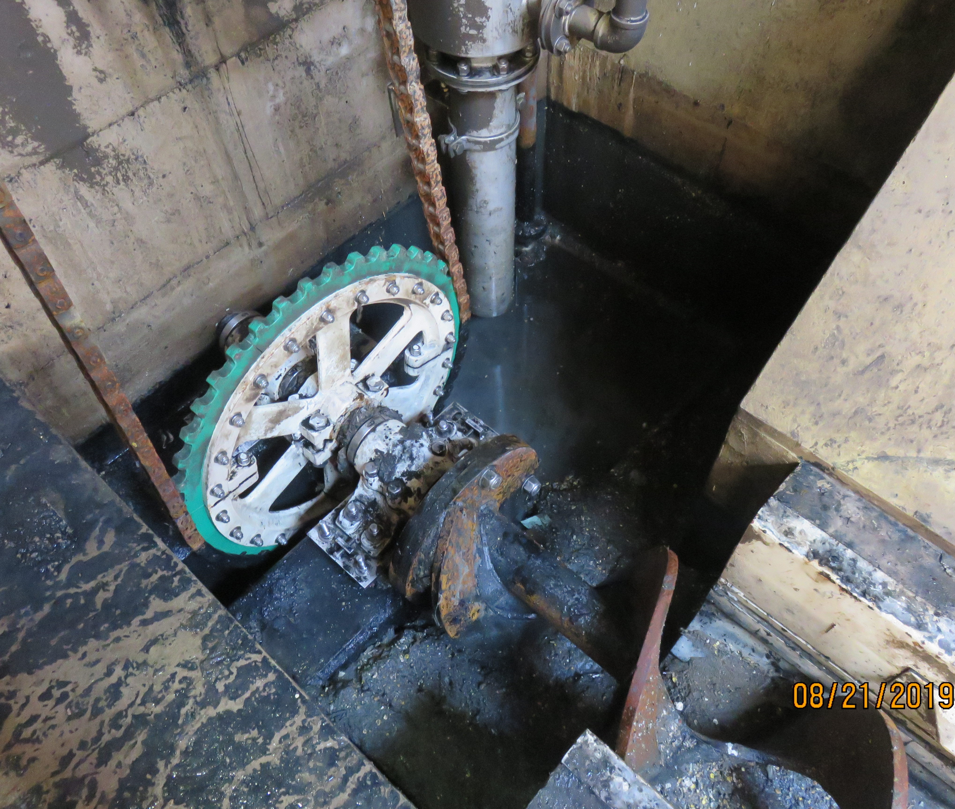
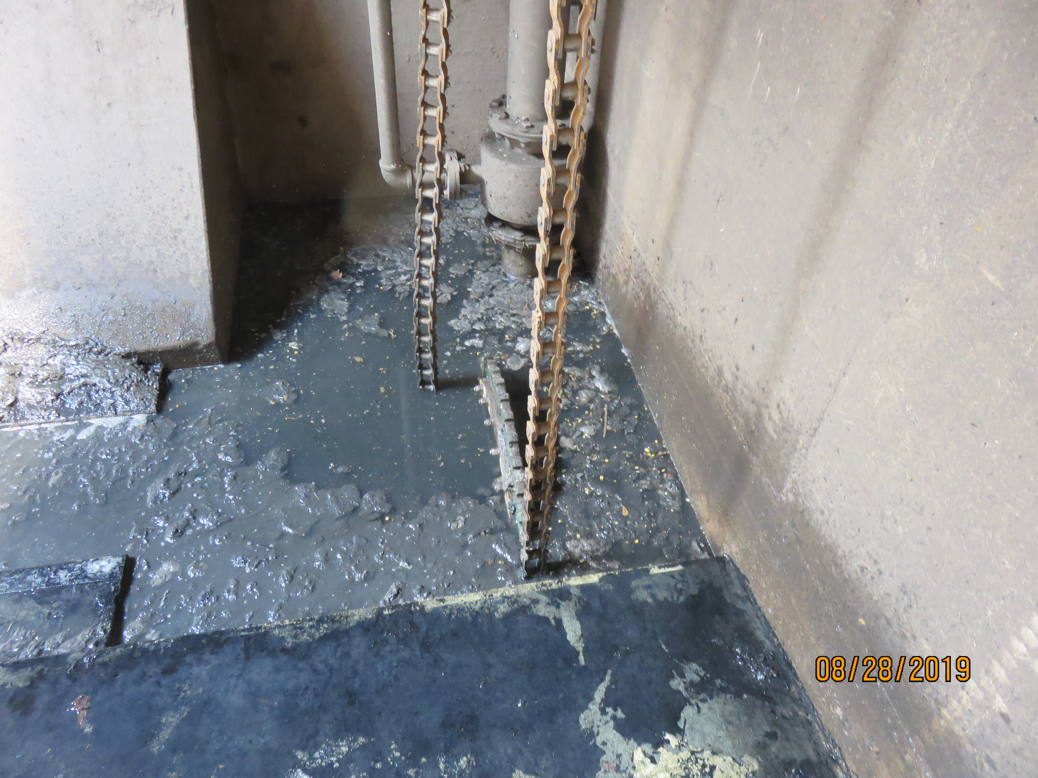
Contract 04-128-3P Startup Challenges

Slide 44
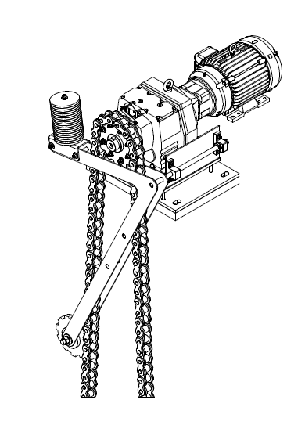
Chain must be kept in tension

Slide 45
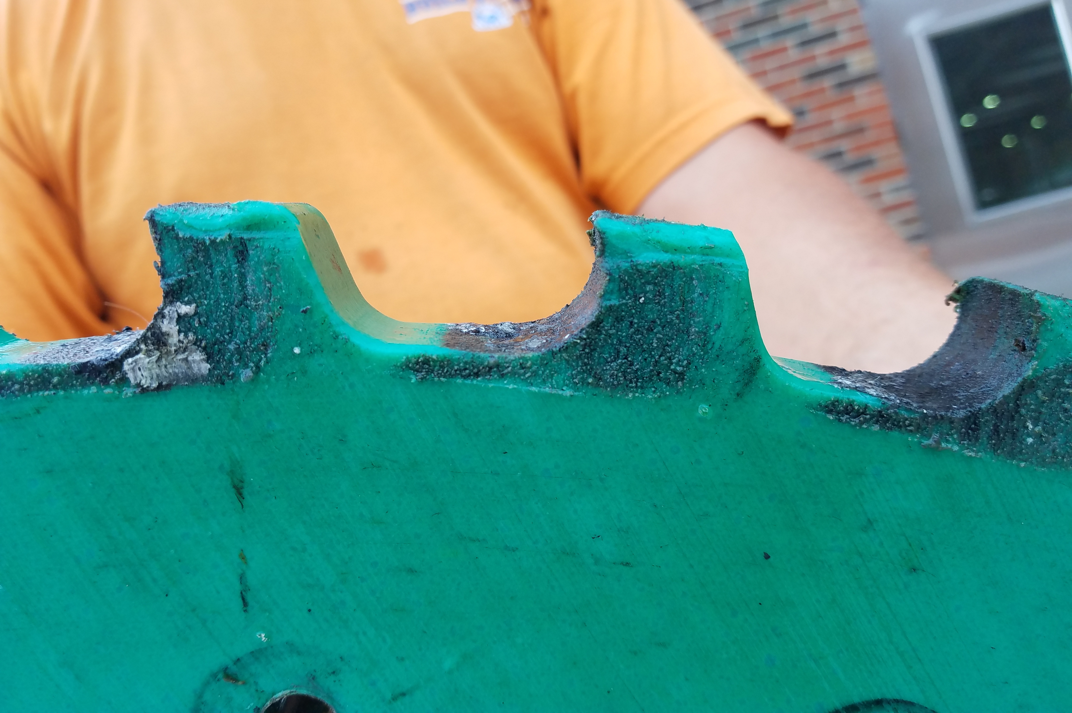
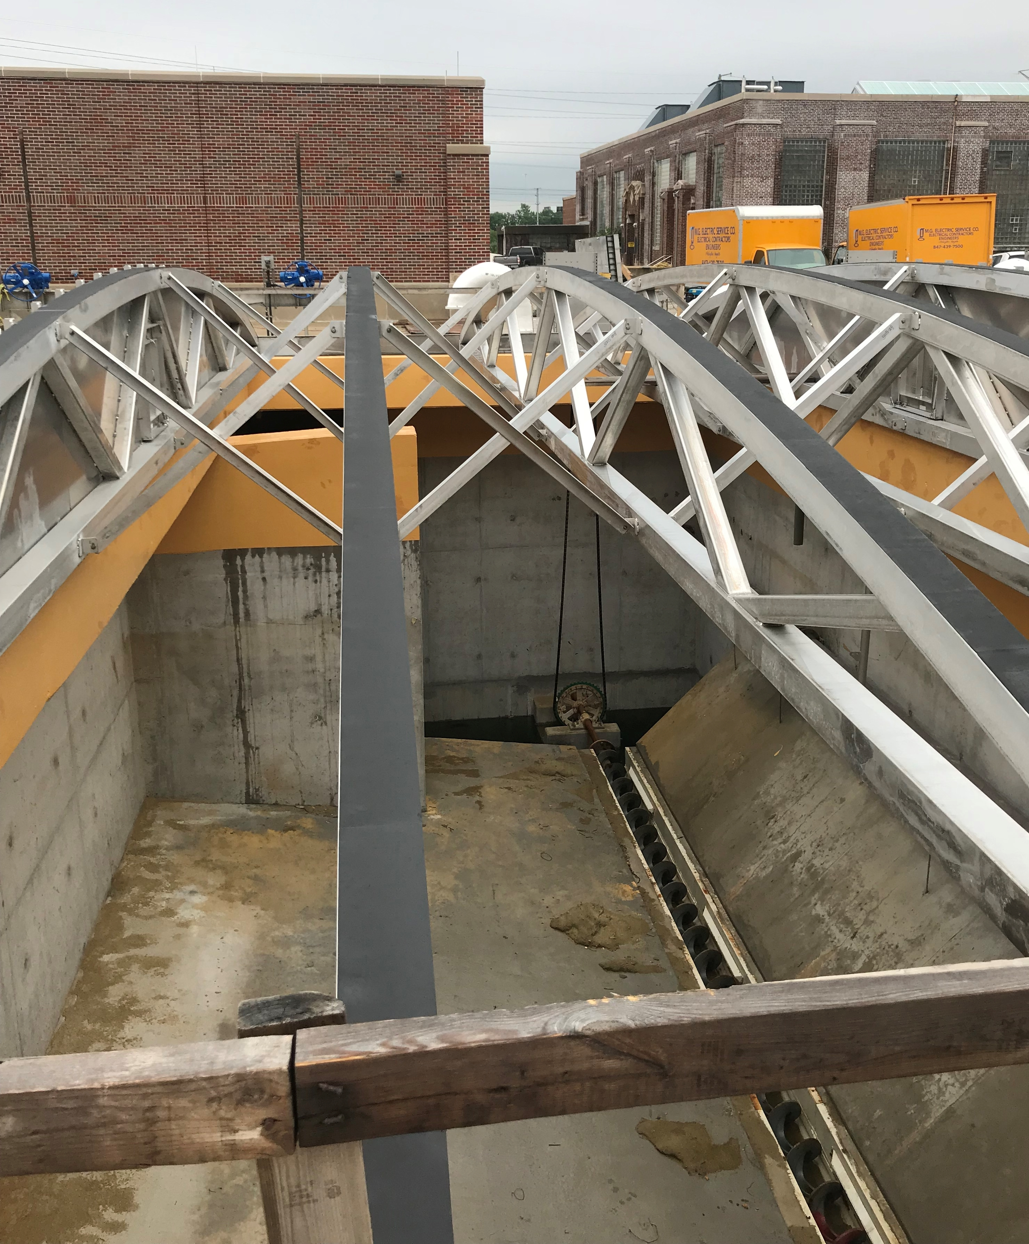
Contract 04-128-3P Startup Challenges

Slide 46
Watch for hydraulic surprises!

Slide 47
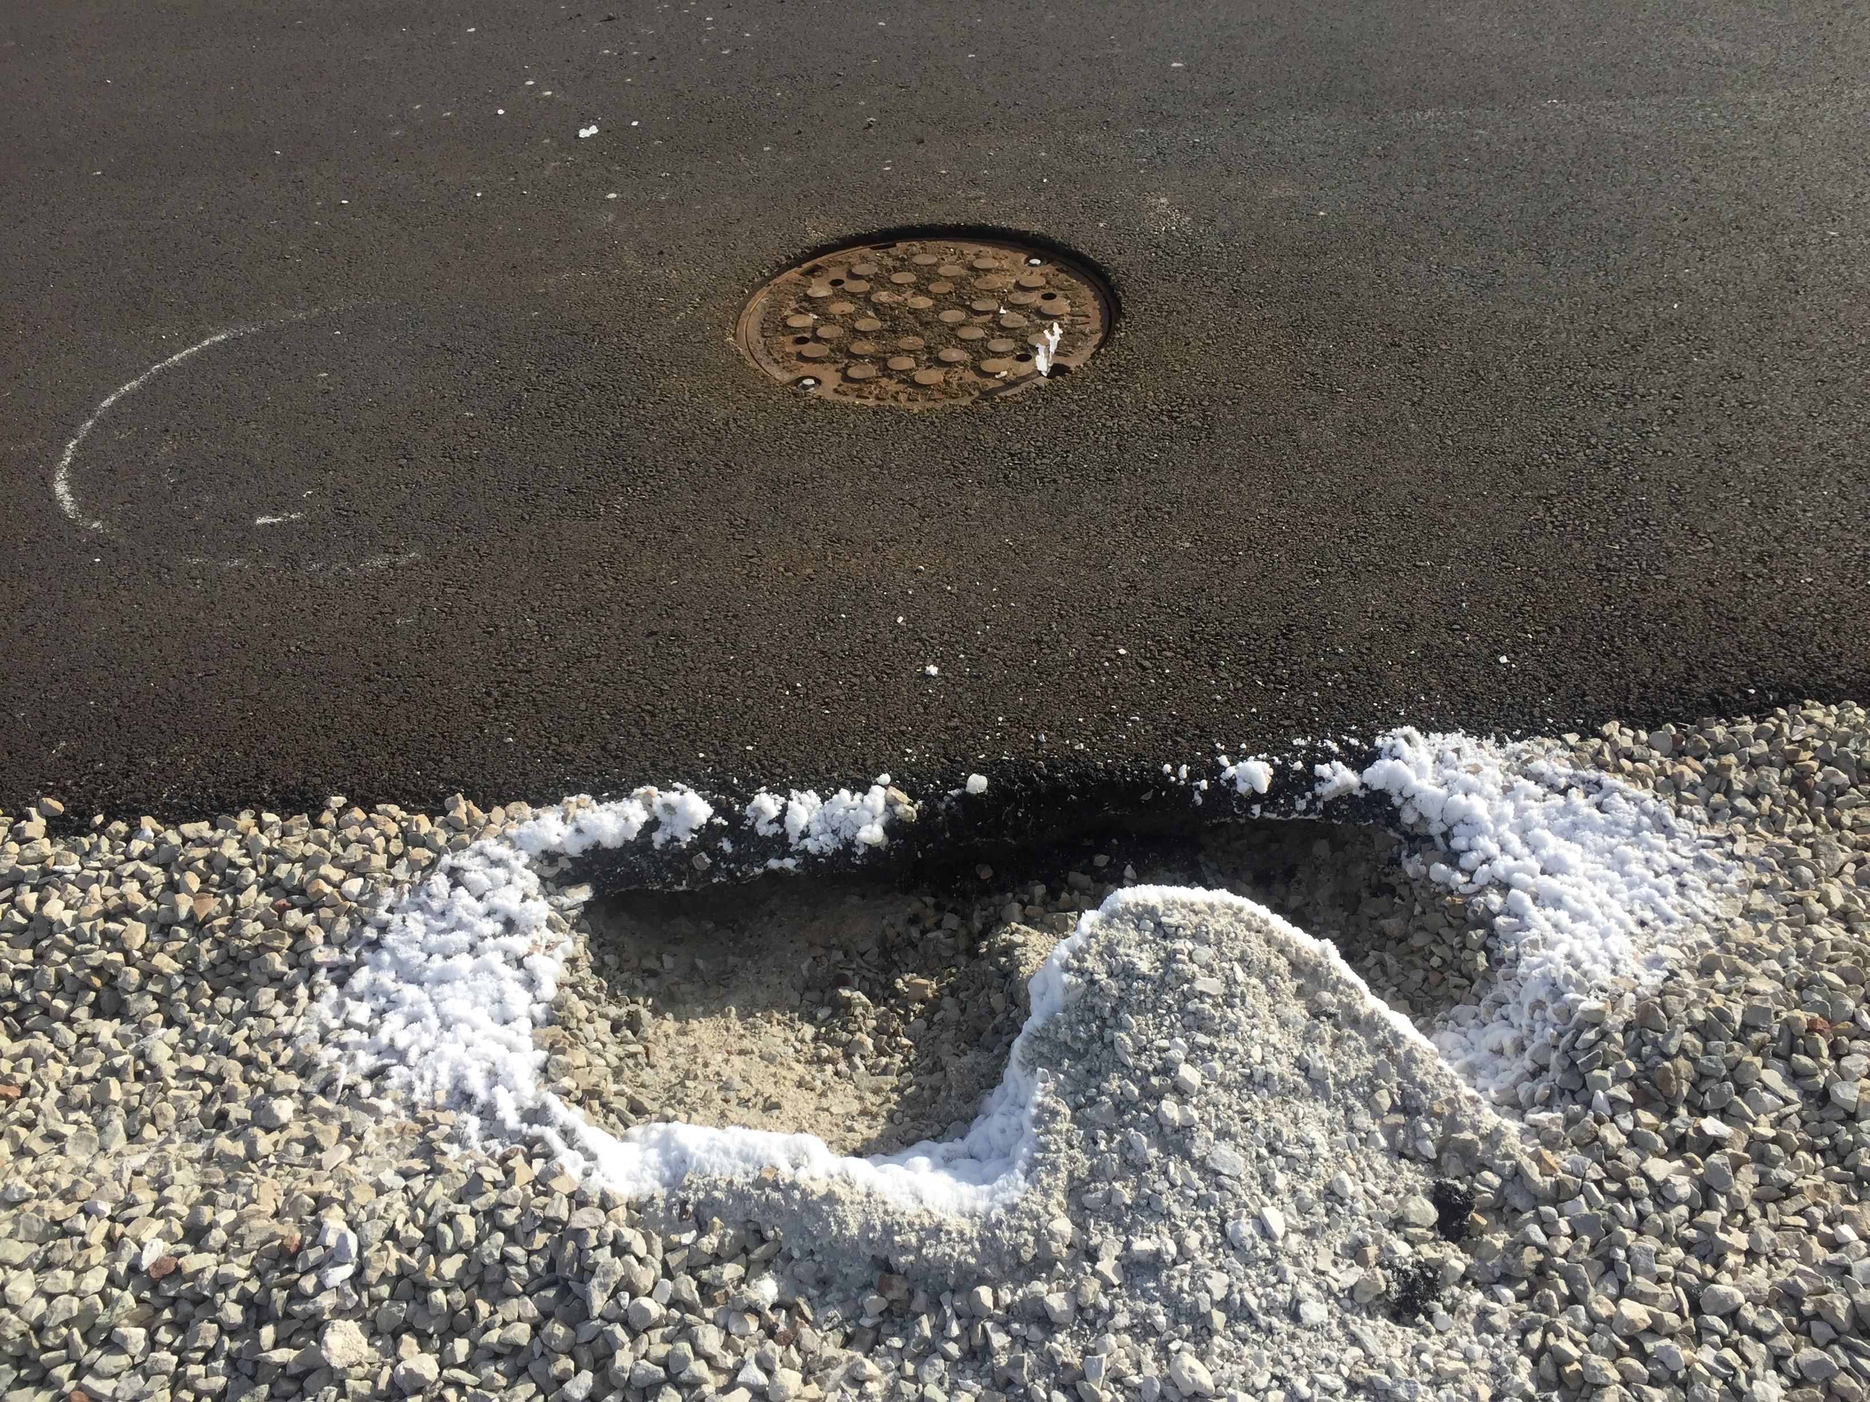
Water is not compressible. Air is.

Slide 48
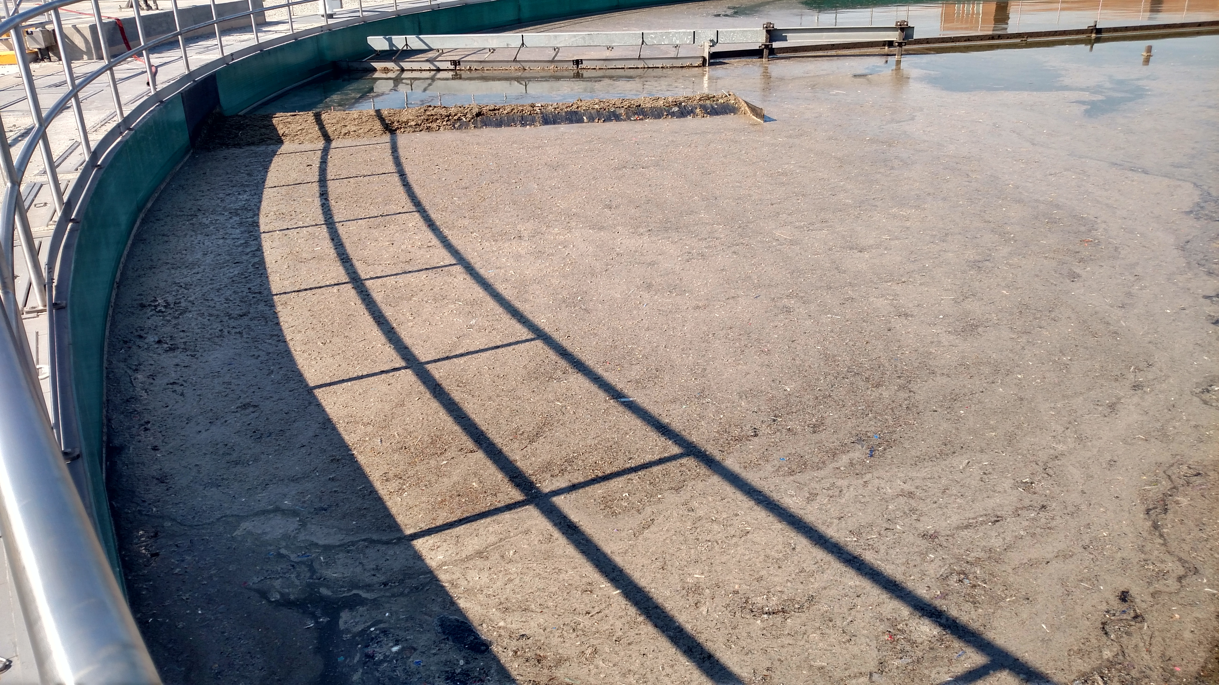
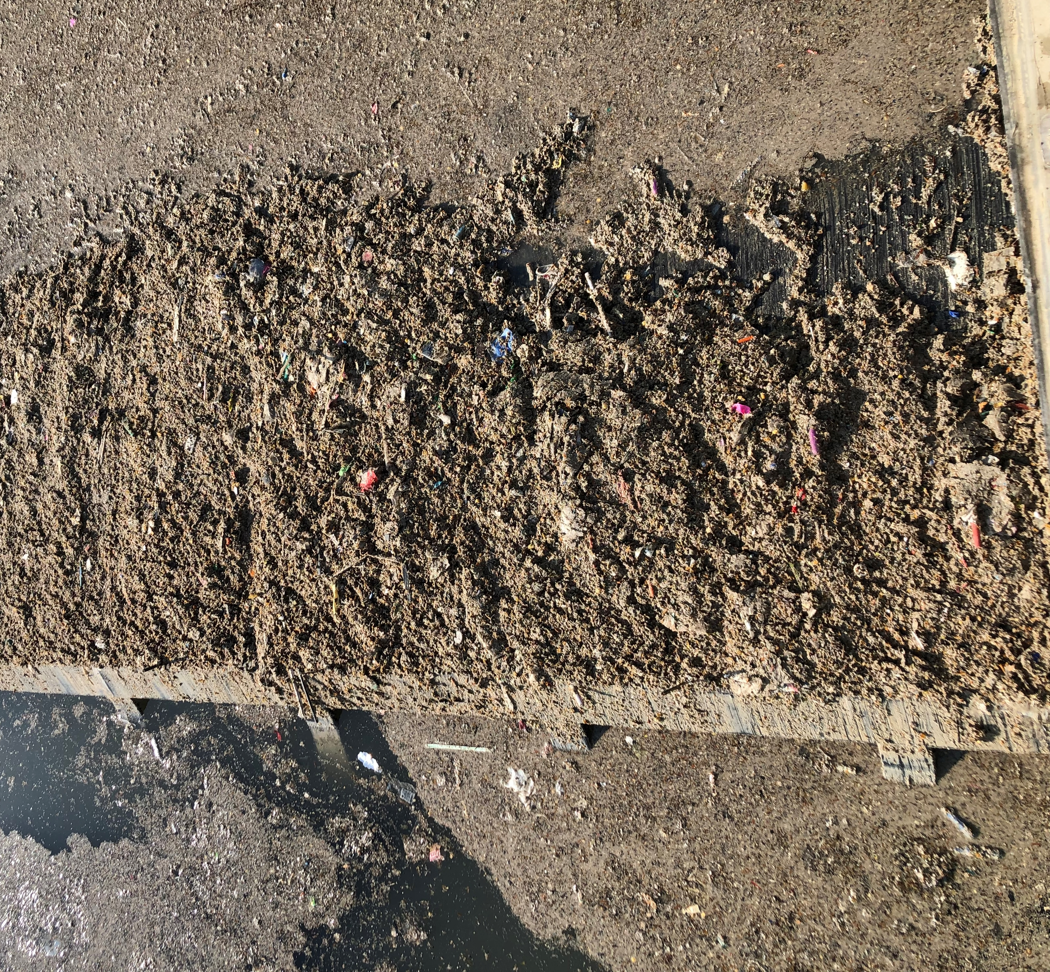
Contract 04-128-3P Startup Challenges

Slide 49
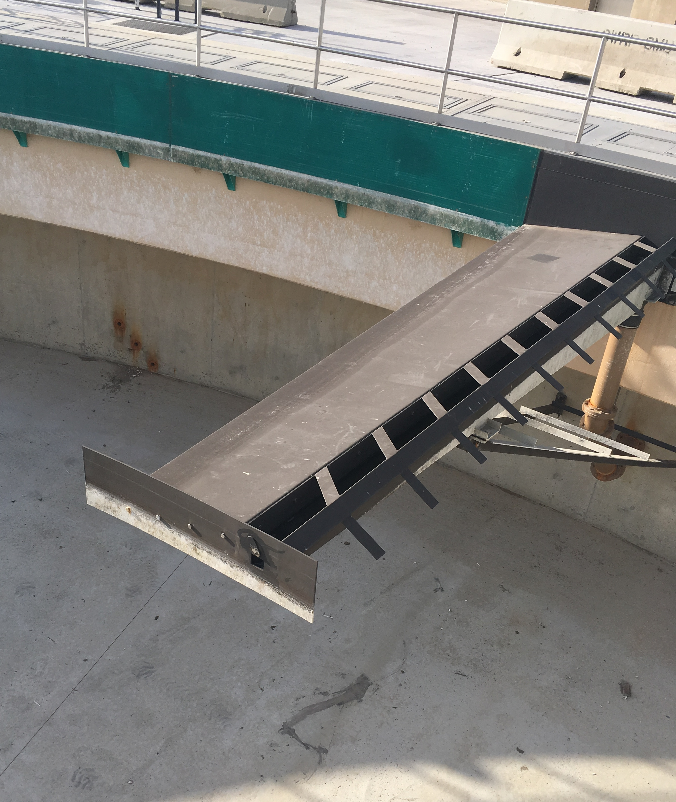
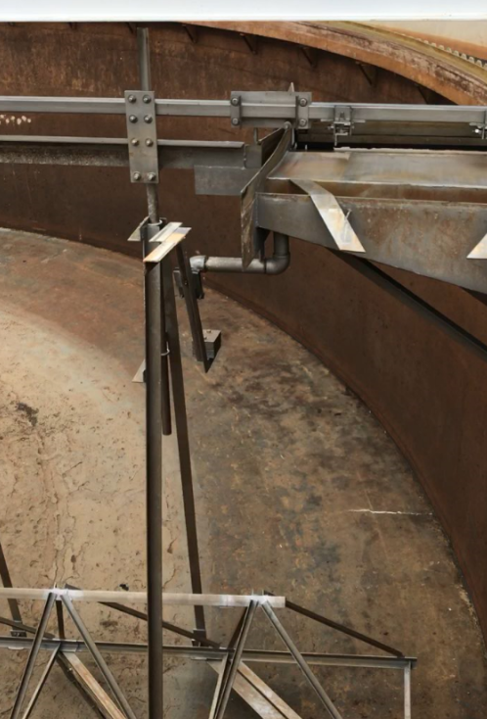
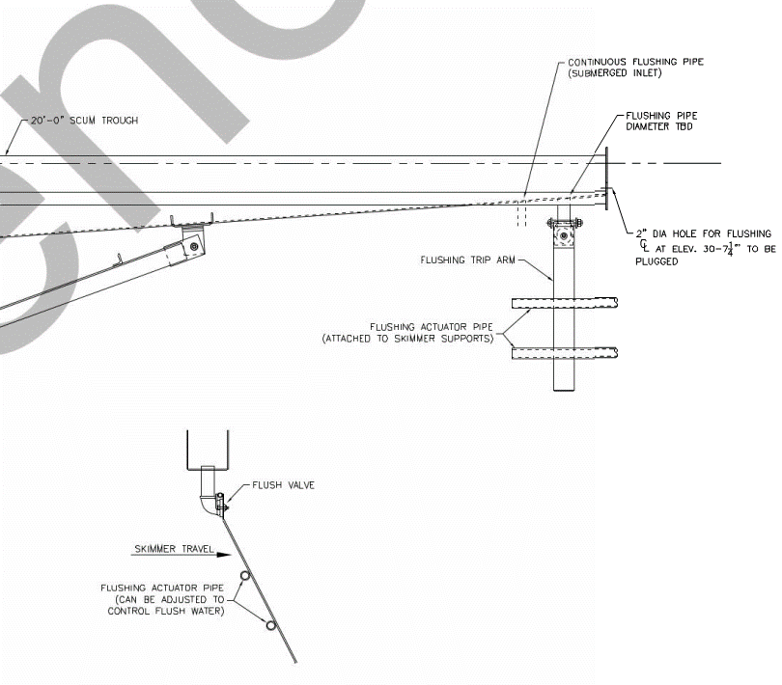
Contract 04-128-3P Startup Challenges

Slide 50
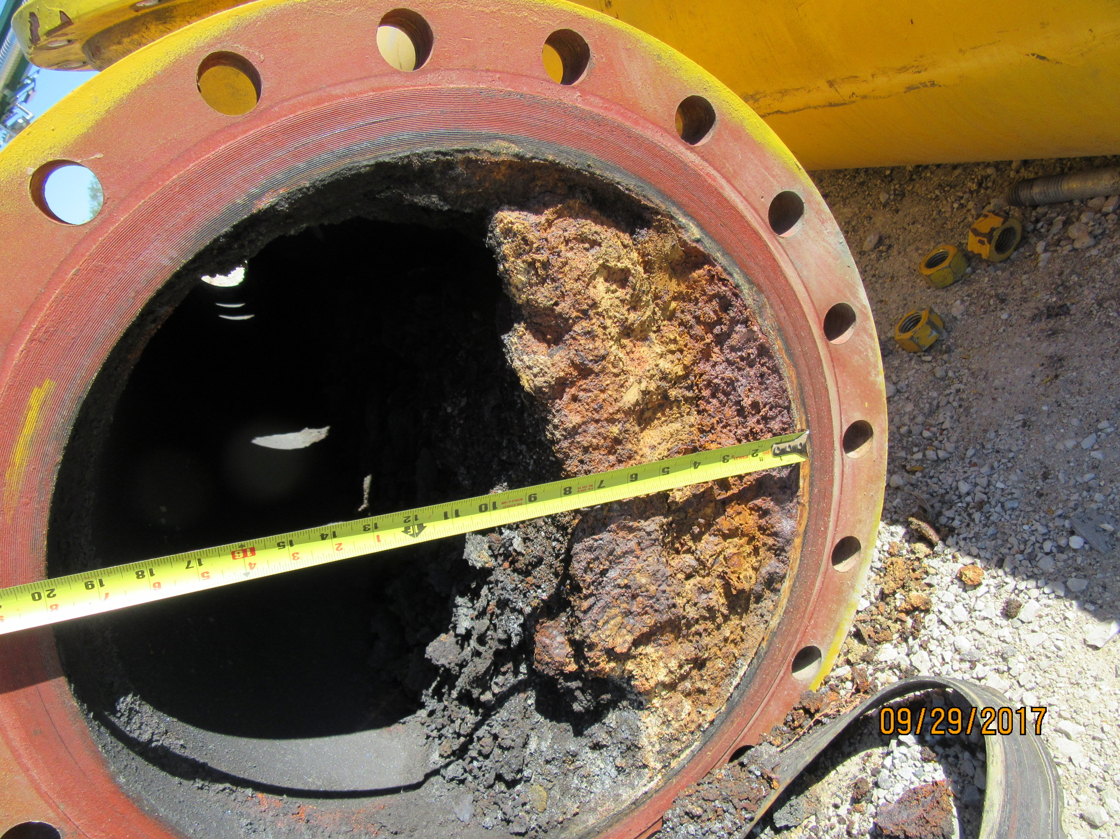
Other Problems
Notes:
Gas piping replacement project. Note also that we will either have to continue to feed Imhoff for the foreseeable future or stop completely, as the bugs within the Imhoff tanks will die if not provided with food. R&D says one month is the most we can go w/o sending sewage to IBAT B&C.

Slide 51
Other Lessons Learned
Provide more flushing valves for lines prone to clogging. Locate valves in accessible areas
Provide more sampling locations for sludge and primary effluent
Coordinate bridge location with scum beach
Increase slope of gravity scum lines
DCS monitoring of current draw for grit screws and tank drives

Slide 52
Conclusion
Coordination and planning required
Make necessary adjustments and gain experience prior to full flow going through the new Project
Allow sufficient time for the other processes at Stickney to adjust, specifically anaerobic digesters

Slide 53
Thank you!
Thanks also to:
Ryan Christopher and the design team at Greeley & Hansen
Beth Zerfas and Greg Florek and their staff in the Construction Division

