Slide 1

WELCOME
TO THE NOVEMBER EDITION
OF THE 2019
M&R SEMINAR SERIES

Slide 2
BEFORE WE BEGIN
SAFETY PRECAUTIONS
  PLEASE FOLLOW EXIT SIGN IN CASE OF EMERGENCY EVACUATION
  AUTOMATED EXTERNAL DEFIBRILLATOR (AED) LOCATED OUTSIDE
PLEASE SILENCE CELL PHONES AND/OR SMART DEVICES
QUESTION AND ANSWER SESSION WILL FOLLOW PRESENTATION
PLEASE FILL EVALUATION FORM
SEMINAR SLIDES WILL BE POSTED ON MWRD WEBSITE (https://mwrd.org/seminars)
STREAM VIDEO WILL BE AVAILABLE ON MWRD WEBSITE (https://mwrd.org/seminars - after authorization for release is arranged)

Slide 3
Fenghua Yang, P.E., BCEE
Fenghua Yang is a Senior Environmental Research Scientist for the Metropolitan Water Reclamation District of Greater Chicago in the Environmental Monitoring and Research Division, leading research scientists and technicians in applied research, including energy efficient wastewater treatment processes, online process control, intelligent water systems, biological nutrient removal, and resource recovery. She is currently involved in the evaluation of new and innovative technologies to improve water and resource recovery.
Prior to this, Ms. Yang was a senior project manager for the Milwaukee Metropolitan Sewerage District, managing and administering design and construction projects for wastewater treatment plant improvements and water course renovation. She has one year of experience working at the Iowa Department of Natural Resources as an environmental engineer/project manager. She has over 10 years of experience in consulting business including MWH (now Stantec), and Lintech Engineering as a process engineer, project manager and lead engineer working on both water and wastewater related projects. She is a licensed professional engineer in the State of Illinois. She holds a Board Certified Environmental Engineer (BCEE) License, specializing in water and wastewater. She received a Bachelor of Science in Environmental Engineering from Hefei University of Technology, China, and a Master of Science in Civil Engineering from the National University of Singapore.

Slide 4
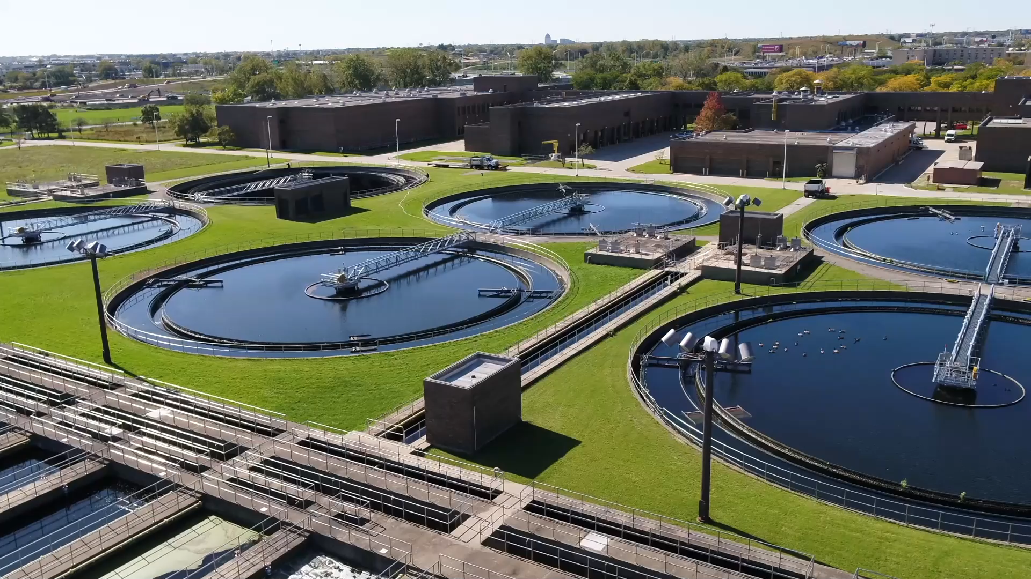
EBPR at the Kirie WRP
Holistic Workplan with Step-By-Step Implementation to Achieve Treatment Goals with Minimum Infrastructure Investment
November 22, 2019

Slide 5
Outline
    Background
    KWRP EBPR Feasibility Analysis
    Pilot Test Implementation and Overall Performance
    Results and Discussion for Targeted Studies
    Summary

Slide 6
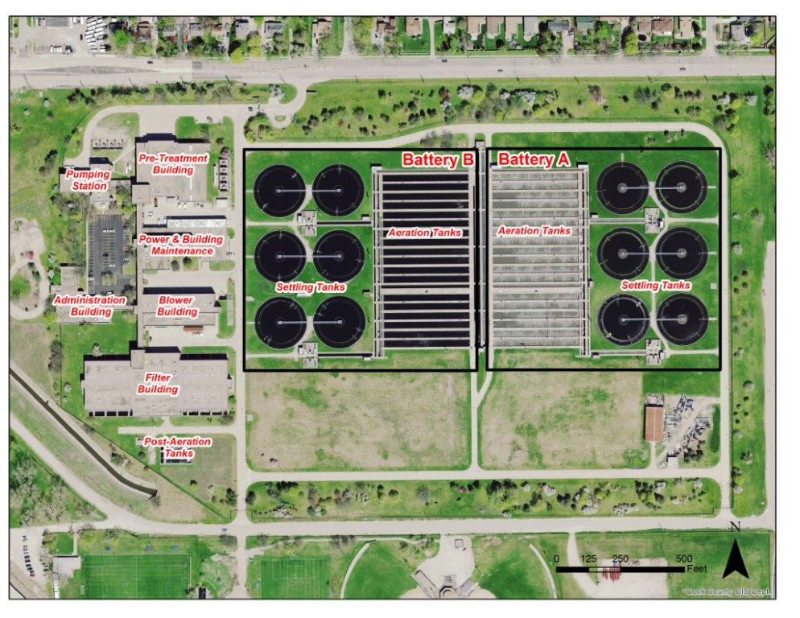
The James C. Kirie Water Reclamation Plant
Only the Battery A operates as secondary treatment
Design Average Flow: 52 mgd
Design Maximum Flow: 110 MGD

Slide 7
Historic Kirie WRP Plant Flow and Hydraulic Retention Time in Aeration Tanks
Kirie WRP flow (MGD)
Year | Min. | Average | Median | Max. | 10% | 90%
2015 | 18 | 34 | 30 | 121 | 21 | 59
2016 | 16 | 34 | 32 | 124 | 23 | 55
2017 | 18 | 38 | 32 | 138 | 21 | 79
2018 | 16 | 43 | 33 | 143 | 23 | 102
Hydraulic Retention Time (HRT) in Battery A Aeration Tanks (hours)
Year | Max. | Average | Median | Min. | 90% | 10%
2015 | 18 | 9.7 | 11.8 | 2.7 | 15.7 | 5.4
2016 | 21 | 9.6 | 11.6 | 2.7 | 14.6 | 5.7
2017 | 18 | 8.6 | 11.6 | 2.4 | 15.5 | 4.0
2018 | 20 | 7.7 | 11.4 | 2.3 | 14.6 | 3.4
Design Average Flow: 52 mgd
Design Maximum Flow: 110 MGD

Slide 8
Kirie WRP Plant Influent Characteristics
Concentration, mg/L
Parameters | Min. | Average | Maximum | StdDev
BOD₅ | 18 | 140 | 794 | 164
SS | 17 | 161 | 1800 | 111
Ammonia-N | 2.1 | 15.3 | 33.1 | 5.6
TKN | 6.0 | 27 | 142 | 12
TP | 0.5 | 3.93 | 27.96 | 2.36
Sol-P | 0.29 | 1.83 | 3.66 | 0.74
BOD₅/TP | 10 | 36.8 | 262 | 15.6

Slide 9
NPDES Permit - Current vs. Future (Draft)
 | Concentration Limits (mg/L)
Parameter | Monthly Average | Weekly Average | Daily Maximum
CBOD₅¹ | 4 |  | 20
Suspended Solids | 5 |  | 24
Ammonia Nitrogen as N
March-May/Sept.-Oct. | 2.1 | 5.3 5.2 | 7.8
June-August | 1.6 | 4.0 | 11.1
Nov.-Feb. | 4.0 | - | 8.4
Total Phosphorus (TP) ² | 1.0
    ¹The limits listed for monthly average CBOD₅ and total suspended solids are for monthly average flows of 52 MGD or less. These limits are 10 mg/L and 12 mg/L respectively for monthly average flows greater than 52 MGD
    ²TP monthly average concentration limit of 1.0 milligram per liter (mg/L) - five years from the effective date of the upcoming NPDES.
    ²TP twelve month rolling geometric mean of 0.5 mg/L - by January 1, 2030, unless the KWRP demonstrates that meeting such limit is not technologically or economically feasible.

Slide 10
KWRP EBPR Implementation Overall Plan and Schedule
BioP Task Force Formed in 2014
  M&R
  M&O
  Engineering
Baseline and feasibility study
(2013/2014)
Develop Pilot test Workplan (2015)
Pilot Test Implementation
(2015 - 2019)
Conceptual Design for Full Plant Implementation
(2018 – 2019)
Final Design and Full Plant Implementation
(2020 – 2023)

Slide 11
Outline
    Background
    KWRP EBPR Feasibility Analysis
    Pilot Test Implementation and Overall Performance
    Results and Discussion for Targeted Studies
    Summary

Slide 12
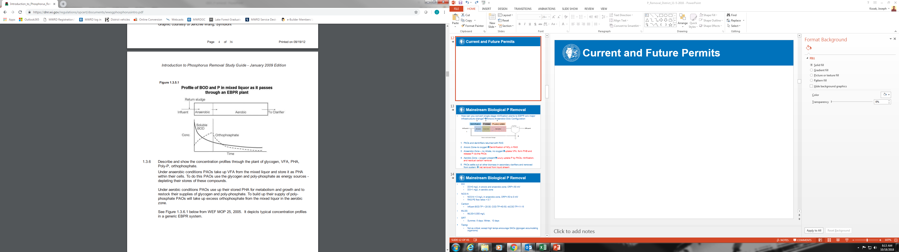
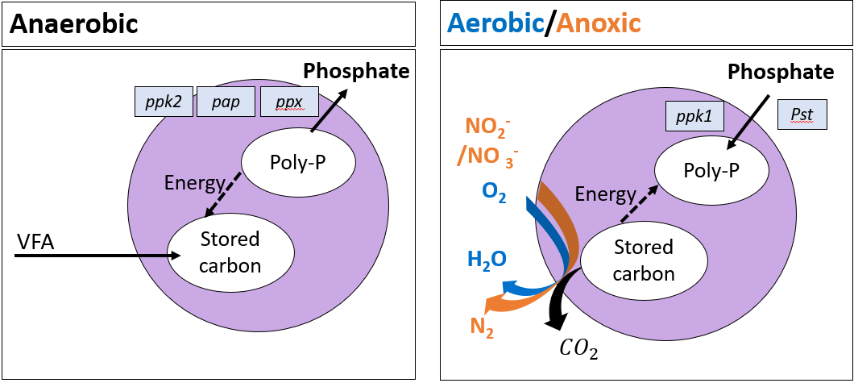
EBPR Fundamentals
Phosphate Accumulating Organisms (PAOs)

Slide 13
KWRP EBPR Feasibility Analysis
    Desktop Evaluation
      Infrastructure evaluation
      Historic data analysis
      Plant nitrification performance
    Influent Characteristic Analysis
      Targeted sampling over one year to catch the seasonal variation (COD, solCOD, rbCOD, VFAs, Ortho-P)
      Sufficient organics, but sometime lack VFA/rbCOD
    Bench Scale Test – ML and RAS Fermentation
      Both RAS and ML fermentation could help to generate VFA/rbCOD
      Concern for future additional P release in the BioP sludge

Slide 14
KWRP EBPR
    Advantages
      Sufficient Influent Carbon – no external carbon need
      No sidestream load – no shock load of ammonia or P
    Challenges
      Lack VFA/rbCOD sometime
      No primary clarifiers
      Large influent flow variation
      Only half of the plant secondary treatment is available – nitrification completed near the end of the aeration tank
      Limitation to increase MLSS due to the RAS channel capacity and risk of solids overload to the secondary clarifiers
      Conveyance and headwork odor control chemicals

Slide 15
KWRP EBPR – Pilot Test
    Isolate two aeration tanks for a pilot study
      Conduct a EBPR pilot study based on Kirie WRP existing infrastructure capability and wastewater characteristics and study key factors for EBPR optimization.
      Information gathered will be used to:
        Evaluate if only Battery A or both Battery A and B are needed to meet the upcoming permit requirement based on the current flow and load.
        Develop Bio-P Removal Strategy and identify key factors for optimal full-scale EBPR implementation.

Slide 16
Outline
    Background
    KWRP EBPR Implementation Evaluation
    Pilot Test Implementation and Overall Performance
    Results and Discussion for Targeted Studies
    Summary

Slide 17
Kirie WRP EBPR Conversion

Slide 18
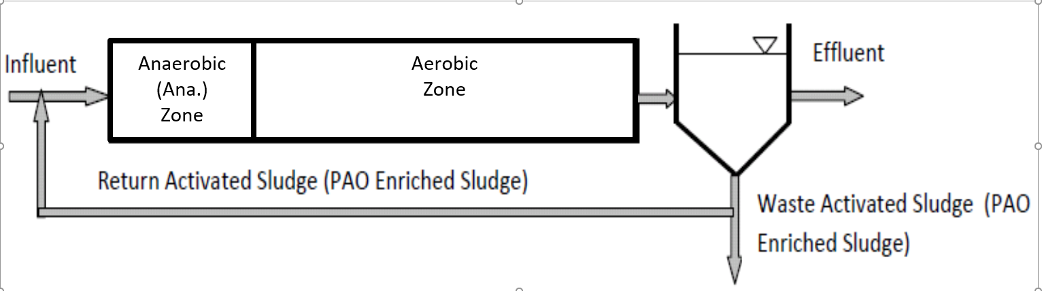
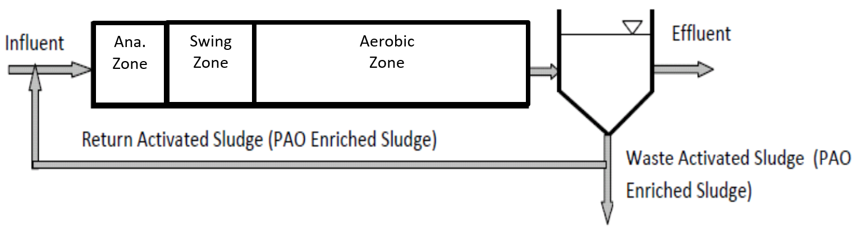
KWRP EBPR Pilot Study
Control tanks 1 through 4 (Typical A/O process)
Pilot Test Tanks 5&6 (A/O process with swing zone)

Slide 19
Monthly Average Outfall Effluent TP Levels

Slide 20
Monthly Average Outfall Effluent Ammonia-N Levels
Two aeration tanks were converted to EBPR in April 2015
Whole plant was converted to EBPR in June 2016

Slide 21
Outline
    Background
    KWRP EBPR Implementation Evaluation
    Pilot Test Implementation and Overall Plant Performance
    Results and Discussion for Targeted Studies
    Summary

Slide 22
Results and Discussion for Targeted Studies
    Continuous Low Air Mixing Versus Intermittent Air Mixing Using Existing Fine-Bubble Diffusers
    Evaluate Baffle Wall Impact on EBPR and Nitrification
    Evaluate Swing-Zone Operation Impact on EBPR and Nitrification
    Large-Bubble Mixer Impact on EBPR
    Seasonal Change and Impact of GAOs on EBPR Performance
    Low DO Operation and Its Impact on EBPR and Nitrification
    EBPR sludge impact to the sludge transmission line and Egan WRP

Slide 23
ORP Profiles During Fine-Bubble Low-Air Mixing Versus Fine Bubble Intermittent Air Mixing
ORP Profiles During Fine-Bubble Low-Air Mixing Versus Fine-Bubble Intermittent Air Mixing
ORP Profiles During Fine-Bubble Low-Air Mixing Versus Fine-Bubble Intermittent Air Mixing
Dotted lines: continuous low air mixing
Solid Lines: intermittent air mixing

Slide 24
Results and Discussion for Targeted Studies
    Continuous Low Air Mixing Versus Intermittent Air Mixing Using Existing Fine-Bubble Diffusers
    Evaluate Baffle Wall Impact on EBPR and Nitrification
    Evaluate Swing-Zone Operation Impact on EBPR and Nitrification
    Large-Bubble Mixer Impact on EBPR
    Seasonal Change and Impact of GAOs on EBPR Performance
    Low DO Operation and Its Impact on EBPR and Nitrification
    EBPR sludge impact to the sludge transmission line and Egan WRP

Slide 25
Why Baffle Walls & Swing Zone Operation?
  Why Baffle Wall?
    Significant back mixing between zones was observed.
      Reduced aeration tank efficiency
      The environment in the back-mixing area may favors the growth of filamentous bacteria.
    Baffle wall provides isolated anaerobic zone and aerobic zone to reduce back mixing and improve aeration tank efficiency.
  Why Swing Zone?
    Kirie influent flow varies greatly.
    Poor ammonia removal and poor P removal were observed at times.
    Swing zone will be operated as aerobic zone for ammonia removal or as anaerobic zone for P removal; it provides flexibility to the plant operation by optimizing aeration tank usage to balance P and ammonia removal needs.
  In 2016, poor pilot tanks effluent monthly average ammonia-N level of 1.52 mg/L triggered baffle wall design
    Two Baffles designed in the first pass of the aeration Tank 6 to have an isolated Fermentation/Anaerobic zone and swing zone.

Slide 26
Comparison of Effluent Ammonia-N Levels Between Aeration Tank 6 (with Baffle Wall) and Aeration Tank 5 (without Baffle Wall)

Slide 27
Comparison of Effluent Ortho-P Levels Between Aeration Tank 6 (with Baffle Wall) and Aeration Tank 5 (without Baffle Wall)

Slide 28
Swing Zone Operation Impact
  Comparison between Tanks 1-4 vs. Tanks 5&6 :
    Tanks 1-4 and Tanks 5&6 have separate sludge systems.
    Tanks 1-4 operated without baffle wall with anaerobic zone through first 4 drops (first 1/3 of Pass 1) and has a open RAS channel for denitrification.
    Tanks 5&6 has no RAS channel, but operated with a swing zone, i.e. first 4 air drops (first 1/3 of Pass 1) for anaerobic/fermentation/ RAS denitrification zone and air drops 5-8 (second 1/3 of Pass 1) for swing zone.
    Tank 6 operated with baffle. Tank 5 operated without baffle wall.

Slide 29
Comparison of Effluent Ortho-P Levels Between Aeration Tanks 1-4 and Tanks 5&6 with Swing-Zone Operation

Slide 30
Comparison of Effluent Ammonia-N Levels Between Aeration Tanks 1-4 and Tanks 5&6 with Swing-Zone Operation

Slide 31
Results and Discussion for Targeted Studies
    Continuous Low Air Mixing Versus Intermittent Air Mixing Using Existing Fine-Bubble Diffusers
    Evaluate Baffle Wall Impact on EBPR and Nitrification
    Evaluate Swing-Zone Operation Impact on EBPR and Nitrification
    Large-Bubble Mixer Impact on EBPR
    Seasonal Change and Impact of GAOs on EBPR Performance
    Low DO Operation and Its Impact on EBPR and Nitrification
    EBPR sludge impact to the sludge transmission line and Egan WRP

Slide 32
Large Bubble Mixers
  Intermittent Mixing Using the Existing Fine Bubble Diffusers
      Able to provide acceptable anaerobic conditions for EBPR.
      Persistent clogging and fouling of the diffuser plates became an increasing maintenance issue. There were several instances in 2016 when air bumping could not be performed due to the clogged diffuser plates.
  Large Bubble Mixer
      Desktop evaluation of mechanical mixers and large bubble mixers was performed. Large bubble mixer was selected because it is simple in maintenance and operation, and it can use the existing high pressure air from in-plant compressor for mixing.
      Large bubble mixing system was installed in the anaerobic/fermentation zone in Tank 5 in April 2017. Then Tank 5 was run side by side with Tank 6, which has the existing fine bubble diffusers for mixing.

Slide 33
Large Bubble Mixer Impacts on BioP Performance

Slide 34
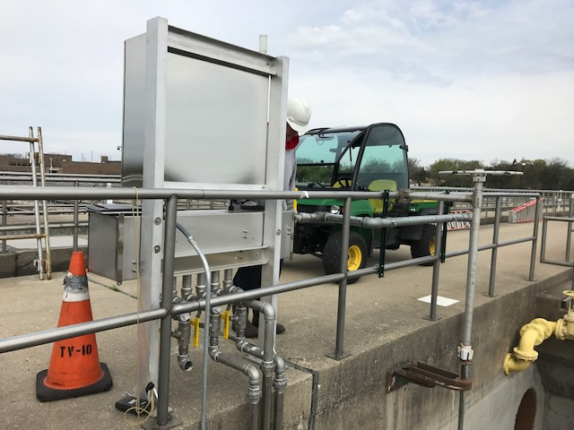
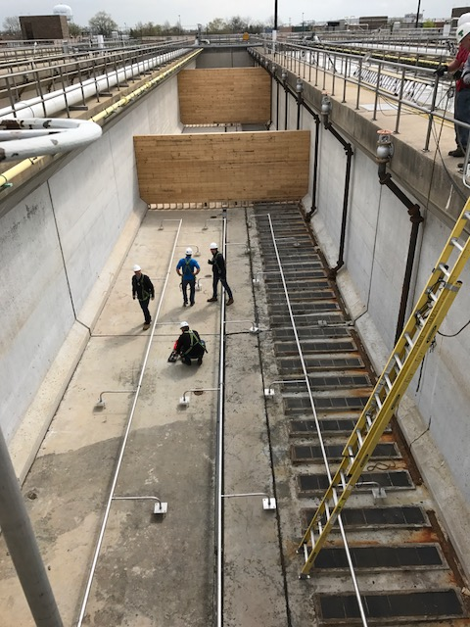
Kirie WRP EBPR Conversion

Slide 35
Results and Discussion for Targeted Studies
    Continuous Low Air Mixing Versus Intermittent Air Mixing Using Existing Fine-Bubble Diffusers
    Evaluate Baffle Wall Impact on EBPR and Nitrification
    Evaluate Swing-Zone Operation Impact on EBPR and Nitrification
    Large-Bubble Mixer Impact on EBPR
    Seasonal Performance Change and Potential Impact of GAOs on EBPR Performance
    Low DO Operation and Its Impact on EBPR and Nitrification
    EBPR sludge impact to the sludge transmission line and Egan WRP

Slide 36
EBPR Seasonal Performance Change and Potential Impact of GAOs on EBPR Performance
  Seasonal change on EBPR performance was observed
    Elevated TP levels in the plant outfall effluent were observed in fall during the study period.
    Elevated effluent Ortho-P levels were observed in late summer/fall during the study period in the two pilot test tanks.
    It is suspected that this phenomenon may be due to the GAOs, which tend to thrive in wastewater with high temp, carbon, and dissolved oxygen.

Slide 37
Glycogen-Accumulating Organism (GAO) Population Versus Effluent Ortho-P Levels from Test Aeration Tanks 5 and 6 in 2017

Slide 38
Results and Discussion for Targeted Studies
    Continuous Low Air Mixing Versus Intermittent Air Mixing Using Existing Fine-Bubble Diffusers
    Evaluate Baffle Wall Impact on EBPR and Nitrification
    Evaluate Swing-Zone Operation Impact on EBPR and Nitrification
    Large-Bubble Mixer Impact on EBPR
    Seasonal Change and Impact of GAOs on EBPR Performance
    Low DO Operation and Its Impact on EBPR and Nitrification
    EBPR sludge impact to the sludge transmission line and Egan WRP

Slide 39
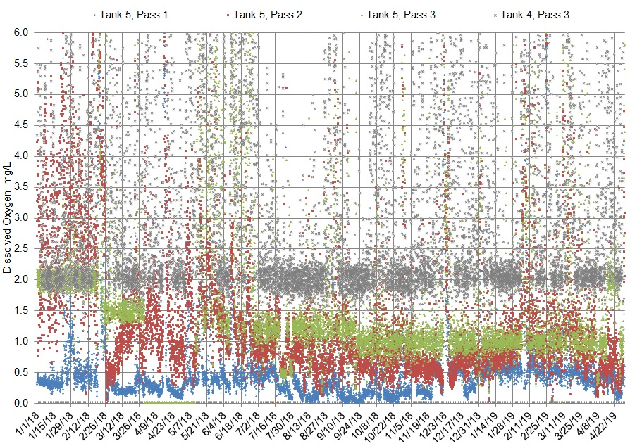
Control and Test Tanks Dissolved Oxygen Levels

Slide 40
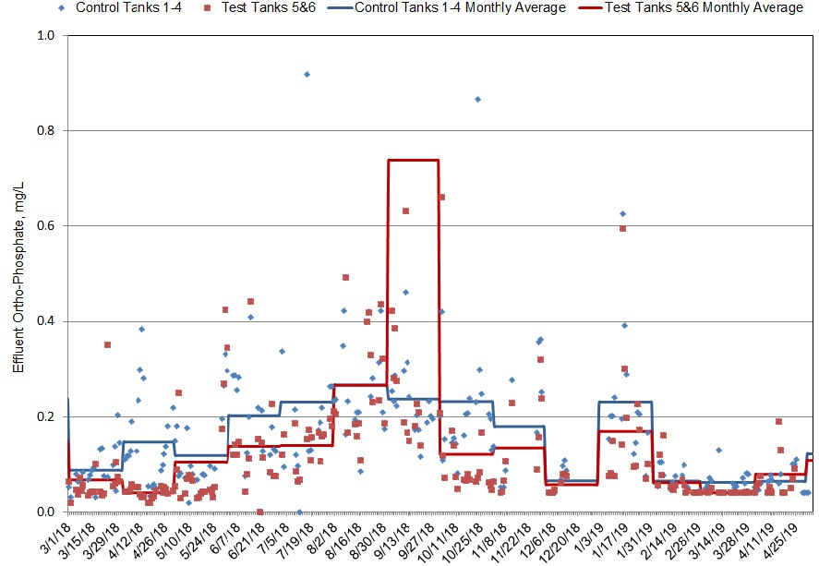
Low DO Operation Impact to EBPR – Comparison Between Test and Control Tanks
Sludge from Tanks 1_4 and 5&6 mixed for plant RAS channel cleaning.

Slide 41
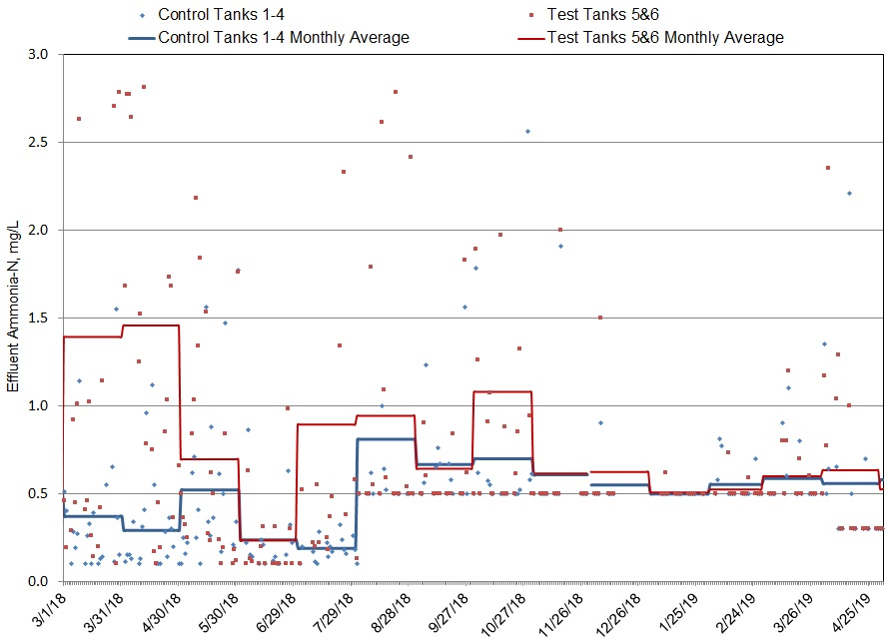
Low DO Operation Impact to Nitrification – Comparison between Test and Control Tanks
DO setpoint
of 1.5 mg/L
DO setpoint
Of 1.25 mg/L
DO setpoint of 1.0 mg/L

Slide 42
Low DO Operation Impact to TN removal - Comparison Between Test and Control Tanks

Slide 43
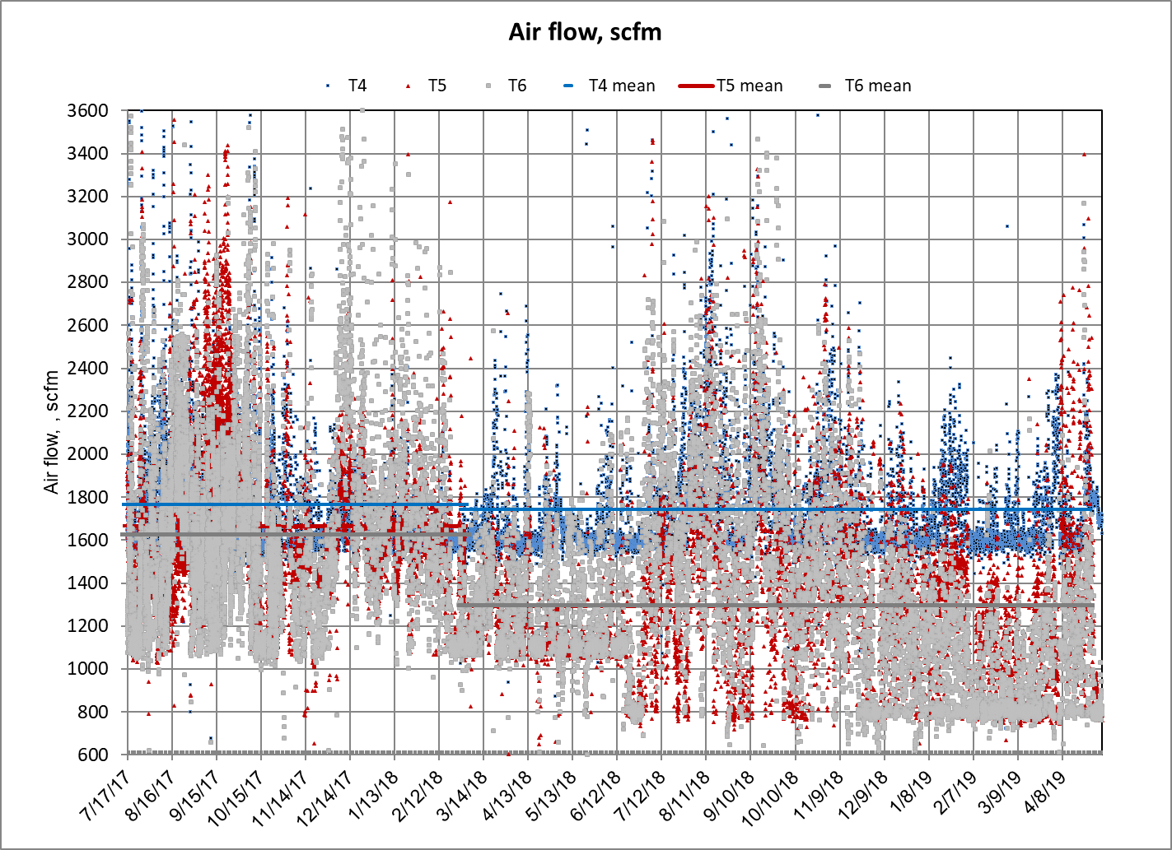
Low DO Operation Air Savings
 | Average Air Flow (scfm)
 | Tank 4 | Tank 5 | Tank 6
Before | 1763 | 1666 | 1625
After | 1742 | 1294 | 1295
 | 1.2% | 22.3% | 20.3%

Slide 44
Glycogen-Accumulating Organism (GAO) Population Versus Effluent Ortho-P Levels from Test Aeration Tanks 5 and 6 in 2018

Slide 45
Low DO Operation Summary
    Low DO operation improved EBPR
    Low DO operation impacted nitrification
      Reduced ammonia removal after reducing DO but seemed to recover after a few months of operation
    Low DO operation achieved nearly 20% air savings
    Improved TN removal through low DO operation

Slide 46
Results and Discussion for Targeted Studies
    Continuous Low Air Mixing Versus Intermittent Air Mixing Using Existing Fine-Bubble Diffusers
    Evaluate Baffle Wall Impact on EBPR and Nitrification
    Evaluate Swing-Zone Operation Impact on EBPR and Nitrification
    Large-Bubble Mixer Impact on EBPR
    Seasonal Change and Impact of GAOs on EBPR Performance
    Low DO Operation and Its Impact on EBPR and Nitrification
    EBPR sludge impact to the sludge transmission line and Egan WRP

Slide 47
    EBPR sludge impact to the sludge transmission line and Egan WRP

Slide 48
    EBPR sludge impact to the sludge transmission line and Egan WRP
    There is no or minimal sludge deposit/scaling in the sludge transmission line
    Significant P release was observed from average of less than 1.0 mg/L at the Kirie WRP to average around 40 mg/L when arriving the Egan WRP
      190 lb/day OrthoP load, equivalent to approx. 30% ortho-P load to Egan WRP Provide opportunity for P recovery - WAS stripping transmission line
      Additional research to evaluate how to increase P release for P recovery

Slide 49
Outline
    Background
    KWRP EBPR Implementation Evaluation
    Pilot Test Implementation and Overall Plant Performance
    Results and Discussion for Targeted Studies
    Summary

Slide 50
Summary
  Intermittent mixing provided better anaerobic condition for P release than continuous low air mixing using fine bubble diffusers
  Fine bubble diffusers were not able to re-suspend the accumulated settled solids while the large bubble mixing system was able to do so.
  Baffle wall and swing zone operation improved plant performance for EBPR and ammonia removal.
  Low DO setpoint of 1.0 mg/L at the end of aeration zone benefited EBPR
  Pilot test tank configuration with large bubble mixers, baffle walls and swing zone operation should be able to meet the upcoming permit limits based on the current flow condition – Recommended for full plant implementation Conceptual Design
  For the sludge transmission, scaling is less likely to happen, but significant Ortho-P released. Recommend further research to evaluate how to increase P release for P recovery

Slide 51
Acknowledgements
WW Process Group Environmental Research Technicians
MWRDGC Analytical Laboratories Division Staff
Kirie WRP Operational Staff
Analytical Microbiology & Biomonitoring Group Staff

Slide 52
Q/A
QUESTIONS?
YangF@mwrd.org

