Slide 1

WELCOME
TO THE DECEMBER EDITION
OF THE 2019
M&R SEMINAR SERIES

Slide 2
BEFORE WE BEGIN
SAFETY PRECAUTIONS
  PLEASE FOLLOW EXIT SIGN IN CASE OF EMERGENCY EVACUATION
  AUTOMATED EXTERNAL DEFIBRILLATOR (AED) LOCATED OUTSIDE
PLEASE SILENCE CELL PHONES AND/OR SMART DEVICES
QUESTION AND ANSWER SESSION WILL FOLLOW PRESENTATION
PLEASE FILL EVALUATION FORM
SEMINAR SLIDES WILL BE POSTED ON MWRD WEBSITE (https://mwrd.org/seminars)
STREAM VIDEO WILL BE AVAILABLE ON MWRD WEBSITE (https://mwrd.org/seminars - after authorization for release is arranged)

Slide 3
George F. Wells, Ph.D.
Dr. Wells is an Assistant Professor in the Department of Civil and Environmental Engineering at Northwestern University, where he directs the Environmental Biotechnology and Microbial Ecology Laboratory. His primary research interests are microbial nitrogen and phosphorus cycling and shortcut biological nutrient removal processes, resource and energy recovery from wastewater, microbial ecology of engineered and impacted natural systems, sustainable biological wastewater treatment, and microbial greenhouse gas production. George collaborates extensively with utilities and practitioners to develop and test feasibility of sustainable biological wastewater treatment processes, with a strong focus on energy efficient shortcut nitrogen removal and phosphorus removal and recovery bioprocesses.
Prior to joining Northwestern University, George spent nearly 2.5 years as a postdoctoral scholar under Dr. Eberhard Morgenroth at the Swiss Federal Institute of Aquatic Science and Technology (near Zürich, Switzerland).
George received his B.S. in Chemical Engineering and B.A. in Environmental Engineering from Rice University, Houston, Texas, and MS and PhD from Department of Civil and Environmental Engineering at Stanford University, under Dr. Craig Criddle and Dr. Chris Francis.

Slide 4
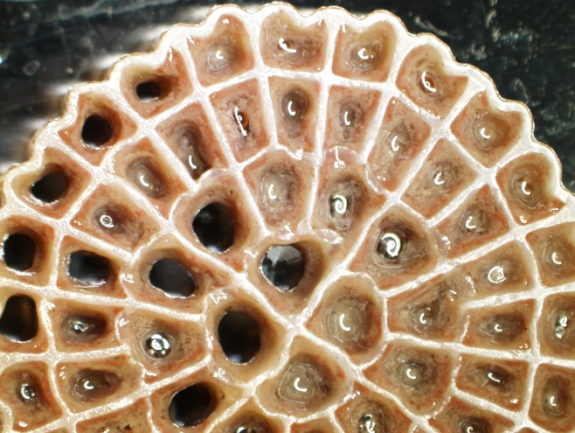
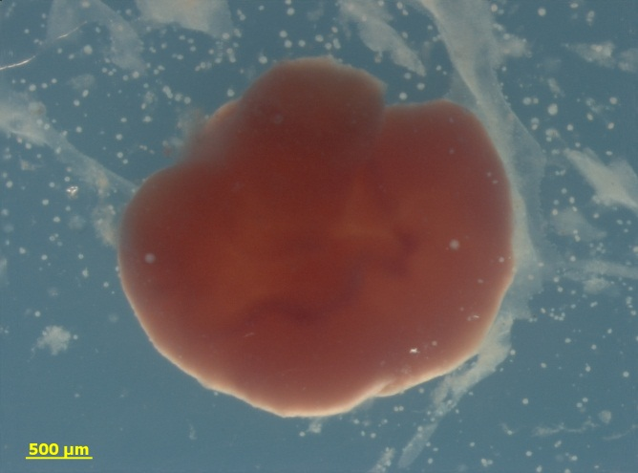
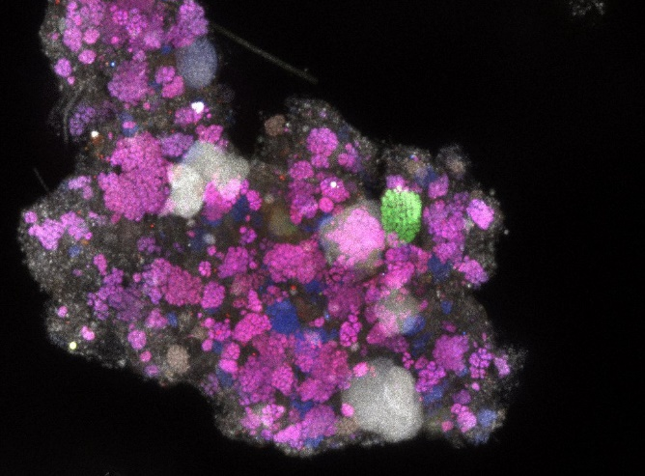
Towards Integrated Mainstream Shortcut Nitrogen and Biological Phosphorus Removal
George Wells
Department of Civil & Environmental Engineering
Northwestern University
Notes:
For Energy and Resource Efficient Nutrient Management
Could cut slides: 6, 7, 8, 15, 17, 41, 43
Could cut 3, 4, 10 and 11

Slide 5
The Wells Research Group at Northwestern
Sustainable Environmental
and Public Health Protection and Resource Recovery from Urban “Waste” Streams
Specific Focus: Microbial Nitrogen and Phosphorus Cycling and Nutrient Pollution Management
Website: wells.northwestern.edu

Slide 6
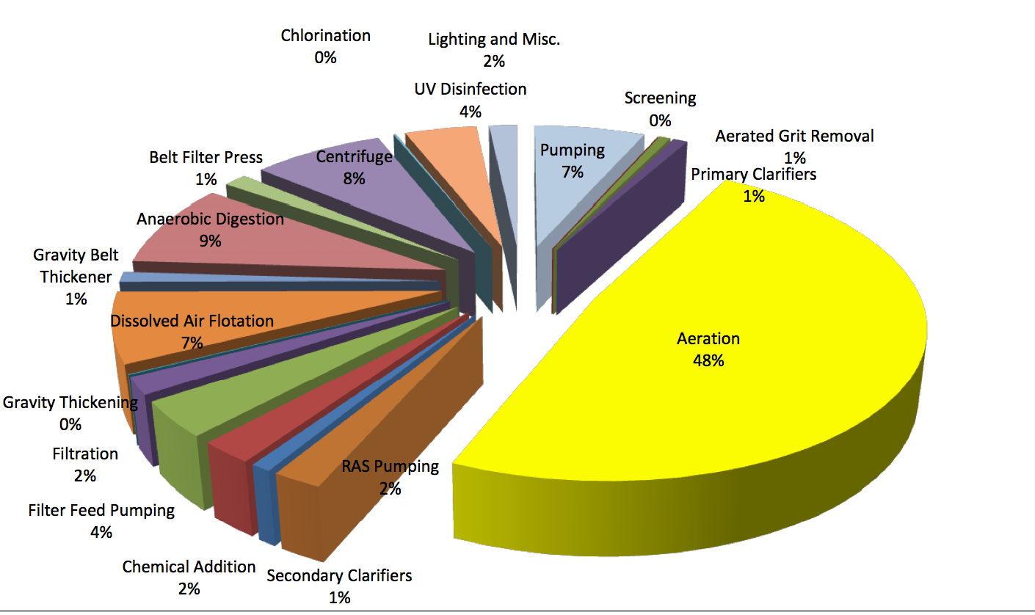
Conventional nitrogen (N) and phosphorus (P) removal bioprocesses at wastewater treatment plants are largely successful, but also highly energy intensive
Wastewater treatment accounts for ~3% of nationwide electricity use (~15 GW)¹
~50% of energy use for oxygen supply (aeration)
Source: Stinson et al. (2013); WEF (2009)
Conversely, organic-rich municipal, industrial, and agricultural wastewater contains potential energy equivalent to ~17 GW of power²
McCarty et al. 2011. Environ. Sci. Technol. 2011, 45, 7100–7106.
Logan et al. 2012. Science 2012, 337, 686-690.
Notes:
I’m particularly interested reducing energy and resource use in nutrient removal because, while…
Dominant point source of N pollution is industrial and municipal wastewater. So where does energy come in? Energy comes in because conventional WWT processes are highly energy intensive…
Aeration is dominant energy consumer, so anything we can do to reduce the need for O2 supply will pay huge dividends in terms of energy savings.
In addition, wastewater is actually a substantial reservoir of potential energy, particularly in the organic C fraction….
This realization and concerns about energy use are leading to a dramatic paradigm shift in the way we view waste as an industry
Typical Energy Usage at a 400 MLD (105 mgd) Nitrifying Activated Sludge Facility: “Energy Conservation in Wastewater Treatment Facilities” – Manual of Practice – No. 32, Water Environment Federation, 2009.
Treatment of organic-rich wastewater currently consumes about 15 GW, or about 3% of all electrical power produced in the United States (1), but domestic, industrial, and animal wastewater together contain ~1.5 × 1011 kilowatt-hour (kWh) of potential energy (~17 GW of power) (2)

Slide 7
A Paradigm Shift Towards Resource Recovery
Current
Wastewater
BOD
Nutrients (N, P)
Centralized WWTP
Disposal to receiving water body
“Misplaced Resources”
Energy, Money, Chemicals (e.g. to drive P or N removal)
Future
Energy Positive Wastewater Treatment by rerouting “misplaced resources” and closing the engineered water cycle
“Used” water
BOD
Nutrients (N, P)
“Biorefinery”
Clean Water for Reuse
Energy, Nutrients, Materials, Platform Chemicals
Notes:
This energy potential inherent in WW is key to the ongoing paradigm shift in our field towards Resource

Slide 8
A Paradigm Shift Towards Resource Recovery
Current
Wastewater
BOD
Nutrients (N, P)
Centralized WWTP
Disposal to receiving water body
“Misplaced Resources”
(Rittmann 2013)
Energy, Money, Chemicals (e.g. to drive P or N removal)
Future
Energy Positive Wastewater Treatment by rerouting “misplaced resources” and closing the engineered water cycle
Given that conventional nutrient removal processes are highly energy intensive, it is unlikely that energy positive wastewater treatment targeting resource recovery can be achieved without new innovations in N and P removal bioprocesses
“Used” water
BOD
Nutrients (N, P)
“Biorefinery”
Clean Water for Reuse
Energy, Nutrients, Materials, Platform Chemicals
Notes:
COULD CUT

Slide 9
Shortcut N Removal Processes: A Critical Opportunity for Sustainable Wastewater Treatment
Conventional Biological N Removal: Nitrification/ Denitrification
N₂ (g)
Denitrification
(Anoxic)
High O₂ (Energy) Requirements
5e-
High organic carbon requirements
0.5O₂
1.5O₂
NH₃ NO₂⁻ NO₃⁻
AOB
NOB
Nitrification (aerobic)
AOB: Ammonia-Oxidizing Bacteria
NOB: Nitrite-Oxidizing Bacteria
Conventional N removal bioprocesses are highly energy intensive due to the need for high dissolved oxygen concentrations (>3 mg/L), and required high levels of organic carbon
Notes:
Doesn’t include 4e- for biomass (denitrification)

Slide 10
Shortcut N Removal Processes: A Critical Opportunity for Sustainable Wastewater Treatment
Shortcut 1: Nitritation-Denitritation (Also called Nitrite Shunt)
N₂ (g)
Denitritation (anoxic)
Denitrification
(Anoxic)
3e-
5e-
0.5O₂
1.5O₂
NH₃ NO₂⁻ NO₃⁻
AOB & AOA
NOB
Nitritation (aerobic)
25% reduction in O₂ demand
40% reduction in carbon demand (potentially redirected to bio P)
Notes:
Note reduction in oxygen requirements AND in organic C requirements

Slide 11
Shortcut N Removal Processes: A Critical Opportunity for Sustainable Wastewater Treatment
Shortcut 2: Deammonification
(or Partial Nitritation/Anammox [PNA])
Deammonification processes decrease O₂ requirement for N removal by ~60%
N₂ (g)
Denitrification
(Anoxic)
Anammox
5e-
0.5O₂
0.75O₂
NH₃ NO₂⁻ NO₃⁻
AOB & AOA
NOB
Nitritation (aerobic)
Deammonification processes decouple C and N removal, thereby thereby enabling efficient use of C for bioP removal or enhanced energy recovery
Notes:
This is a bit simplified stoichiometry, but it makes clear that we can save quite a bit of O2 AND eliminate quite a bit of organic C by using shortcut N removal.

Slide 12
Initial Development of Shortcut N Removal Processes has focused on sidestream treatment of anaerobic digester supernatant
Sidestreams are characterized by:
High temperature (~30ºC)
High NH₄⁺
(~500-1000 mgN/L)
Digester supernatant (can be ~20% of N load to secondary treatment)
Notes:
Cut “COD”

Slide 13
Key Research Question: How can we apply shortcut N removal bioprocesses in the mainstream?
The mainstream is characterized by:
Low temperatures
(~10-20ºC)
Low NH₄⁺
(~20-30 mgN/L)
Dynamic process conditions
Source: Gao, Scherson, & Wells (2014) ES:P&I. 16: 1223-1246
Notes:
CUT “high COD:N”

Slide 14
Critical Challenges to
Mainstream Shortcut N Removal
Robust and stable suppression of NOB
Maintenance of high levels of slow growing anammox biomass and activity
Robust process performance and stability under dynamic conditions expected in the mainstream
Integrated shortcut N and biological P removal
Notes:
What are these critical challenges?

Slide 15
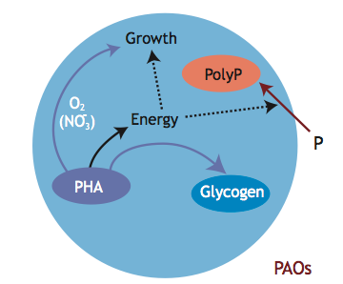
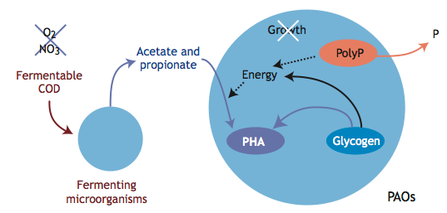
Polyphosphate Accumulating Organisms (PAOs)
PAOs are a critical microbial functional guild in processes that facilitate Enhanced Biological Phosphorus Removal processes (BioP or EBPR). Most PAOs are thought to affiliate with as-yet-uncultivated Candidatus ‘Accumulibacter phosphatis’.
Anaerobic Conditions:
P Release from Polyphosphate
Aerobic (or denitrifying?) Conditions:
P Uptake for Polyphosphate Synthesis
(NO₃⁻)
(NO₂⁻)
Source: Wentzel et al. (2008) “Phosphorus Removal” in Henze, van Loosdrecht, Ekama, and Brdjanovic, Ed. Biological Wastewater Treatment: Principles, Modeling, and Design. IWA Publishing: London, UK
Notes:
To understand why we think bioP is complementary to CANDO, I need to spend a minute or two talking about the underlying microbiology. This quite complex, but also fascinating. I don’t have time to go into too much detail about the fundamental underpinnings, but the basis idea is that a Biological P removal selects for a group of microbes called Polyphosphate Accumulating Organisms, or PAOs. Selection for PAOs requires cyclic redox conditions. PAOs release PO43- under anaerobic conditions, and take it up under aerobic (and sometimes anoxic) conditions. Most PAOs are thought to affiliate with a monophyletic clade in the Betaproteobacterial class termed “candidatus Accumulibacter phosphatis”. At least some PAO clades are capable of denitrification from NO3- or NO2-, but the extent of this metabolic versatility across PAOs is unclear, as are appropriate conditions for denitrifying P removal processes. So the basic take away is the bio-P removal (and subsequent recovery) relies on dynamic switching between anaerobic and aerobic (or possibly anoxic) conditions
DPAOS: offer a critical opportunity to couple Carbon efficient N removal to P accumulation and recovery. WHY: decrease aeration (O2 requirements). Alos, very importantly, DPAOs use the same C pool for both N and P removal, meaning they save quite a bit of C. This is useful in C limited systems (quite common), and can also be used to route excess C to recovery as CH4 or other value added products
Key: at least some PAOs are capable of P uptake under anoxic conditions in the presence of NO2- or NO3-. It’s not entirely clear which PAO clades are capable of this, but previous work in other groups has suggested that, at least under some operational regimes, DPAOs may be capable of very high levels of N2O production.
ppk1 phylogeny revealed two major clades (I and II), which are further subdivided into types IA-IE and IIA-II. First genome in 2006 (Garcia Martin et al.) was UW-1 (IIA); second was Flowers et al. 2013 (UW-2, IA); next 8 were from Skennerton et al. (SK- and BA- strains in table I below; Subdivisions IA,IB, IC, IIC, and IIF). Tong’s group published latest genome HKU-1 (IB). Remaining clades without genomes are ID, IE, IIB, IID, IIE. Phylogeny has been linked to phenotypic differences, such as denitrification and C utilization
Skennerton et al. 2015: UW-2 and UW-1 (IA and IIA) previously were shown to use and not use nitrate (Flower’s et al. 2009), but a complete denitrificion pathway was found in both subdivisions.

Slide 16
Enhanced Biological Phosphorus Removal (EBPR)
He, S. & McMahon, K. D. Microbial Biotechnology. 4.5 (2011): 603-619

Slide 17
Conventional Routes for Integrated BioP and N removal
PAOs selection (VFA uptake)
Denitrification
P uptake by PAOs
Nitrification
A²O Process:
Anaerobic
Anoxic
Aerobic
O₂
NO₃⁻
Settled biomass recycle
Conventional BioP and N removal processes are energy intensive due to the need to provide O₂ for both nitrifiers and PAOs
In addition, they are often carbon limited because bCOD is needed to drive both PAO and denitrifier activity. Carbon limitations can lead to poor bioP performance.
→These deficiencies can potentially be addressed by integrating carbon and energy efficient shortcut N removal with bio-P
Notes:
[ADD:
Anaerobic: PAO selection/ P release; VFA uptake
Anoxic: Denitrification, additional COD needed
Aerobic: O2 for NH4→ NO3-
O2 for P uptake
-inefficient because massive O2 requirement for full nitrification and O2 to drive P uptake; and massive carbon requirements due to need for rbCOD for both PAOs and denitrifiers
Carbon needs for bioP: see Grady textbook page 485 and 511. ~7-10 mg acetic acid needed to remove 1 mg P. BOD5/P needs and COD/P needs depend on process configuration. See table 12.4. For high efficiency A/O, need 15-20 mg BOD5/ mgP (~26-34 mg COD/P)

Slide 18
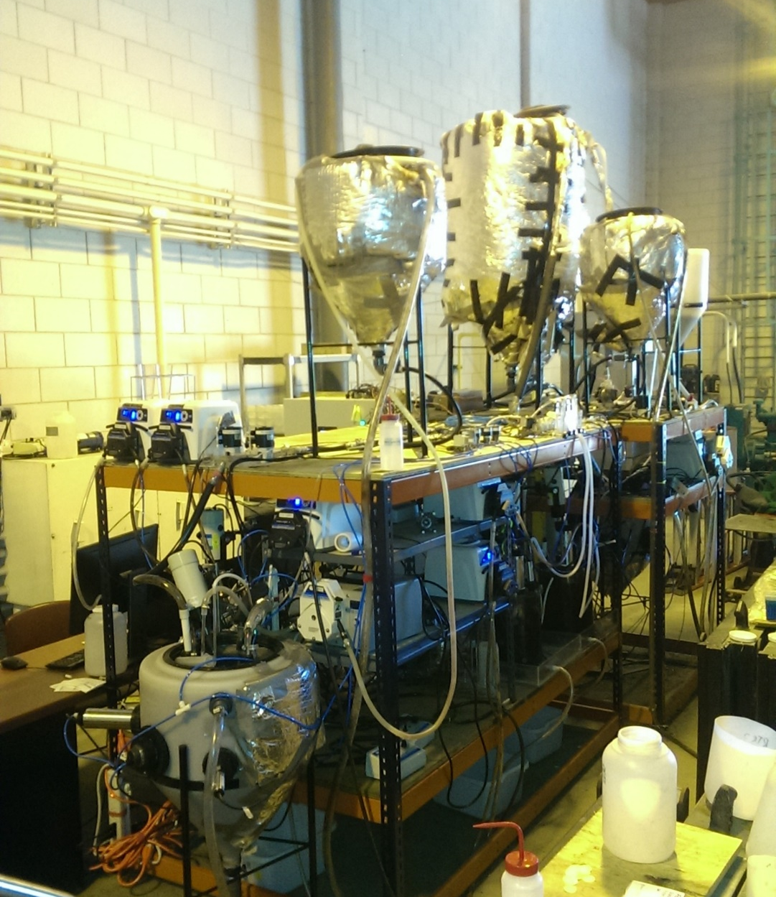

Shortcut Biological N and BioP Removal Research Station
O’Brien Water Reclamation Plant (Chicago, IL, USA)
Reactor operation on multiple parallel treatment trains began in Spring 2016
Uninterrupted Access to Primary Effluent
  Broad Objective: Evaluate strategies for mainstream shortcut N removal coupled to biological P removal
Notes:
Emphasize carbon and N efficiency!

Slide 19
Advantages of Shortcut N Removal Bioprocessesª
Project Objective: Strategy evaluation at the bench-scale of shortcut N removal process alternatives to facilitate energy and organic carbon savings in support of the MWRDGC’s energy neutrality and robust bioP removal goals
 | Nitrification/ Denitrification | Nitritation/ Denitritation | Deammonification
O₂ (mole) | 1.8 | 1.3 | 0.7
Reducing Equivalents from Organics (e⁻) | 9 | 5.5 | 1
Biomass Produced (g VSS)^{b} | 28 | 18 | 7
ªPer mol ammonia. Calculations based on reported biomass yield and typical SRT for each unit operation (Rittmann & McCarty, 2001). ^{b}Value includes biomass produced from ammonia oxidation and NO_{x} reduction
Source: Gao, Scherson & Wells (2014) Environ. Sci: Processes Impacts 16:1223-1246
Notes:
Note reducing equivalents includes organics incorporated into biomass and used for denitrification. (numbers are roughly equivalent to Stinson et al. numbers)
Key benefits: energy savings (O2)→ potentially 12-15% of total plant energy use
12-15% of the District WRP electricity may be possible (75-100 million kwh per year electricity reduction)
Carbon redirection
Table includes biomass production, which is why numbers are slightly different than previous slides
-decrease in O2 requirements with associated dramatic energy savings (about 60% for deammonification)
-and because this is a completely autotrophic process, we again preclude a denitrification step, so we nearly completely alleviate any external organic carbon requirements, opening the possibility of dramatic increases in methane production for energy capture; (about 90% reduction in organic C requirement)
-because anammox are extremely slow growers, we see an enormous decrease in waste sludge production; waste sludge disposal is a significant fraction of the operating budget of an wastewater treatment plant, so this thus leads to significant cost savings (~75% reduction in biomass production)
Organic C savings to energy if all is routed to digester: 128,403 kWh/day of potentially recoverable electricity at Stickney. That's equivalent to the electricity usage of approximately 5000 Illinois homes or approximately 11% of Chicago's municipal electricity usage in 2010.
Approach: COD equivalent of the CO2 lost during denitrification, and use that quantity to estimate how much electricity could be generated if it was 100% re-routed to the anaerobic digesters. So, let me summarize the calculations:
I compared nitrification/denitrification with nitritation/anammox on a per unit of ammonia removed (this is favorable to anammox because we consider the NO3- residual as part of the removal and assume that all nitrogen at Stickney undergoes denitrification...on second thought, that part may not be defensible).
I calculated that 0.84 moles-C are mineralized and lost per mole of ammonia removed in nit/denit, and I neglect the small net CO2 assimilation in nitrit/anammox.
0.84 moles-C corresponds to 4.2 e- equivalents of municipal wastewater in Rittmann&McCarty. That works out to 2.4g COD lost/g NH4+ removed.
I multiply 2.4 by an fe value of 0.9, then by 0.25 gCH4/gCOD, then by 0.0155 kWh/gCH4, then by 40% electricity recovery (thats from Sherson 2014).
That comes to 3350 kWh/metric ton NH4-N removed.
I took Stickneys average 2013 flowrate of 676MGD and multiplied it by 3.78L/gal, and then by an estimated 15 mg NH4-N/L. That comes to 38.3 metric tons of nitrogen per day flowing through the plant.
3350 x 38.3 gives me 128,403 kWh/day.

Slide 20
Shortcut Biological N and BioP Removal Research Station
O’Brien Water Reclamation Plant (Chicago, IL, USA)
Reactor operation on multiple parallel treatment trains began in Spring 2016
Uninterrupted Access to Primary Effluent
  Broad Objective: Evaluate strategies for mainstream shortcut N removal coupled to biological P removal
Integrated Nitritation/ Denitritation with BioP
High rate BioP followed by Mainstream Deammonification
  2a. IFAS (Biofilm + Suspended Growth)
  2b. Suspended Growth
Notes:
Based on a comprehensive literature review, we’ve targeted bench-scale feasibility testing and optimization of two process options that offer the greatest opportunities for energy and organic carbon savings:

Slide 21
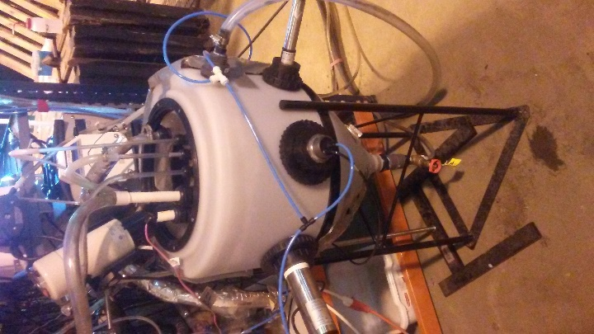
Strategy 1: Integrated Nitritation/Denitritation + BioP
Single sludge process for energy and COD efficient N and P removal
Well-suited for modification of existing MWRD infrastructure (e.g. Kirie WRP)
56 L SBR
Anaerobic Zone
(P release, VFA uptake)
Aerated Zone
(Intermittent aeration for nitritation/ denitritation and P uptake)
RAS
WAS
Simple kinetic strategy for NOB outcompetition:
Intermittent aeration
Robust “nitrite sink” (denitrifiers)
Tight SRT control for NOB washout
Operated with primary effluent as feed for >500 days
Notes:
Energy & COD savings over conventional processes and combined N & P removal
Potential direct application in existing infrastructure, i.e. Kirie WRP
Important but untested adaptation of NiDeMA to include:
Full-scale: envisioned as contiguous plug-flow reactor zoned into anaerobic, anoxic/ aerobic. A final short reaeration zone or IFAS anammox could be included for ammonia polishing may also be needed.
1)P removal
2)Fully manage C in a single-stage, rather than upstream A-stage
3) Anammox polishing in presence of heterotroph dominated suspended growth, rather than separate “C-stage”
Original NiDeMA process (only demonstrated at pilot scale at HRSD by Pusker Regmi and Charles Bott) had A-stage HRAS, no P removal, and separate MBBR anammox polishing
Advantage: shortcut N removal, relatively straightforward modification of existing MWRD infrastructure (e.g. PFR reactor), 1 sludge
Disadvantage: Nitritation-Denitritation still uses far more O2 and COD than deammonification for N management. Also, COD is not decoupled completely from N removal, and is not captured for resource recovery

Slide 22
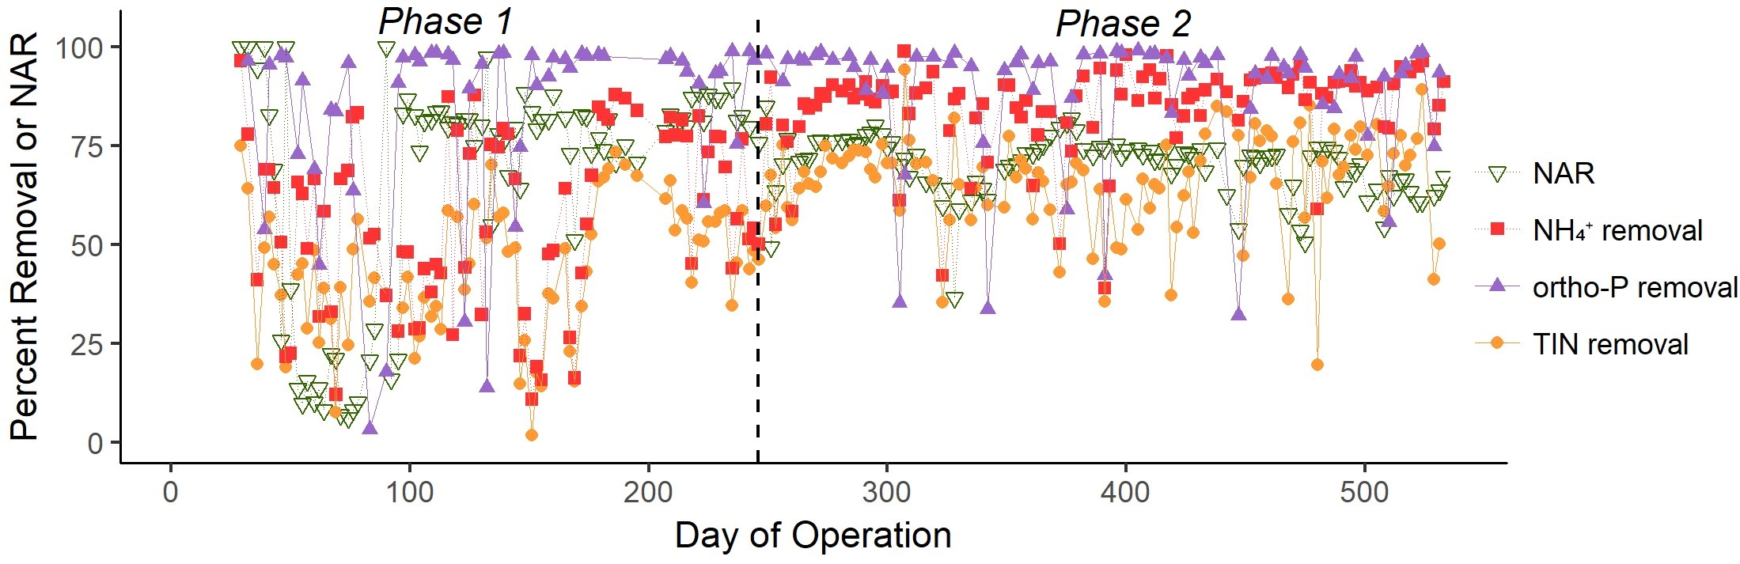
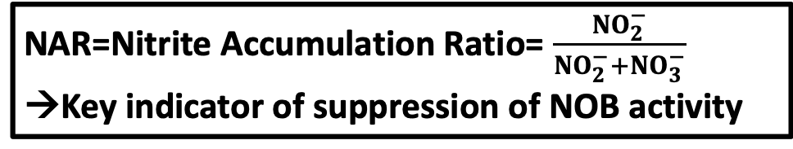
Robust High Rate N, C, and P Removal
Roots et al. 2019 ES:WR&T (In Press)
Phase 2:
Total Inorganic Nitrogen (TIN) removal = 68%
NH₄⁺ removal = 87%
Ortho-P removal = 91%
NAR= 70%
NAR=Nitrite Accumulation Ratio= $\frac{NO_{2}^{−}}{NO_{2}^{−}+NO_{3}^{−}}$
→Key indicator of suppression of NOB activity
Notes:
SKIP Operation; key points:
X-axis, y-axis
NAR = NO2−−N/(NO2−−N + NO3−−N) × 100%
-Phase 1: startup and optimization
-Phase 2: Robust High Rate
DO setpoint: 1 mg/L
SRT: ~9 days (see paper)

Slide 23
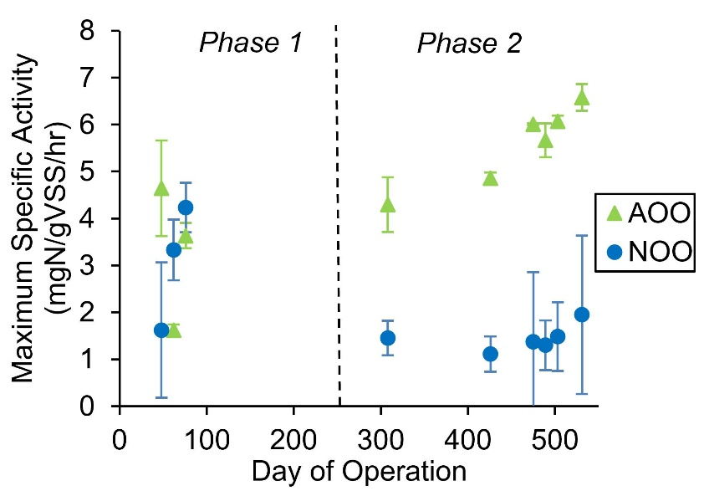
Maximum Activity Assays Confirm NOB Suppression
AOB and NOB Maximum Activity Assays
AOB
NOB
Roots et al. 2019 ES:WR&T (In Press)
Notes:
[Max Activity

Slide 24
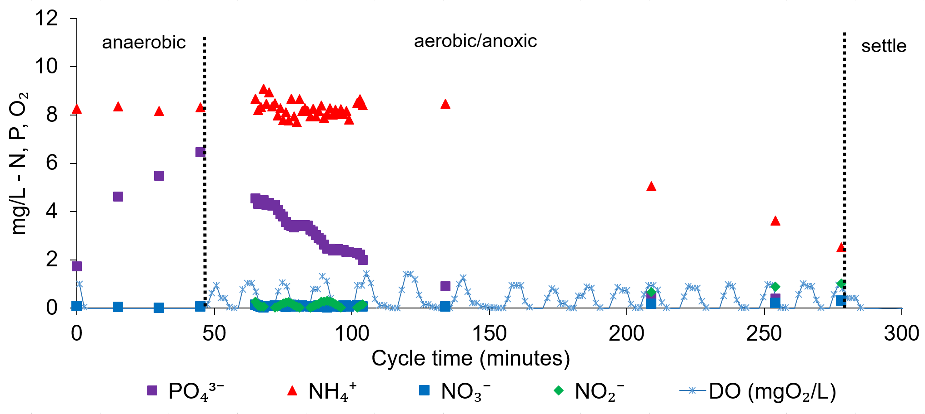
NOB Suppression is Also Apparent in Within-Cycle Profiling
Nitritation/Denitritation + BioP SBR with intermittent aeration
Roots et al. 2019 ES:WR&T (In Press)
Notes:
COULD CUT
Within cycle test on 2/28/18

Slide 25
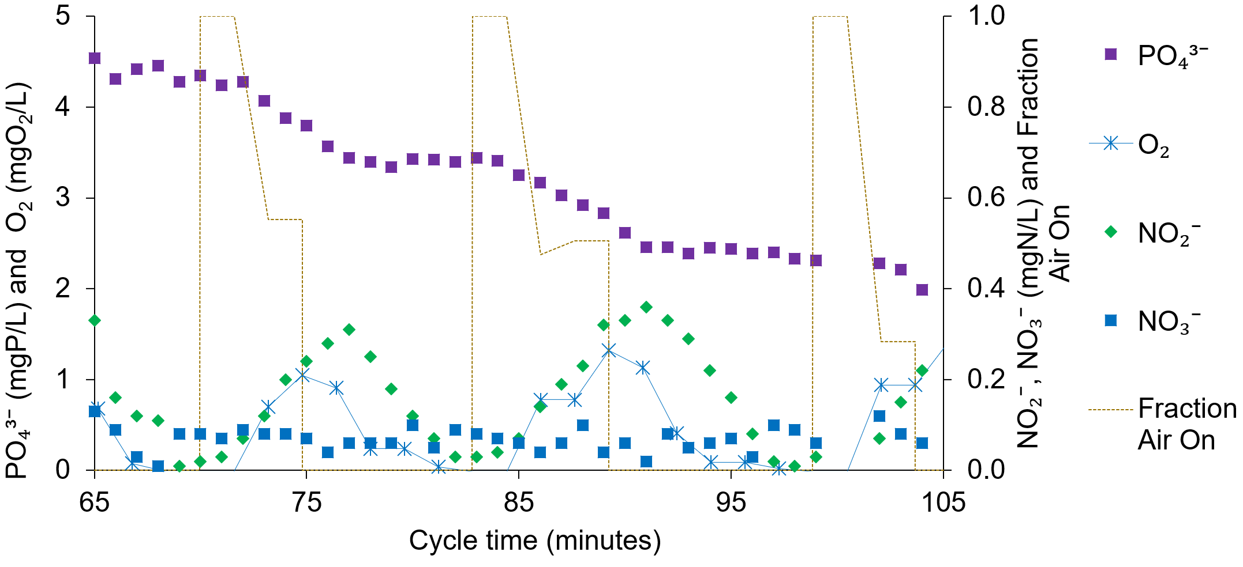
NOB Suppression is Also Apparent in Within-Cycle Profiling
Nitritation/Denitritation + BioP SBR: Within Cycle Test Feb. 28, 2018
Nitrite, but not nitrate, accumulates during aerated periods, and is consumed during anoxic periods
Roots et al. 2019 ES:WR&T (In Press)
Notes:
No negative impact on P removal of intermittent aeration
MODIFY TO GIVE BROADER TAKEAWAY: Nitritation-denitritation with integrated bioP is possible under dilute low temperature conditions, with only simple substrate limitations and SRT control needed for NOB suppression– then go into P uptake
NAR 85-95% during these two aeration cycles

Slide 26
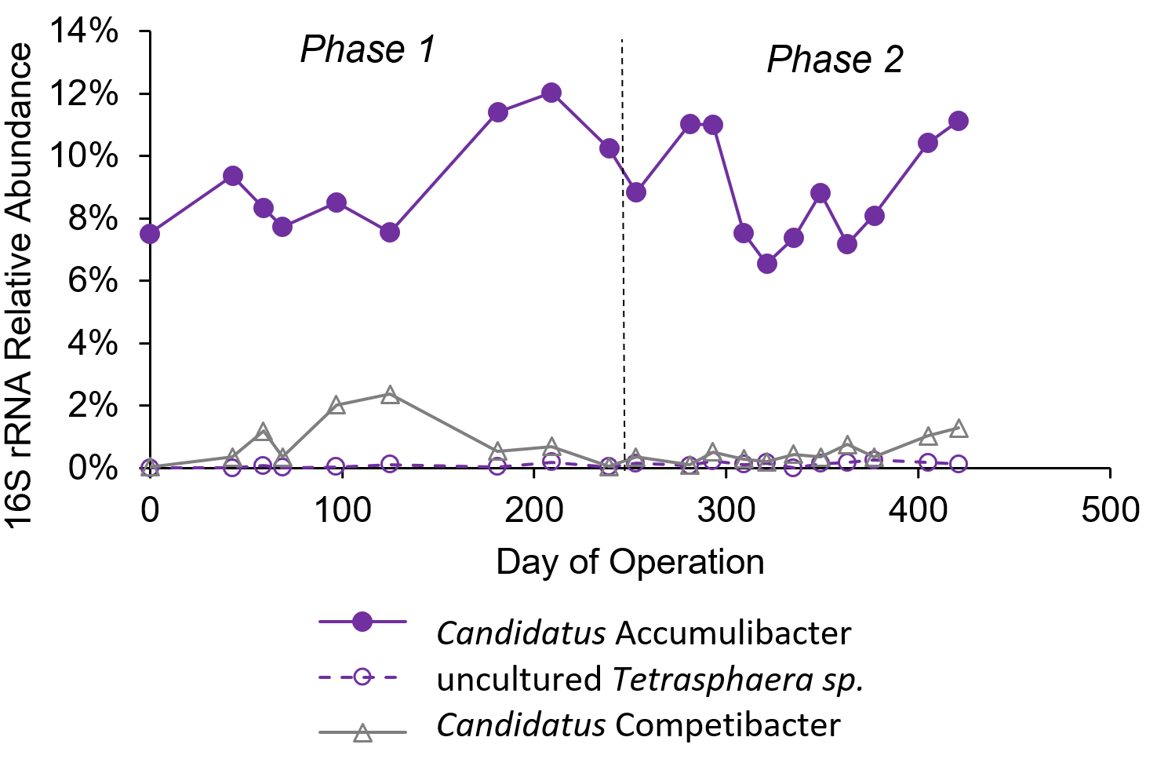
Intermittent aeration for NOB suppression is compatible with selection for a robust Accumulibacter PAO population for biological P removal
Notes:
Relative Accumulibacter, Tetrasphaera, and Competibacter abundance through the first 421 days of reactor operation according to 16S rRNA gene sequencing. Day “0” represents the inoculum, which was sampled before reactor operation began.
Databased on 16S rRNA gene amplicon sequencing

Slide 27
Strategy 1: Integrated Nitritation/Denitritation + BioP
Lessons Learned:
Carbon and energy efficient nitritation/denitritation with biological P removal is feasible and robust under dynamic mainstream process conditions→ well suited to scale up in existing infrastructure
A simple kinetic strategy based on minimizing substrate availability enables effective NOB suppression without negatively impacting PAO activity
Notes:
CUT: Future work is warranted to increase DPAO activity in order to maximize efficiency of carbon utilization
MODIFY TO GIVE BROADER TAKEAWAY: Nitritation-denitritation with integrated bioP is possible under dilute low temperature conditions, with only simple substrate limitations and SRT control needed for NOB suppression– then go into P uptake
NAR 85-95% during these two aeration cycles

Slide 28
Strategy 2: High Rate BioP followed by Deammonification
AB process:
A-Stage: High-Rate Activated Sludge and biological P removal (HRAS-P)
B-Stage: Deammonification
HRAS-P (A stage)
Deammonification (B stage)
Anaerobic Zone
(P release, VFA uptake)
High Rate Aerobic Zone
(P uptake, COD removal)
Partial Nitritation/ Anammox
(N removal)
RAS
RAS
WAS
WAS
Two stage (two sludge) system enables high-rate removal of C and P in stage A (for sidestream resource recovery), and shortcut low energy total N removal in stage B decoupled from carbon management

Slide 29
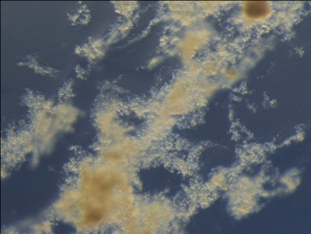


Strategy 2: High Rate BioP followed by Deammonification
Experimental Approach: Benchscale Testing with Sequencing Batch Reactors (SBRs) in Series
Motivation: The applicability of biofilm versus suspended growth deammonification processes for mainstream N removal is a major open research question
→Aggregate type is thought to strongly influence both NOB outcompetition and anammox biomass retention
Notes:
JUSTIFY WHY TWO MAINSTREAM DEAMMONIFICATION REACTORS ARE NEEDED
Much simpler schematic than Fig. 3 on page 6; this also includes proposed sensor layout, pumps, PLC/ SCADA system, etc.

Slide 30
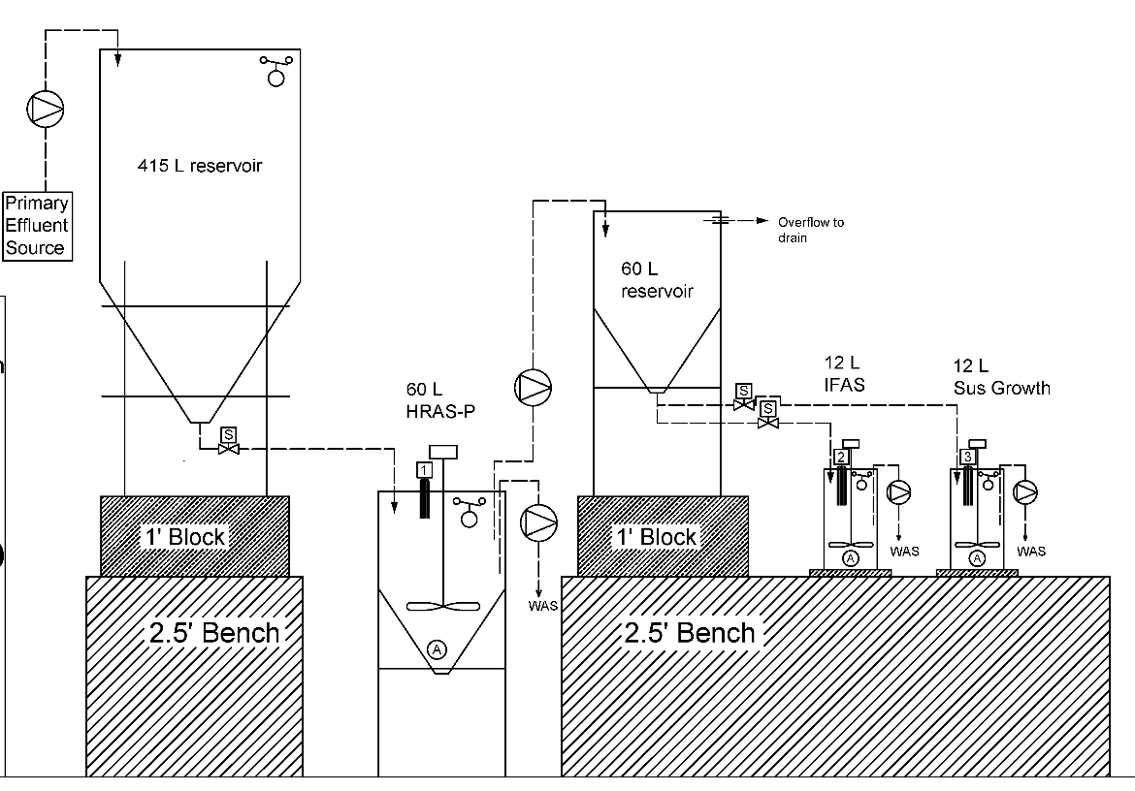
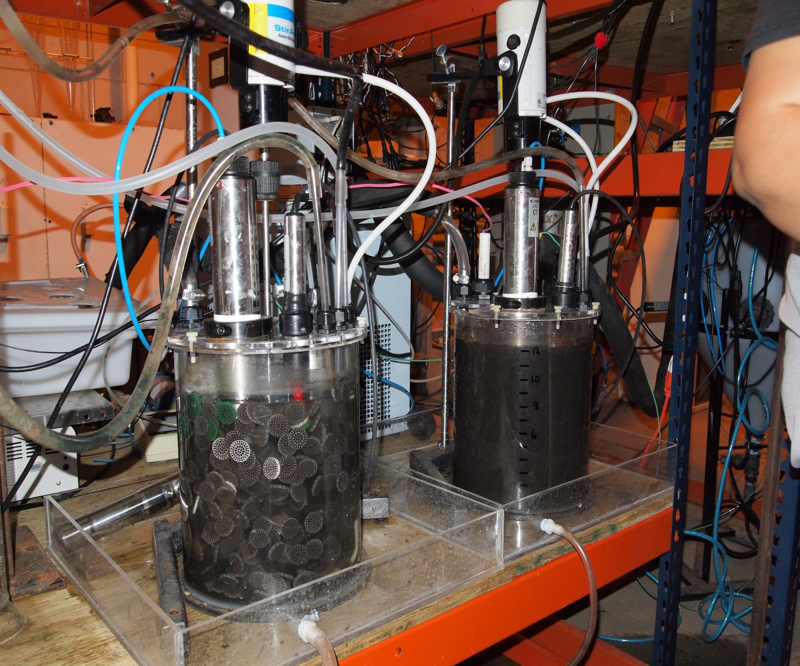
Strategy 2: High Rate BioP followed by Deammonification
Suite of SBRs operated with primary effluent as feed for >500 days at 20ºC
Treatment Objectives:
1) High Rate BioP:
<1 mg Ortho-P/L
70% sCOD removal
2) Deammonification
N removal via anammox
Suppress NOB with low DO
1x High Rate Bio-P SBR
2x Deammonification SBRs in parallel
2a. IFAS (Biofilm/ Suspended Growth Hybrid)
2b. Suspended Growth
Notes:
SKIP OPERATIONal INFO
IFAS: 0.1 - 0.2 mgO2/L (constant DO during aeration)
SRT for flocs: The average since we added suspended biomass from R4 (Nov 9 2018 to Mar 22 2019) is 6.9 days.

Slide 31
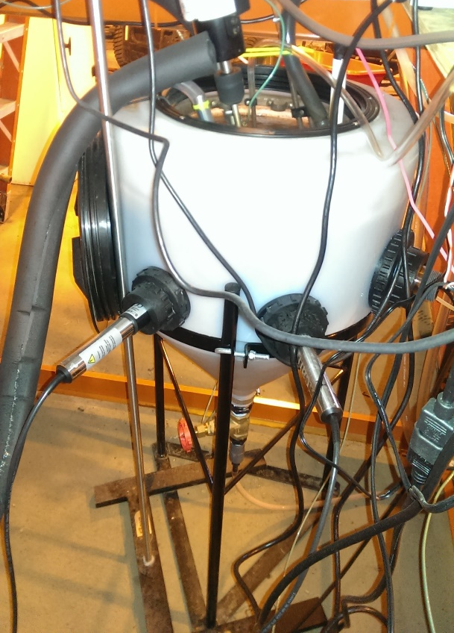
A-Stage:
High-Rate Activated Sludge with Phosphorus removal (HRAS-P)
IFAS
Low CO₂
Effluent:
Low COD & P
High NH₄⁺
Suspended Growth
Influent:
High COD, NH₄⁺ & P
SRT: 2.3 days
Aerobic SRT: 1.4 days
HRT: ~4.2 hrs
Ortho-P Removal: 82% (<0.5 mgP/L
Waste:
High COD & P
Roots et al. (In prep)
 | Phase 1 | Phase 2
Total SRT | 2.7 ± 0.6 days | 2.3 ± 0.2 days
Aerobic SRT | 1.6 ± 0.3 days | 1.4 ± 0.2 days
HRT (not including settling + decant) | 4.9 hours | 3.7 – 4.9 hours
Ortho-P removal | 44% | 82%

Slide 32
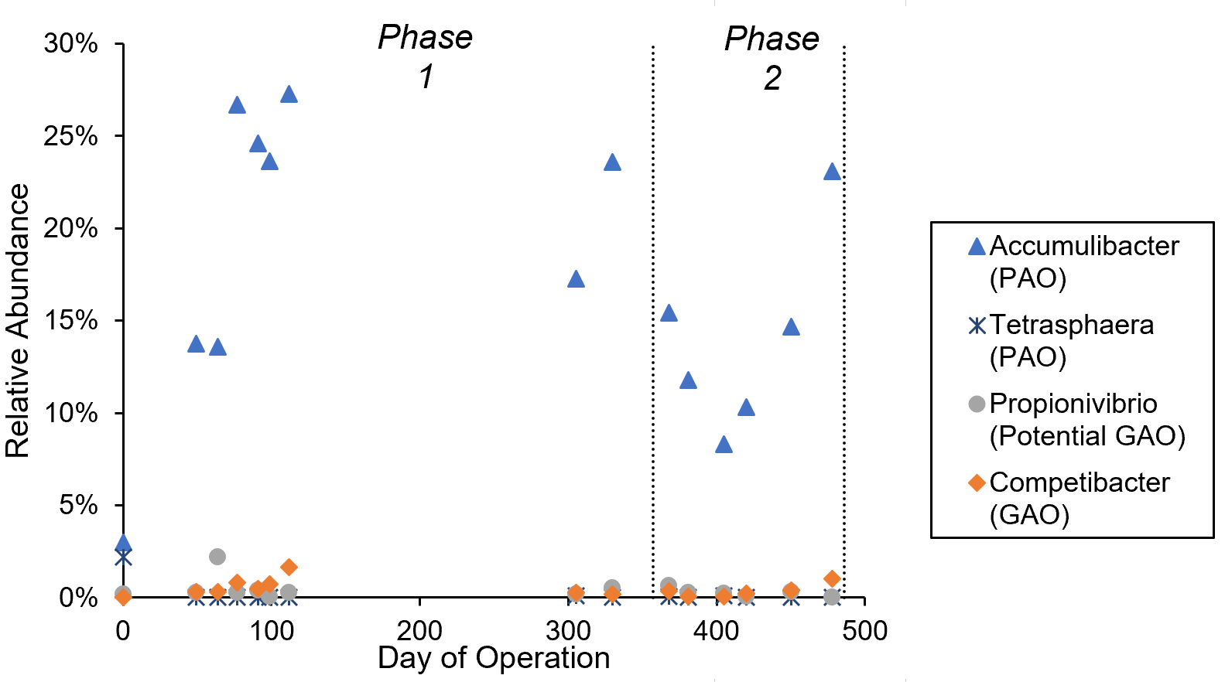
Robust P removal was accompanied by strong enrichment of Accumulibacter PAOs
Roots et al. (In prep)

Slide 33
Strategy 2: High Rate BioP followed by Deammonification
Suite of SBRs operated with primary effluent as feed for >500 days at 20ºC
Treatment Objectives:
1) High Rate BioP:
<1mg Ortho-P/L
70% sCOD removal
2) Deammonification
N removal via anammox
Suppress NOB with low DO
1x High Rate Bio-P SBR
2x Deammonification SBRs in parallel
2a. IFAS (Biofilm/ Suspended Growth Hybrid)
2b. Suspended Growth
Notes:
SKIP OPERATIONal INFO
IFAS: 0.1 - 0.2 mgO2/L (constant DO during aeration)
SRT for flocs: The average since we added suspended biomass from R4 (Nov 9 2018 to Mar 22 2019) is 6.9 days.

Slide 34

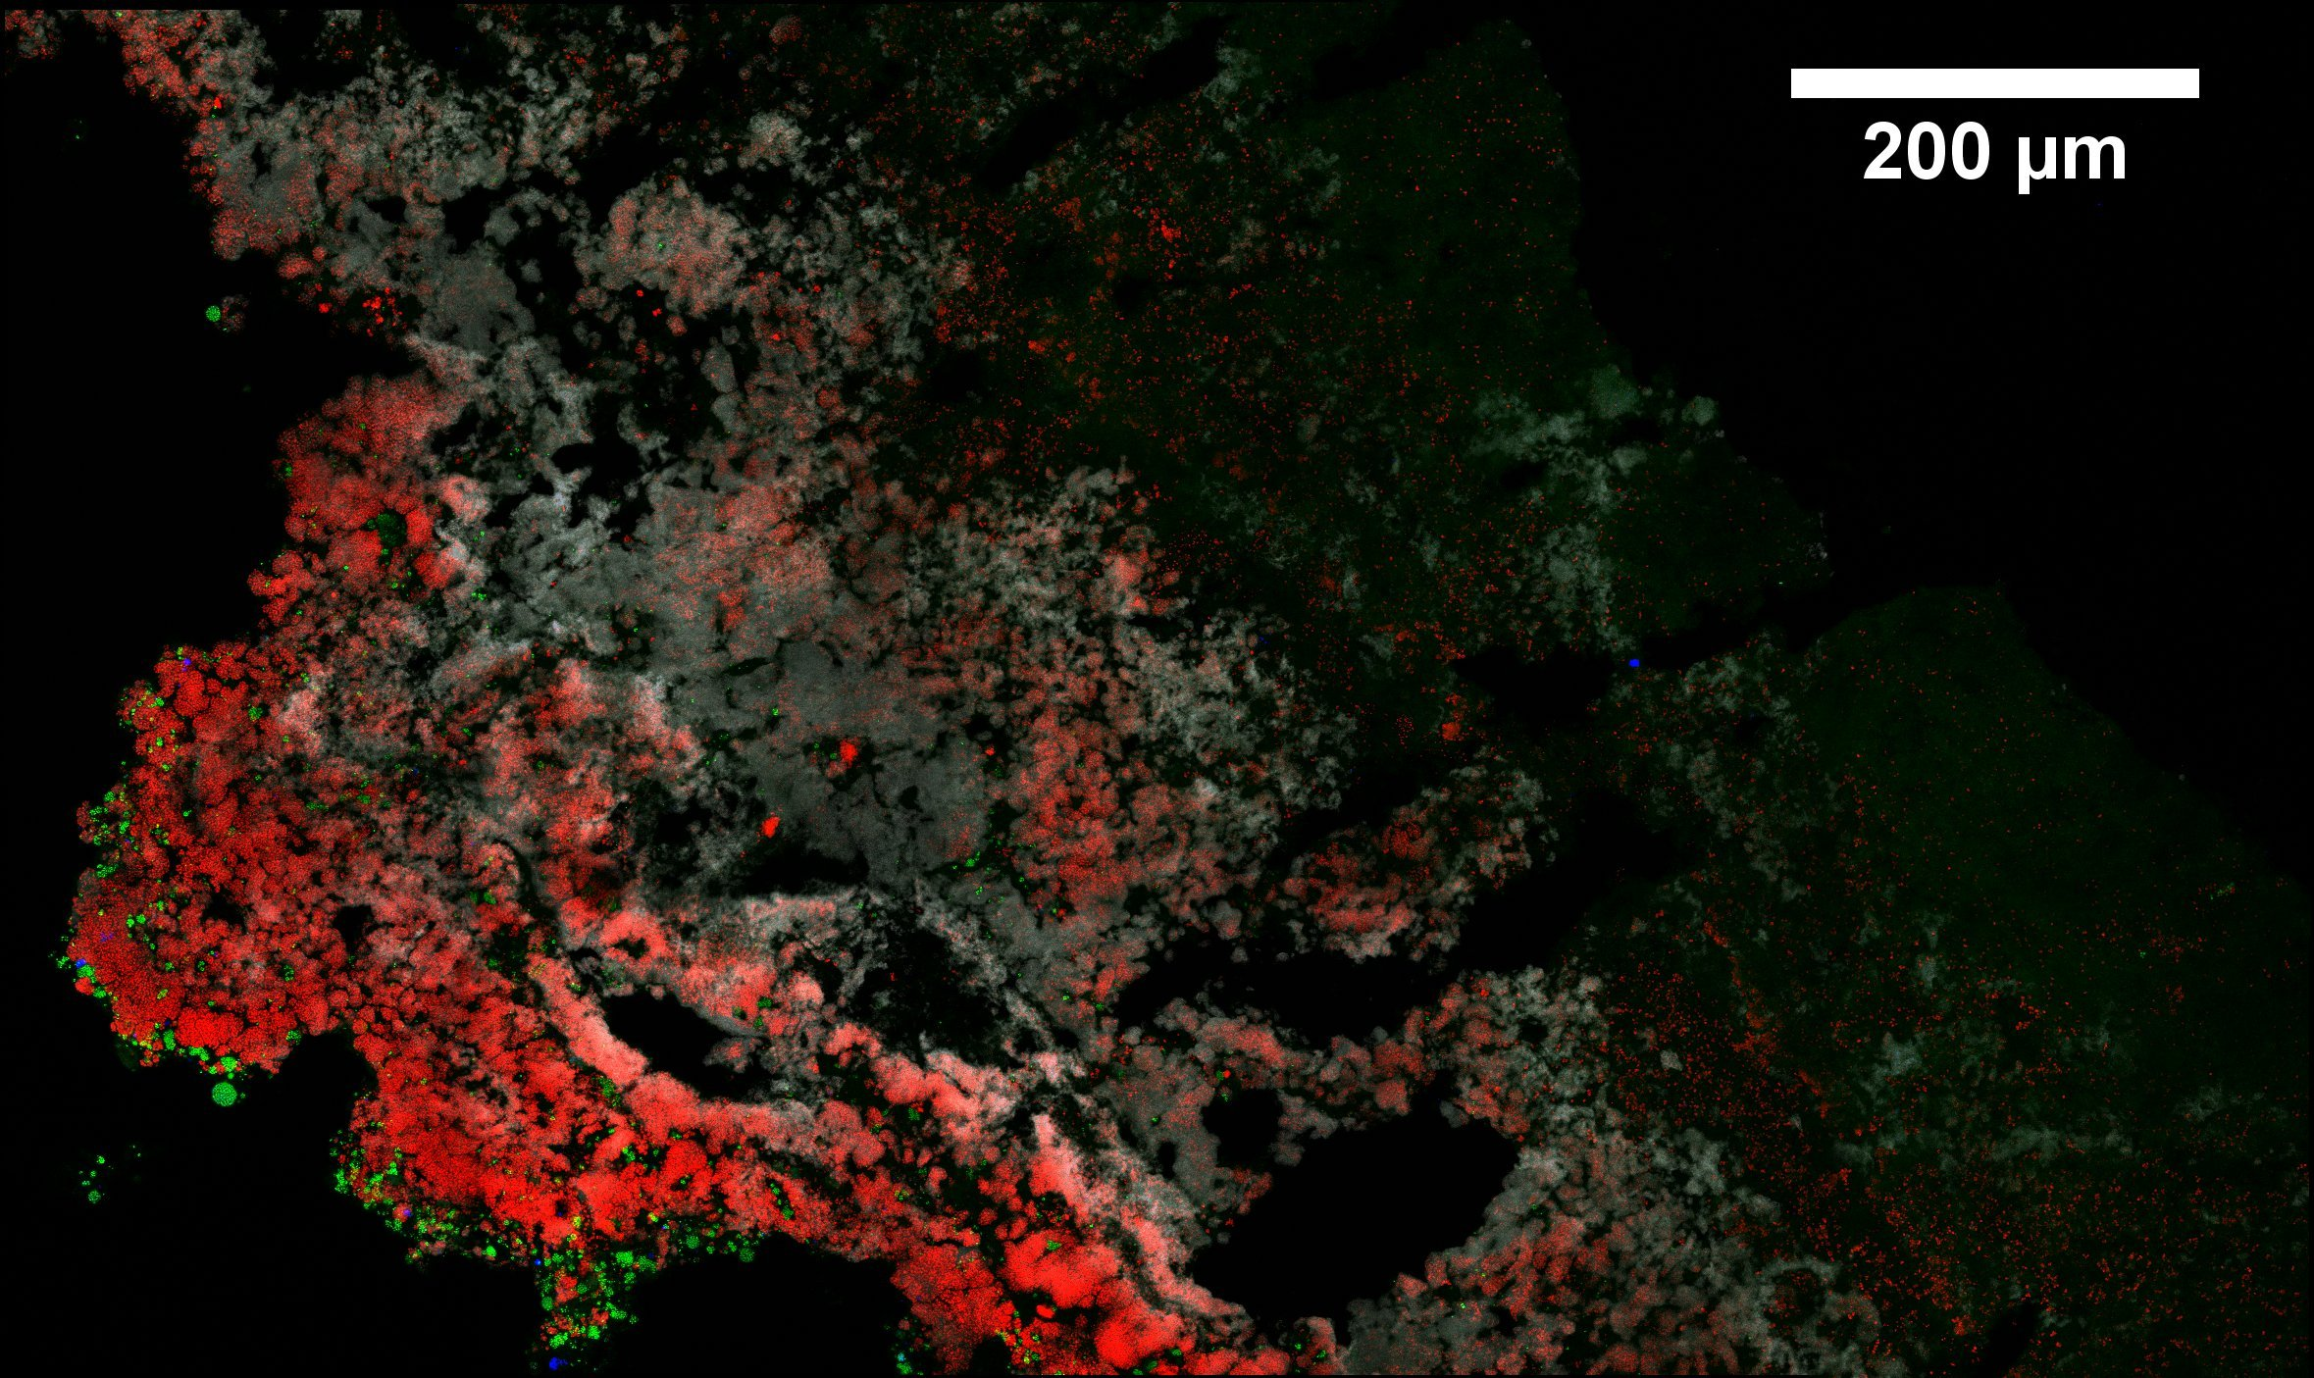
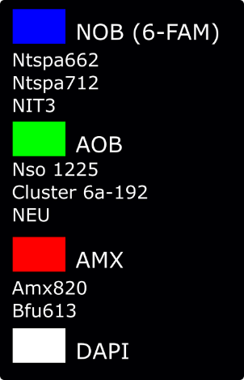
B-Stage: IFAS Deammonification Reactor
Initial Condition
Sidestream enriched biofilm
(ANITA Mox K5 biofilm carriers)
Dense underlying layer of anammox microcolonies
Selective enrichment of AOB at the bulk liquid interface

Slide 35
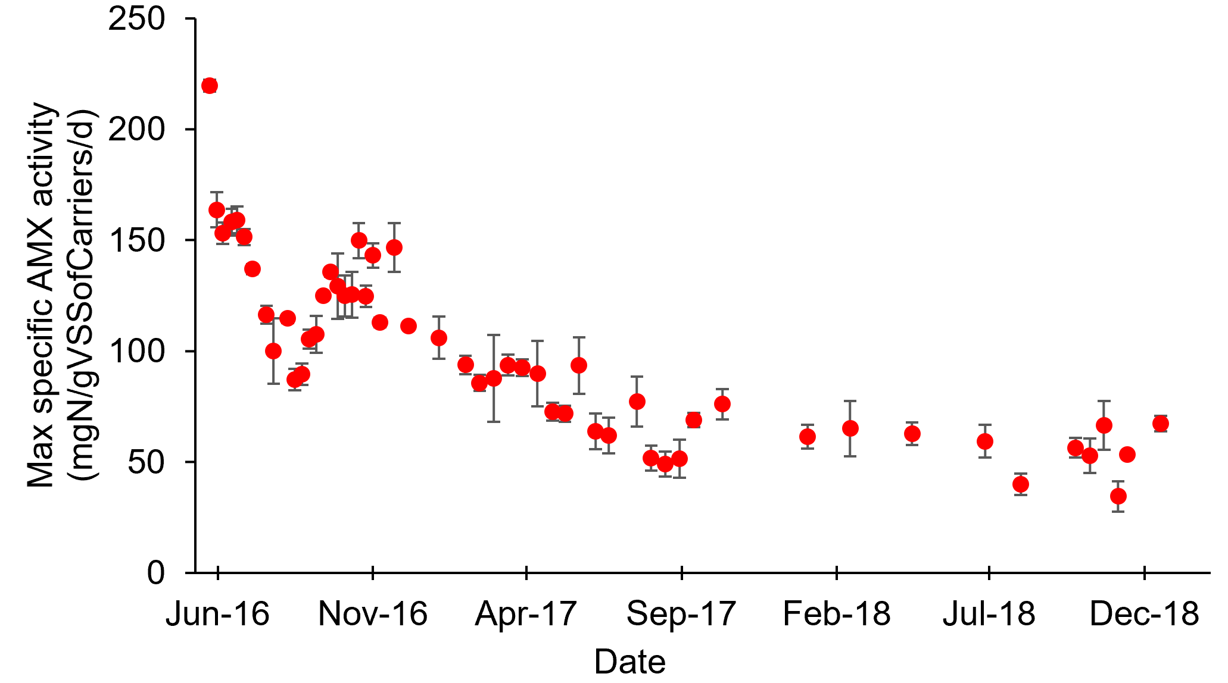
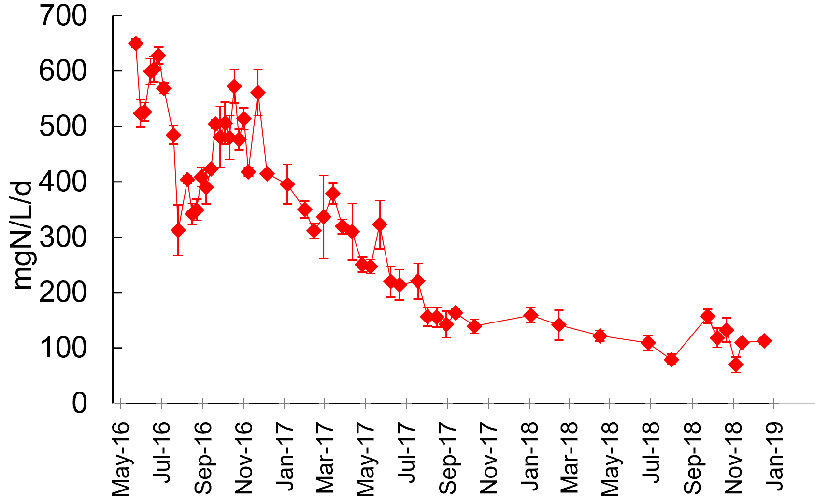
IFAS Deammonification Reactor:
Robust Retention of Anammox Biomass and Activity
Observed decline then stabilization of maximum anammox activity
Aug 2017 – Dec 2018
Max anammox activity:
129 ± 28 mg N/L/d
Average N loading:
68 mg TKN/L/d
O’Brien N loading :
≈ 65 mg TKN/L/d
Maximum anammox activity
~2 years of mainstream operation without bioaugmentation
Notes:
Obrien N Loading is 2000-2013
Note choice of plots: activity in volume basis (per L) or per carrier biomass.
Note on Sept 20, 2018: we added an additional 16% packing ratio (total = 38%) of carriers from the Egan AnitaMOX process. However, biofilms were thin and this represented only a 32% increase in carrier biomass. Impact on the process was minimal, but we cannot say “no bioaugmentation.”
Data for N loading rate calc: IFAS influent TKN Aug 2017 – Dec 2018 = 16.2 mgN/L, average IFAS HRT = 5.75 hr

Slide 36
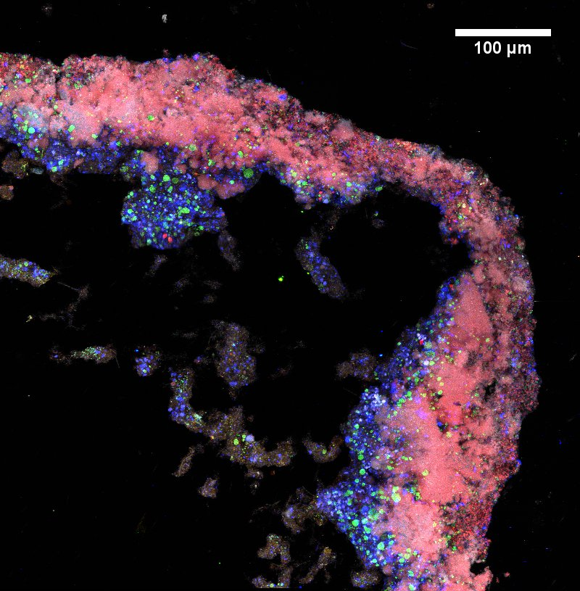

IFAS Deammonification Reactor:
NOB proliferation
Day 292
Nitrogen removal efficiency declined
Effluent nitrate increased
Accumulation of NOB observed
Notes:
OR just take out intermittent aeratoina nd mention we tried many tricks here!
Mention--> to combat NOB proliferation we tried:
different aeration regimes
different levels of COD in influent
different levels of suspended growth biomass (different SRTs with COD to increase conc.)
SWITCH TO CONSTANT LOW DO on July 12, 2017
Paul email 3/25/19: “I suggest that you take out the aeration regime discussion entirely, you could mention is passing while on slide 33 that different aeration regimes were tested and low, constant DO proved to be the most effective. This way you can keep the narrative straightforward and focus on the shift that occurred on 11/9/2018 when we added 10% PE and mixed liquor from R4. In retrospect I don't really think that the fact that the biomass was from R4 was all that important; I think that the increased biomass (which has since been managed by returning more solids from the clarifier to the reactor) in combination with increased COD in the influent caused the improved performance. I've added a slide (34) to demonstrate that the nitrifier activity shifted from the biofilm to the suspension after 11/9/2018, but obviously it's up to you if you want to use it or not.

Slide 37
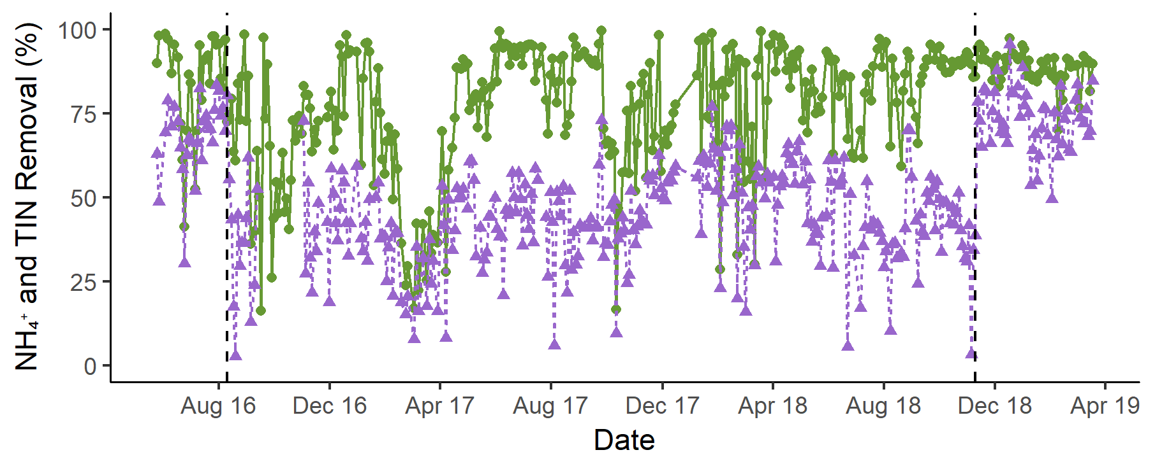
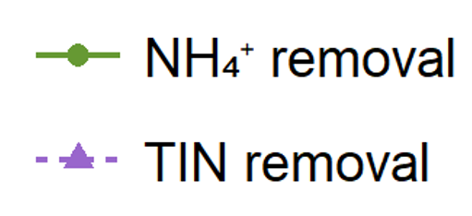
From NOB proliferation to suppression
Nov 9, 2018
Added 10% PE to feed, influent tCOD ↑ 35%
(45 to 61 mgCOD/L)
MLVSS ↑ 152%
(250 to 630 mgVSS/L)
 | May ‘16 to Aug ‘16 | Aug ‘16 to Nov ‘18 | Nov ‘18 to Mar ‘19
% NH₄⁺ removal | 84 | 77 | 89
% TIN removal | 68 | 42 | 73
NO₃⁻ : NH₄⁺ ratio | 0.07 | 0.43 | 0.16
10% PE feed and
mixed liquor
addition
NOB proliferation
Conservative estimate of anammox contribution:
If all tCOD removal went to denitrification, ~50-60% of N removal is from anammox
Notes:
NOTE: If all tCOD removal went to denitrification, then 56% of N removal is from denitrification, 44% from anammox
Note that 3 L of mixed liquor was added from R4 on 11/9/2018, and since then a higher MLVSS (average 630mgVSS/L) has been maintained in the reactor
Average IFAS influent sCOD/N (via NH4+):
May 24 2016 to Nov 9 2018 = 2.54
Nov 10 2018 to Mar 15 2019 = 3.31
Paul email 3/25/19: “I suggest that you take out the aeration regime discussion entirely, you could mention is passing while on slide 33 that different aeration regimes were tested and low, constant DO proved to be the most effective. This way you can keep the narrative straightforward and focus on the shift that occurred on 11/9/2018 when we added 10% PE and mixed liquor from R4. In retrospect I don't really think that the fact that the biomass was from R4 was all that important; I think that the increased biomass (which has since been managed by returning more solids from the clarifier to the reactor) in combination with increased COD in the influent caused the improved performance. I've added a slide (34) to demonstrate that the nitrifier activity shifted from the biofilm to the suspension after 11/9/2018, but obviously it's up to you if you want to use it or not.
Anammox contribution (Paul email 3/25/19): assumes full denitrification at 4gCOD/gN. The average SRT for the time frame of that calculation (Nov 9 2018 to Jan 2 2019) was 5.2 days and near 20degC, so from Daigger Fig 2 carbon requirements would 4.3 gCOD/gN for denitrification and 2.6 gCOD/gN for denitritation. Using the 2.6 gCOD/gN for denitritation, the maximum contribution of denitrifiers to N removal would be 86%, and 14% from anammox. See end of slides for plot from Paul of IFAS suspended SRT, along with suspended and carrier VSS. The dashed line shows when we implemented NH4+ based control and therefore variable HRT (and thus the increase in calculated SRT points).
SETTLING (Paul email 3/25/19): There are two reasons we're seeing increased suspended biomass in IFAS. One, we have more COD in the influent and therefore more biomass growth. Second, we are more frequently returning biomass lost in the effluent but collected in the downstream clarifier back to the reactor. Remember, settling behavior in IFAS is not that meaningful because suspended solids get trapped in between the carriers, which float at the surface during the settling period. So, we always lose a good deal of solids in the effluent. Keep in mind that for a long time my strategy was to intentionally keep the suspended SRT low in hopes of washing out NOB, so I did not return solids from the clarifier to the reactor during that time. Of course, this strategy didn't work because I was in fact promoting NOB development and retention on carriers. Now that I want to keep the suspended concentration higher, I periodically collect solids from the clarifier and return them to the reactor.

Slide 38
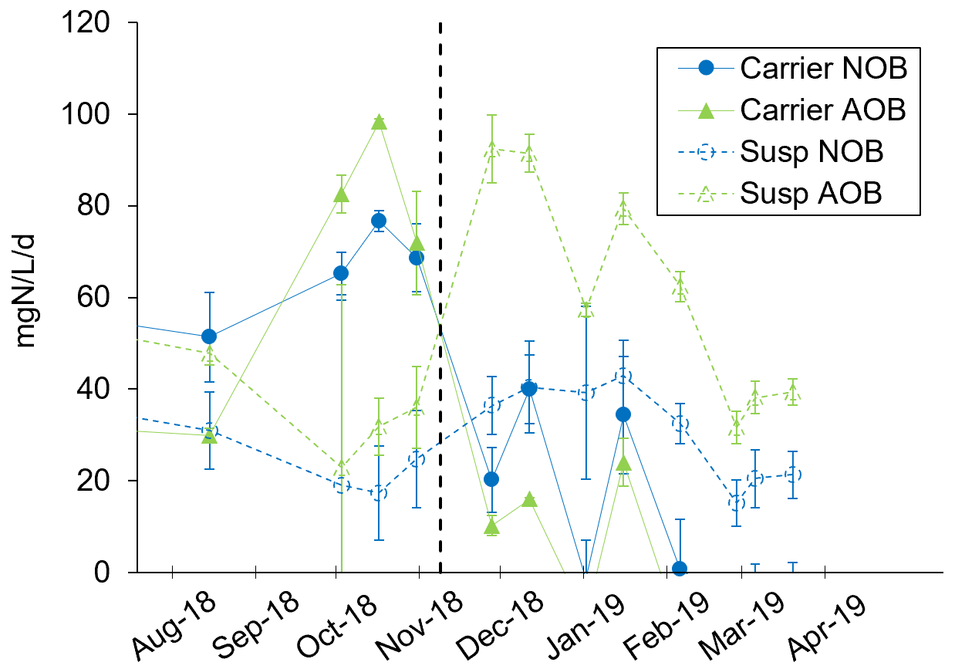
Nitrifier shift from carriers to suspension
Maximum AOB and NOB activity
10% PE feed and
mixed liquor
addition
This is important because NOB are more easily washed out from suspension via SRT than from carriers
Notes:
Key point: increase in suspended VSS led to a sharp shift of nitrifier activity from carriers to to suspension. This is a key observation, as it led to easier washout of NOB
ADD TAKEAWAY!
AND REPHRASE:
Mainstream PN/A is feasible but not straightforward:
Requires multiple aggregate types (flocs and biofilms) with low DO operation
Low DO operation
Robust nitrite sink (high activity anammox)
Aggregate type and architecture play a key role in controlling competntion between AOB, NOB, and anammox.
Intermittent aeration alone was insufficient to promote high rate PN/A activity and NOB outcompetition

Slide 39

Strategy 2: High Rate BioP followed by Deammonification
Lessons Learned:
Mainstream deammonification is feasible but depends strongly on aggregate architecture
  Performance is greatly aided by hybrid systems with elevated suspended growth biomass and small amounts of influent COD
  Future efforts are warranted to increase anammox contribution to total N removal, and to integrate bioP directly in anammox processes
Notes:
SKIP OPERATIONal INFO
IFAS: 0.1 - 0.2 mgO2/L (constant DO during aeration)
SRT for flocs: The average since we added suspended biomass from R4 (Nov 9 2018 to Mar 22 2019) is 6.9 days.

Slide 40
Strategy 2: High Rate BioP followed by Deammonification
1x High Rate BioP SBR
2x Partial Nitritation/Anammox SBRs in parallel
Is mainstream deammonification feasible in a suspended growth bioprocess?
2b Suspended Growth
2a. IFAS
Notes:
SKIP OPERATIONal INFO
IFAS: 0.1 - 0.2 mgO2/L (constant DO during aeration)
SRT for flocs: The average since we added suspended biomass from R4 (Nov 9 2018 to Mar 22 2019) is 6.9 days.

Slide 41
Complete Ammonia Oxidation (Comammox):
A new twist in the microbial nitrogen cycle
N₂ (g)
Anammox
Denitrification
Nitrification has been viewed as a 2 step process for >100 years:
O₂
COD
O₂
NH₃ NO₂⁻ NO₃⁻
AOB & AOA
NOB
Comammox
AOB: Ammonia-Oxidizing Bacteria (Nitrosomonas, Nitrosospira)
AOA: Ammonia-Oxidizing Archaea
NOB: Nitrite-Oxidizing Bacteria (Nitrospira, Nitrobacter, Nitrolancea, Nitrotoga)
Comammox: Complete Ammonia Oxidizing Bacteria (Nitrospira)
Notes:
The comammox metabolism overturned a >100-year paradigm that nitrification is a two-step process requiring coordinated activity of ammonia oxidizing bacteria or archaea (AOB or AOA, ammonium [NH₄⁺] to nitrite [NO₂⁻]) and nitrite oxidizing bacteria (NOB, NO₂⁻ to NO₃⁻).

Slide 42
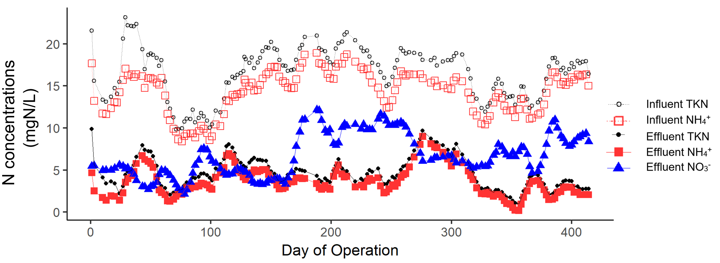
The Suspended Growth SBR was initially operated for deammonification, but transitioned to low DO full nitrification after ~90 days
50-60% TIN removal, ΔNO_{x}/ΔNH₄⁺=0.24
~20% TIN removal, ΔNO_{x}/ΔNH₄⁺=0.6-0.7
Roots et al. 2019 Water Research
Notes:
Inoculated with sidestream DEMON biomass
Fig: Effluent N concentrations over time
First 77 days of operation saw ~50% TIN removal and 80% NH4 removal, with NO3/NH4 of 0.24
Bulking event led to rapid anammox washout after ~90 days, after which the reactor was transitioned to a full nitrification reactor at low DO
NH4 removal ~80%, TIN removal ~20%

Slide 43
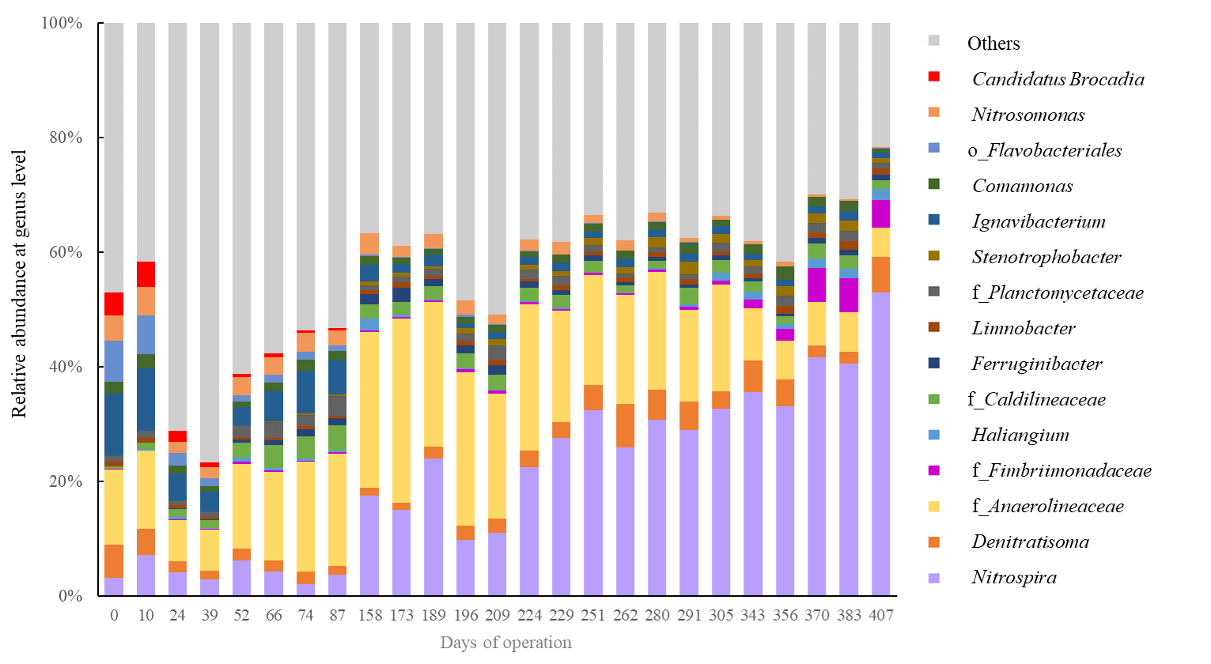
Nitrospira increased in abundance to 53% of the overall microbial community
16S rRNA Gene Amplicon Sequencing
AOB
Nitrospira
Anammox
Roots et al. 2019 Water Research
Notes:
16S rRNA gene sequencing revealed a declining trend of canonical AOB from 4.4% of total reads on Day 3 of reactor operation to 0.8% of total reads by Day 407, while NOB (which included only Nitrospira) steadily climbed from 3.1% of total reads on Day 3 to an unusually high 53% of reads on day 407
decline of anammox (which included all OTUs affiliated with the genus Brocadia; no other anammox genera were detected) relative abundance from 4% of total amplicons on day 13 to less than 0.1% by day 161; paralleled the rapid decline in maximum anammox activity (Figure 2) and TIN removal (Figure 1) in this system.
unexpected strong declining trend of canonical betaproteobacterial AOB (OTUs affiliated with the genus Nitrosomonas; no Nitrosospira, AOA, or gammaproteobacterial AOB were detected) from 4.4% of total reads on day 3 to 0.8% of total reads by day 407,
putative NOB (which included only OTUs affiliated with the genus Nitrospira; Nitrobacter and Nitrotoga were not detected, and Nitrolancea was <0.2% for all time points) steadily climbed from 3.1% of total reads on day 3 to an unusually high 53% of reads on day 407
Taken together, these patterns of relative abundance of Nitrospira and AOB-affiliated OTUs in 16S rRNA gene sequencing datasets led us to hypothesize the accumulation of comammox Nitrospira due to the consistent high ammonia oxidation activity and complete nitrification in the reactor.
Figure S1. Relative abundance of the 15 most abundant bacterial genera at each time point according to 16S rRNA gene sequencing data. Sampling time point is shown on the x axis. The OTUs that were unclassified at the genus level are presented with the corresponding lowest annotable taxonomy names; ‘f_’ indicate ‘Family’, and ‘o_’ indicates ‘Order.’

Slide 44

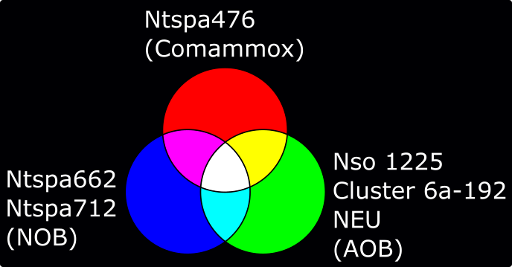
Strong enrichment of Nitrospira and decline in abundance of AOB was confirmed by FISH
Ntspa476
Probe Ntspa476 (magenta) targets a subset of lineage II Nitrospira that includes comammox
Roots et al. 2019 Water Research
Notes:
COULD CUT
16S-based methods are inadequate to distinguish comammox from canonical NOB; to do this, we need to use s pecific function gene markers
16S rRNA gene sequencing revealed a declining trend of canonical AOB from 4.4% of total reads on Day 3 of reactor operation to 0.8% of total reads by Day 407, while NOB (which included only Nitrospira) steadily climbed from 3.1% of total reads on Day 3 to an unusually high 53% of reads on day 407
decline of anammox (which included all OTUs affiliated with the genus Brocadia; no other anammox genera were detected) relative abundance from 4% of total amplicons on day 13 to less than 0.1% by day 161; paralleled the rapid decline in maximum anammox activity (Figure 2) and TIN removal (Figure 1) in this system.
unexpected strong declining trend of canonical betaproteobacterial AOB (OTUs affiliated with the genus Nitrosomonas; no Nitrosospira, AOA, or gammaproteobacterial AOB were detected) from 4.4% of total reads on day 3 to 0.8% of total reads by day 407,
putative NOB (which included only OTUs affiliated with the genus Nitrospira; Nitrobacter and Nitrotoga were not detected, and Nitrolancea was <0.2% for all time points) steadily climbed from 3.1% of total reads on day 3 to an unusually high 53% of reads on day 407
Taken together, these patterns of relative abundance of Nitrospira and AOB-affiliated OTUs in 16S rRNA gene sequencing datasets led us to hypothesize the accumulation of comammox Nitrospira due to the consistent high ammonia oxidation activity and complete nitrification in the reactor.
Figure S1. Relative abundance of the 15 most abundant bacterial genera at each time point according to 16S rRNA gene sequencing data. Sampling time point is shown on the x axis. The OTUs that were unclassified at the genus level are presented with the corresponding lowest annotable taxonomy names; ‘f_’ indicate ‘Family’, and ‘o_’ indicates ‘Order.’

Slide 45
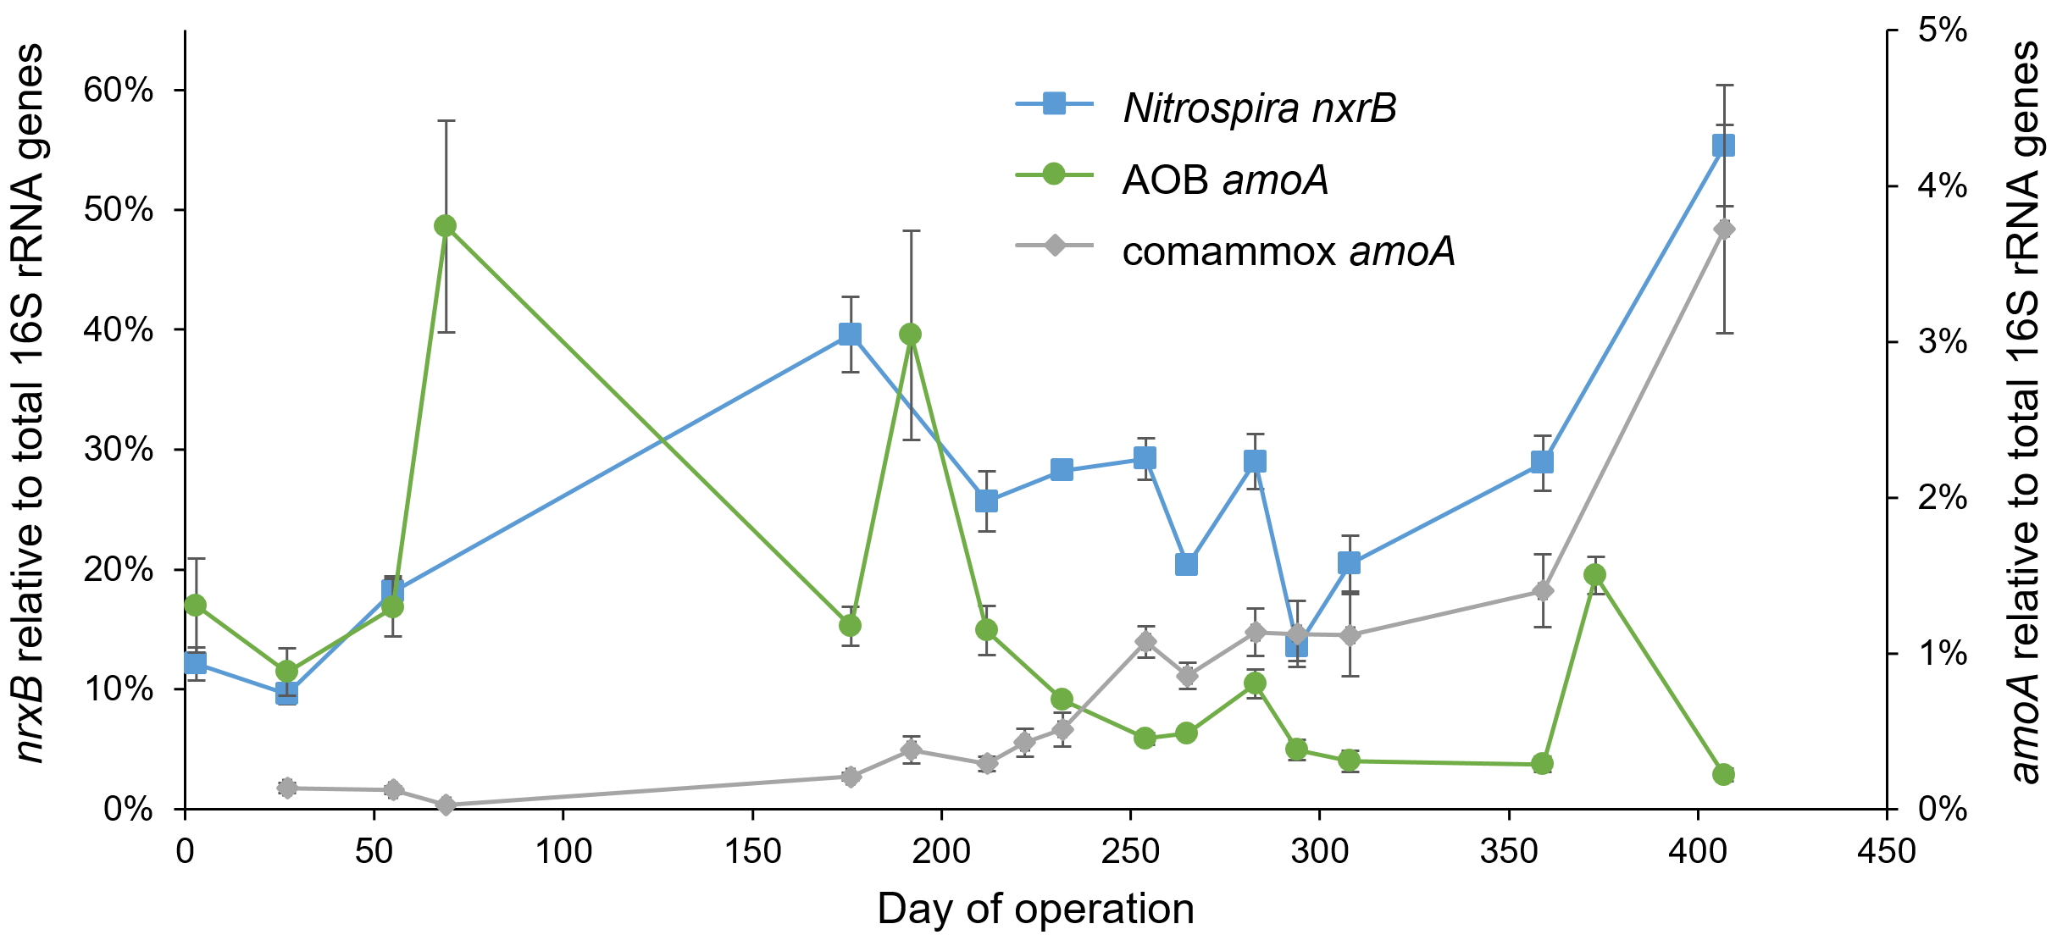
Comammox dominates the ammonia-oxidizing community in this low DO nitrification reactor
qPCR Quantification of amoA and nxrB genes
By day 407, comammox accounted for 94% of amoA gene copies in the reactor
Roots et al. 2019 Water Research
Notes:
-Presence or abundance of comammox Nitropsira cannot be definitely resolved with 16S rRNA amplicon sequencing or FISH alone
To test for comammox enrichment, we therefore turned to several qPCR assays
-x-axis, y-axis
-In Green shows some dynamics in AOB amoA, but in general a strong downwards trend from 1-2% of the overall population to less than .1 % in our final sampling time point, in line with 16S sequencing and FISh
-In blue, we see a corresponding increase of total Nitrospira from about 10% to 55% of the overall community, in line with our 16S sequencing and FISH
-the kicker is the gray line, which shows trends in relative abundance of comammox amoA. What we see is a shift in comammox abundance, from close to non detect in the first 150 days to a strong enrichment over the last 200 days of operation.
By day 407, comammox amoA was about 20fold more abundant than AOB amoA, demonstrating strong dominance in terms of ammonia oxidizer population abundance by comammox
-I’ll also point out that while we saw a strong enrichment of comammox Nitrospira, we also saw a very large and diverse community of non-comammox Nitrospira, so comammox do not appear to be driving all of nitrite reduction in this reactor
YUBO:
meta results: Comammox amoA accounted for ~ 0%, 70% and 98% of all the amoA gene annotated on day0, day 230 and day 405;
q-PCR results: comammox amoA accounted for 0%, 42%, and 94% of all the amoA genes on day0, day 230 and day 405;
The presence or abundance of comammox Nitrospira cannot be resolved from 16S rRNA amplicon sequencing alone (Lawson and Lücker, 2018), and the unusually abundant Nitrospira population warranted the use of better tools for functional group quantification. For this purpose, qPCR was used to quantify comammox (targeting amoA), canonical AOB (amoA), total Nitrospira (nxrB), and total bacteria (16S rRNA).
The comammox amoA trend revealed an increasing abundance in comammox Nitrospira beginning around Day 222. Comammox was the dominant ammonia oxidizer from Day 254 to 414 according to qPCR, with an average 79% of total amoA reads. However, during that same time range comammox amoA reads were only 5% as abundant as total nxrB reads. By Day 407, comammox comprised 94% of all detected ammonia oxidizers (via amoA qPCR).
NOTE comammox amoA reads were only 5% of total Nitrospira nxrB reads in this system. This result suggests that while comammox Nitrospira were the putative dominant ammonia oxidizers in this system (based on abundance relative to canonical AOB), a large fraction of the total Nitrospira community was incapable of comammox metabolism.
Abundance of Nitrospira nxrB (squares), AOB amoA (circles), and comammox amoA (diamonds), as measured by qPCR. Results are normalized to total bacterial 16S rRNA gene copies. Nitrospira results are shown on the left y-axis, and AOB and comammox results are shown on the right y-axis.

Slide 46
Ammonia Removal Rate Comparison to Parallel Full-Scale Nitrifying Activated Sludge Bioreactor
 | Low DO Nitrification Reactor | O’Brien Water Reclamation Plant (Full-scale)
DO (mg/L) | 0.2-1 | 3-5*
Average NH₄+ Removal Rate (mg NH₄⁺/L-d) | 59 | 50
Low DO nitrification with comammox could be an energy-saving alternative to conventional high DO nitrification systems
* End of basin. Effluent NH₄⁺ concentrations differ between O’Brien and the low DO nitrification reactor.
Notes:
Connection to practice: highly efficient nitrification demonstrated at low DO (0.2-1 mg/L, intermittent aeration), at volumetric removal rates parallel full-scale AS reactor
Suggests potential for an energy-efficient and comammox-driven low DO alternative to conventional high DO nitrification processes
HRT = 5 hrs
Effluent NH₄⁺ = 2 mgN/L
NH₄⁺ removal = ~80%
HENG: I have a question regarding the information presented on slide 43. Is the DO values a range? The DO at the beginning of full-scale aeration tank is typically very low. Also, this comparison doesn’t include effluent concentration. Normally, the volumetric removal rate would be lower as the effluent concentration gets lower. The information could be misleading if presented partially. Just a thought for your consideration.
PAUL: Regarding the DO, they are right; it ranges from 0 mg/L at the beginning to 3 - 5 mg/L at the end of the basins. And regarding the NH4+ removal rate, yes, it considers the full aeration basin as I have no way of knowing where or when NH4+ reaches the target effluent concentration in the basin. This is calculated similarly for O'Brien and the SG SBR, that is, by looking at influent and effluent NH4+ and using the HRT to calculate the removal rate. So on the one hand it is a fair comparison, but on the other hand it may really just highlight the fact that there is excess treatment capacity (at least from a nitrification perspective) designed into the basins at O'Brien. SEE Description in comammox paper

Slide 47
Take Home Points
Integrated mainstream shortcut N and biological P removal is a promising emerging route for resource and energy efficient nutrient management
  Both Nitritation/ Denitritation + bioP and Deammonification are robust and stable in the mainstream under appropriate operational conditions
  Comammox Nitrospira may be well-suited to energy-efficient low DO processes for complete nitrification
Notes:
CUT: Operational “levers” to select for high DPAO activity for integrated P removal are not well understood

Slide 48
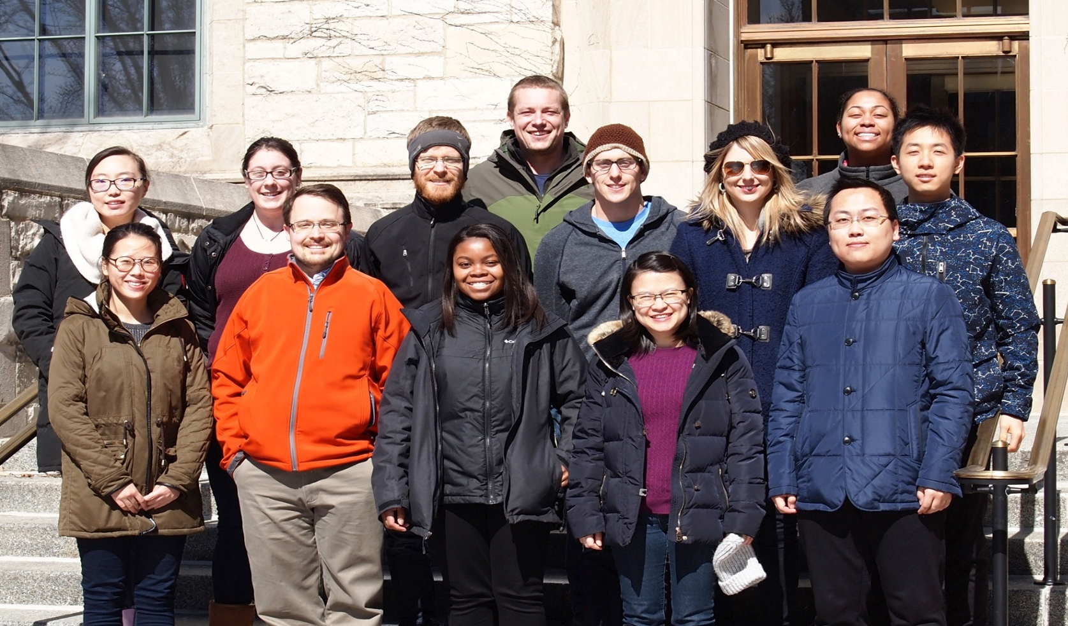


Acknowledgements
Wells Environmental Biotechnology and Microbial Ecology Lab
Paul Roots
Alex Rosenthal
Yubo Wang
Fab Sabba
MWRDGC
District SCBNR Project Team: Monitoring & Research, Maintenance & Operations, and Engineering Departments

Slide 49
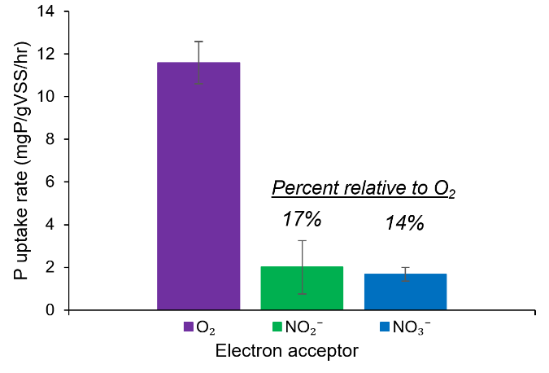
However, P removal was driven by aerobic PAOs, rather than C-efficient DPAOs
Notes:
COULD CUT!
P uptake rates in the presence of O₂, NO₂⁻, and NO₃⁻ from ex situ batch tests.

Slide 50
Take Away Points and Future Directions
Mainstream shortcut N removal has extraordinary promise, but is in its infancy, with key remaining challenges to be addressed
  Mainstream NOB outselection is feasible, but remains a considerable challenge
  Reliability at low temperatures (10-15ºC) is uncertain
  Operational conditions often used in shortcut N removal processes may inadvertently select for comammox and associated complete nitrification
Conversely, comammox Nitrospira may be well-suited to energy-efficient low DO processes for complete nitrification
Notes:
CUT: Operational “levers” to select for high DPAO activity for integrated P removal are not well understood

Slide 51
Summary and Discussion Points
Robust P and shortcut N removal via two different EBPR processes without supplemental carbon:
NiDeMA-P:
  Robust P removal with intermittent aeration to 1 mg O₂/L
  Compatible with N removal via nitritation-denitritation
  P removal transiently impacted by heavy wet-weather flows
HRAS-P:
  Excellent P and sCOD removal at a 2.3 day SRT
  RAS fermenter (via higher SRT) stabilized P removal during wet-weather flows
  Compatible with downstream N removal via deammonification
P and COD removal performance was maintained in both processes down to ~10 ºC

Slide 52
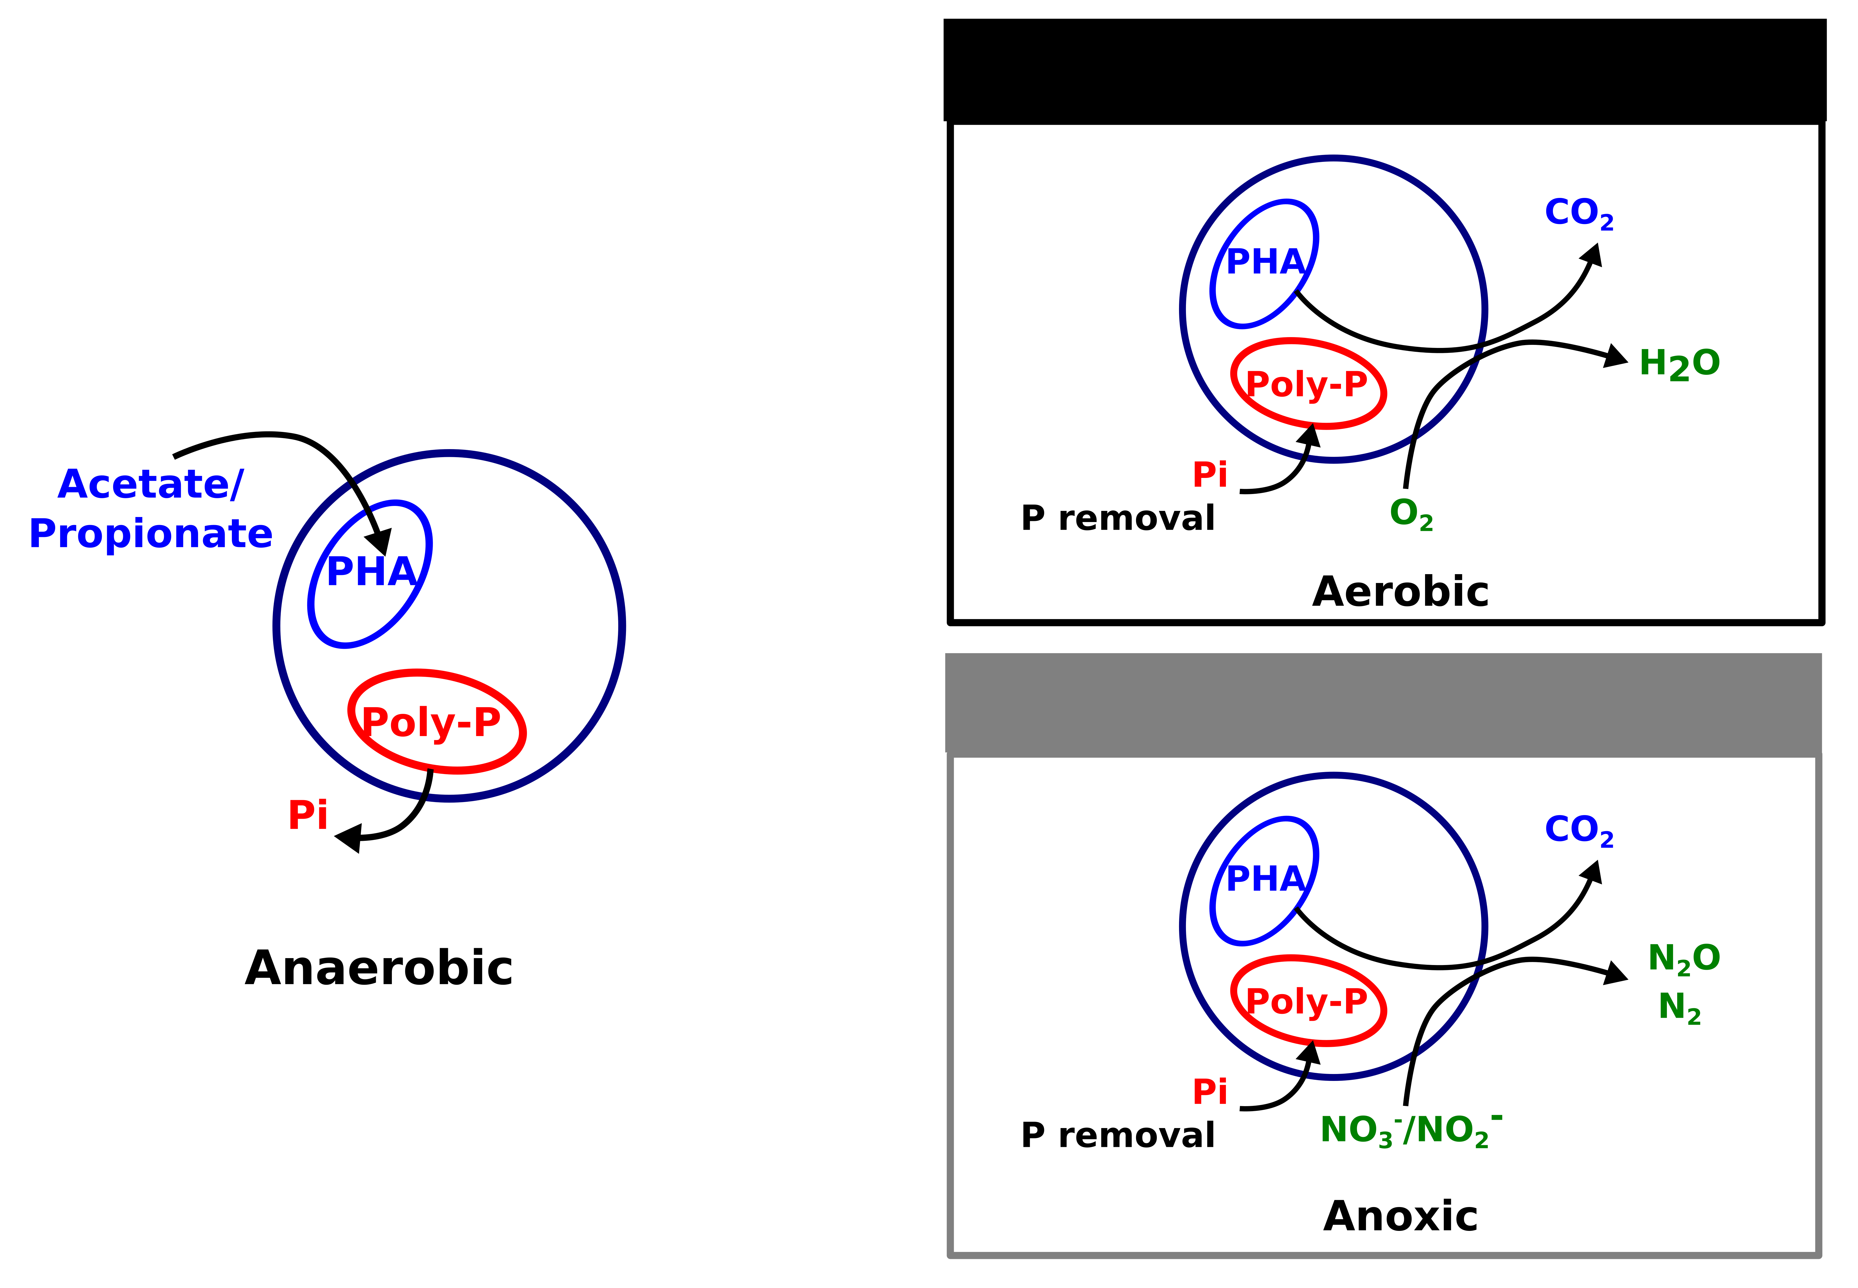
The Promise of Denitrifying PAOs
Some (but not all) Accumulibacter clades are capable of denitrification. These so-called DPAOs are little understood, but offer a critical opportunity to couple N removal to P accumulation and recovery.
Typical PAOs
Denitrifying PAOs
Advantages of DPAO-based Bioprocesses relative to Aerobic PAOs:
Potential for dramatic energy savings due to decreased aeration requirements
Optimized use of organic matter for combined N and P removal
Key research question: Can we exploit new knowledge of metabolic versatility of PAOs to link N removal, P recovery, & bioenergy production?
Notes:
Key research question… this is the driving focus behind a number of projects in my group at present, including ongoing bench-scale work with the MWRDGC

Slide 53
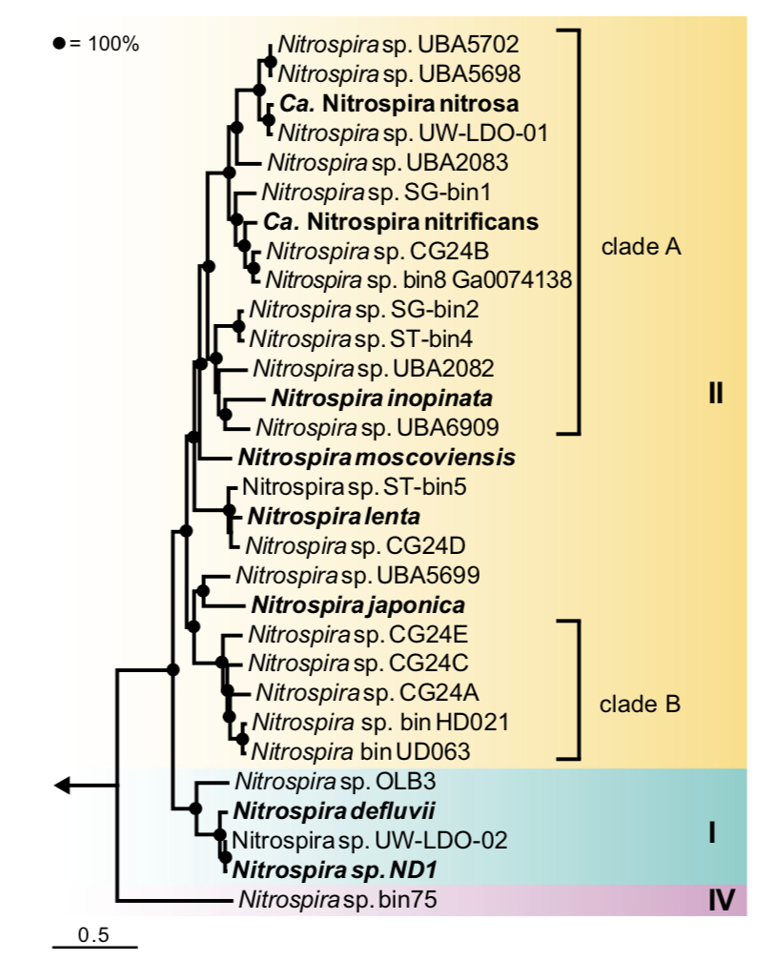
Comammox Diversity, Putative Niche, and Relevance to Practice
Comammox form two distinct clades within the genus Nitrospira ¹
Comammox Nitrospira appear to be adapted to an oligotrophic lifestyle with low NH₄⁺, and possibly also low dissolved oxygen ²
Early reports suggested that comammox are absent or present at low abundance in nitrifying activated sludge, and thus may not be important from a functional standpoint ^{3,4}
Clade A
Non-comammox Nitrospira
Clade B
1. Daims et al. 2015 Nature 428: 504-509
2. Kits et al. 2017 Nature 549: 269-272.
3. Gonzalez-Martinez et al. 2016 Environ. Sci. Pollut. Res. 23:25501-25511
4. Annavajhala et al. 2018 ES&T Letters 5(2): 110-116
Koch et al. 2018 AMAB (doi.org/10.1007/s00253-018-9486-3 )
Notes:
Despite their novel metabolic capabilities, comammox affiliate with a very familiar bacterial genus, Nitrospira, that are commonly found as NOB in WWTPs. Their detection and quantification is complicated by the fact that they form two distinct phylogenetically distinct clades within lineage 2 Nitrospira
While much remains to be learned, over the last 2-3 years evidence has emerged from the microbial ecology community that comammox are very slow growing organisms with high growth yields and with high affinity for ammonia, and possibly also high affinity for DO, and thus may be adapted to a highly oligotrophic lifestyle– for example, in drinking water sand filters. These aren’t conditions that are typically found in BNR systems, at least not in conventional systems.
Indeed, early reports suggested that while comammox were present in some NDN systems, they were generally very low abundance, and therefore may not be important from a function standpoint
The extent of their importance to wastewater treatment, however, has been downplayed in recent studies (Gonzalez-Martinez et al. 2016; Annavajhala et al. 2018).
The “oligotrophic lifestyle” (Kits et al., 2017) of comammox suggests that they may not be able to compete in the relatively nutrient-rich environments of wastewater treatment plants (WWTPs), and two surveys for comammox in WWTPs seem to confirm this (Annavajhala et al., 2018; Gonzalez-Martinez et al., 2016).

Slide 54
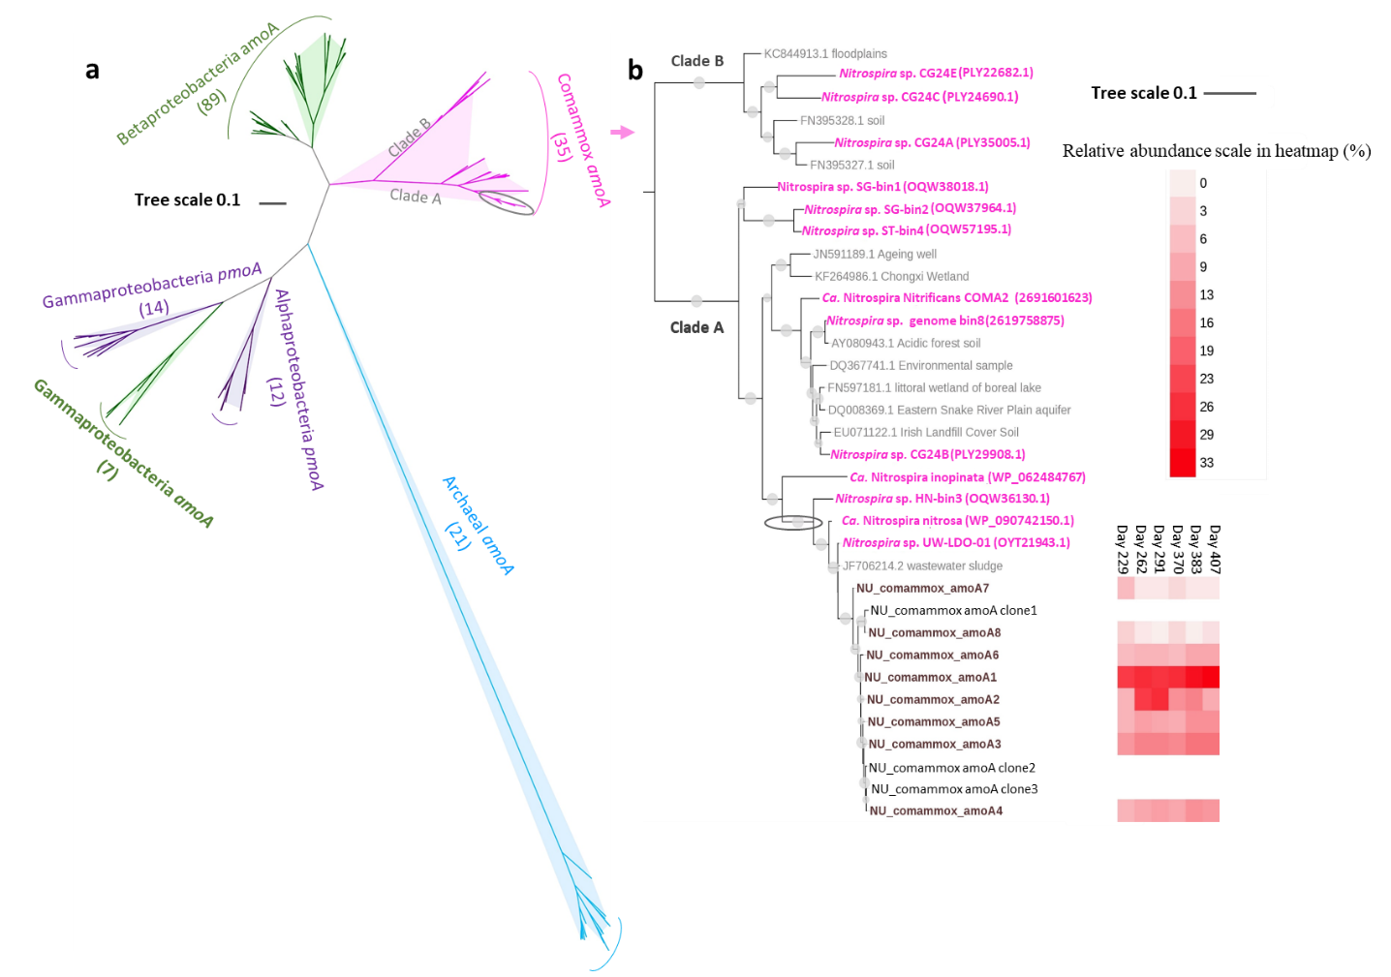
Comammox affiliated with Ca ‘Nitrospira nitrosa’
Comammox amoA Phylogenetic Tree
Results from amoA gene amplicon sequencing coupled to genome resolved shotgun metagenomics
Roots et al. 2019 Water Research
Notes:
Used complementary analyses of first functional gene sequencing (amoA) followed by targeted genome binning from shotgun metagenomes to evaluate diversity of comammox in this system as well as to validate relative abundance of comammox compared to AOB.
On right, I’m showing you an amoA phylogenetic tree; this is essentially an evolutionary tree demonstrating relatedness between different comammox strains. In pink are available comammox genomes from a variety of environments.
In maroon at the bottom of the tree are the amoA unique sequence variants that we retrieved from our reactor, and the red heatmap shows relative abundance of these different unique sequence variants.
What you’ll note is that we do have ome microdiversity with in the comammox community in this system, but essentially all of the commaox
demonstrate that that we enriched a diversity of comammox, but that the majority of this comammox in this system affiliated with clade A, and were closely related to Ca Nitrospira nitrosa

Slide 55
NOO Suppression is Also Apparent in Within-Cycle Profiling…. but P uptake is limited to aerated periods
Nitritation/Denitritation + BioP SBR: Within Cycle Test Feb. 28, 2018
In the absence of O₂ and presence of NO₂⁻, P uptake is not observed → P uptake by Denitrifying Polyphosphate Accumulating Organisms (DPAOs) is surprising limited
Roots et al. 2019 (In review)
Notes:
This question is a key focus of two linked projects in my group. One project is a collaborative effort with the MWRDGC to examine a suite of bioprocesses and bench/ pilot scale for shortcut bioN removal with ….
The second allied project in which the MWRDGC is heavily involved is a WE&RF project I’m leading with Kartik Chandran….
3 primary objectives, the first of which is…
Utilities:
MWRDGC (Chicago)
Denver MWRD
St. Petes (Fl)
HRSD (Nansemond and James River)
DC Water (Blue Plains)
VCS Denmark (Ejby Molle)
Strass
Alex Renew
Also Pueblo, CO
Consulting groups:
CH2M
Brown and Caldwell
Hazen & Sawyer

Slide 56
Strategy 1: Integrated Nitritation/Denitritation + BioP
Future Direction: How can Denitrifying Polyphosphate Accumulating Organisms (DPAOs) be effectively selected for in integrated shortcut N and P removal processes?
DPAOs offer the opportunity to decrease aeration (energy) requirements and optimize use of organic matter for combined N and P removal
Conditions and process configurations that select for high DPAO activity (in conventional or shortcut BNR) aren’t well understood
Notes:
This question is a key focus of two linked projects in my group. One project is a collaborative effort with the MWRDGC to examine a suite of bioprocesses and bench/ pilot scale for shortcut bioN removal with ….
The second allied project in which the MWRDGC is heavily involved is a WE&RF project I’m leading with Kartik Chandran….
3 primary objectives, the first of which is…
Utilities:
MWRDGC (Chicago)
Denver MWRD
St. Petes (Fl)
HRSD (Nansemond and James River)
DC Water (Blue Plains)
VCS Denmark (Ejby Molle)
Strass
Alex Renew
Also Pueblo, CO
Consulting groups:
CH2M
Brown and Caldwell
Hazen & Sawyer

Slide 57
Advantages of Shortcut N Removal Bioprocessesª
 | Nitrification/ Denitrification | Nitritation/ Denitritation | Partial Nitritation/ Anammox
O₂ (mole) | 1.8 | 1.3 | 0.7
Reducing Equivalents from Organics (e⁻) | 9 | 5.5 | 1
Biomass Produced (g VSS)^{b} | 28 | 18 | 7
ªPer mol ammonia. Calculations based on reported biomass yield and typical SRT for each unit operation (Rittmann & McCarty, 2001). ^{b}Value includes biomass produced from ammonia oxidation and NO_{x} reduction
Source: Gao, Scherson & Wells (2014) Environ. Sci: Processes Impacts 16:1223-1246
Notes:
[CUT?]
Note reducing equivalents includes organics incorporated into biomass and used for denitrification. (numbers are roughly equivalent to Stinson et al. numbers)
Key benefits: energy savings (O2)→ potentially 12-15% of total plant energy use
12-15% of the District WRP electricity may be possible (75-100 million kwh per year electricity reduction)
Carbon redirection
Table includes biomass production, which is why numbers are slightly different than previous slides
-decrease in O2 requirements with associated dramatic energy savings (about 60% for deammonification)
-and because this is a completely autotrophic process, we again preclude a denitrification step, so we nearly completely alleviate any external organic carbon requirements, opening the possibility of dramatic increases in methane production for energy capture; (about 90% reduction in organic C requirement)
-because anammox are extremely slow growers, we see an enormous decrease in waste sludge production; waste sludge disposal is a significant fraction of the operating budget of an wastewater treatment plant, so this thus leads to significant cost savings (~75% reduction in biomass production)
Organic C savings to energy if all is routed to digester: 128,403 kWh/day of potentially recoverable electricity at Stickney. That's equivalent to the electricity usage of approximately 5000 Illinois homes or approximately 11% of Chicago's municipal electricity usage in 2010.
Approach: COD equivalent of the CO2 lost during denitrification, and use that quantity to estimate how much electricity could be generated if it was 100% re-routed to the anaerobic digesters. So, let me summarize the calculations:
I compared nitrification/denitrification with nitritation/anammox on a per unit of ammonia removed (this is favorable to anammox because we consider the NO3- residual as part of the removal and assume that all nitrogen at Stickney undergoes denitrification...on second thought, that part may not be defensible).
I calculated that 0.84 moles-C are mineralized and lost per mole of ammonia removed in nit/denit, and I neglect the small net CO2 assimilation in nitrit/anammox.
0.84 moles-C corresponds to 4.2 e- equivalents of municipal wastewater in Rittmann&McCarty. That works out to 2.4g COD lost/g NH4+ removed.
I multiply 2.4 by an fe value of 0.9, then by 0.25 gCH4/gCOD, then by 0.0155 kWh/gCH4, then by 40% electricity recovery (thats from Sherson 2014).
That comes to 3350 kWh/metric ton NH4-N removed.
I took Stickneys average 2013 flowrate of 676MGD and multiplied it by 3.78L/gal, and then by an estimated 15 mg NH4-N/L. That comes to 38.3 metric tons of nitrogen per day flowing through the plant.
3350 x 38.3 gives me 128,403 kWh/day.

Slide 58
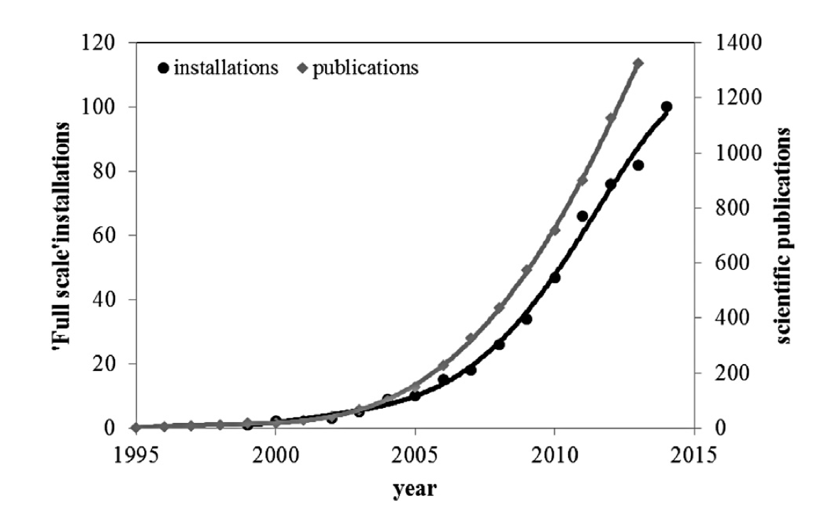
While challenges remain to be addressed, particularly regarding process stability, sidestream deammonification is a rapidly maturing technology
Source: Lackner et al. 2014. Water Research, 55 (2014) 292-303.
Notes:
[COULD cut]

Slide 59
OUTLINE
OUTLINE (40 min total, aim for 35 min-- ~35 slides):
N removal intro– why a concern [may remove or shrink quite a bit– could easily cut slides 5-7]]
Conventional vs. shortcut N removal– intro to nitrite shunt, PN/A
key challenges
Our approach: Shortcut N removal research station with MWRD, 2 overall strategies
Nitrite shunt with bioP
IFAS PN/A
SG comammox
TO DO:
  Standardize NOB to NOO, AOB to AOO
  Standardize terminology (nitrite shunt vs. nitritation/ denitritiation, deammonification vs. PN/A)
Notes:
Patrick: “Painting a big picture early is always good, then there will be plenty of people interested in the details of research and implications, ending with a "boader overview of approaches and challenges to mainstream shortcut N removal" would be great. So this answers isn't a one thing is best, but I guess the opposite of trying to hit the big broad picture and show your cool new work and approaches. They don't care about minute method details like qPCR protocols, but just saying "we used qPCR to identify X" is enough.”
Abstract: “While conventional approaches for removing nitrogen (N) from wastewater are largely effective, they are also costly, energy intensive, and ill-suited for the nascent transformation of urban wastewater treatment plants into energy-positive water resource recovery facilities. Emerging shortcut N removal bioprocesses, including nitrite shunt as well as deammonification processes that leverage anaerobic ammonia oxidizing bacteria (anammox), offer the potential for dramatic savings in energy use relative to conventional N removal process. In addition, they offer the intriguing possibility of substantially enhanced waste organic carbon redirection for energy recovery or generation of value-added products. While application of such shortcut N removal systems to N-rich sidestreams is rapidly maturing, implementation in dilute, low temperature mainstream wastewater faces considerable challenges. In this talk, I will detail our ongoing work to understand and implement both nitrite shunt and deammonification processes in the mainstream. I will focus on our efforts to address key impediments limiting mainstream shortcut N removal, including suppression of unwanted microbial populations (nitrite-oxidizing bacteria [NOB]), retention of biomass and activity of desirable microbial consortia members (anammox), and integration with biological phosphorus removal and recovery. Our work has shown that nitrite shunt integrated with biological phosphorus removal is feasible in the mainstream, but also has elucidated challenges in selecting for high activity denitrifying rather than aerobic P uptake by polyphosphate accumulating organisms. Moreover, we’ve shown that operational conditions commonly employed in shortcut N removal processes (long SRT, low dissolved oxygen) may in some cases inadvertently select for high levels of newly discovered complete ammonia oxidizers (comammox). Conversely, we’ve also shown that comammox-driven systems may offer opportunities for high rate low DO nitrifying bioprocesses that are much more energy efficient than conventional high DO nitrifying activated sludge. These results have important implications for implementation and optimization of shortcut N removal bioprocesses in the mainstream.”

Slide 60
IFAS PN/A SRTs
Notes:
IFAS PN/A (from Paul, email 3/25/19): Anammox contribution in main slide assumes full denitrification at 4gCOD/gN. The average SRT for the time frame of that calculation (Nov 9 2018 to Jan 2 2019) was 5.2 days and near 20degC, so from Daigger Fig 2 carbon requirements would 4.3 gCOD/gN for denitrification and 2.6 gCOD/gN for denitritation. Using the 2.6 gCOD/gN for denitritation, the maximum contribution of denitrifiers to N removal would be 86%, and 14% from anammox. Below is a plot of IFAS suspended SRT, along with suspended and carrier VSS. The dashed line shows when we implemented NH4+ based control and therefore variable HRT (and thus the increase in calculated SRT points).

Slide 61
IFAS Reactor
Performance History
July 2017: Switched from intermittent aeration to continuous low-DO (0.1 mg/L) operation
 | May 16 – Aug 16 | Aug 16 – Dec 17 | Dec 17 – Mar 18
% NH₄⁺ removal | 85 | 75 | 77
% TIN removal | 68 | 39 | 55
NO_{X}/NH₄⁺ ratio | 0.09 | 0.47 | 0.21
December 2017 – March 2018
Effluent NH₄⁺ = 2.9 ± 2.5 mgN/L
HRT = 6.0 ± 1.2 hr
MLVSS = 133 ± 66 mg/L
SRT ≈ 4 d (suspended growth)

Slide 62

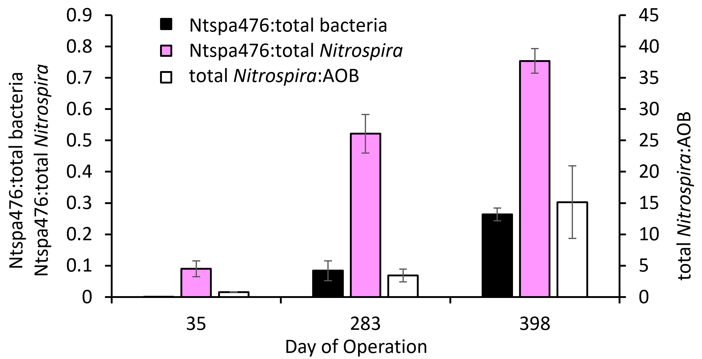
qFISH demonstrates strong enrichment of putative comammox

Slide 63
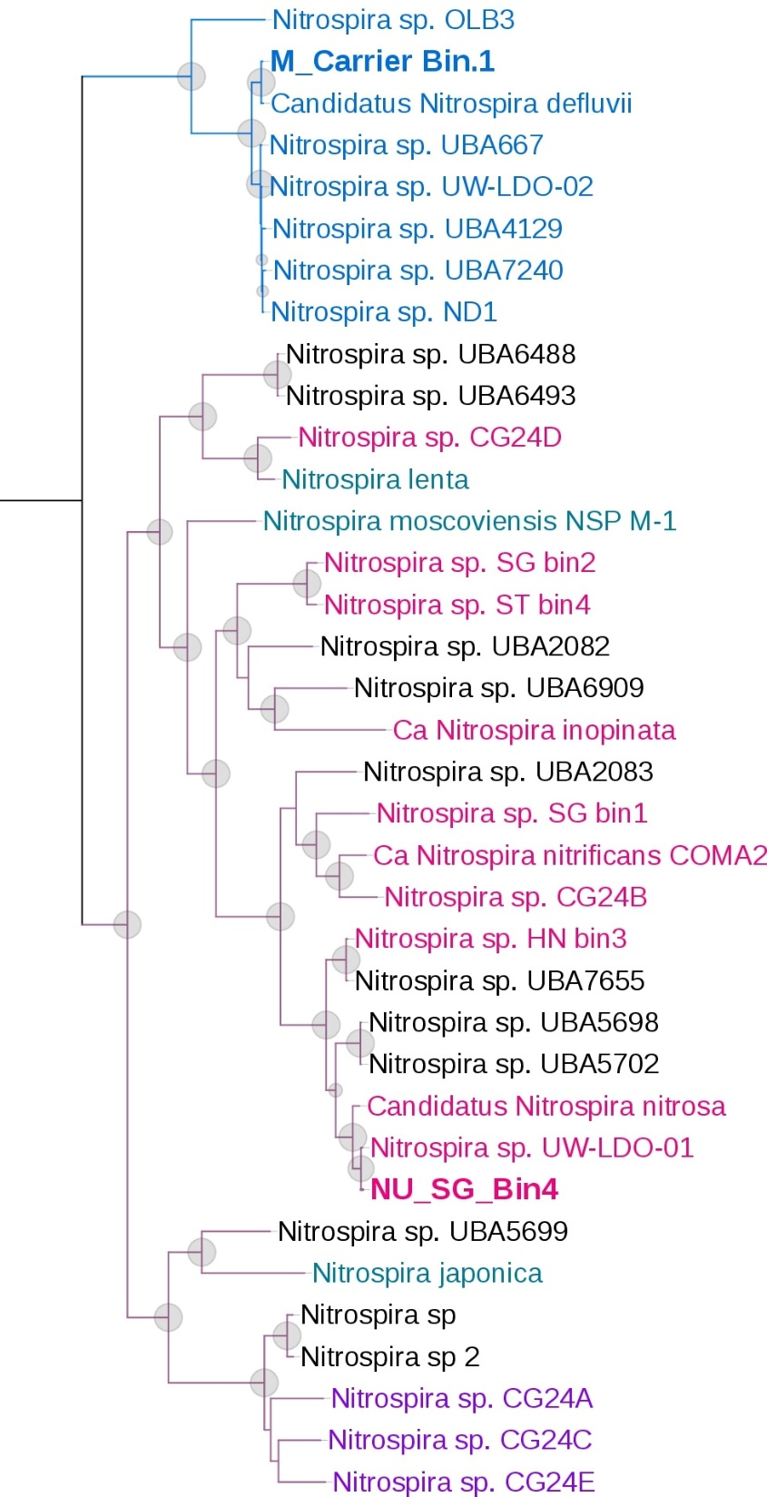
Lineage I
108 Essential single copy gene based phylogenetic association of Nitrospira genomes recovered from the metagenome dataset;
Genome of Nitrobacter hamburgensis was applied as the outgroup genome here;
Bootstrap value > 0.7 was displayed as circle at each branch, and the size of the circle was in positive relationship with the bootstrap value;
Nitrospira sp. CG24D
Clade A
Lineage II
Clade B

Slide 64

PN/A SBRs
Bio-P Reactor Effluent
30 mg sCOD/L
16 mg NH_{x}-N/L
0.3 mg Ortho-P/L
10mg TSS/L
Biofilm reactor seeded with sidestream enriched anammox carriers from the James River treatment plant (HRSD)
Suspended growth reactor seeded with sidestream enriched DEMON sludge from the York River treatment plant (HRSD)
Notes:
[COULD EASILY CUT]

Slide 65
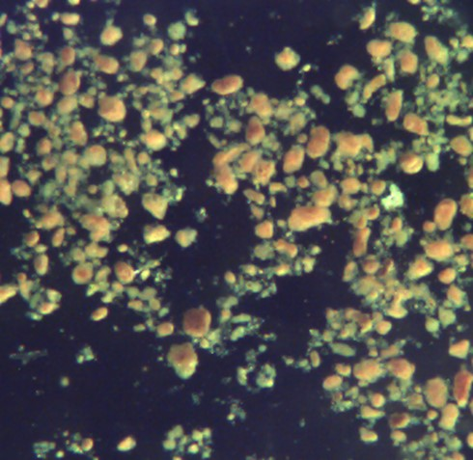
Suspended Growth SBR operation
Biomass not intentionally wasted to preserve anammox, though biomass was lost through the effluent
  Very long SRT: 50-99 days
  HRT: 9 hrs until day ~300, then 5.4 hrs
Two primary DO strategies:
  Intermittent aeration, target DO = 1 mgO₂/L
  Continuous aeration, target DO = 0.1 mgO₂/L
Fill
t_{f} = 2 minutes
Anaerobic react
t_{an} = 20 minutes
Aerobic react
t_{aer} = 30 – 300 minutes
(Stop when NH₄⁺-N < 2 mg/L)
DO = 0.1 mgO₂/L
Anaerobic react
t_{an} = 20 minutes
Settling
t_{s} = 30 minutes
Decant
50% volume decant
t_{d} = 4 minutes

Slide 66
Process Option 1: HRAS-P + Deammonification
(High-Rate Activated Sludge (HRAS) and biological P removal (stage A) and Deammonification (stage B)
HRAS-P (A stage)
Deammonification (B stage)
Anaerobic Zone
(P release, VFA uptake)
High Rate Aerobic Zone
(P uptake, COD removal)
Combined Nitritation and Anammox
(N removal)
RAS
RAS
WAS
WAS
This is an alternative approach to dPAOs for addressing carbon limitations for combined N and P removal from mainstream wastewater

Slide 67
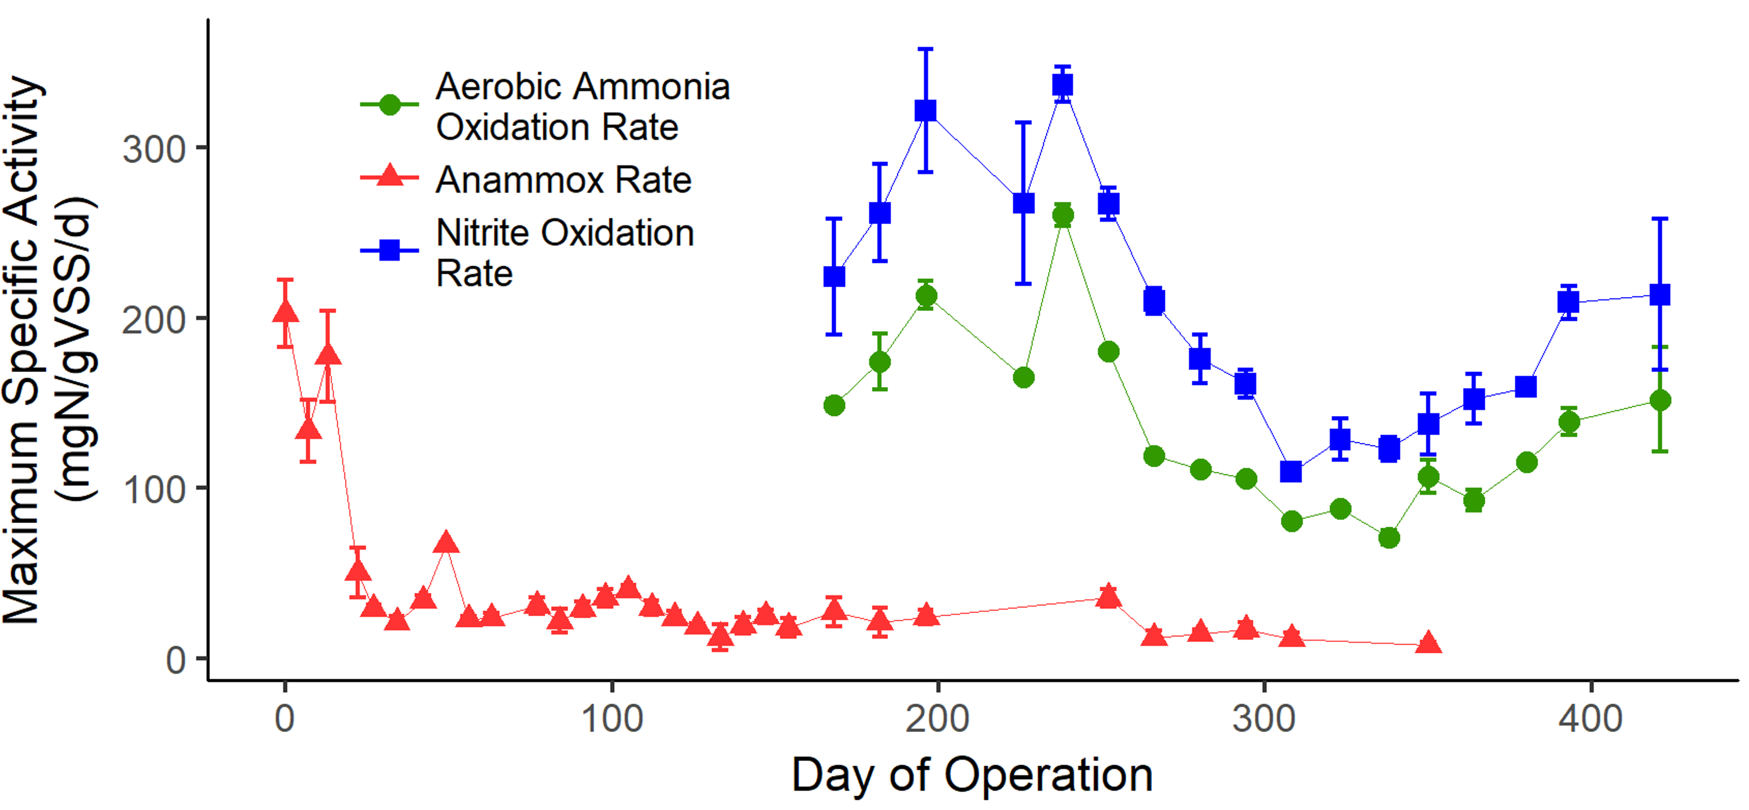
[paralleled by steep drop in anammox activity]

Slide 68
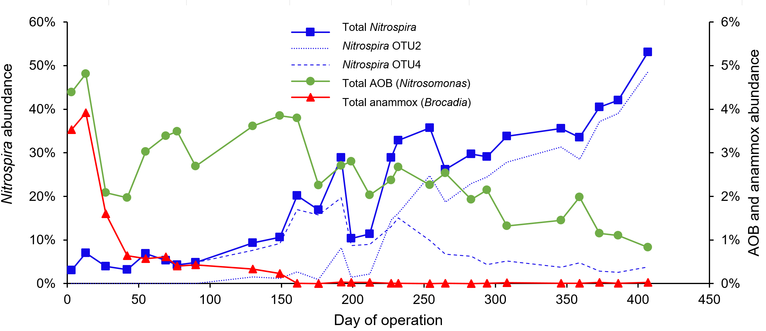
Notes:
Figure 3. Relative abundance of total Nitrospira, total AOB (all Nitrosomonas) and total anammox (all Brocadia), based on 16S rRNA amplicon sequence analysis. Relative abundance for Nitrospira is shown on the left y-axis, and AOB and anammox are shown on the right y-axis. Nitrospira OTU2 and OTU4 together comprise 95.3 – 99.8% of total Nitrospira for all time points.

Slide 69
Mainstream Deammonification Challenges
Carbonaceous, Cold, Dilute, Dynamic
 | Sidestream | Mainstream (Chicago) | Mainstream Consequence
cBOD:N | <1 | >4 | -Heterotrophic competition
Temperature (°C) | 30-35 | 10-23 | -Lower growth rates -Lower selective pressure against nitrite oxidizing organisms
TKN_{x,Influent} | 500-1000 | 7-21 | -Lower surface loading rate -Lower selective pressure against nitrite oxidizing organisms

Slide 70
 | Primary effluent |  |  | A-stage effluent |  |  | Reactor effluent |  |  | O'Brien effluent
TKN (mgN/L) | 20.6 | ± | 4.4 | 16.5 | ± | 4.7 | 4.5 | ± | 2.7 |  | 1.9 | ± |  | 0.2
NH₄⁺ (mgN/L) | 15.5 | ± | 3.6 | 14.3 | ± | 3.8 | 3.6 | ± | 2.6 |  | 0.7 | ± |  | 0.1
NO_{X} (mgN/L) | ---ª | ± | --- | 0.5^{b} | ± | 0.7 | 7.2 | ± | 3.3 |  | 7.4 | ± |  | 2.1
COD (mgCOD/L) | 141 | ± | 43 | 42 | ± | 32 | 24 | ± | 17 |  | not available^{c}
sCOD (mgCOD/L) | 84 | ± | 21 | 29 | ± | 11 | 20 | ± | 7 |  | not available
alkalinity (meq/L) | 4.7 | ± | 0.5 | 4.6 | ± | 0.5 | 3.3 | ± | 0.6 |  | not available
TSS (mg/L) | 45 | ± | 25 | 15 | ± | 35 | 7 | ± | 8 |  | 6
ªNO_{X} in primary effluent was at or below detection limit of 0.15 mgN/L in 93% of samples
^{b}NO_{X} in A-stage effluent was at or below detection limit of 0.15 mgN/L in 54% of samples ^{c}COD not measured, but BOD₅ in O’Brien WRP effluent = 5.7 ± 2.9 mgBOD/L

Slide 71
HRAS-P/Deammonification 2-Sludge Process
1x High Rate Bio-P SBR
2x Deammonification SBRs in parallel

Slide 72
Challenge 1: Carbonaceous BOD (and P) Removal
Tested Solution: Remove the carbon in a high rate Bio-P Reactor
Deammonification Biofilm Reactor
Primary Effluent
High COD, NH₄⁺ & P
Effluent:
Low COD & P
High NH₄⁺
Deammonification Suspended Growth Reactor
Waste:
High COD & P

Slide 73
Deammonification SBRs
Bio-P Reactor Effluent
30 mg sCOD/L
16 mg NH_{x}-N/L
0.3 mg Ortho-P/L
10mg TSS/L
Biofilm reactor seeded with sidestream enriched anammox carriers from the James River treatment plant (HRSD)
Suspended growth reactor seeded with sidestream enriched DEMON sludge from the York River treatment plant (HRSD)

Slide 74
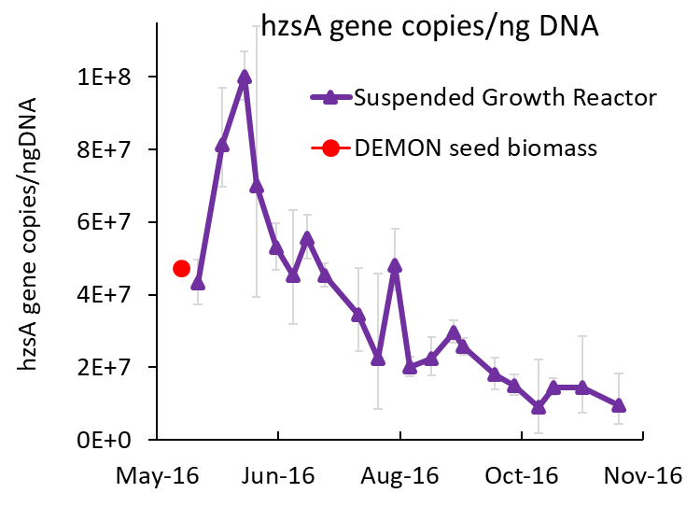
Suspended Growth Reactor
Decline in Anammox Abundance and Activity
Quantification of anammox abundance via qPCR of the hzsA gene
Maximum in situ anammox activity

Slide 75
…Comammox!
Supporting Evidence
16s sequencing data
  High nitrospira
  Almost no AOB
FISH
  High Nitrospira
  High Nitrospira Ntspa476
  (“comammox” probe from van Kessel et al. 2015)
  Almost no AOB
qPCR
  ~10% Comammox

Slide 76
Final Suspended Growth Reactor Performance
Target DO = 0.1 mg/L (occasionally 0.05 mg/L)
HRT = 6.3 ± 2.3 hr
Effluent NH₄⁺ = 3.6 ± 3.2 mgN/L
NH₄⁺ removal = 75%
 |  | Chicago Plants
 | SG | O’Brien | Kirie | Stickney
N loading rate (mg TKN/L/d) | 83 | 65 | 64 | 81
Low-DO nitrification with comammox could be an energy-saving alternative to conventional high-DO nitrification systems

